Slide 1
HCMI 3243: Health Care Economics
Busn 106: Tue/Thur 12:30 PM – 1:45 PM
Shane Murphy – shane@uconn.edu
Office Hours: W 4-6

Slide 2
Welcome to class!
Introductions:
What is your name and major?
What is one, two, or three pieces of content (tv show, movie, book, podcast) that are explain something about you?
What is your favorite animal (optional)?

Slide 3
Class organization
Textbook - https://openstax.org/details/books/principles-microeconomics-3e
Readings
Homework (10 points each)
Due on Wednesdays?
One week grace period
After one week, one point will be deducted
Quizzes? (10 points each)
About once a week
Open note/open internet/open friend
Office Hours
Midterm
March 7
Paper Replication
R, STATA, ?
Final Exam

Slide 4
Health Economics Course Topics
Microeconomics
Supply and Demand, Markets, Optimization, Externalities
Econometrics
Probability and Insurance
Macroeconomics
Fiscal Policy
Special Topics
Medicare and Medicaid
Industrial Organization: Hospitals
Industrial Organization: Cost and Expenditure
US Health Policy
Cost Effectiveness
Comparative Health Systems

Slide 5
Models and Functions
Y=f(X)
Y is an outcome variable
Dependent variable
Range
X is a predictor
Independent variable
Domain
A function is a relationship between an X and a Y
A model, a simplification

Slide 6
Models in Economics

Slide 7
Models in Economics
Models estimate and predict outcomes
Can we perfectly predict an outcome?
Yes, how?
What are some models in health economics? As functions what are the predictors and what are the outcomes?

Slide 8
Price and Marginal Cost
What are the prices of some healthcare goods?
What is the marginal cost of some healthcare goods?

Slide 9
Quantity
How do we measure quantity of health?
Mortality Rate: deaths per year usually per 100,000 people
Morbidity: illness, measured also as a rate per 100,000
YLL: years of life lost to a disease
DALY/QALY
Disability Adjusted Life Year/Quality Adjusted Life Year
DALY/QALY: sum of YLL and years of life lived with a disability
Quantity of goods
Doses
Interventions

Slide 10
Key Prices
GAVI ensures all vaccine prices to be below $5 per dose (often well below) in lower-income countries
https://www.unicef.org/supply/media/2471/file/Gavi-product-menu-April2020.pdf
Preventative Services of Essential Health Benefits (EHB) under the ACA free for insured patients
Premium Tax Credit caps benchmark ACA marketplace silver insurance plan to 9.86% of household income
Uninsured out of pocket ER visit costs, on average, $1000 to $2000

Slide 11
Key Costs
US annual average expenditure on health care in 2022
$13,493 – 17.3% of the GDP
Why do we measure as percent of GDP?
How does this vary? Who costs more, less?
Average expenditure per person is about 10% lower for people aged 20-65 than the average, over 50% lower for people aged 20-24 than the average, and about 15% higher for women than men (why?)
https://vizhub.healthdata.org/dex/

Slide 12
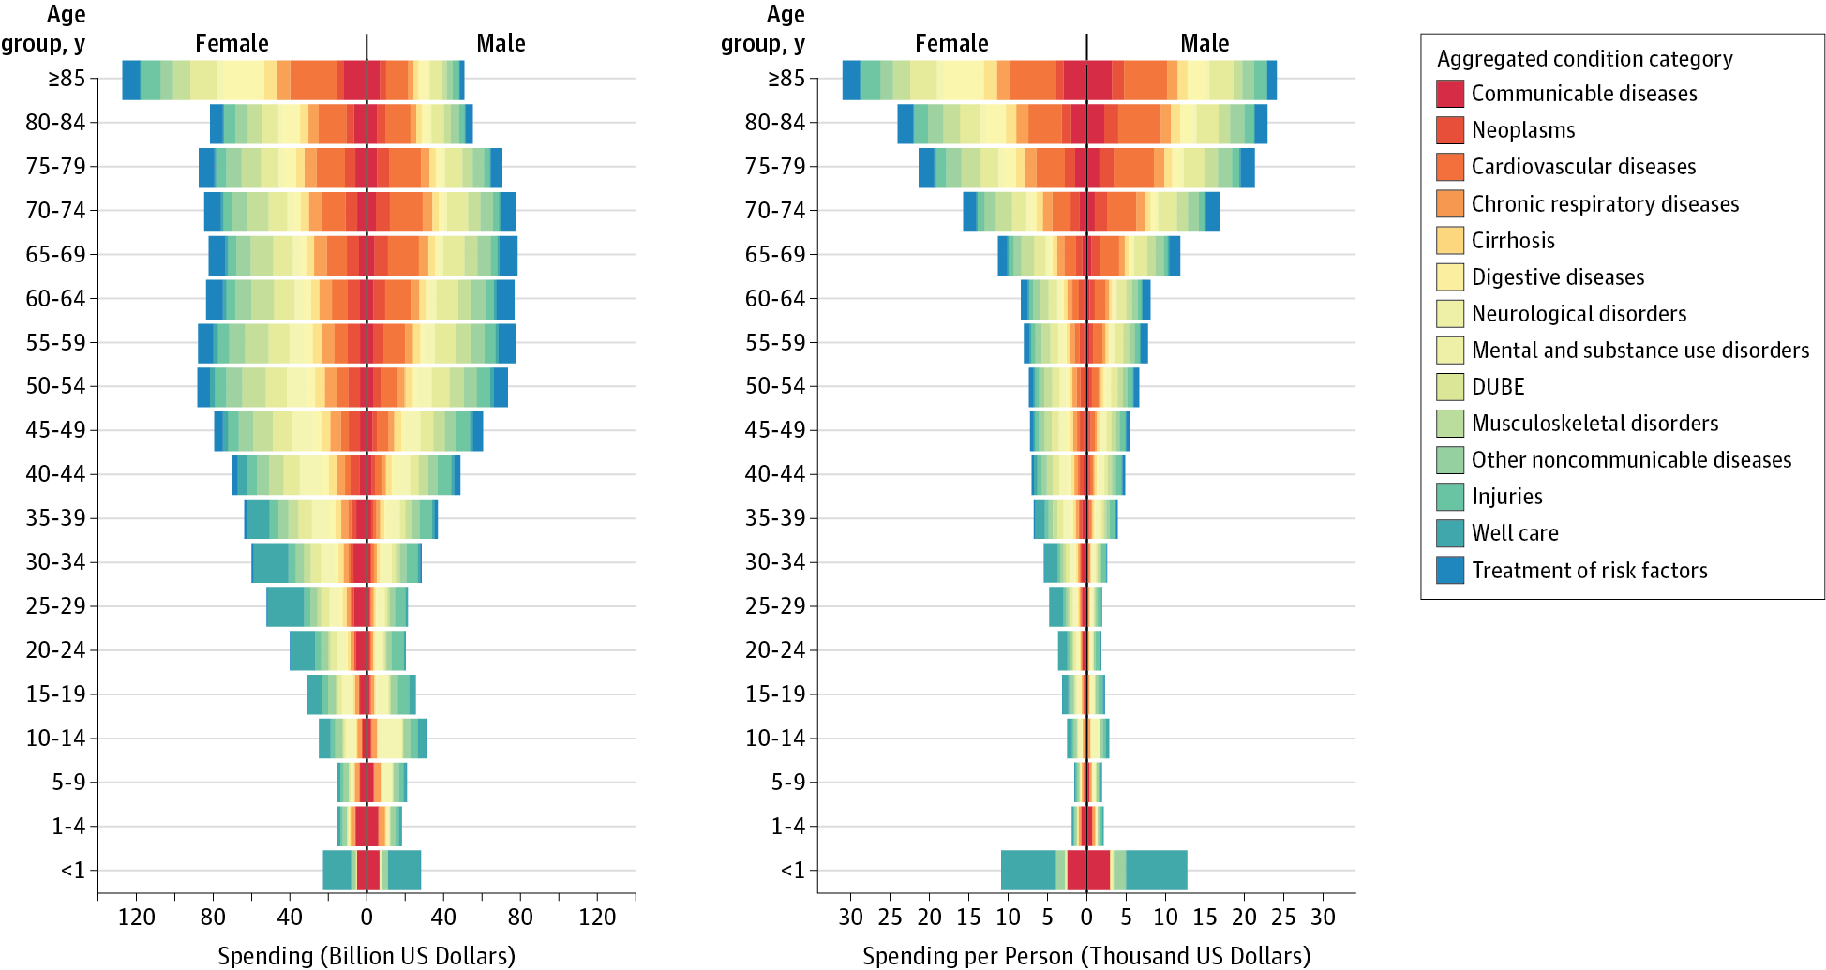
Health Care Costs by Age, Sex, and Disease
Dielman et al 2016

Slide 13
Budget Constraints
Single good – how many can I but with my money
Two goods:

Slide 14
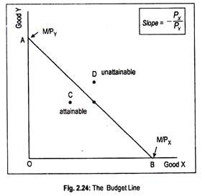
Budget Constraints
Single good – how many can I but with my money
Two goods:

Slide 15
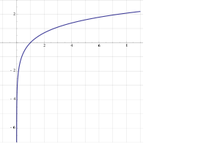
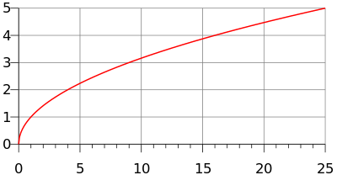
Utility
y=U(x)
Utility is generally increasing in x
(So U’(x)>0)
Utility is generally concave
U(E(x))>E(U(x))
(also U’’(x)<0)
Examples
y=ln(x)
y=√x

Slide 16
Marginal utility
Marginal utility the change in utility from a change in input (wealth) given the current level of the input
What is change in utility if someone's wealth changes by a dollar
Diminishing marginal utility
In general, the wealthier someone is, the less utility they gain from earning an extra dollar
The less utility they lose from losing an extra dollar
The utility lost if someone loses $1000 is greater if they are poorer

Slide 17
Utility and preferences
Consumers utility is a function of a bundle of goods, not just one good
Diminishing marginal utility -> people prefer variety
Why?
Demand curves can be derived from consumer preferences
People demand health goods, and people derive utility from health and from health goods
Grossman model
Food is a health good which both contributes to utility and health

Slide 18
Homework
Read
Anderson, Gerard F., Peter Hussey, and Varduhi Petrosyan. "It’s still the prices, stupid: why the US spends so much on health care, and a tribute to Uwe Reinhardt." Health Affairs 38, no. 1 (2019): 87-95.
Define (you may need to look outside this paper): OECD, GDP, per capita, mean, median
What are some of the goods whose prices are discussed in the paper (list at least three)?
What are the number of Nurses, MDs, and hospital beds per capita in the US? What is the average in the OECD?
What is “service intensity”? Why might it be good? Why might it be bad?

