Slide 1
HCMI 3243: Health Care Economics: Prices
BUSN 203: Mon/Wed 9:30 PM – 10:45 AM
Shane Murphy – shane@uconn.edu

Slide 2
Models in Economics

Slide 3
Models in Economics
Models estimate and predict outcomes
Can we perfectly predict an outcome?
Yes, how?
What are some models in health economics? As functions what are the predictors and what are the outcomes?

Slide 4
Price and Marginal Cost
What are the prices of some healthcare goods?
What is the marginal cost of some healthcare goods?

Slide 5
Quantity
How do we measure quantity of health?
Mortality Rate: deaths per year usually per 100,000 people
Morbidity: illness, measured also as a rate per 100,000
YLL: years of life lost to a disease
DALY/QALY
Disability Adjusted Life Year/Quality Adjusted Life Year
DALY/QALY: sum of YLL and years of life lived with a disability
Quantity of goods
Doses
Interventions

Slide 6
Key Prices
GAVI ensures all vaccine prices to be below $5 per dose (often well below) in lower-income countries
https://www.unicef.org/supply/media/2471/file/Gavi-product-menu-April2020.pdf
Preventative Services of Essential Health Benefits (EHB) under the ACA free for insured patients
Premium Tax Credit caps benchmark ACA marketplace silver insurance plan to 9.86% of household income
Uninsured out of pocket ER visit costs, on average, $1000 to $2000

Slide 7
Key Costs
US annual average expenditure on health care in 2022
$13,493 – 17.3% of the GDP
Why do we measure as percent of GDP?
How does this vary? Who costs more, less?
Average expenditure per person is about 10% lower for people aged 20-65 than the average, over 50% lower for people aged 20-24 than the average, and about 15% higher for women than men (why?)
https://vizhub.healthdata.org/dex/

Slide 8
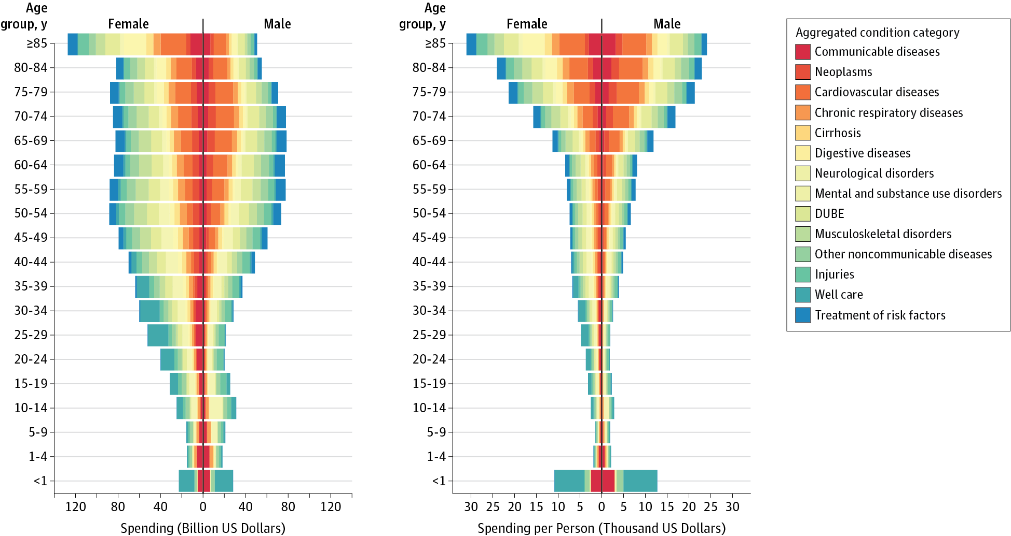
Health Care Costs by Age, Sex, and Disease
Dielman et al 2016

Slide 9
Budget Constraints
Single good – how many can I but with my money
Two goods:

Slide 10
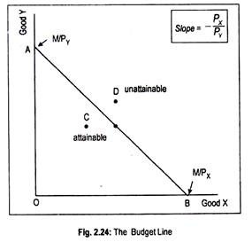
Budget Constraints
Single good – how many can I but with my money
Two goods:

Slide 11
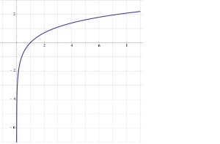
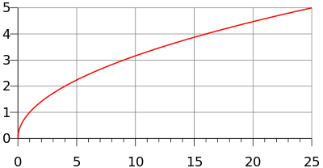
Utility
y=U(x)
Utility is generally increasing in x
(So U’(x)>0)
Utility is generally concave
U(E(x))>E(U(x))
(also U’’(x)<0)
Examples
y=ln(x)
y=√x

Slide 12
Marginal utility
Marginal utility the change in utility from a change in input (wealth) given the current level of the input
What is change in utility if someone's wealth changes by a dollar
Diminishing marginal utility
In general, the wealthier someone is, the less utility they gain from earning an extra dollar
The less utility they lose from losing an extra dollar
The utility lost if someone loses $1000 is greater if they are poorer

Slide 13
Utility and preferences
Consumers utility is a function of a bundle of goods, not just one good
Diminishing marginal utility -> people prefer variety
Why?
Demand curves can be derived from consumer preferences
People demand health goods, and people derive utility from health and from health goods
Grossman model
Food is a health good which both contributes to utility and health

Slide 14
Models
Two somewhat rhetorical questions:
In what sense are the concepts of price and quantity “real” and in what sense are the “models”?
How is marginal utility a different way to model the concept of price in an economic theory?
Discussion question:
When is marginal utility more useful for a theory and when is price more useful?
What explains this difference?

Slide 15
It’s Still the Prices, Stupid
Refers to the unofficial slogan of the 1992 Clinton campaign, “It’s the Economy Stupid”
2019 update of 2003 paper, It’s the Prices, Stupid
Lot’s has changed from 2003, but not really

Slide 16
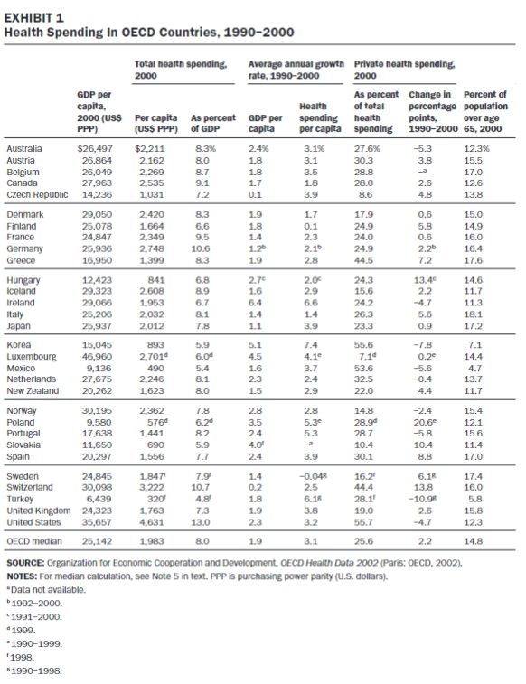
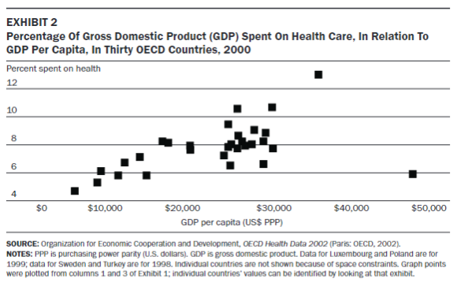
Percent of GDP spending on health increases as GDP increases
Why? What does that mean?

Slide 17
Themes from article
Spending on pharmaceuticals in the US is above average
Nurses per capita in the US is above average
Physicians per capita in the US is below average
But specialist physicians per capita in the US is above average
Hospital beds per capita and average LOW is below average
LOS = Length of Stay
MRIs and CTs per capita in the US is above average
MRIs and CTs are imaging technology

Slide 18
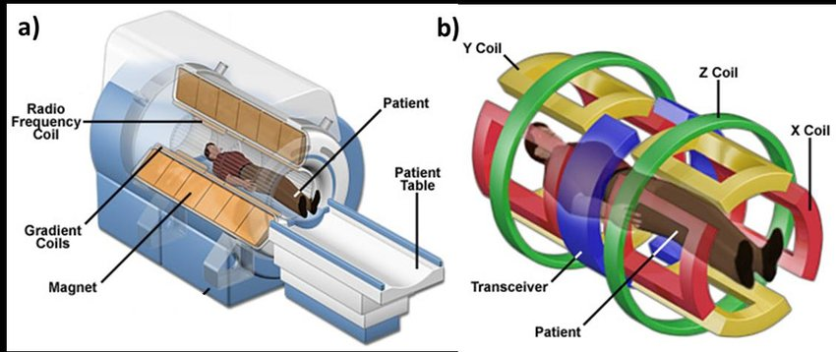
Imaging technology: MRI (magnetic fields and radio waves)
In the US, and MRI can cost $3 Million, usually closer to $200,000 to $1,000,000.
The machine includes a tank of super-cooled helium – about $30k per tank of helium.
Coil systems may includes a hand coil, a foot coil, a body coil, a head coil, a shoulder coil, a breast coil, and a spine coil, each costing $50,000-$150,000.
MRI techs make $35-$60 per hour
Gadolinium/Eovist contrast costs over $100 per use
Notes:
https://www.researchgate.net/figure/a-Schematic-illustration-of-the-MRI-system-where-the-main-components-are-indicated_fig6_318658798

Slide 19
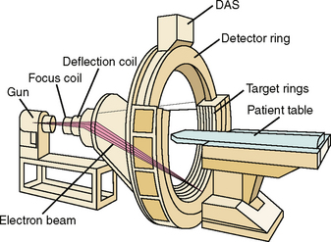
Imaging technology: CT (rotating x-ray tube)
In the US, and CT can cost $1 Million, usually closer to $100,000 to $300,000.
CT techs make $35-$60 per hour
Iodine contrast costs under $100 per use
Notes:
https://www.researchgate.net/figure/a-Schematic-illustration-of-the-MRI-system-where-the-main-components-are-indicated_fig6_318658798

Slide 20
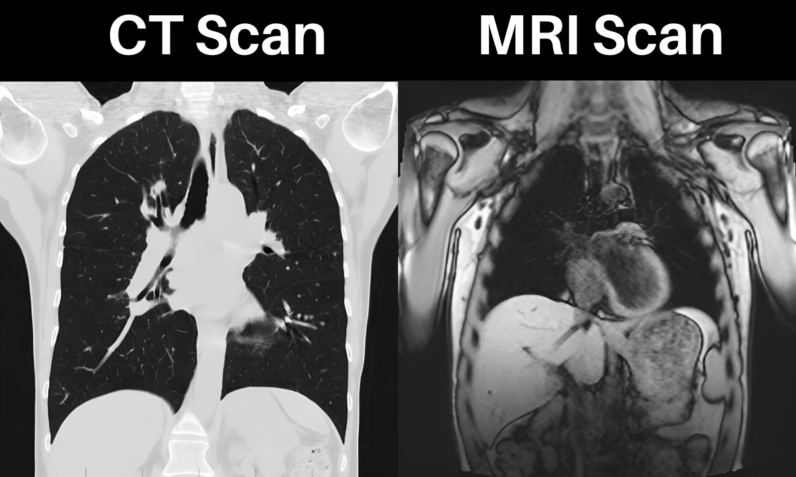
Price vs quantity/utilization
What determines the demand for MRIs?
Who buys an MRI?
Who prescribes an MRI?
Who pays for an MRI?
What is the alternative to an MRI? What determines the benefit to an MRI over the alternative?

Slide 21
Utility
y=U(x)
Utility is generally increasing in x
(So U’(x)>0)
Utility is generally concave
U(E(x))>E(U(x))
(also U’’(x)<0)
Examples
y=ln(x)
y=√x

Slide 22
Marginal utility
Marginal utility the change in utility from a change in input (wealth) given the current level of the input
What is change in utility if someone's wealth changes by a dollar
Diminishing marginal utility
In general, the wealthier someone is, the less utility they gain from earning an extra dollar
The less utility they lose from losing an extra dollar
The utility lost if someone loses $1000 is greater if they are poor

