Slide 1
HCMI 3243: Health Care Economics: Grossman Model
BUSN 203: Mon/Wed 9:30 PM – 10:45 AM
Shane Murphy – shane@uconn.edu

Slide 2
Job posting
Hi UConn HCMI,
I’m reaching out to let you know that we are actively recruiting for summer interns within our CT, NJ and NYC offices. Our recruiting department has posted the opportunity via Handshake however I’ve included the link below for reference as well. Please feel free to distribute through your usual channels - class notes, HCM Society, etc.
Our intern program lasts for 10 weeks from June to August. All internships are hybrid meaning they require candidates to be within commuting distance of the office. If any students have questions, please do not hesitate to have them reach out.
Health & Benefits Internship
Regards,
Leanna Alexander
Assistant Vice President | Health Solutions | Aon
Notes:
https://jobs.aon.com/jobs/72488?lang=en-us&previousLocale=en-US

Slide 3
Gary Becker and Applied Microeconomics
Economics of the Household
Economics of the Family
Influenced many subfields of economics
Labor Economics
Behavioral Economics
Experimental Economics
Education Economics
Development (Innovation, Technology)
Urban Economics (Real Estate, Transportation, Rural)
Sports Economics, Wine Economics, other niches
Health Economics
Freakonomics, popular economics writing, TED talks

Slide 4
Economic concept: Utility
Economists generally use utility as a way to express preferences
The value an individual gets from a basket of goods can be expressed as an individuals utility
Modeled with a utility function
Individuals prefer more utility
It may be hard or even impossible to aggregate utility functions across individuals
So maximizing societal utility is not necessarily a function of maximizing individual utilities
"that property in any object, whereby it tends to produce benefit, advantage, pleasure, good, or happiness...[or] to prevent the happening of mischief, pain, evil, or unhappiness to the party whose interest is considered.“ – Jeremy Bentham c. 1823

Slide 5
Economic concept: Utility Maximization
Economic model may include a utility function and some constraints
Constraints often include time and money
So a big picture model of your life may be:
You get more utility as you get more stuff
You get more utility as you have more leisure time
The amount of stuff you have is constrained by how much money you have
How much money you have is constrained by how much you work
How much you work reduces your leisure
So your optimal behavior is to balance work and leisure to make sure you have stuff and free time to enjoy it!
This class is not about solving utility maximization problems
ie no linear programming, probably not even any calculus!
But we will look at these problems and think about what is being modeled

Slide 6
The Grossman Model of Demand for Health
Individuals maximize their utility functions:
$$U_{t}=U\left(H_{t},Z_{t}\right)$$
Where $H_{t}$ is the level of health and $Z_{t}$is a composite good that represents everything else.
Subject to some constraints…
Notes:
Grossman’s model integrates theory of human capital and household production to understand the demand for health.
The main ways health differs from the demand for other goods and services are described in the set-up of the model.

Slide 7
The Grossman Model: Production of Health
Health is a durable good where value carries over into the next period, and investments can be made and depreciation occurs over time:
$H_{t+1}=H_{t}− ∂H_{t}+I_{t}^{H}$
The rate of depreciation ($∂$) might include biological processes such as aging, disease, accidents, etc.
Individuals can add to health stock by investing in health, $I_{t}^{H}$ .
$$I_{t}^{H}=I(M_{t}, T_{t}^{H};E)$$
At each period, t, investments in health stock can be made, through medical care or other market inputs, $M_{t}$, and time spent in healthy activities, $T_{t}^{H}$.
How much these investments raise health is also a function of efficiency, $E$.
Notes:
The first two constraints are related to the production of health and from them we can get the health production function.
A person is born with initial endowment of H, which they add to by investment.
The rate of H production will depend on the efficiency of investment in H.
There will be δ in the value of the stock of H through age, accident, carelessness, sudden disease.

Slide 8
Investing in health
INPUTS
PRODUCTION PROCESS
OUTPUT
Health Care
Diet
HEALTH
STOCK
HEALTHY DAYS
Exercise
Environment
Income
Time

Slide 9
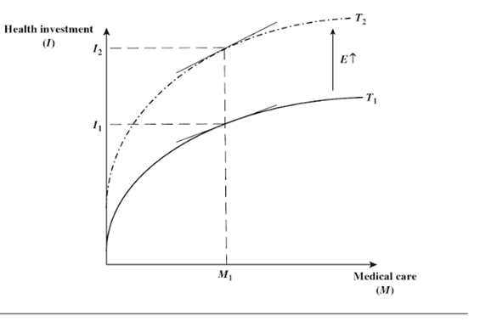
Economic Concept: Diminishing marginal returns
A poor person may get a greater increase in utility from an additional $10,000 than a rich person
The return to an individual of a single extra unit of an input decreases as the stock of that input the individual has increases.
The contribution to ones health of medical care spending shows diminishing marginal returns
Graphically, diminishing marginal returns is concave

Slide 10
Health Production Function
The concave shape of the total product curve, T1, reflects the law of diminishing marginal productivity.
In other words, Higher levels of medical care or market inputs increase the level of health, but at a diminishing rate.
Efficiency is similar to technology in a firm’s production process. For the same levels of inputs (M1), a more efficient person can produce higher levels of health.
Notes:
Efficiency is kind of like technology in a firm’s production process. If a new technology comes in, it can shift the production function upward.

Slide 11
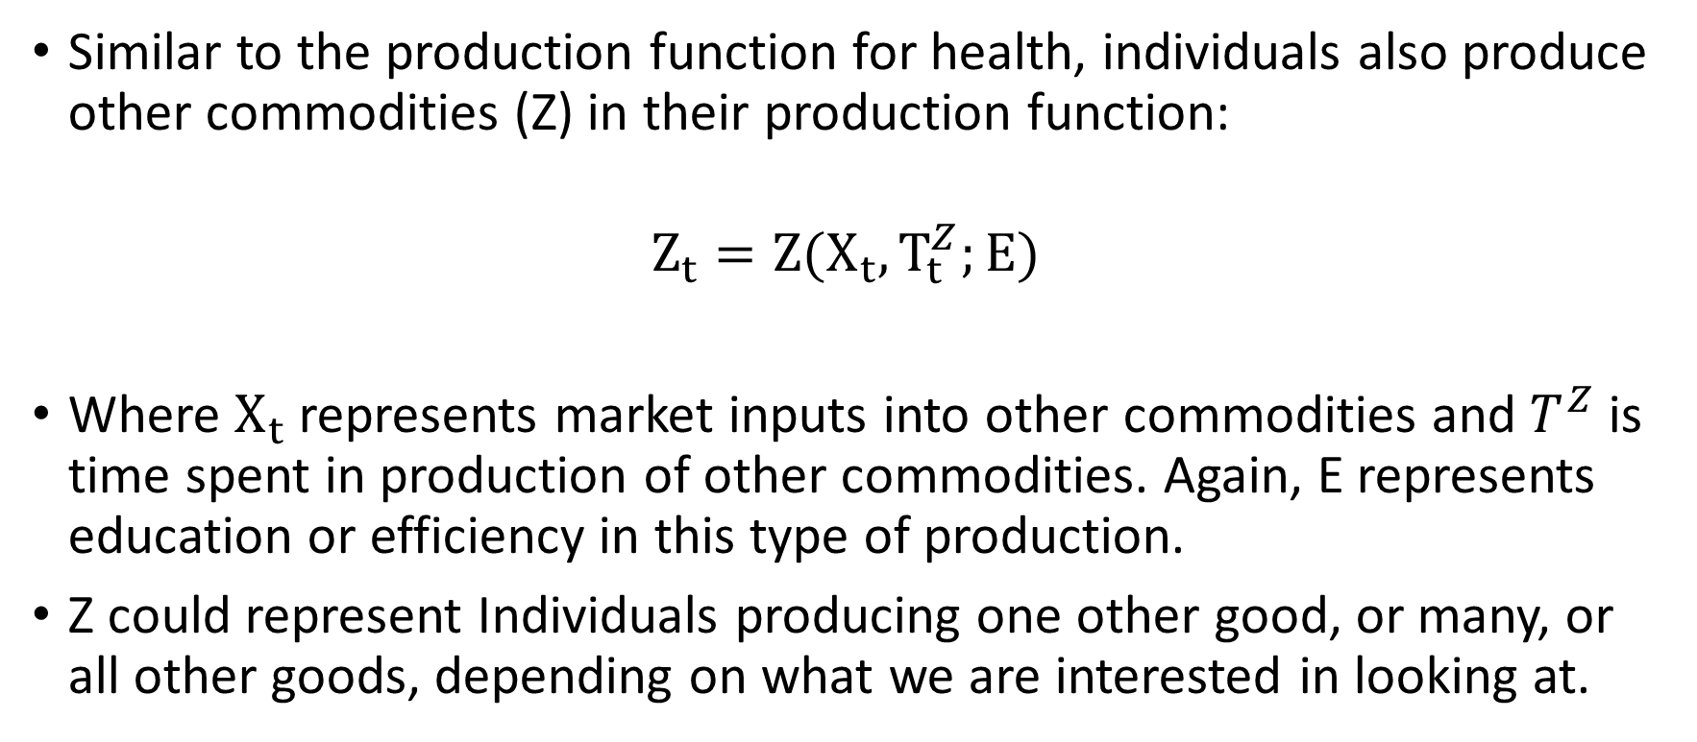
The Grossman Model: Production of All Else
Similar to the production function for health, individuals also produce other commodities (Z) in their production function:
$$Z_{t}=Z(X_{t}, T_{t}^{Z};E)$$
Where $X_{t}$ represents market inputs into other commodities and $T^{Z}$is time spent in production of other commodities. Again, E represents education or efficiency in this type of production.
Z could represent Individuals producing one other good, or many, or all other goods, depending on what we are interested in looking at.
Notes:
These production functions for health and for other commodities capture the fact that individuals have some control over the production process, and that they can determine what quantity and mix of resources to use in producing their health, entertainment, transportation, meals, etc.
Individuals combine their time with inputs bought in the marketplace. Like all resources, these resources are scarce and are constrained by individuals total time and income.

Slide 12
The Grossman Model: Budget & Time Constraints
The individual faces two constraints, the budget and time:
$$W ∙T^{W}=P^{M}∙M+P^{X}∙X$$
Where is $W$the wage rate $T^{W}$ is time spent working. $P^{M}$is the price of market inputs into health and $P^{X}$ is the price of market inputs into all other goods.
$$θ=T^{W}+T^{Z}+T^{H}+T^{S}$$
Where $T^{W}$ is time spent on work, $T^{H}$is time spent improving health, $T^{Z}$is time spent in all other commodities, and $T^{S}$is time spent sick.

Slide 13
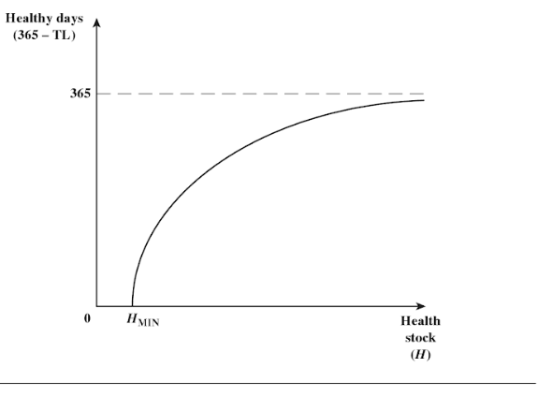
The Grossman Model: Production of Healthy Days
This final condition tells us that health capital provides some return over time:
$$Healthy Days=F\left(H\right)=(365 −T^{S})$$
An increase in health stock (H) reduces an individual’s time lost to sickness, $T^{S}$, and raises the individual’s total effective time.
The bowed shape indicates that the number of healthy days increases at a decreasing rate with improvements in health.
There is a minimum level of health stock, when health falls below it, death occurs.
Marginal product of health is positive, but diminishing.
Notes:
The final condition captures another important aspect of health capital. Any capital good exhibits two characteristics: it is durable and adjusts over time due to depreciation and investments (the second equation told us that), and that it provides some return over time.
This equation assumes that time is measured as days per year – so an individual’s total healthy days in a year equals 365 – time sick. This equation also tells us that the number of healthy productive days is a function of the underlying health stock (H). The more H, the more healthy & productive days in a year.

Slide 14
Implied choices
Inter-related time choices:
Labour time (income) vs. leisure time vs. ill time
Within leisure time choice:
health producing time (gym) vs. non-health producing time
Resource choices:
Health care inputs vs. other consumption
subject to budget constraint

Slide 15
Determining the Optimal Investment in Health
Suppose we just focus on the investment aspect of the model. We can assume that individuals consume and demand health purely for it’s investment features: Health produces Productive Days.
Focusing on this allows us to find the optimal investment in health.
We know: Diminishing returns mean that healthy days occur at a decreasing rate.
Formally, this can be done using two new concepts: MEC and Cost-of-Capital:

Slide 16
What exactly is the Cost of Capital?
The opportunity cost of a capital investment is the interest rate the investor would have received had they put the money into another investment (for example, stocks and bonds)
The problem is more complicated, however, because capital goods depreciate over time.
For an investment to be worthwhile, it must not only earn a competitive return each year, but it also must provide enough return to cover depreciation.
This suggests that the cost of holding this capital good for any one year, as well as over time, will equal the opportunity cost of the capital (interest foregone) plus the depreciation (deterioration of value).
Cost-of-Capital = Cost of health investment times (Opportunity cost + depreciation)
Cost-of-Capital = C * (r + δ)
Notes:
Note: There was an error in this slide that led to come confusion at the end of class – the correct equation should be:
C = Cost of a health investment multiplied by (Opportunity cost + rate at which capital good depreciates)
Where the Opportunity cost is cost of foregone alternatives i.e. interest rate.

Slide 17
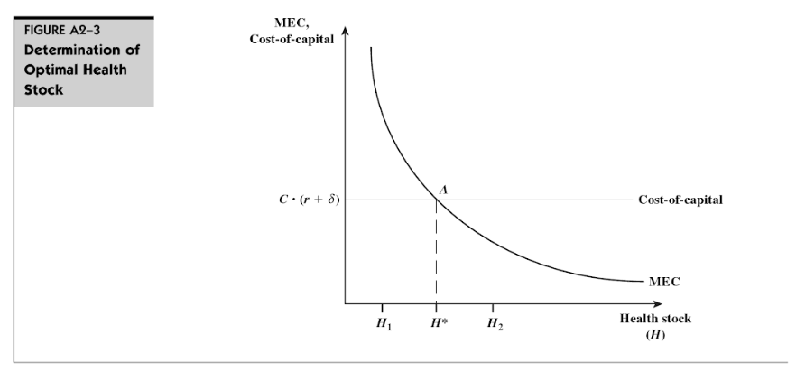
What is the MEC?
Marginal Efficiency of Capital, MEC, captures the value of an additional healthy day gained from a one-unit increase in the stock of health.
Increasing health stock will give agent more healthy days
More healthy days will increase days working
One unit increase in health stock will increase health by a number of days, this is the Marginal Product of Health (MPH)
So the MPH is a number of healthy days in this example
The so the value of the MPH from the perspective of working only is the increase in earned wages, so for W the daily Wage:
MEC = MPH * W

Slide 18

What is the MEC?
Marginal Efficiency of Capital, MEC, captures the value of an additional healthy day gained from a one-unit increase in the stock of health.
We assume that wage is the opportunity cost of time and the marginal efficiency of capital is the marginal product of health multiplied by the wage rate:
$$MEC=MPH∙Wage$$
MEC is downward sloping because of the diminishing marginal product of health.
Why are there asymptotes?
We can interpret the MEC as a demand curve for health capital.

Slide 19
Detour: Marginal thinking
In Microeconomics, a firm produces a quantity up until Marginal Benefit equals Marginal Cost
Why?
How does a firm deal with its cash?
Investing for price setters

Slide 20
Detour: Marginal thinking
In Microeconomics, a firm produces a quantity up until Marginal Benefit equals Marginal Cost
Why?
Is MEC a marginal benefit or a marginal cost?
What plays the role of marginal benefit and marginal cost in this model of investing health behavior?

Slide 21
Detour: Marginal thinking
In Microeconomics, a firm produces a quantity up until Marginal Benefit equals Marginal Cost
Why?
Is MEC a marginal benefit or a marginal cost?
Marginal benefit
What plays the role of marginal benefit and marginal cost in this model of investing health behavior?
MEC is marginal benefit
Interest rate plus depreciation is marginal cost
What does that mean? In what sense are interest rates and depreciation marginal cost?

Slide 22
Optimal Investment in Health
If rate of return on capital good is greater (less) than cost of capital, then the good will (not) be purchased. Capital good will be purchased only up to point where:
Equilibrium condition:
Rate of return = Cost of Capital
MEC = r + δ

Slide 23
Practical questions
What effect on optimal health stock or demand for health inputs do the following have:
Increases in life expectancy?
Getting a higher salary?
Going to college?
Changes in Medical Prices?

Slide 24
Changes in Equilibrium - Age
The rate at which health stock may depreciate may increase during some periods of life and decline during others.
As an individual ages the δ rate of health stock is likely to increase (from δ₀ to δ₁ and finally to δ_{D}) i.e. the health of older individuals is likely to deteriorate faster than the health of younger individuals.
Grossman allows the depreciation rate, δ, to increase with age. This directly raises the cost-of-capital and shifts the supply curve of health upwards.
What does this imply about optimal health stock as a person ages?

Slide 25
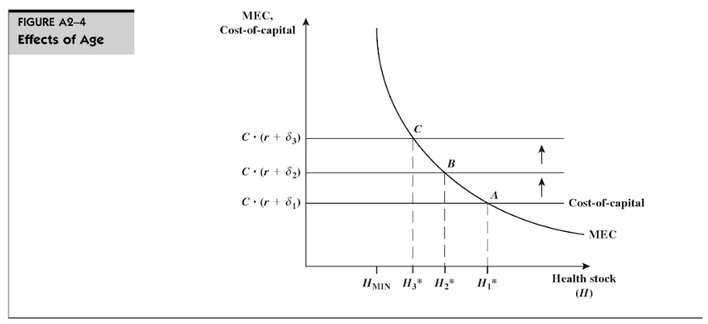

Slide 26
Changes in Equilibrium - Age
The rate at which health stock may depreciate may increase during some periods of life and decline during others.
As an individual ages the δ rate of health stock is likely to increase (from δ₀ to δ₁ and finally to δ_{D}) i.e. the health of older individuals is likely to deteriorate faster than the health of younger individuals.
Grossman allows the depreciation rate, δ, to increase with age. This directly raises the cost-of-capital and shifts the supply curve of health upwards.
Assume that wage and other factors determining MEC are not substantially altered by aging, ceteris paribus
Optimal health stock decreases with age (i.e. H_{O} > H₁)

Slide 27
Optimal death?
What happens as depreciation gets very high?
Optimal health get’s lower and lower.
Explain in words – what does it mean when optimal health stock gets too low?

Slide 28
Changes in Equilibrium - Wage
Changes in Wage directly affect the MEC: $MEC=MPH∙Wage$
Wages are a part of the cost of health investment, soif we remember:
Cost-of-Capital = Cost of health investment times (Opportunity cost + depreciation)
Cost-of-Capital = C * (r + δ)
.

Slide 29
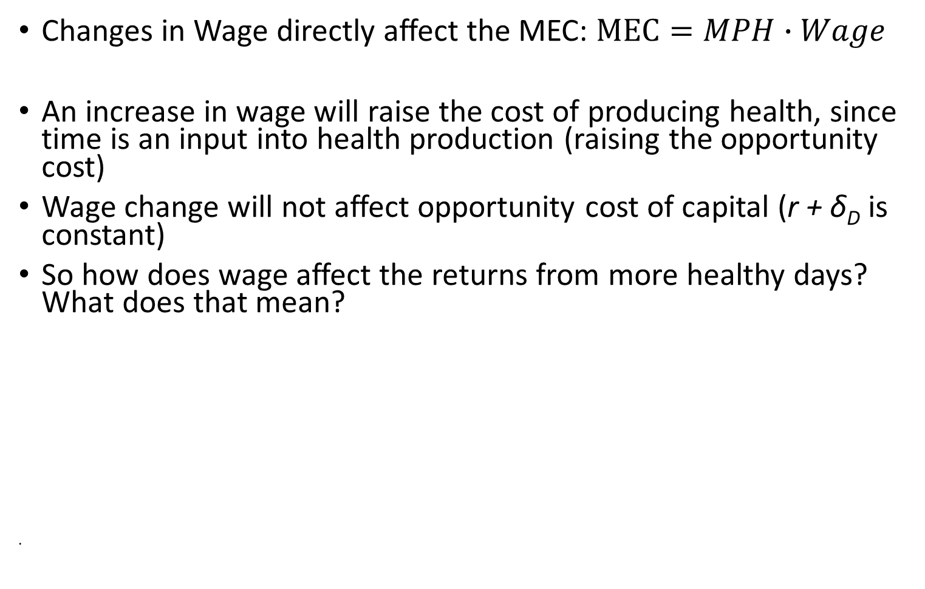
Changes in Equilibrium - Wage
Changes in Wage directly affect the MEC: $MEC=MPH∙Wage$
An increase in wage will raise the cost of producing health, since time is an input into health production (raising the opportunity cost)
Wage change will not affect opportunity cost of capital (r + δ_{D} is constant)
So how does wage affect the returns from more healthy days? What does that mean?
.

Slide 30
Changes in Equilibrium - Wage
Changes in Wage directly affect the MEC: $MEC=MPH∙Wage$
An increase in wage will also raise the cost of producing health, since time is an input into health production (raising the opportunity cost)
Wage change will not affect cost of capital (r + δ_{D} is constant)
Increased wage rate will increase returns obtained from health days, hence a higher MEC curve i.e.
8 hrs @ $4/hr = $36
8 hrs @ $5/hr = $40
If original MEC curve represents lower-wage case, then optimal health stock is H_{O} . MEI² shows MEC for someone with higher wages, with higher optimal health stock (H₂)
Optimal health stock increases with level of wages (i.e. H₂ > H₀). Benefits of being healthy are greater for higher-wage workers

Slide 31
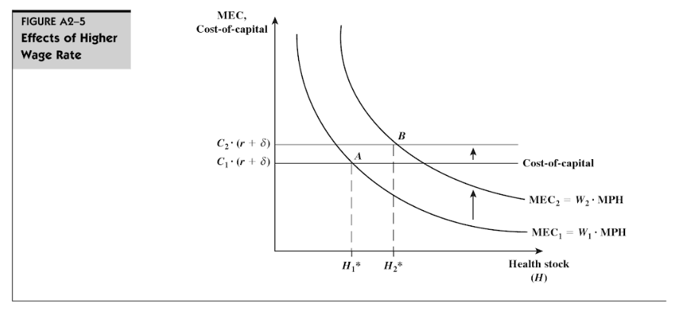
Note: In class we assumed ceteris paribus that the increase in wages would not include an increase in prices – and could not explain why cost-of-capital was increasing, with that assumption. However, In a general equilibrium model, an increase in wages may increase prices throughout the market, in particular, the price of an increase in H may be represented by an increase from C1 to C2.
Notes:
Note: In class we assumed ceteris paribus that the increase in wages would not include an increase in prices – and could not explain why cost-of-capital was increasing, with that assumption. However, In a general equilibrium model, an increase in wages may increase prices throughout the market, in particular, the price of an increase in H may be represented by an increase from C1 to C2.

Slide 32
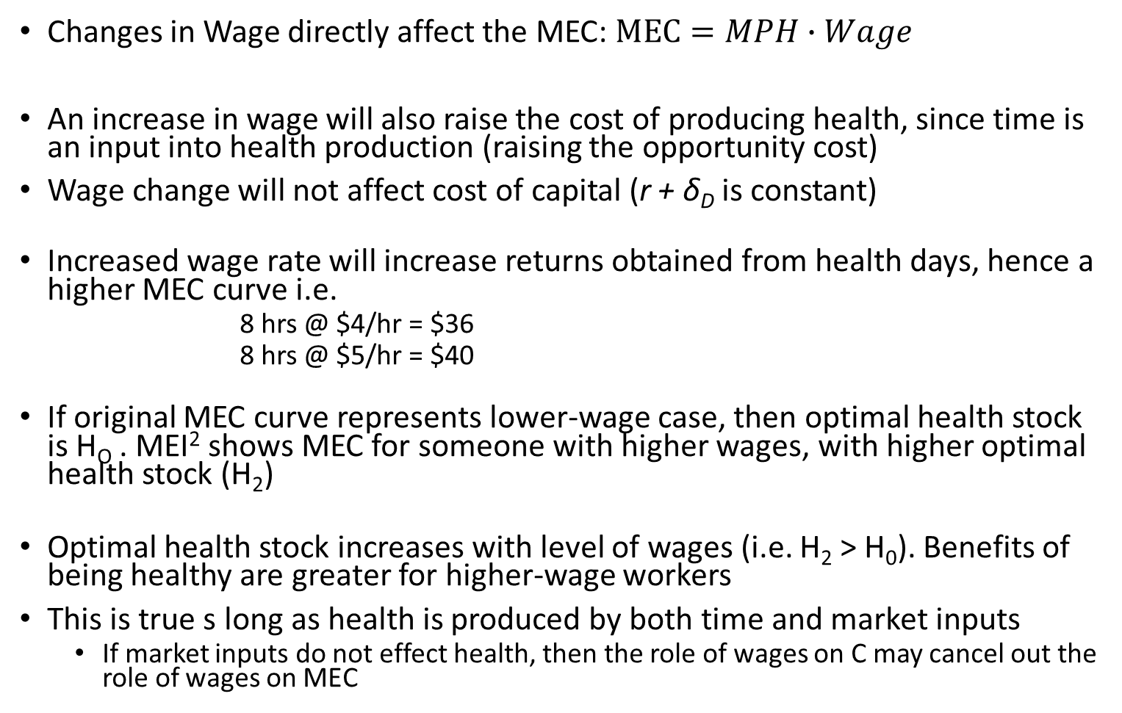
Changes in Equilibrium - Wage
Changes in Wage directly affect the MEC: $MEC=MPH∙Wage$
An increase in wage will also raise the cost of producing health, since time is an input into health production (raising the opportunity cost)
Wage change will not affect cost of capital (r + δ_{D} is constant)
Increased wage rate will increase returns obtained from health days, hence a higher MEC curve i.e.
8 hrs @ $4/hr = $36
8 hrs @ $5/hr = $40
If original MEC curve represents lower-wage case, then optimal health stock is H_{O} . MEI² shows MEC for someone with higher wages, with higher optimal health stock (H₂)
Optimal health stock increases with level of wages (i.e. H₂ > H₀). Benefits of being healthy are greater for higher-wage workers
This is true s long as health is produced by both time and market inputs
If market inputs do not effect health, then the role of wages on C may cancel out the role of wages on MEC

Slide 33
Changes in Equilibrium – Education
Education improves efficiency in production
Higher education level raises marginal product of direct inputs i.e. less inputs are needed to produce a given amount of investment. A given investment can be generated at less cost for an educated person , hence higher rate of return to a given stock of health (MPH)
Higher education level means a higher MEC curve (similar to effect of increased wage rate).
Optimal health stock increases with level of education (i.e. H₂ > H₀). A more educated person will choose a higher optimal stock of health than the less educated person.

Slide 34
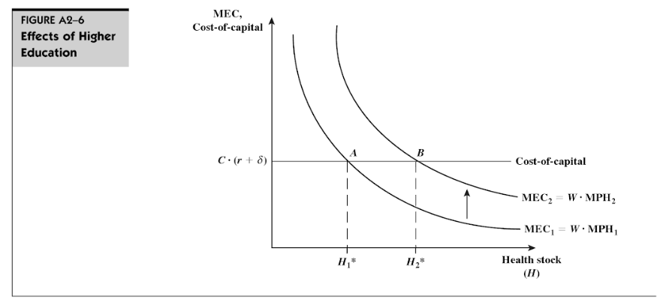

Slide 35
Change in the Price of Medical Care
A fall in the price of a unit of health inputs results in the budget line swivelling outwards from the intercept on the consumption axis
IE, a persons utility function will intersect with their budget constraint at a point which involves purchasing more health goods
Assuming that the individual did not devote all of her income to consumption before the price change, she will employ more health inputs and consequently will be achieve better health.
This is a shift in C, and a shift down in the cost-of-capital curve
This suggests that subsidising the price of health inputs (for example, milk and heating) will result in improved health for those receiving such subsidies.
There is no effect on MEC in this model

Slide 36
Recap: What does the Grossman model tell us?
The individual is both the consumer and producer of health – in other words, individuals consume health for two reasons:
Individuals get utility/enjoyment from being healthy
Health raises individual productive capacity by raising available productive time
Health is both a consumption commodity as well as an investment commodity
Health is a capital stock, and has features of a durable good:
It can depreciate over time
We can make investments that carry value over time
Health belongs in an individual’s utility function, not medical care.
We do not directly demand medical care, we demand it due to our underlying demand for health.
Notes:
The seven equations we looked at so far capture the main features of Grossman’s framework and also summarize why we view health as different from other commodities. These are the four essential takeaways from the Grossman model.

Slide 37
Policy implications
The model can be used to predict the likely (and opposite than intended) effects of policy changes
e.g the government may attempt to reduce queuing time in order to encourage greater utilisation of health care by the poor
This will increase the MEC of both rich and poor but since the value of extra time is greater for the rich, the MEC will shift up further for this group, thus increasing the inequality

Slide 38
Some Criticisms of the Grossman Model
Assumes individuals are rational, forward-looking, have full information
Rationality implies weighing all costs and benefits – do people do this?
Forward-looking – Do people consider costs and benefits realized in the future? There is individual variation in rate-of-time preference.
Full information – There are strong information asymmetries between consumers and providers, and uncertainty about decisions, outcomes, and costs. Do we really know the costs and benefits of our choices before we make them?
Assumes Health is a constant lifetime investment
Ignores insurance markets
It is deterministic – down the point of when we die

Slide 39
Some Applications of the Grossman Model
Health Production Function
Risky Behaviors: Determinants of smoking, drinking, drug use, obesity
If other capital stocks are low an individual might choose to deplete her health stocks in order to replenish other stocks
e.g a high wage occupation that causes the stock of health to decline may be chosen if the stock of wealth is low
A similar kind of argument might be applied to the type of recreation activities which are chosen
e.g. an individual with low stocks of wealth relative to health may smoke since it is a relatively cheap in terms of wealth and expensive in terms of health

Slide 40
EMPIRICAL ANALYSES USING GROSSMAN’S MODEL Results
Sickles and Yazbeck (1998) developed and estimated a structural model of health production that looks at the demand for leisure and the demand for consumption for elderly males. They find that both health care and leisure consumption tend to improve health.
Demand for health is estimated by Gerdtham and Johannesson (1999) and their results are consistent with the theoretical predictions and show that the demand for health increases with income and education and decreases with age, urbanization, being overweight, and being single.

Slide 41
Economic Effects of Obesity
Obesity is a bad health investment, leading to higher medical expenditures and lower earnings. Finkelstein and colleagues (2009) report that medical spending for the obese was about 42 percent higher per year when compared to someone of normal weight.
Cawley (2004) finds that heavier white females, black females, Hispanic females, and Hispanic males tend to earn less, and heavier black males tend to earn more, than their less heavy counterparts.

Slide 42
Schofield, Schofield and James, 1985; Whitney and Cataldo, 1983 estimate the 10- to 12-pound increase in median weight occurring in the past two decades requires a net caloric imbalance of about 100 to 150 calories per day
One hundred and fifty calories per day is three Oreo cookies or one can of Pepsi.
It is about a mile and a half of walking

Slide 43
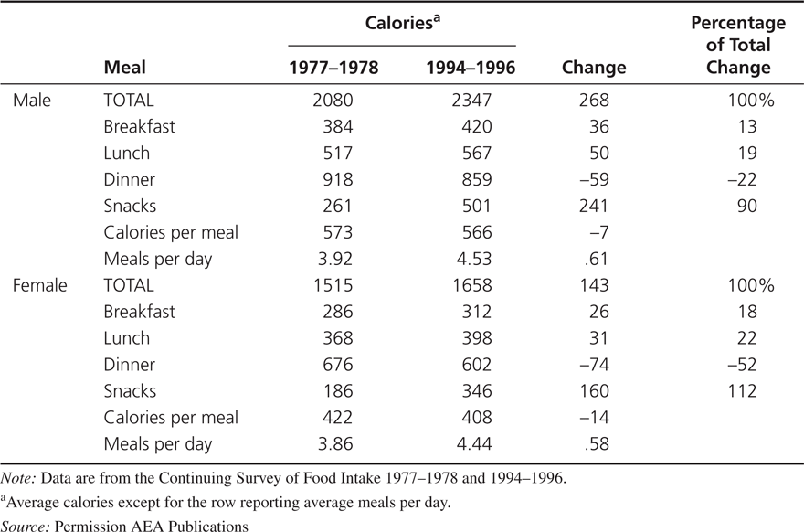
Why Has Obesity Increased?
Cutler, Glaser, and Shapiro (2003) show that there was increased caloric intake for men and women from the late 1970s to the late 1990s and no significant change in caloric expenditure.
Changes in Food Consumption, 1977-1978 to 1994-1996

Slide 44
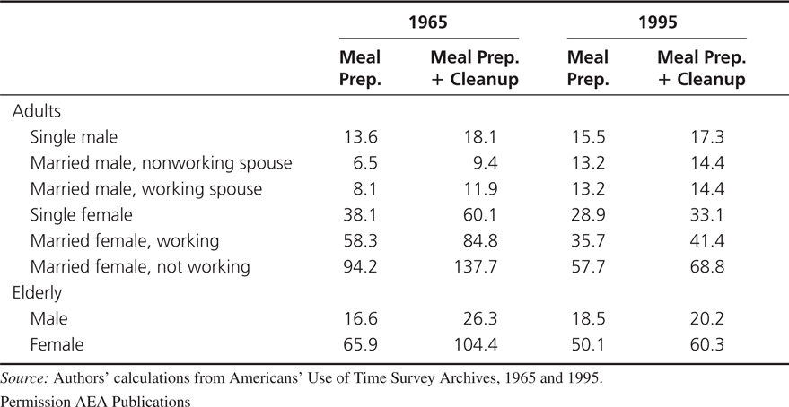
Why Has Obesity Increased?
A reduction in the cost of food increases consumption
The reductions in the time required to prepare food reduced the per-calorie cost of food by 29 percent from 1965 to 1995.
Time Costs by Demographic Group (minutes)

Slide 45
Implications of the time-cost theory of obesity
The lower costs of food preparation mean that individuals should consume a wider range of products at more times during the day.
The increase in food consumption should come mostly in foods that had an improvement in mass preparation technology (and complements to those foods).
Individuals who have taken the most advantage of the new technologies should have had the biggest increase in obesity.
Obesity rates should be higher in countries with greater access to technological changes in food consumption.

Slide 46
Hyperbolic discounting
People discount the future more at the moment of making a decision than they expect they will when planning a future decision making process.
People plan to invest more in their own health but when given a choice, they often choose less investment
Hyperbolic discounting discounts more in the near term than in the long term
Exponential discounting discounts at a constant rate at all times
Decreasing time delay between deciding to eat and eating increases the perceived payoff to eating greater for hyperbolic discounters than for exponential discounters
Notes:
I think these bullet points need to be shortened.
The example is with the alarm clock, the night before people like to set their alarm clock early, comparing the discounted disutility of getting up early against the discounted utility of getting stuff done during that time. However in the morning, they discount the utility of getting the stuff done relatively more than they did the night before, and prefer to hit the snooze button. Thus their discounting is time inconsistent.

Slide 47
Time-cost and obesity
Yaniv, Rosin, and Tobol (2009) build on this model
Assuming that healthy meals are cooked at home with purchased ingredients and time inputs
For a non-weight conscious individual a fat tax will unambiguously reduce obesity, but a thin subsidy may increase obesity
A thin subsidy may still subsidize eating more – even too much healthy food can cause obesity
for a weight-conscious individual, particularly one who is physically active, even a fat tax may increase obesity, as it may reduce not just the consumption of junk-food, but also the time devoted to physical activity.

Slide 48
Discussion
Cutler et al:
Do you believe their conclusion that sedentary lifestyle is less important than food consumption in explaining obesity?
They assume calories in equals calories out. If this assumption is not true, how might it change their conclusions? How could they have altered their approach to ask that question?

Slide 49
Bonus Discussion
Can we model irrational behavior? What does a utility function look like for someone who you disagree with about health behavior? What could be a part of that person’s utility function that renders public health campaigns unsuccessful for that person?

Slide 50
Discussion
Grossman:
The Grossman model assumes a degree of rationality and full information that is unrealistic. What problems can this create in the model?
Cutler et al:
Do you believe their conclusion that sedentary lifestyle is less important than food consumption in explaining obesity?
They assume calories in equals calories out. If this assumption is not true, how might it change their conclusions? How could they have altered their approach to ask that question?
Do you think people are hyperbolic in their discounting? What implications does this have for other health behaviors? When could hyperbolic discounters make decisions that are “better” than exponential discounters?

