Slide 1
HCMI 3243: Health Care Economics: Grossman Model
BUSN 203: Mon/Wed 9:30 PM – 10:45 AM
Shane Murphy – shane@uconn.edu

Slide 2
Economic Effects of Obesity
Obesity is a bad health investment, leading to higher medical expenditures and lower earnings. Finkelstein and colleagues (2009) report that medical spending for the obese was about 42 percent higher per year when compared to someone of BMI under 25.
Cawley (2004) finds that heavier white females, black females, Hispanic females, and Hispanic males tend to earn less, and heavier black males tend to earn more, than their less heavy counterparts.

Slide 3
Schofield, Schofield and James, 1985; Whitney and Cataldo, 1983 estimate the 10- to 12-pound increase in median weight occurring in the past two decades requires a net caloric imbalance of about 100 to 150 calories per day
One hundred and fifty calories per day is three Oreo cookies or one can of Pepsi.
It is about a mile and a half of walking

Slide 4
Growth in obesity

Slide 5
Why Has Obesity Increased?
Cutler, Glaser, and Shapiro (2003) in American Economic Review

Slide 6
Weight equals calories in minus calories out(?)
Calories out hadn’t changed as of 2003
Recent evidence suggests some groups now exercise more
Labor intensity of jobs changed?
Increased caloric intake for men and women from the late 1970s to the late 1990s

Slide 7
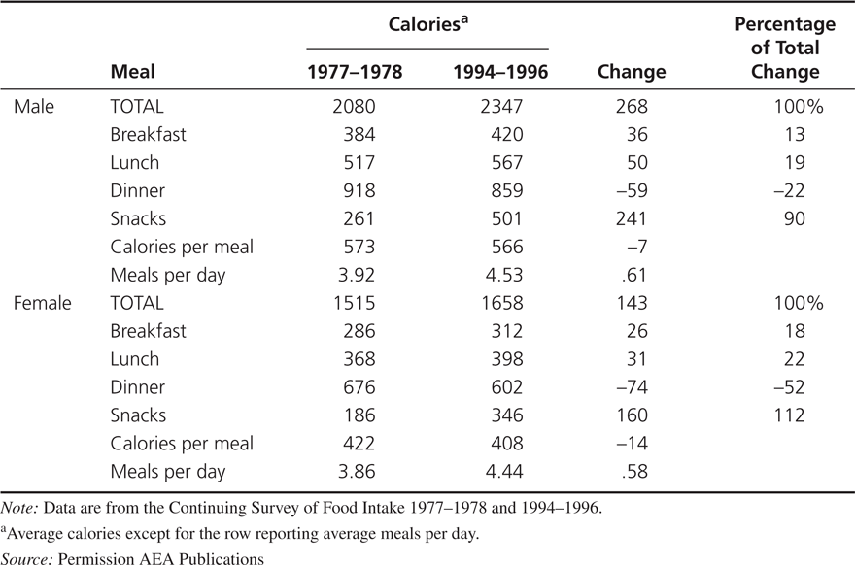
Why Has Obesity Increased?
Increased caloric intake for men and women from the late 1970s to the late 1990s and no significant change in caloric expenditure.
Changes in Food Consumption, 1977-1978 to 1994-1996

Slide 8
Technological innovation in food
Vacuum packing
Improved preservatives
Deep freezing
Artificial flavors
Microwaves
Enable food manufacturers to cook food centrally and ship it to consumers for rapid consumption

Slide 9
Technological innovation in food
Vacuum packing
Improved preservatives
Deep freezing
Artificial flavors
Microwaves
These methods do not in themselves necessarily contribute to obesity
Economic studies generally do not find things like preservatives unhealthy
Exceptions exist

Slide 10
Potato: The social scientists favorite food
High nutrition and calorie value
Easy to grow
Played role in population and urbanization growth in the past 300 years
Shift from baked, boiled, or mashed to fried forms
Raw potatoes store well
Pealed, cut, cooked, and flash frozen to be fried the most common current form
Potato consumption from 1977-1995 up 30%

Slide 11
Note on reading economic research
Good introduction previews paper
In particular, tells reader what will be analyzed and what results are found
End of introduction often serves as a table of contents written in paragraph form

Slide 12
Definition and Measurement of Obesity
Body Mass Index (BMI) = kg/m^2
Definition of obesity
Youth: BMI > historic 95th percentile
Adult: BMI > 30 (for person 5’9”, this is 203 lbs, person 5’4”, this is 175 lbs)
Ignores difference in density of muscle vs fat
BMI’s relationship with health outcomes differ by important factors including race
Alternative: Percent body fat or fat mass
But most literature uses BMI – ease of use

Slide 13
Calories
Approximately 3500 calories is one pound
Basal metabolism and calories burned during exercise increase with weight
Changes with age and sex
As a result, there is a equilibrium weight associated with any calorie consumption level
Increase in average weight in the US from 1977-1995 result from an average increase of 100-150 calories. Increase from 1977-2015 from 220 calories.
Denoting K as daily calories consumed:

Slide 14
200 Calories of Food!
100-150 calories and 200 calories is not very much food
Note: there are implications of this for individual dieting, but this class is not seeking to give dieting advice
Notes:
https://height-weight-chart.com/
https://www.strava.com/athletes/75382103

Slide 15
Survey Methodology
Food Recall Study (Continuing Survey of Food Intake 1977–1978 and 1994–1996.)
The average male in 1994-1996 reports consuming 2,347 calories
The average female reports consuming 1,658 calories.
These imply steady-state weights considerably below those measured
Time Use Study
Diaries
Under-reporting may not be a problem if level of under-reporting is constant
But under-reporting may be decreasing or increasing
Same may be true about over-reporting

Slide 16
Types of data
Large sample size – large N
Data is limited information from is large groups of people
Survey (including diaries)
Census
Small sample size – small N
Data is detailed information from limited group of people
Interviews
Ethnographies
Case Studies
Meta-analyses, systematic review, and literature review
Data is existing literature

Slide 17
Why Has Obesity Increased?
Increased caloric intake for men and women from the late 1970s to the late 1990s and no significant change in caloric expenditure.
Changes in Food Consumption, 1977-1978 to 1994-1996

Slide 18
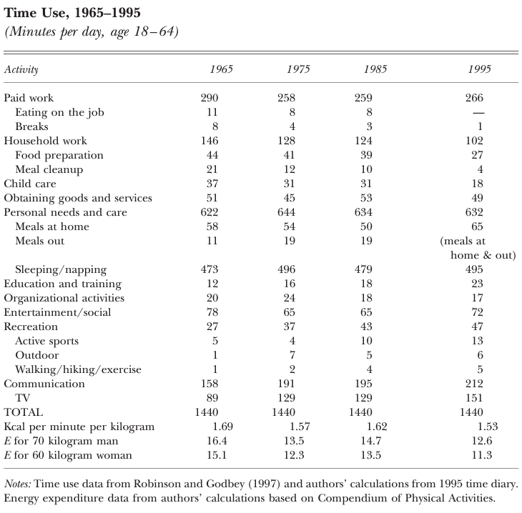
Time Use
Large changes in time use
Decrease in paid and household work times
Particularly meal cleanup
Increase in Recreation, TV
E declined by about 25%
4 points

Slide 19
Possible explanations
Increase in income
But incomes are negatively associated with obesity in general
Decrease in price of food relative to other goods
Relative decrease in food prices limited
Rise of mass production
See next slides

Slide 20
Food technologies
Technology often most important factor in economic change over time
Controlled and modified atmosphere processing
Slow ripening and prevent spoilage
Hydrogen peroxide sterilization and stretch-wrap films
Flavor barrier technology
Artificial flavors
Polyethylene packaging for moisture control
Increase in microwave ownership (1978: 8%; 1999: 83%)

Slide 21
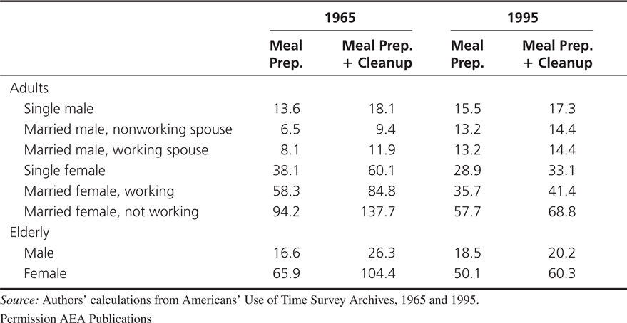
Why Has Obesity Increased?
A reduction in the cost of food increases consumption
The reductions in the time required to prepare food reduced the per-calorie cost of food by 29 percent from 1965 to 1995.
Time Costs by Demographic Group (minutes)

Slide 22
Implications of the time-cost theory of obesity
The lower costs of food preparation mean that individuals should consume a wider range of products at more times during the day.
The increase in food consumption should come mostly in foods that had an improvement in mass preparation technology (and complements to those foods).
Individuals who have taken the most advantage of the new technologies should have had the biggest increase in obesity.
Obesity rates should be higher in countries with greater access to technological changes in food consumption.

Slide 23
Time-cost and obesity
Yaniv, Rosin, and Tobol (2009) build on this model
Assuming that healthy meals are cooked at home with purchased ingredients and time inputs
For a non-weight conscious individual a fat tax will unambiguously reduce obesity, but a thin subsidy may increase obesity
A thin subsidy may still subsidize eating more – even too much healthy food can cause obesity
for a weight-conscious individual, particularly one who is physically active, even a fat tax may increase obesity, as it may reduce not just the consumption of junk-food, but also the time devoted to physical activity.

Slide 24
Discussion
Cutler et al:
Do you believe their conclusion that sedentary lifestyle is less important than food consumption in explaining obesity?
They assume calories in equals calories out. If this assumption is not true, how might it change their conclusions? How could they have altered their approach to ask that question?

Slide 25
Bonus Discussion
Can we model irrational behavior? What does a utility function look like for someone who you disagree with about health behavior? What could be a part of that person’s utility function that renders public health campaigns unsuccessful for that person?

Slide 26
Discussion
Grossman:
The Grossman model assumes a degree of rationality and full information that is unrealistic. What problems can this create in the model?
Cutler et al:
Do you believe their conclusion that sedentary lifestyle is less important than food consumption in explaining obesity?
They assume calories in equals calories out. If this assumption is not true, how might it change their conclusions? How could they have altered their approach to ask that question?
Do you think people are hyperbolic in their discounting? What implications does this have for other health behaviors? When could hyperbolic discounters make decisions that are “better” than exponential discounters?

