Slide 1
HCMI 4225: History of Public Health Insurance in the US
BUSN 204: Tue/Thur 9:30 PM – 10:45 AM
Shane Murphy – shane@uconn.edu

Slide 2
Contents
Federal expenditure before 1900
Civil War
Freedmen’s Bureau
Pensions
Mutual Aid organizations
Early Welfare States

Slide 3
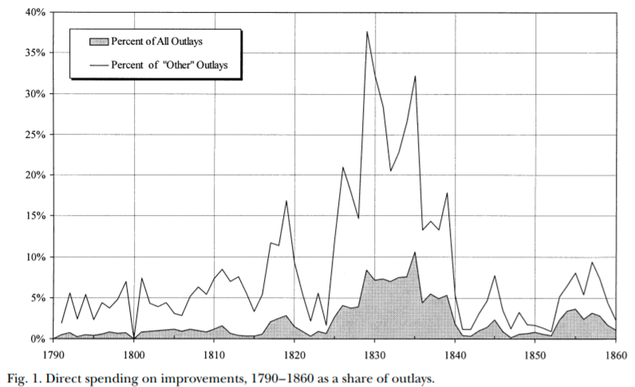
Federal expenditure before the Civil War (1861-1865)
Internal improvements, war, veterans pensions
Defense (including pensions) made up about half of expenditure most years
Congressional structure made federal spending particularly hard
Before 1820, non-defense spending was largely government employee salaries
Ways and means controlled budget; Finance committee (1816), Appropriations committee (1867) came later
Increased Westward expansion and industrialization
1820s until 1920s were an era of appropriations

Slide 4
Internal improvements
Building roads, canals, and railroads, river and harbor projects, and erecting lighthouses and other aids to navigation
Henry Clay and John Quincy Adam’s “American System”
Seven Points of 1815
Era of internal improvements was 1825-1838
Opposed by President Andrew Jackson (1829-1837)
Ends with Panic of 1837
Land grants – distribution of land sale revenues to states – expanded greatly after 1841
Westward expansion and railroads
Organization of Nebraska territory
Slavery question
Transcontinental railroad (1863-1869)

Slide 5
Detor: Civil war and emancipation
Secession starts in 1860 after Lincoln elected, before inauguration, war begins April 12, 1861
First Confiscation Act (August 6, 1861) legalizes giving escaped slaves right to remain across Union lines – called contraband
Emancipation proclamation (September 22, 1862)
Went into effect on January 1, 1863
Reconstruction
Bureau of Refugees, Freedmen and Abandoned Lands (March 3, 1865)

Slide 6
Freedmen’s Bureau
Impose a “free labor system” – northern labor ideology onto the South
Give labor rights to workers, largely black
Less than 1000 agents, budget under $6 million per year
Headed by Oliver O. Howard
Opposed by President Johnson, financing stripped in 1869, fully closed in 1872
Black Codes (1865-1866)
Federal troop occupation of the south continued until 1877 – reconstruction era is 1865-1877
Set up schools, hospitals, banks, orphanages, old-age homes, distribute food and clothes
By September 1867, ran 45 hospitals, with 5,292 beds, budget about $250,000 per year (budget supplemented by donations and by exchange with garrisons)
Pressure to move fiscal responsibility to local officials led to closures of most hospitals in 1869.

Slide 7
Civil War pensions
Competitive, patronage oriented political parties
Republican coalition was complex and cut across class and region civil war pensions funded by precisely targeted tariffs could further electoral goals of the party
Administered by the US Bureau of Pensions (merged into the VA in 1930)
Pensions were advocated by the Grand Army of the Republic, a social group for veterans
GAR became an important political group
Disabled and elderly Veterans and their dependents were more generously aided than in fledgling welfare states of the day

Slide 8
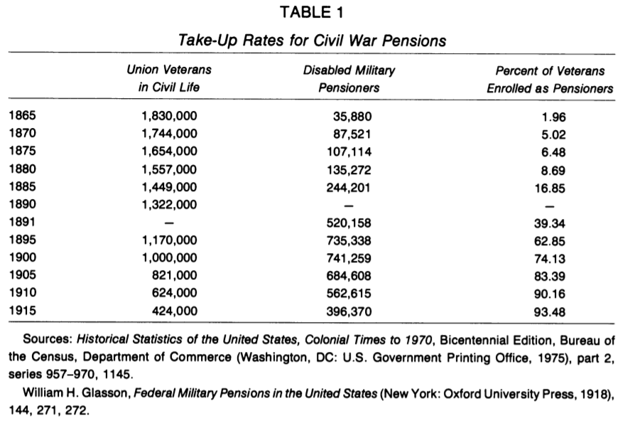
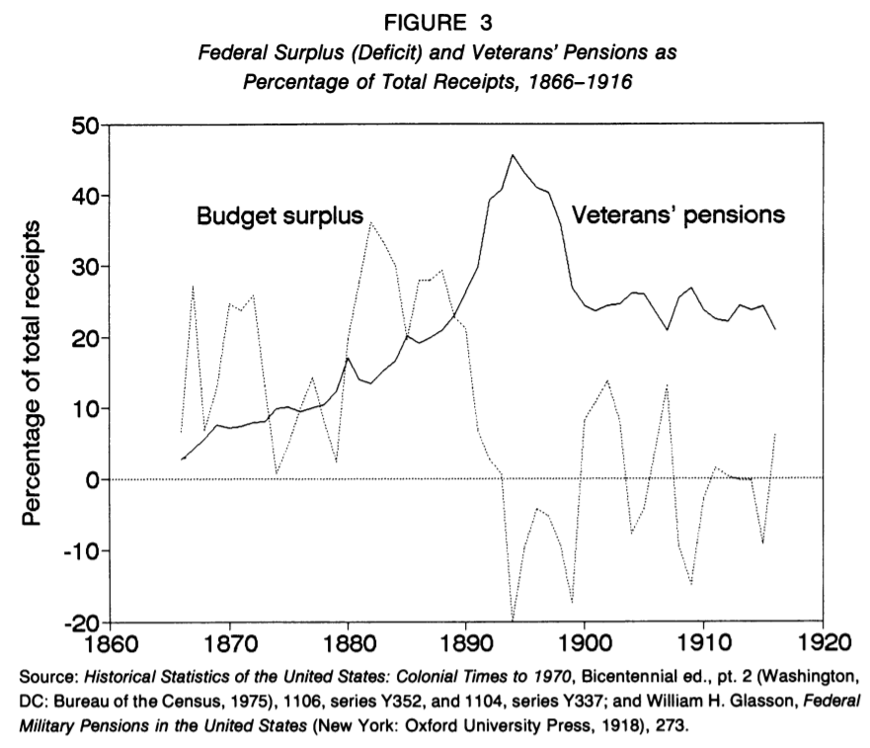
Civil War pensions

Slide 9
Extending benefits beyond veterans
Proposals to extend Civil War benefits used the language of "army of labor" to generalize from the Union Army
Proposals had some limited support from trade unions
Early 1900s proposals for old-age pensions, health and unemployment insurance, and labor regulations were rebuffed by the state
Popular support for these early programs floundered due to negative reactions to being seen as unfounded charity
Future programs would deal with this by becoming contributory
Failures at the federal level led to state level attempts state level attempts had limited long-term success, but did develop ideas and expertise that would later be incorporated into the New Deal. Wisconsin - social insurance rather than tax financed welfare

Slide 10
Maternalist movement
However, maternalist welfare state did begin to form
In the early 1900s, women's organizations grew in strength, pushing for women's rights as well as increased social protection for women
Both of these issues were cross-cutting, middle class women were aware of the possibility of destitution
Maternalist social organization was advocated especially by groups such as:
National Child Labor Committee, National Consumers League, the General Federation of Women's Clubs, the National Congress of Mothers, and the Daughters of the American Revolution.

Slide 11
Comparing maternalist and fraternal social organization
Male dominated social groups cut across class and region
But middle class female dominated groups formed with religious, charitable, and welfare purposes
Task of shaping public opinion was key both in influencing legislatures to act and influencing courts to accept
This was in contrast with courts striking down laws intended to shield unions, regulate working conditions, and regulate the market

Slide 12
Local medical systems
Poorhouses/workhouses/pesthouses
Urban public hospitals systems
Funded by cities
Staffing supplemented by medical students
Limited willingness of counties and states to subsidize local systems before the Progressive Era (1890s-1916)

Slide 13
Children’s Bureau (1912)
The Children's Bureau was a key federal program that resulted from this effort
Key leaders were Lillian Ward (Nurse, worked at juvenile wards, mental health advocate, co-founder of NAACP), Jane Addams (First US female Peace Prize winner, cofounder of ACLU, city-level activist, Hull settlement house), Florence Kelley (labor advocate, cofounder NAACP, congressional advocate), and Julia Lothrop (social worker training, supported AALL push for greater public health insurance, Juvenile courts, first head of the Children's Bureau)

Slide 14
Key federal programs
Children's Bureau:
Birth registration Infant health campaigns commissioned studies Advocated for child labor protection - Keating Owen Act (1917-1918) Sheppard-Towner Act (1921-1929) New Deal
Sheppard-Towner Act
Midwife training programs, licensing, and enforcement Parent education through traveling health demonstrations, health centers, home visits, correspondence courses, and classes Establishment of standards and licensing procedures for maternity homes Data collection on maternal and infant mortality
Lacked elite support: Keating Owen Act (1917-1918) - Killed by the Supreme Court Sheppard-Towner Act (1921-1929) - Sunsetted/failed to be renewed
Opposed by AMA general congress – supported by Pedriatic section

Slide 15
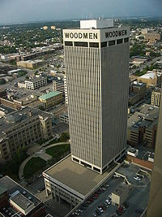
19th Century US Life Insurance
Life Insurance:
Legal Reserve Insurance
Stock companies
Owned by Investors
Mutual companies
Owned by policy holders
Fraternal orders
Notes:
https://www.youtube.com/watch?v=f7odiGPRBqc

Slide 16
Legal Reserve Insurance
Collects premiums in advance
Establishes reserves and holds assets
US regulation began in 1849 in New York
State regulation of insurance

Slide 17
Mutual Aid and Fraternal Insurance
Ancient Order of United Workmen (AOUW) formed in 1868
3 years after the end of the Civil War
Fraternal insurers grew from beginnings in 1860s to controlling half the market in the 1890s
Regulated after 1900
Generally required solvency
Disappeared thereafter, shrinking to 8% of the market by 1930s

Slide 18
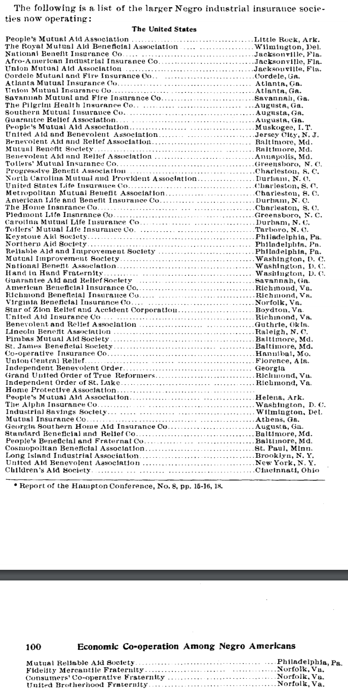
African American Insurance Societies
Mutual Aid Societies also played multiple important roles in African American Society
Insurance and social organization

Slide 19
Products of Fraternal Societies
Life Insurance
Sickness Insurance
Accident Insurance
Fixed-Fee Medical Care Provision
Other Charity
Social Organization

Slide 20
Causes of decline of Fraternal Insurance
Regulation
No regulation until 1888
Federal regulation began in 1893
Reserve requirement
Self regulating Mobile Bill of 1910
Growth of group insurance
Financial strain and dissolution
Workers compensation laws and assistance

Slide 21
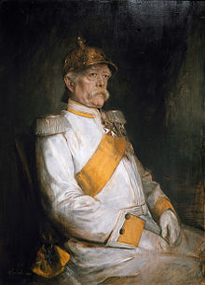
Detor: Otto van Bismarck
Minister President of Prussia from 1862-1890
Oversaw Prussian Military victories from 1863-1871
Oversaw Prussian led unified Germany in 1871
Then appointed Imperial Chancellor, serving from 1871-1890
“First” social insurance scheme in 1881, 1883, & 1884
Employer based: employers paying 2/3, employees 1/3
Responding to rising social movements and combat socialism

Slide 22
Why Germany?
Germany saw greatest level of industrial growth in late 1800s
German political philosophers (such as Fichte, Wagner, and Schaeffle) were less libertarian than Anglo counterparts (Smith, Mill, Franklin)
Note that in many ways, Marx was more pro-state than French Socialists
Well developed labor movement
1848 revolutions
Goals: Democracy (anti-monarchy and pro working class), social justice, and, in the case of Germany, unification
Bismarck worked with German Socialists from 1848 revolutions such as Ferdinand Lasalle

Slide 23
Initial forms
First: Accident and sickness insurance
Sickness in 1883, accident in 1884
Base on no-fault principle, industrial accidents a fact of life
Later: Old age and invalidity
Even later:
Insurance for survivors of industrial accidents (widows and orphans)
Maternity insurance (First program created in 1911 in Italy)
Four Social Risks: injury, sickness, old age, and unemployment

Slide 24
Spread of accident insurance
Social insurance programs were initially slow to spread, with only Germany, Austria, and Hungary having programs by 1894
But by 1904, most of Western, Central, and Northern Europe had programs
United States was late, creating a program for federal employees only in 1908
Two years after the creation of a program in Mexico (first in state of Nuevo Leon)
Canadian provinces largely created programs between 1908-1910
Sickness and unemployment insurance did not spread as quickly, more locally based

Slide 25
Federal and State programs in the US
First state social insurance law was in Maryland in 1902
Accident insurance
For workers in mines, quarries, and steam and electric railroads
Granted $1,000 in case of fatal accident
Based on equal employee and employer contributions
Declared unconstitutional in 1904
Grounds that it deprived both parties right of trial by jury

Slide 26
Other early programs
Voluntary, equal contribution accident programs were set up in Massachusetts and Illinois in 1905 and 1908, but these were not popular among workers and unions
Connecticut state legislature investigation in 1907 found such programs would be good, but could not find a solution out of fear of interstate competition
However, Theodore Roosevelt succeeded in passing an accident insurance bill for US employees in 1908
He had supported a similar bill when he was governor of NY in the 1890s

Slide 27
State programs opposed by the population and by the Supreme Court
Early programs by Maryland (1904), Montana (1910) and New York (1910) were later declared unconstitutional
Other 1910 programs by Massachusetts, Maryland, and New York were voluntary and failed
Starting in 1911, States began enacting effective programs
TW – medical procedure: Phossy Jaw

Slide 28
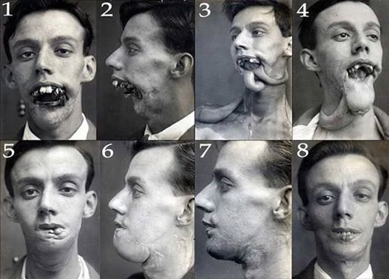
Phossy Jaw and the AALL
American Association for Labor
Legislation sough federal regulation
of yellow phosphorus used in match
manufacturing
Substitutes existed, the substance was banned in Europe, and it led to a painful, debilitating and sometimes deadly condition
Phosphorus necrosis
AALL marketing effective increased support regulation
regulation began in 1912
Momentum behind public support, guides for future legislation

Slide 29
Characteristics of initial state programs
Limited scope
Limited forms of industries
Iron and steel building erection, elevator operation, work on scaffolding, electricians, work with/near explosives, railworkers, construction of tunnels and subways, and compressed air work.
Dangerous operation with little interstate competition
Constitutional legality based on police power of state
Elective programs included changes to liability law
Non-electing companies no longer as able to waive liabilities
Electing employees reduced in ability to extract unlimited damages
But such programs generally were unsuccessful

Slide 30
Nudges
In most states, most employers did not elect to join scheme
Laborers were not in a strong position and were not generally able to take advantage of increased legal rights
Voluntary program in New Jersey was exception
In NJ, employers were assumed to have elected to join scheme unless they made a specific statement not to join
Many employers were uninterested or uninformed and joined by default
Voluntary program in Illinois was another exception
In both NJ and Illinois, insurance rates were lower so compensation was cheaper than liability

Slide 31
Workers compensation
State Employer Liability Acts passed between 1855 and 1907 allowed workers to sue for injury caused by employer negligence
Starting with Wisconsin in 1911, 36 states created workers’ compensation laws in the 1910s.
Mississippi was the last state to pass such legislation in 1948

Slide 32
Response of US labor
Organized labor initially fought against early programs
In 1909, the American Federation of Labor began to support social insurance
Private programs were created as well
US Steel and International Harvester
Values were placed on injuries
As the idea of public social insurance grew in popularity, state and federal jurists became less likely to make constitutional arguments against it

Slide 33
HCMI 4225: History of Insurance
BUSN 202: Mon/Wed 12:30-1:45
Shane Murphy – shane@uconn.edu

Slide 34
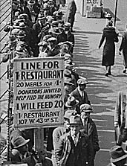
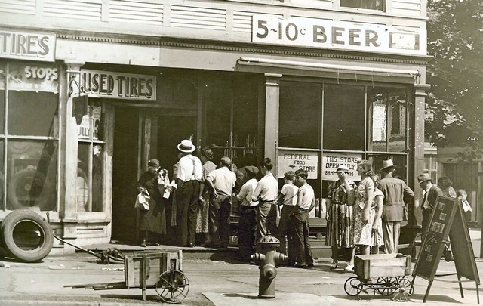
Great Depression (1929-1939)
Notes:
https://www.youtube.com/watch?v=IzjWk1DD6gE
https://www.youtube.com/watch?v=l4zfEkKs2ZM

Slide 35
1935 Social Security Act and the Welfare State in the US
Federal Old Age, Survivors, Disability and Hospital Insurance Program
Originally entitled the Federal Old Age Benefits (I) program
Program now also encompasses Medicare and is funded through FICA
Federal-state unemployment compensation program
FUTA (1954)
9 other programs including aid to states for programs for the blind (X), needy dependent children (IV)
Avoided using the word “insurance” to provide some protection from conservative SC justices – but programs were called social insurance after SC ruling in support in 1939
American Medical Association opposed early efforts for state or national health insurance

Slide 36
Health Insurance programs in the Social Security Act
Four key programs
Maternal and Child Health
Crippled Children Services
Vocational rehabilitation
Public Health
Created as grants to states for state run programs
Initial plans included national health insurance, which AMA opposed and FDR thought was politically too risky, eventual AMA support of Act was reluctant

Slide 37
New Deal
First New Deal included banking reform, the National Recovery Administration, and the Civil Works Administration
Second New Deal included labor union protections, establishment of the Works Progress Administration, the creation of the US Housing Authority, the Fair Labor and Standards Act of 1938, and the Social Security Act
FDR (a New York Democrat) vs the conservative coalition of Republicans and Southern Democrats
Harry F. Byrd Sr was a noted leader of the conservative coalition
Opposed Federal control over standards for old age assistance and other programs

Slide 38
Rise of Fascism, American Fascism, and the New Deal
Mussolini, not Hitler, was the superstar of Fascist politics in the early 1930s
Fritz Julius Kuhn’s German-American Bund, founded in 1936
William Dudley Pelley’s Silver Legion, founded in 1933
Business Plot of 1933
William Joseph Simmons’s 2nd KKK, founded in 1915
William Shepard and Virgil Effinger’s Black Legion, founded in 1920s, Effinger took control in 1931
National Industrial Recovery Act of 1933 - authorized the President to regulate industry for fair wages and prices
Supported by Huey Long and Father Charles Coughlin
Recognized as being modelled on Italian cooperative state
However, Italian statism, liberals argued, was in the service of the state
The NRA sought to protect the interests of the people
German and Italian Fascism came to be identified with business interests
New Deal philosophy more closely resembled the British Labor Party or Social Corporatism/Social Democracy (1930s Norway and Sweden)
Division grew and by 1939, the New Deal was called the Jew Deal by Kuhn

Slide 39
Judicial Procedures Reform Bill of 1937
National Industrial Recovery Act of 1933 found unconstitutional in Schechter Poultry Corp. v. United States (1935)
Judicial review
Created by Chief Justice John Marshall in case called Marbury v Madison (1803)
Granted the president power to appoint an additional justice to the Supreme Court for every member of the court over the age of 70 years and 6 months.
Up to a maximum of six
Proposed in February 1937
In March, anti-new deal justice made pro-new deal decision
"the switch in time that saved nine“
Bill was wildly unpopular

Slide 40
Year | Size | Enacting Legislation | Comments
1789 | 6 | Judiciary Act of 1789 | Original court with Chief Justice & five associate justices; two justices for each of the three circuit courts. (1 Stat. 73)
1801 | 5 | Judiciary Act of 1801 | Lameduck Federalists, at end of President John Adams's administration, greatly expand federal courts, but reduce the number of associate justices¹ to four in order to dominate the judiciary and hinder judicial appointments by incoming President Thomas Jefferson. (2 Stat. 89)
1802 | 6 | Judiciary Act of 1802 | Democratic-Republicans repeal the Judiciary Act of 1801. As no vacancy had occurred in the interim, no seat on the court was ever actually abolished. (2 Stat. 132)
1807 | 7 | Seventh Circuit Act | Created a new circuit court for OH, KY, & TN; Jefferson appoints the new associate justice. (2 Stat. 420)
1837 | 9 | Eighth & Ninth Circuits Act | Signed by President Andrew Jackson on his last full day in office; Jackson nominates two associate justices, both confirmed; one declines appointment. New President Martin Van Buren then appoints the second. (5 Stat. 176)
1863 | 10 | Tenth Circuit Act | Created Tenth Circuit to serve CA and OR; added associate justice to serve it. (12 Stat. 794)
1866 | 7 | Judicial Circuits Act | Chief Justice Salmon P. Chase lobbied for this reduction.¹ The Radical Republican Congress took the occasion to overhaul the courts to reduce the influence of former Confederate States. (14 Stat. 209)
1869 | 9 | Judiciary Act of 1869 | Set Court at current size, reduced burden of riding circuit by introducing intermediary circuit court justices. (16 Stat. 44)
Notes
1. Because federal justices serve during "good behavior", reductions in a federal court's size are accomplished only through either abolishing the court or attrition—i.e., a seat is abolished only when it becomes vacant. However, the Supreme Court cannot be abolished by ordinary legislation. As such, the actual size of the Supreme Court during a contraction may remain larger than the law provides until well after that law's enactment.

Slide 41
World Wars
World War I (1914-1918) and World War II (1939-1945)
WWI: Allied Powers (France, Britain, Russia, Serbia, Belgium, Japan, Italy, US, Romania, Portugal, US, China, and others) vs Central Powers (Germany, Austria-Hungary, Ottoman Empire (Turkey), Bulgaria)
WWII: Allies (Russia [1941], US [1941], UK, China) vs Axis (Germany, Japan, Italy)
In 1919, as a part of the Treaty of Versailles, the International Labor Organization was created (now a part of the UN)
In 1927, the International Social Security Association was established affiliated with the ILO
In 1945, the UN was established

Slide 42
Communist programs
Leninist social insurance programs based on two 1912 principles
Cost solely responsibility of employers
Administration by employees
Program evolved greatly in 1930s
Centralized in 1931, expanded to include health care in 1936
Adopted by China in 1930s and other socialist countries after WWII

Slide 43
Spread of the German Model
Old age and sickness insurance in the German model spread through non-Communist states more quickly after 1919
US adopted old-age and unemployment insurance in 1935

Slide 44
1941, Roosevelt, and WWII
Four Freedoms - https://www.youtube.com/watch?v=qrNDwyj4u1w – Jan 6
Freedom of speech, Freedom of worship, Freedom from want, Freedom from fear
The third is freedom from want—which, translated into world terms, means economic understandings which will secure to every nation a healthy peacetime life for its inhabitants—everywhere in the world.
Atlantic Charter - https://www.youtube.com/watch?v=-msKSTzmQxk – Aug 14
Set ideological goals of Anglo-American alliance
WWII was not just to be a military war against Germany and the axis, but also an ideological war against Naziism and Fascism
5. The desire to bring about the fullest collaborations between all nations in the economic field with the object of scoring, for all, improved labor standards, economic advancement and social security.
Pearl Harbor bombed – Dec 7

Slide 45
Social Security development during WWII
1941 UK: Beveridge Plan
Led to the creation of social programs in the UK forming the Welfare State
Family Allowances Act 1945, National Insurance (Industrial Injuries) Act 1946, National Insurance Act 1946, National Health Service Act 1946, Pensions (Increase) Act 1947, Landlord and Tenant (Rent Control) Act 1949, National Insurance (Industrial Injuries) Act 1948, National Insurance Act 1949
1943 US: Wagner-Murray-Dingell Bill
Failed law for national medical and hospitalization coverage
1943 Canada: Marsh Plan
1944 India: India Beveridge Plan
1945 China, etc
By the 1950s, most industrial capitalist countries had comprehensive systems for all of the four social risks

Slide 46
Age of privatization
Neo-liberal ideology grew in influence since around 1980
Chicago Boys, Led by University of Chicago economists such as Milton Friedman
1981 privatization of the Chilean pension system
Under the Pinochet regime
Replace public pension with fully funded individual accounts system with contributions by individuals and administered privately
During debt crises in the 1980s (and carrying into the 1990s) in low and middle income countries (especially in Latin America) the World Bank and IMF pushed other countries with to privatize

Slide 47
Key Legislation
1915: AALL bills (failed)
1921: Sheppard-Towner Act (expired in 1929)
1935: Social Security Act (health insurance was omitted from the final draft)
1942: Stabilization Act
1944: Economic Bill of Rights proposal (FDR died a year later)
1946: Wagner-Murray-Dingell and Taft-Smith-Ball bills (no action)
1950: Social Security Amendments of 1950
1956: Social Security Amendments of 1956
1965: Social Security Amendments of 1965 (Medicare and Medicaid)
1972: Social Security Amendments of 1972
1974: Employee Retirement Income Security Act (ERISA)
1985: Consolidated Omnibus Budget Reconciliation Act (COBRA)
1996: The Health Insurance Portability and Accountability Act (HIPAA)

Slide 48
1915: AALL bills (failed)
State level campaign led by labor organization - American Association of Labor Legislation
Cover working class and low income individuals
Cover the services of physicians, nurses, and hospitals
Also cover as was sick pay, maternity benefits, and a death benefit for funeral expenses
Initially supported by the AMA, but opposed by many state societies
Opposed by the American Federation of Labor (AFL)
Grew in support by 1917, but faltered thereafter and was dead by 1920
Never enacted in any state

Slide 49
1921: Sheppard-Towner Act (expired in 1929)
Federal subsidies for state-run child and maternal health
Massachusetts, Connecticut nd 4 other states didn’t participate
Opposed by the AMA
Although supported by the Pediatric Section of the AMA
Led to the formation of the American Academy of Pediatrics
Renewed in 1926 but opposition grew and funding lapsed in 1929

Slide 50
1942: Stabilization Act
During WWII, increased government spending was leading to inflation
Increased demand for war-time goods and increased demand for workers due to increased military spending led to labor shortages
Bill meant to combat inflation and labor shortages
Limit employer’s ability to raise wages
Employer response was to increase benefits
Health benefits became part of employment packages

Slide 51
1944: Economic Bill of Rights proposal (FDR died a year later)
Part of FDR’s inaugural address
Also called the second bill of rights
The right to a useful and remunerative job in the industries or shops or farms or mines of the nation;
The right to earn enough to provide adequate food and clothing and recreation;
The right of every farmer to raise and sell his products at a return which will give him and his family a decent living;
The right of every businessman, large and small, to trade in an atmosphere of freedom from unfair competition and domination by monopolies at home or abroad;
The right of every family to a decent home;
The right to adequate medical care and the opportunity to achieve and enjoy good health;
The right to adequate protection from the economic fears of old age, sickness, accident, and unemployment;
The right to a good education.
FDR was elected to his fourth term in November 1944 but died in April 1945

Slide 52
Key Legislation
1946: Wagner-Murray-Dingell and Taft-Smith-Ball bills (no action)
Bills were in part in opposition to each other, but both sought to provide health payments to low income workers
Neither bill made it to the floor

Slide 53
Blue Cross
In 1929, a group of Dallas school teachers contracted with Baylor University Hospital to receive up to 21 days of inpatient care a year for regular monthly payments of 50 cents.
By 1937, there were 26 such plans with more than 600,000 members total.
These combined under the auspices of the American Hospital Association (AHA) to form the Blue Cross network of plans

Slide 54
Blue Shield
In the 1930s, physicians became concerned about proposals for compulsory national health insurance and the threat of insurance competition from Blue Cross.
Specifically, doctors worried that third-party payers would lower their incomes by restricting their ability to set their own fees. In response, physicians established a network of their own insurance plans covering physician services.
These plans, known as Blue Shield, preempted the hospital-oriented Blue Cross plans from entering into the primary care sector.

Slide 55
WWII and the 1950s
During World War II wage and price controls prevented employers from using higher salaries to attract workers.
They were, however, allowed to offer fringe benefits like health insurance for up to 5 percent of a worker's wages.
In addition, the National Labor Relations Board ruled that health insurance benefits were a legitimate subject of labor-management negotiations.
Lastly, the IRS and the National War Labor Board determined that employers could deduct the cost of employee health benefits from taxable business income, and employees did not have to include the value of those benefits in calculating their taxable income.
As a result the market for health insurance of all kinds increased dramatically during the 1940s, from a total enrollment of 20,662,000 in 1940 to 142,334,000 in 1950.

Slide 56
UN Declaration of Human Rights
Proclaimed by the United Nations General Assembly in Paris on 10 December 1948
https://www.youtube.com/watch?v=Lp-3CQ6ZD4k
Article 25.
(1) Everyone has the right to a standard of living adequate for the health and well-being of himself and of his family, including food, clothing, housing and medical care and necessary social services, and the right to security in the event of unemployment, sickness, disability, widowhood, old age or other lack of livelihood in circumstances beyond his control.
(2) Motherhood and childhood are entitled to special care and assistance. All children, whether born in or out of wedlock, shall enjoy the same social protection.

Slide 57
1950s: Social Security Amendments of 1950 and 1956
Payments to health care providers for welfare recipients established in 1950 and expanded in 1956

Slide 58
LBJ and the Great Society
Civil Rights
Civil Rights Act of 1964 outlawed discrimination based on race, color, religion, sex, or national origin
Voting Rights Act of 1965
Section 5 largely struck down by Shelby County v. Holder (2013)
War on Poverty
1964 creation of the Office of Economic Opportunity
Job corps and work training programs
Head Start
1965 Elementary and Secondary Education Act
Housing and Urban Development Act of 1965
National Endowment for the Humanities and the National Endowment for the Arts
1965 National Foundation on the Arts and Humanities Act
Environmental legislation
Pro-immigration legislation
https://youtu.be/nXVAOcs5oVA?t=24

Slide 59
1965: Social Security Amendments of 1965 (Medicare and Medicaid)
Major issue in 1962 Kennedy Campaign (Kennedy was assassinated in 1963)
Johnson strongly supported legislation
Initial proposal failed in 1964
Supported by the AFL-CIO, both parties

Slide 60
1970: Title X
Provides federal support for comprehensive family planning and related preventive health services
prioritize the needs of low-income families or uninsured people (including those who are not eligible for Medicaid)
These services are provided to low-income and uninsured individuals at reduced or no cost.
Created in 1970
FDA approved the Pill in 1960
Planned Parenthood formed in 1916, changed name to Planned Parenthood in 1942, large advocate for Title X

Slide 61
Title X
Administered by US Department of Health and Human Services (10 regional offices)
Award grants to health departments, university and community centers, Planned Parenthood clinics, and other public and nonprofit agencies.
Any public or nonprofit entity (located in a designated state) that offers a broad range of acceptable family planning methods and services is eligible to apply.
In 2008, there were 4522 Title X clinics serving more than 5 million individuals.

Slide 62
Services
Among female family planning users in 2008
44% received cervical cancer screening (Papanicolau tests)
46% received breast cancer screening (clinical breast examinations)
49% received chlamydia testing; 57% of male family planning users received chlamydia testing
Among every 10 family planning users, on average 4.7, 1.4, and 1.6 gonorrhea, syphilis, and HIV tests were provided, respectively.
90% of spending is on clinical family planning services
Commonly, Title X is their avenue of entry into the health care system

Slide 63
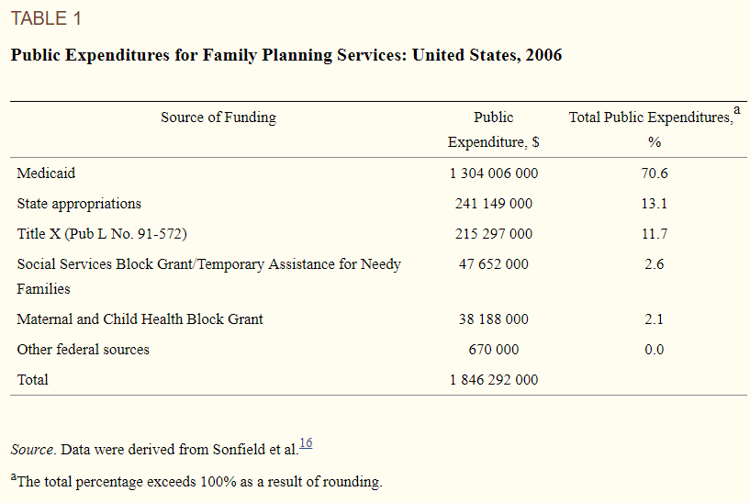

Slide 64
Restrictions
Federal regulations initiated in 1987 prohibiting clinics receiving Title X funding from disseminating abortion information or referrals (i.e., the “gag rule”). This legislation, although further supported by the Supreme Court as being constitutional in 1991, was later banned in 1993 by President Clinton.⁹
An attempt by the Reagan administration in 1982 to require minors to obtain written parental consent before receiving services (i.e., the “squeal rule”).This legislation was later reintroduced as the Parental Notification Act of 1998.
Legislation enacted in 1998 emphasizing abstinence-only education and ignoring the teaching of medically accurate and age-appropriate sexual information stressing health promotion and disease prevention.
Legislative proposals to repeal sections of Title X or the policy in its entirety.

Slide 65
Criticisms
"Title X is welfare for affluent teenagers “
Most (~80%) recipients are poor or near poor, 1/3 are teenagers, 1/6 under 18, few under 16.
"The existence of [Title XI puts the United States government on record declaring that it is appropriate for government to decide who has children.”
Title X statute stipulates that "the acceptance by any individual of family planning services or family planning or population growth information . . . shall be voluntary and shall not be a prerequisite to eligibility for or receipt of any other service or assistance

Slide 66
Criticisms
"Planned Parenthood and its affiliates . . . constitute most of the Title X network. “
About ¼ Title X funds go to PP providers
". . . no one can deny the fact that Title X does indeed subsidize teenage sexual activity. “
The rise and recent decline in teenage sexual activity is unlikely to have much to do with politics and public policy at this level.

Slide 67
Criticisms
“[In 1981, it was] demonstrated that the programs providing these teenage birth control services were not only totally ineffective in achieving their professed goals of reducing premarital pregnancy, illegitimate births, and abortion among teenagers, but had actually contributed significantly toward making these problems worse”
"Most Title X funds go to organizations which engage in abortion, pro- mote abortion, lobby for abortion, litigate about abortion. If the advocates of Title X want it to continue ... I need their support for legislation that will prohibit the use of Title X funds by any organization which in any way engages in abortion, abortion referral, abortion counseling, abortion lobbying, abortion advertising.“
"[Title X] was begun as family planning assistance for low-income families. It sounded commendable. Its stated purpose was to assist poor couples to plan their families. As with many other programs with humanitarian intent, Congress established Title X and left it in the hands of the federal bureaucracy. That is when things went haywire.”

Slide 68
1972: Social Security Amendments of 1972
Extended Medicare to disabled
Increased payroll taxes to finance

Slide 69
HMOs
In 1970, Paul Elwood coined the phrase "health maintenance organization" to emphasize the clinical prevention role of plans like Kaiser's formed in 1945 and the 1929 Ross-Loos Medical Group plan for LA city and county employees.
HMOs were able to reduce resource utilization rates, particularly hospital admissions and lengths of stay.
The Health Maintenance Organization Act of 1973 was passed to encourage HMO growth in the marketplace.
This law provided grants and loans to start or expand HMOs, removed state restrictions on federally certified HMOs, and required employers of 25 or more employees to offer this type of plan as a benefit option.
In the 1970s there were 26 plans with about 3 million subscribers nationwide; by 1991 the numbers had grown to 556 plans with 35 million enrollees.

Slide 70
1973: Health Maintenance Organization Act
Provided money and federal protection to HMOs
Some state laws restricted health insurers, federally qualified HMOs could avoid such restrictions
Dual choice mandate (expired in 1995, never enforced)
Employers with 25+ employees that offered coverage should offer at least one group model and one HMO

Slide 71
1974: Employee Retirement Income Security Act (ERISA)
Established minimum standards for private pensions and health benefits plains
Two key amendments:
The Consolidated Omnibus Budget Reconciliation Act of 1985 (COBRA)
Provides some employees the right to continue coverage after termination of employment for a limited time
The Health Insurance Portability and Accountability Act of 1996 (HIPAA)
Ensures coverage of some pre-existing medical conditions
Bars some forms of discrimination

Slide 72
Failed Proposals: Nixon, Ford Carter, and Clinton
https://www.youtube.com/watch?v=_A0O7IVsVhY
Nixon:
Nixon Comprehensive Health Insurance Plan of 1974
National Health Insurance Partnership
An employer mandate
Replace Medicaid with fully financed federally run plan that covers families with children with low income head of household

Slide 73
Failed Proposals: Nixon, Ford Carter, and Clinton
Nixon:
Nixon Comprehensive Health Insurance Plan of 1974
National Health Insurance Partnership
An employer mandate
Replace Medicaid with fully financed federally run plan that covers families with children with low income head of household

Slide 74
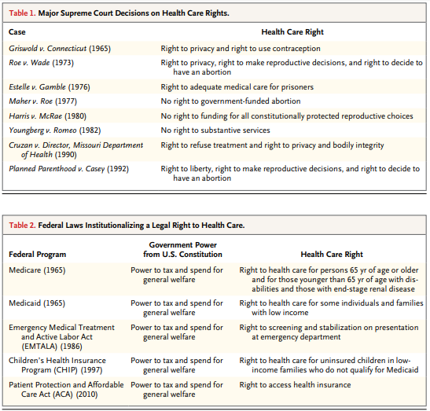
Federal Laws

Slide 75
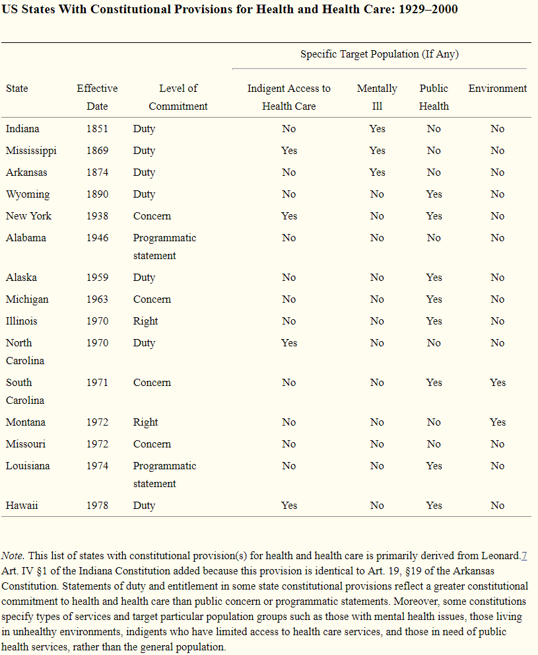
US State Constitutions
As of April 2014, 15 state constitutions specifically mention health and health care—either in the form of a programmatic statement, public concern, individual right, or government duty.

Slide 76
Universal health care
Video: CSPAN: Harry and Louise Ads, 1993
https://www.youtube.com/watch?v=CwOX2P4s-Iw

Slide 77
Hillarycare: the Health Security Act of 1993
Universal coverage
Most people would get insurance plans from their employers because all employers were required to provide health insurance coverage to every employee.
People without jobs could purchase health insurance on their own from the regional health alliances.
The Federal government would subsidize the costs for low-income people.

Slide 78
Hillarycare: the Health Security Act of 1993
Regional health alliances
Regional Health Alliances were state-based health insurance purchasing groups.
The alliances would control costs by setting the prices for health care providers based on a fee-per-service.
Companies with more than 5,000 full-time employees could provide their own insurance outside the alliances.

Slide 79
Hillarycare: the Health Security Act of 1993
National health board
The National Health Board was a new federal agency.\It set a cap on total health care spending for the nation.
That meant it regulated health insurance premiums. For individuals, it set limits on maximum annual out-of-pocket costs.
It also determined minimum coverage requirements.

Slide 80
Defeat
Association of American Physicians and Surgeons opposition
Doctors opposed losing control over pricing, care and treatment
Congressional concern over the deficit
1990-1991 Recession was over and workers felt confident about future employer-based insurance prospects
Labor unions didn’t support the initiative.
They were angry at the President for signing NAFTA.

Slide 81
Comparing Hillarycare and Obamacare
Feature | Hillarycare | Obamacare
Universal coverage | All employers | Most employers
Pre-existing conditions covered | Yes | Yes
Non-employer coverage | Regional health alliances | Health insurance exchanges
Reliance on insurance | Yes | Yes
Universal mandate | Yes | Yes
Required coverage | Yes | 10 essential health benefits
Low-income subsidies | Provided by federal government | Expanded Medicaid
Tax on high-end insurance | Income tax | Cadillac tax on businesses
Focus on Preventive Care | Yes | Yes
Funded by | Deficit spending | Obamacare taxes
Doctors paid on | Fee-for-service | Patient wellness
Medicare | "Doughnut hole" did not exist | Eliminate "doughnut hole"

Slide 82
Mental Health Provision
Public Good?
Opportunity cost and Marginal Social Benefit?
Ability to pay?
Natural Monopoly?

Slide 83
Mental Health up to the 1950s
Dorothea Dix’s national crusade for moral treatment for the mentally ill in the 1840s
Clifford Beers mental hygiene movement of the 1910s and 1920s
Hospitals run by states, but with increasing levels of federal financial support
Block grants as a part of FDRs New Deal in the 1930s
Truman’s National Mental Health Act of 1946 creating the NIMH
In 1955, the first antipsychotic, Chlorpromazine (Thorazine), came on the market and was quickly heavily prescribed
Gave hope for an end to mental health illness
Dire conditions in mental health facilities was growing in the national consciousness
One Flew Over the Cuckoo’s Nest – Ken Kesey (1962)

Slide 84
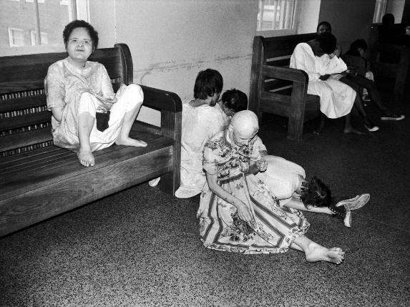
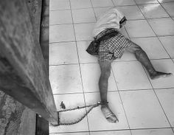
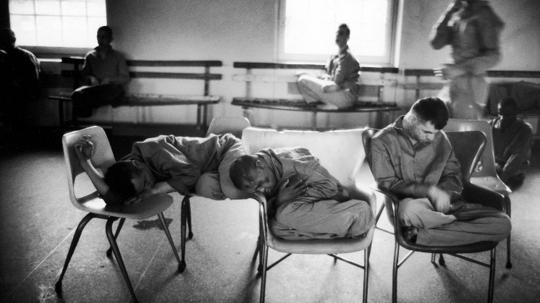
Mental Health: Willowbrook Wars
“The Willowbrook State School, located in Staten Island, New York City, was a squalid dumping ground for 5,400 profoundly mentally retarded children and adults. . .Naked bodies could be found sprawling on concrete floors; some residents seemed to live in soiled clothing; toilets didn't work, feces were everywhere, and the stench was unbearable. The physical plant was dilapidated, the interior filthy beyond imagination. Disease-especially hepatitis and shigella-was rampant. Medical care was inadequate, therapy largely nonexistent.”

Slide 85
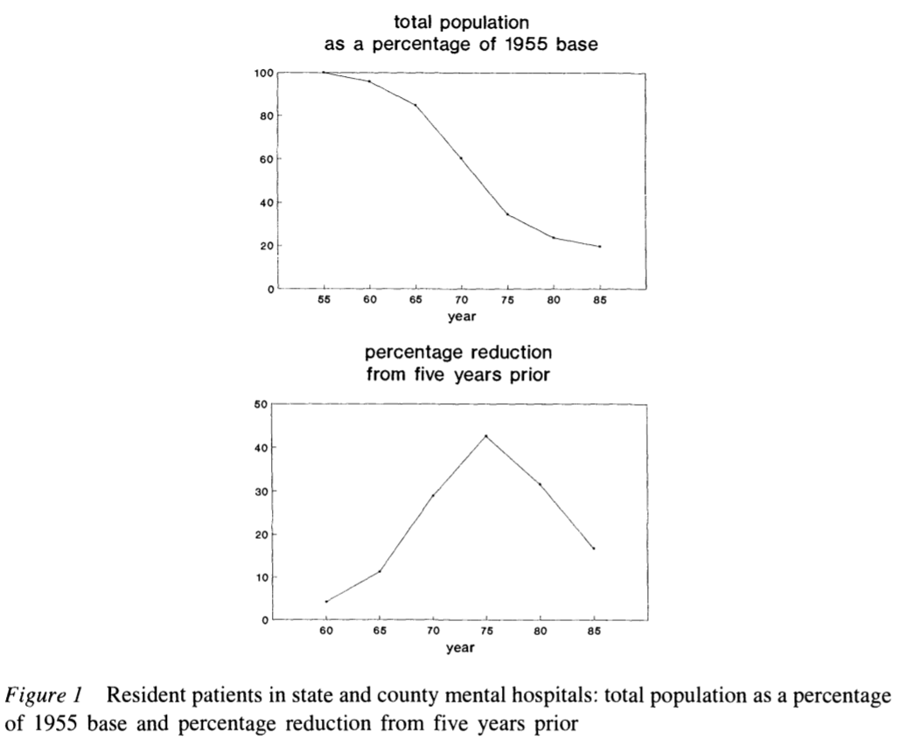
Deinstitutionalization
The peak institutionalized population was in 1955-- approximately 550,000 patients in mental institutional around the US, at a time when the US population was 165 million, roughly one in every 300 Americans.
In 2019, with a population twice the size of 1955, we have roughly 110,000 patients institutionalized -- roughly a %90 reduction in the percentage of the population institutionalized.

Slide 86
Federalization: Kennedy’s Community Mental Health Act of 1963
US government decided for the first time since President Pierce vetoed the National Mental Health Act of 1854 that it had a role in the direct delivery of mental health services
At the time, there were 30,000 psychiatrists in the US
This has increased 10 fold, 20 fold if psychiatric nurses are included
However, Congress did not authorize adequate funding
Kennedy was assassinated the next month, in November 1963
funding amendments passed in 1965 (along with the creation of Medicare and Medicaid)

Slide 87
Decentralization of Care: Role of Insurance and Community Hospitals
Insurance began to cover mental health benefits
Including Medicaid, which was created in 1965
Created federally designated mental health catchment areas which were eligible to apply for federal grants to fund care
Supplementary Security Income (created in a 1972 law) provided additional assistance for people whose mental illness constituted a recognized disability
Hospitals developed specialized psychiatric units
Mental health episodes became characterized by short lengths of stay
But little community follow up
Functions previously associated with mental health hospitals now distributed across various groups/agencies

Slide 88
Defunding
Through the 1970s, Governors including Reagan in California and Carter in Georgia passed progressive mental health care laws
Ford opposed extending funding of mental health care but Johnson era law was kept in place using continuing resolutions until the election of Carter in 1976
Carter's Mental Health Systems Act of 1980 (repealed in 1981 and 1985) & Civil Rights of Institutionalized Persons Act of 1980
Reagan’s (elected to president in 1980) cut funding to community health centers (sunsetting the funds, cutting 25% per year for 4 years)
SSI, Medicaid, and patient fees made up some of the difference
Depriving the community based health organizations of the funding they needed to support the deinstitutionalized.

Slide 89
Managed Care era
Health Maintenance Organizations became a federally supported preferred method of insurance with the HMO act of 1973
Since then, and growing in importance starting in the 1990s there has been increased emphasis on managed care as a method of price control
This system incentivizes patients to use in-network providers for care
Reduction in fee-for-service reimbursement and growth of network requirements further defunded mental health care providers
Managed Care coverage varies for mental health and psychiatric prescriptions
Carve-in (integrated) vs Subcontracted management vs Carve-out (separated

Slide 90
Sources
Cutler, David L., Joseph Bevilacqua, and Bentson H. McFarland. "Four decades of community mental health: A symphony in four movements." Community Mental Health Journal 39, no. 5 (2003): 381-398.
Mechanic, David, and David A. Rochefort. "Deinstitutionalization: An appraisal of reform." Annual Review of Sociology 16, no. 1 (1990): 301-327.

Slide 91
Readings:
Quadagno, Jill. "Why the United States has no national health insurance: Stakeholder mobilization against the welfare state, 1945-1996." Journal of Health and Social Behavior (2004): 25-44.
Blendon, Robert J., and John M. Benson. "Americans’ views on health policy: a fifty-year historical perspective." Health Affairs 20, no. 2 (2001): 33-46.
Freed, Gary L., and Anup Das. "Nixon or Obama: Who Is the Real Radical Liberal on Health Care?." Pediatrics 136, no. 2 (2015): 211-214.

Slide 92
Readings:
Cutler, David M., and Richard Johnson. "The birth and growth of the social insurance state: Explaining old age and medical insurance across countries." Public Choice 120, no. 1-2 (2004): 87-121.
Zanjani, George. "The Rise and Fall of the Fraternal Life Insurer: Law and Finance in US Life Insurance, 1870-1920." (2003).
Du Bois, William Edward Burghardt. "Economic co-operation among Negro Americans." In Conference for the Study of the Negro Problems 1907: Atlanta, Ga.). The Atlanta University Press, 1907. Section 11 p92-109
Rubinow, Isaac Max. Social insurance: With special reference to American conditions. H. Holt, 1913. (https://archive.org/details/socialinsurancew00rubiiala) Chapters 2, 10, 11, 12
Guyton, Gregory P. "A brief history of workers' compensation." The Iowa orthopaedic journal 19 (1999): 106.
Hu, Aiqun, and Patrick Manning. "The global social insurance movement since the 1880s." Journal of Global History 5, no. 1 (2010): 125-148.

