Slide 1
HCMI 4448: Clinical and Social Issues in Health Care
Busn 203: Wed 6:00 PM – 8:50 PM
Shane Murphy – shane@uconn.edu
Office Hours: Wed 4:00 PM – 6:00 PM

Slide 2
Welcome to class!
Introductions:
  What is your name and major?
  What is one, two, or three pieces of content (tv show, music, movie, book, podcast) that are explain something about you?
  What is your favorite animal (optional)?

Slide 3
Class organization
  Homework (10 points each)
    Due on Wednesdays?
      One week grace period
      After one week, one point will be deducted
  Quizzes/Discussion points? (10 points each)
    About once a week
    Open note/open internet/open friend
  Office Hours
  Discussions
    Google Docs sign ups
  Midterm
    Online
  Final Paper
    Presentation option
  Final Exam

Slide 4
Health Providers
Your normal days may be your patients’ worst days
Your job is to manage crises
  Pandemics, overburdened facilities, cost overruns and revenue shortfalls, uninsured patients, mental illness in patients and fellow staff/prividers
There will be a pandemic or near pandemic most years
There will be major shifts in the financing, regulations, and/or organizational structure of health care in your area/state/region most decades if not more often

Slide 5
Clinical and Social Issues in Health Topics
Issues in managing clinical health provision spaces
  Providers, staff, patients
  Patient activism
  Hotelling
  Regulation
  Mental Health
  Staffing and Care Shortages
  Women’s Health
  Obesity
  Policy and politics

Slide 6
In particular
Week 1: Epidemiology
Week 2: Pandemics (AIDS, Covid)
Week 3: Cancer
Week 4: Dementia and Alzheimer's
Week 5: Hard to Diagnose Diseases (Celiac, IBS, Lyme, Chronic Fatigue, Endometriosis, …)
Week 6: Heart Disease, Stroke, and Diabetes
Week 7: Pre- and post-care patient interactions, adherence, managed care
Week 8: Wellness Plans, Long Term Care
Week 9: Mental Health (suicide, violence, drug abuse)
Week 10: Women’s Health (Maternity Care, Abortion Care)
Week 11: Nursing and Staffing (Shortage, Education, Travel Nursing, Expanding Roles, Abuse)
Week 12: Obesity (Food, Bariatric Surgery, and Ozempic)

Slide 7
Measures of health
Mortality Rate: deaths per year usually per 100,000 people
Morbidity: illness, measured also as a rate per 100,000
YLL: years of life lost to a disease
DALY/QALY: sum of YLL and years of life lived with a disability

Slide 8
Visualizing US Health and Health Expenditure
Health:
  https://vizhub.healthdata.org/gbd-compare/
Health Expenditure:
  https://vizhub.healthdata.org/dex/

Slide 9
Discussion Question
What causes the most disability?

Slide 10
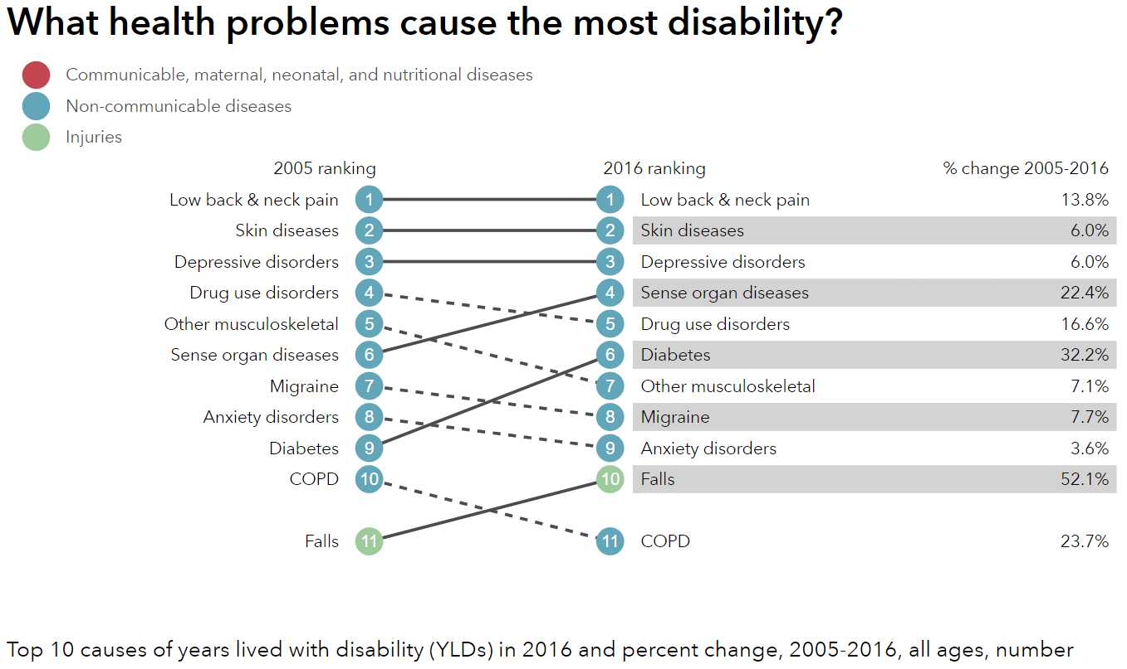
http://healthdata.org/us-health

Slide 11
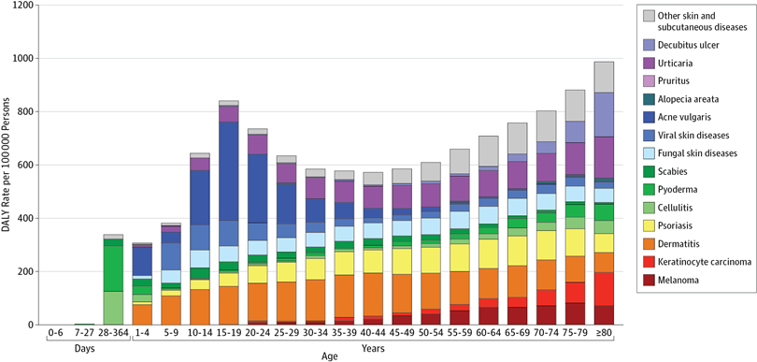
Unpacking DALY cost of skin diseases by age
Karimkhani et al 2017

Slide 12
Discussion Question
What causes the most deaths?

Slide 13
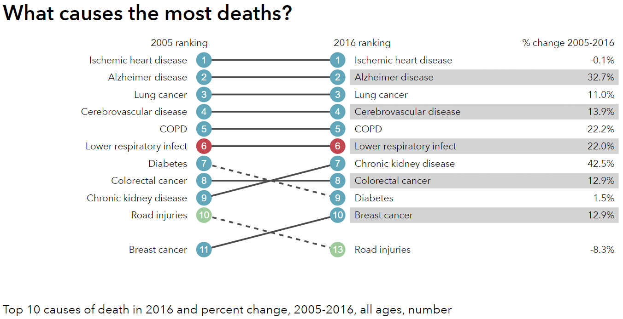
http://healthdata.org/us-health

Slide 14
Visualizing US Health and Health Expenditure
Health:
  https://vizhub.healthdata.org/gbd-compare/
Health Expenditure:
  https://vizhub.healthdata.org/dex/

Slide 15
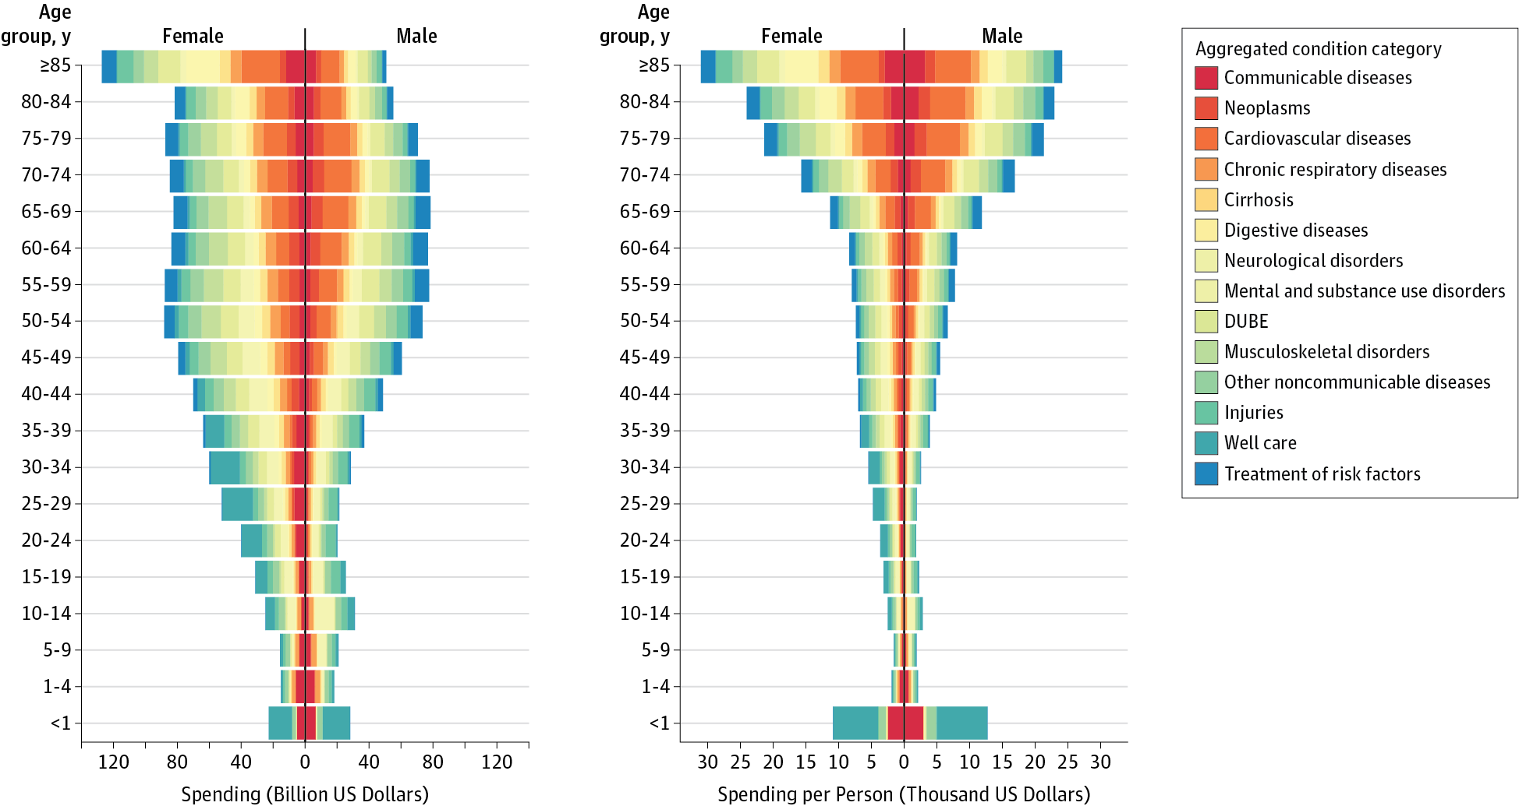
Health Care Costs by Age, Sex, and Disease
Dielman et al 2016

Slide 16
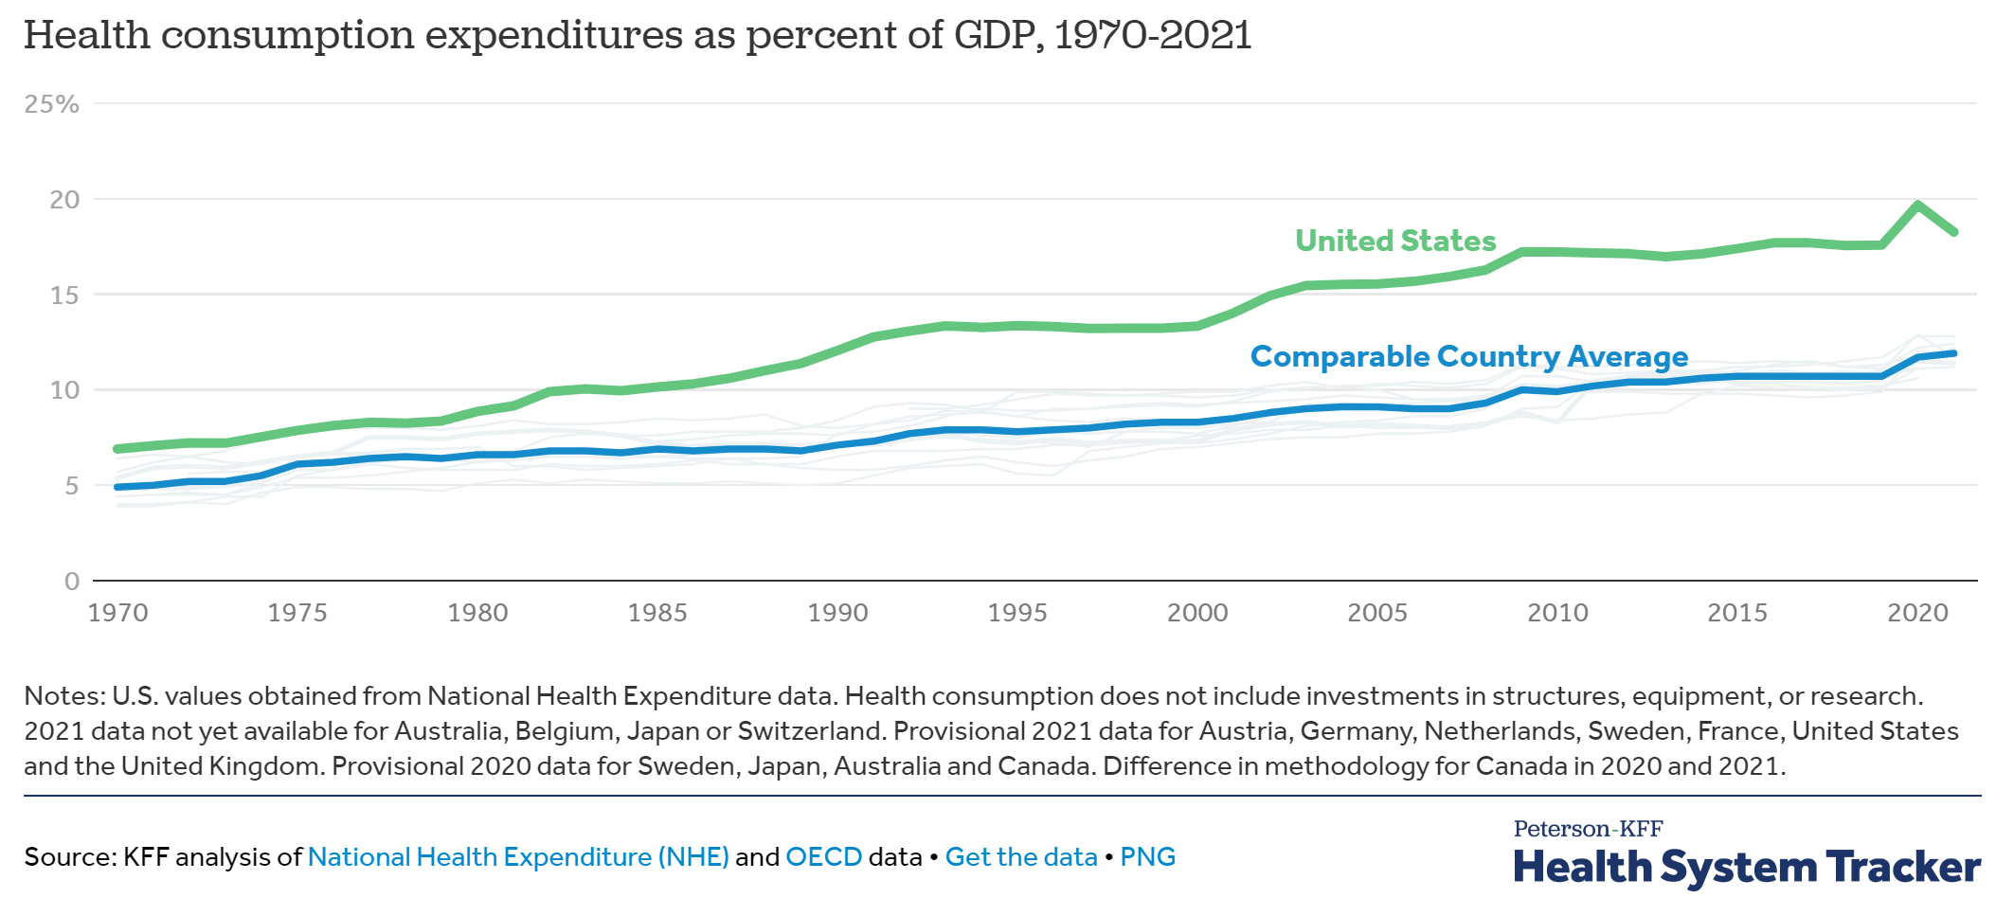
Comparing National Health Expenditures
Notes:
https://www.healthsystemtracker.org/chart-collection/health-spending-u-s-compare-countries/#Health%20consumption%20expenditures%20as%20percent%20of%20GDP,%201970-2021

Slide 17
Comparing National Health Expenditures (Preston Curve)

Slide 18
Unresolved Question?
Is the problem Big Pharma? Is it too many hospital administrators? Is it predatory nursing facilities?
In a broad sense, who is driving health care costs?
How should insurance premiums be structured given the distribution of costs across age and sex?
Does Medicare cause Health Care Costs to grow among people aged 65 and up or does increasing illness cause Health Care Costs to grow in this population?

Slide 19
Discussion question
Why do some say that health care in the united states is the best in the world?

Slide 20
Discussion question
Why do some say that health care in the united states is the best in the world?
  For those who can afford care, quality is often very high
  US is leader in innovation and development
  Inequality in disease risk is higher in US than other wealthy countries
  US leads in some statistics such as cancer survival rates
  About 40 percent of the world’s medical travelers—people who go abroad to obtain acute elective care—come to the United States

Slide 21
Hospital care in the US is (mostly) excellent
Five-Year Survival Rates for Patients Diagnosed with Five Common Cancers in Seven Countries, 2005–2009
Country | Female Breast | Colon | Lung | Prostate | Childhood Leukemia
Canada* | 85.8 | 62.8 | 17.3 | 91.7 | 90.6
France** | 86.9 | 59.8 | 13.6 | 90.5 | 89.2
Germany | 85.3 | 64.6 | 16.2 | 91.2 | 91.8
Italy | 86.2 | 63.2 | 14.7 | 89.7 | 87.7
Japan | 84.7 | 64.4 | 30.1 | 86.8 | 81.1
United Kingdom* | 81.1 | 53.8 | 9.6 | 83.2 | 89.1
United States | 88.6 | 64.7 | 18.7 | 97.2 | 87.7
Allemani, Claudia, Tomohiro Matsuda, Veronica Di Carlo, Rhea Harewood, Melissa Matz, Maja Nikšić, Audrey Bonaventure et al. "Global surveillance of trends in cancer survival 2000–14 (CONCORD-3): analysis of individual records for 37 513 025 patients diagnosed with one of 18 cancers from 322 population-based registries in 71 countries." The Lancet 391, no. 10125 (2018): 1023-1075.

Slide 22
Population Health and Risk Factors
The major driver of poor performance of US health outcomes is not the US health system (uninsurance and under insurance leading to underutilization, hospital quality, number of physicians or nurses or hospital beds, etc)
The major driver of poor performance of US health outcomes is behavioral risk factors
Note: While this class is not focusing on the high cost of care, drivers of high expenditures in the US include utilization, administrative costs, utilization intensity, and prices
  Underlying poor population health in the US less important than these factors
https://vizhub.healthdata.org/gbd-compare/

Slide 23
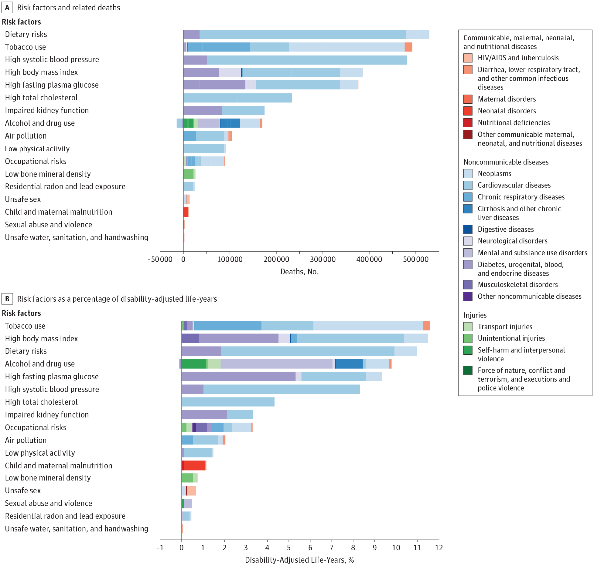
Risk Factors

Slide 24
Risk Factors

Slide 25
Discussion – What’s happening here?
https://vizhub.healthdata.org/subnational/usa

Slide 26
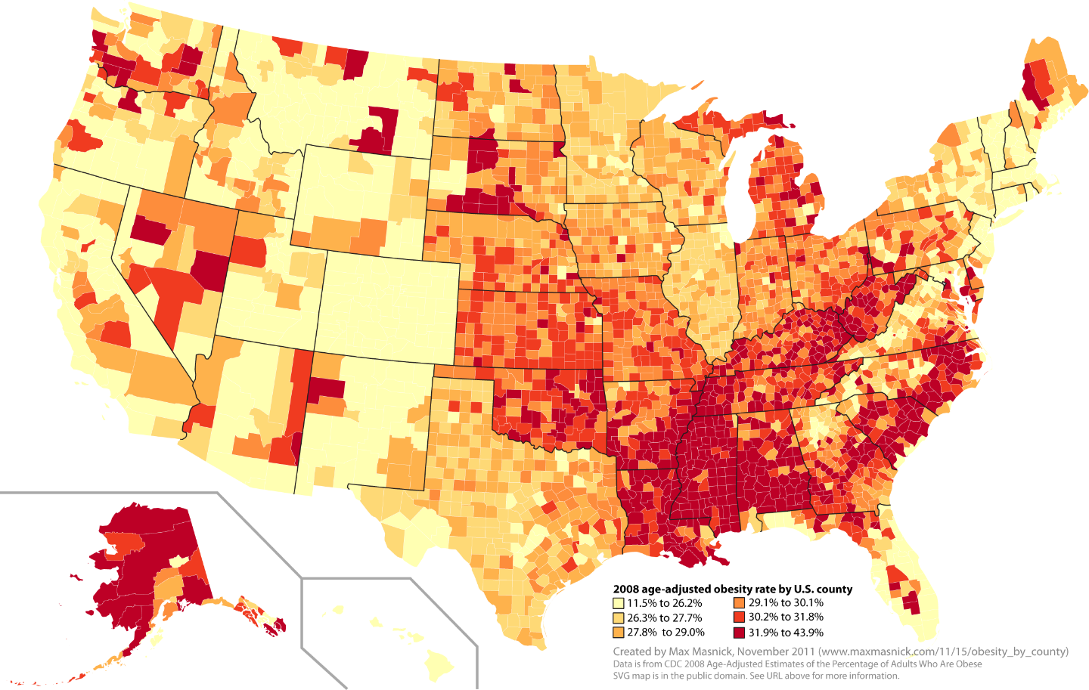
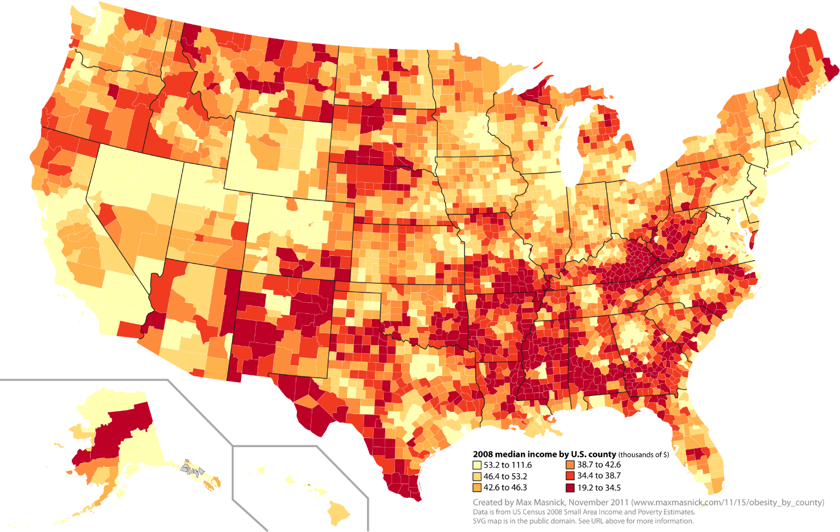
Obesity and poverty
Notes:
https://www.maxmasnick.com/2011/11/15/obesity_by_county/

Slide 27
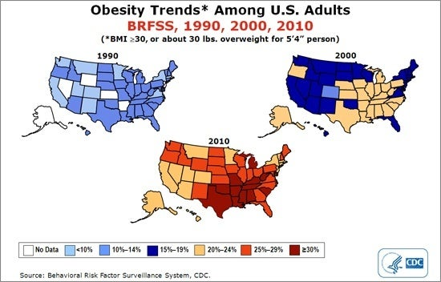
Obesity trends
Notes:
https://www.hsph.harvard.edu/obesity-prevention-source/us-obesity-trends-map/

Slide 28
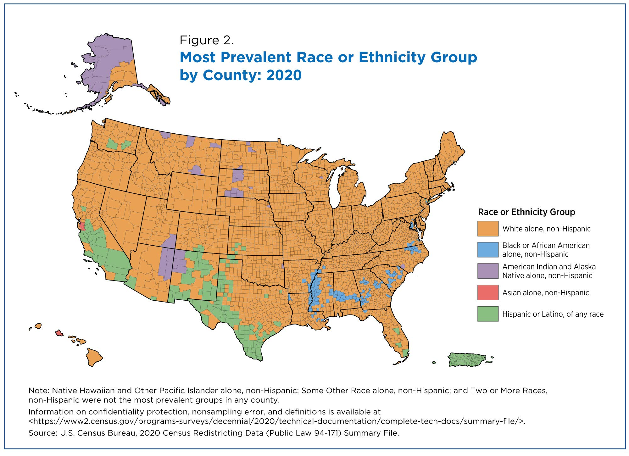
Race
Notes:
https://www.census.gov/library/stories/2021/08/2020-united-states-population-more-racially-ethnically-diverse-than-2010.html

Slide 29
Sources:
Fuchs, Victor R. "Major trends in the US health economy since 1950." New England Journal of Medicine 366, no. 11 (2012): 973-977.
Dieleman, Joseph L., et al. "US spending on personal health care and public health, 1996-2013." Jama 316.24 (2016): 2627-2646.
Indicators, O. E. C. D. "Health at a Glance 2017." OECD Indicators, OECD Publishing, Paris. https://read.oecd-ilibrary.org/social-issues-migration-health/health-at-a-glance-2017_health_glance-2017-en#page1
Karimkhani, Chante, Robert P. Dellavalle, Luc E. Coffeng, Carsten Flohr, Roderick J. Hay, Sinéad M. Langan, Elaine O. Nsoesie et al. "Global skin disease morbidity and mortality: an update from the global burden of disease study 2013." JAMA dermatology 153, no. 5 (2017): 406-412.
IHME Data Visualizations: https://vizhub.healthdata.org

