Slide 1
HCMI 4448: Clinical and Social Issues in Health Care
Busn 203: Wed 6:00 PM – 8:50 PM
Shane Murphy – shane@uconn.edu
Office Hours: Wed 4:00 PM – 6:00 PM

Slide 2
Discussion part 1: Personal experience

Slide 3
What makes for a good care center?
Hotelling
Aspects of care center outside of care provision
Staff behavior
Quality of provision of care
…

Slide 4
Staff behavior
‘I think the attitude of staff HAS to be the most important thing really.’
‘a smaller community feel to it, the nurses have got more time for you They’re just all so very, very well trained and nice people.’
‘The nurses have been fantastic here...some of the nurses, they will sit and listen to you.’
as far as people’s well-being goes they’ve got every-thing organized here they’ve got everything off to a tee you know...They know exactly what’s going on so you just feel that they’re completely in control...and they’re there for you, you know. They can almost sense that something’s wrong with you.’
‘She’s really nice, she’s good at her job. She know swhat she’s on about.’
‘What I say is staff (need to be different)...They’re cheerful. If you can get laughter, that’s important. That’s another healer I think.’

Slide 5
Hotelling: environment
‘Clean environment, friendly, staff are bloody brilliant and if there’s anything you want to know the doctor comes and tells you.’
‘if it’s bright and not dismal it makes you feel better. You want to wake up in the morning and sit out in your chair.’
‘being in a bright and airy ward makes you feel better in yourself.’
‘Friendly. Everyone knows everyone by their first name, everyone speaks as soon as they come in.’
‘When you’re with other people who are in the same boat as you, you get on top of things.’
‘The lady opposite is very ill. It makes me wonder what I’m moaning about you know.’
‘the brightness and to see what is going on around you and people going through the same things you’re going through. Not feeling isolated basically’
‘The patients all seem very amiable although some of them are very ill.’

Slide 6
Hotelling: Preference for multi-bed (especially for outpatient care)
‘there’s more life. You see more going on and there’s always someone to chat to’
‘If you’re ill and just want quiet a cubicle is great but if your brain is active and alive you want a room where you can have a conversation.’
‘Last week I just wanted to give up hope, I wanted to die, I just wanted to go last week. Then I thought “you can’t be like that, you’ve got to pick yourself up, you’ve got to look forward” then something kicks in and you talk to somebody. But I think if you’re stuck in a room on your own you’re going to dwell on things. You can’t have one cubicle for each person. You can’t do that. You need at least 4 to a cubicle.’
‘a ward with 4 people in it is ideal, not enough communication. (in a cubicle)’
‘when I came back this time (from a cubicle to a 4-bedder) it was fantastic, really relaxing and everyone’s around here talking and I’m taking it all in.’
‘Just not feeling closed in and, you know, seeing things happening around you distracts you and takes your mind off things.’

Slide 7
Hotelling: Preference for single-bed
Some patients, especially very Ill patients prefer singles:
‘for me and everybody else.’
‘It was nice for my visitors and things like that and it was private and I was so ill so I was just happy to sleep but now I’m feeling better I prefer to be outside.’
‘you can have the telly on and not worry about bothering anyone.’
‘If you have a patient who comes in in pain, and they don’t shout a lot but there’s a lot of movement in the night because they’re in pain. Nurses walking back and forth, a side ward would be ideal because you’re not disturbing the other patients.’

Slide 8
Hotelling: satisfizing
‘perhaps I shouldn’t be saying this, perhaps it has been recently decorated has it?’‘ If I could just reach into my drawer it would be good.’
‘someone’s got to go without (a view). Simple as that.’
‘You can’t change what you’ve got really can you?’

Slide 9
Hotelling: windows
‘You know, you can sit, relax in a bit more comfort (In the day room). Look outside rather than at your wall all the time.’
‘The other thing is (to improve the environment) a flower garden. Benches and flowers you know.’
‘Huge pictures of the coastline and the countryside and waterfalls’ ‘That to me is wonderful because it is something you can see instantly.’
‘I live in the country and I like sitting down and looking out of the window, cows and things.’
‘Being able to look around and see outside. They’ve got lovely big windows here.’
‘In some wards you’re overlooking a brick wall and they should think of that.’
‘If they could do it, it would be really nice if they could build it so there was an open aspect all the way around looking out on some nice gardens.’ ‘some nice pretty pastel shades and some pretty pictures.’

Slide 10
Broader Themes
Systematic Review/Literature Review
Zadeh, Rana Sagha, Paul Eshelman, Judith Setla, Laura Kennedy, Emily Hon, and Aleksa Basara. "Environmental design for end-of-life care: An integrative review on improving the quality of life and managing symptoms for patients in institutional settings." Journal of pain and symptom management 55, no. 3 (2018): 1018-1034.

Slide 11
Types of data
Large sample size – large N
Data is limited information from is large groups of people
Survey (including diaries)
Census
Small sample size – small N
Data is detailed information from limited group of people
Interviews
Ethnographies
Case Studies
Meta-analyses, systematic review, and literature review
Data is existing literature

Slide 12
Broader Themes: Social interaction
Four types of interactions:
Patient-to-family interaction
Furniture
Professional caregiver-to-patient/family interaction
Access to nurse station
Ease of approach to patient
Line of sight
Patient-to-patient interaction
Facility-to-community interaction

Slide 13
Broader Themes: Distractions
Nature
Windows
Outdoor time
Stimulation
Color
Art
Music
Scent

Slide 14
Broader Themes
Privacy
Home-like environment
Hiding equipment
Furniture
Patient’s personal goods
Optimization of ambient environment
Acoustics
White noise
Relaxing music
Temperature
High temperature more dangerous
Lights
Melatonin and cortisol
Reduce glare
Natural light

Slide 15
What makes for a good care center?
Discussion

Slide 16
HCMI 4448: Clinical and Social Issues in Health Care
Busn 203: Wed 6:00 PM – 8:50 PM
Shane Murphy – shane@uconn.edu
Office Hours: Wed 4:00 PM – 6:00 PM

Slide 17
Palliative Care
Focus on providing relief from symptoms and stress of illness
Quality of life
Values of patient
Symptom management | Psychosocial-spiritual support | Decision making
Pain | Counseling | Prognostic awareness
Nausea | Social work | Advance care planning
Delirium | Pastoral care | Understanding of outcomes
Fatigue anorexia | Caregiver support | Defining quality of life
Anxiety depression | Bereavement | Eliciting values and goals

Slide 18
Teleology (purpose)
What is the meaning of the rest of a dying patient’s life?
What is it they value during that time?
What activities and relationships are important to them?
PCPs often play key role, although MD and MSW/psychiatry specialists exist

Slide 19
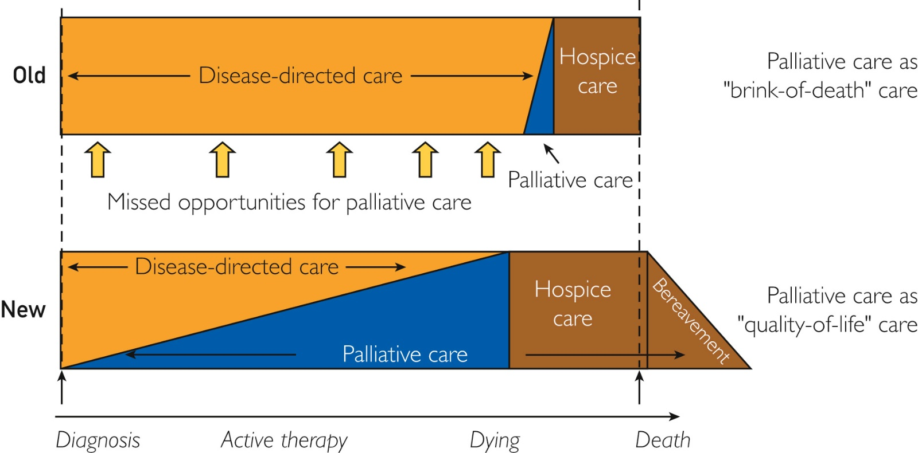
Advance care planning
Advance directive
Health care proxy
Surrogate decision maker
Benefits to early integration into patient care
Not “brink-of-death care”

Slide 20
Hospice
1983 Medicare hospice benefit
75% of hospice patients die at home
vs 25% of all patients, although vast majority desire to die at home
Team: Nurse, social worker, home health aids, chaplain, volunteers, Hospice medical director
4 levels: routine home care, general inpatient care, continuous care (8-24 hours), and respite care
Hospice covers durable medical equipment, (hospital bed, commode, and supplemental oxygen, medications related to the hospice diagnosis, including schedule II opioid analgesics
Nurse on call
Palliative care now defined separate from hospice

Slide 21
Hospice
Patient expected to die with 6 months
Recertification (90 days x2 then 60 days)
Disenrollment possible
Hospice only required to provide comfort-focused care
Medicare hospice benefit requires forgoing of curative-only treatments
How one lives vs how long one lives
Palliative care phase can include conversations about hospice
DNR order optional
Notes:
https://www.ncbi.nlm.nih.gov/pmc/articles/PMC6886728/

Slide 22
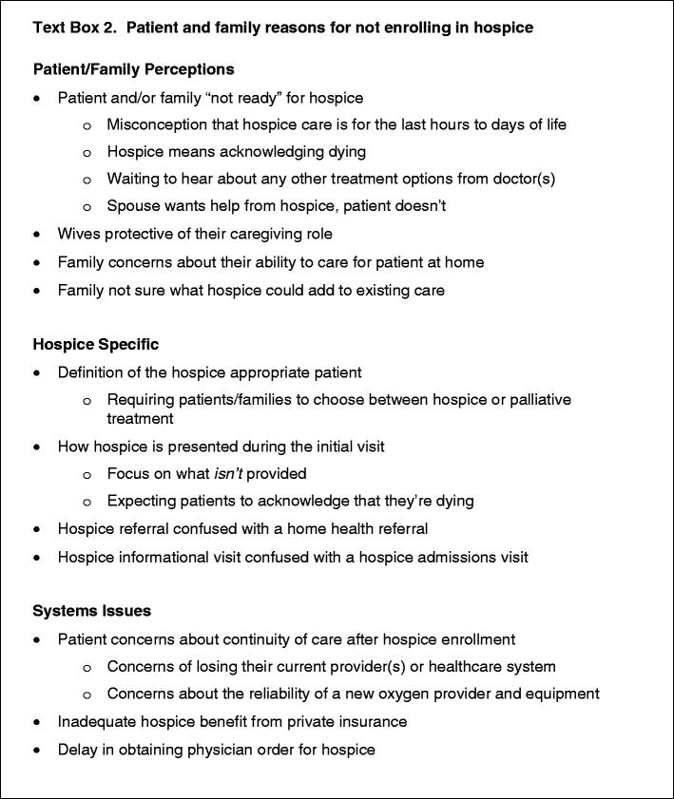
Why don’t people transition to hospice?

Slide 23
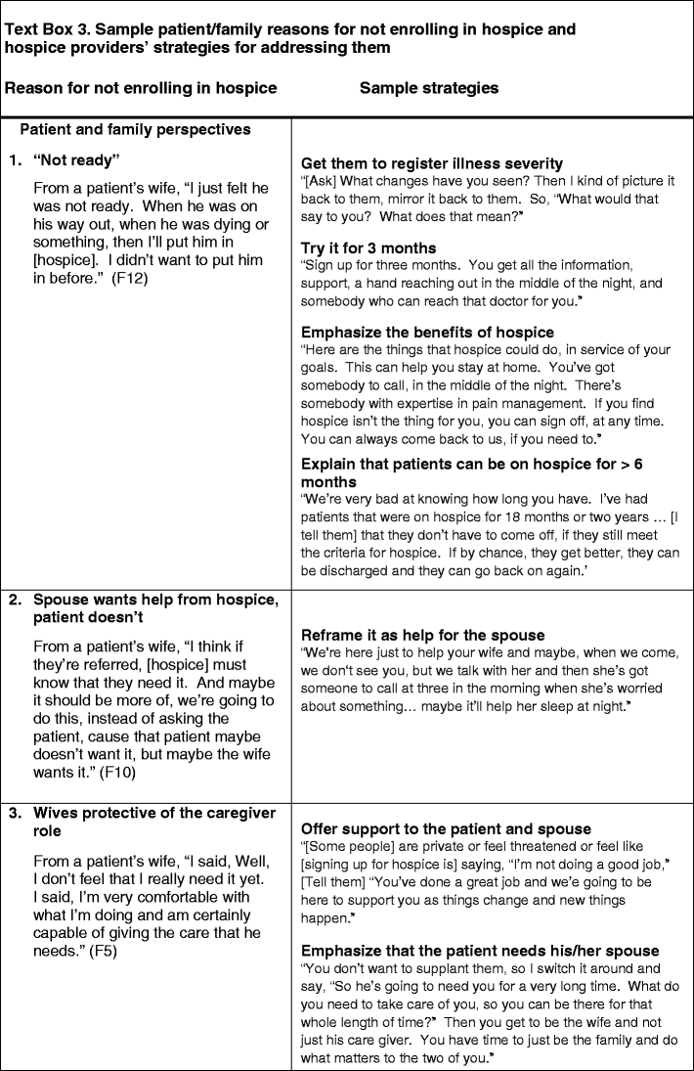
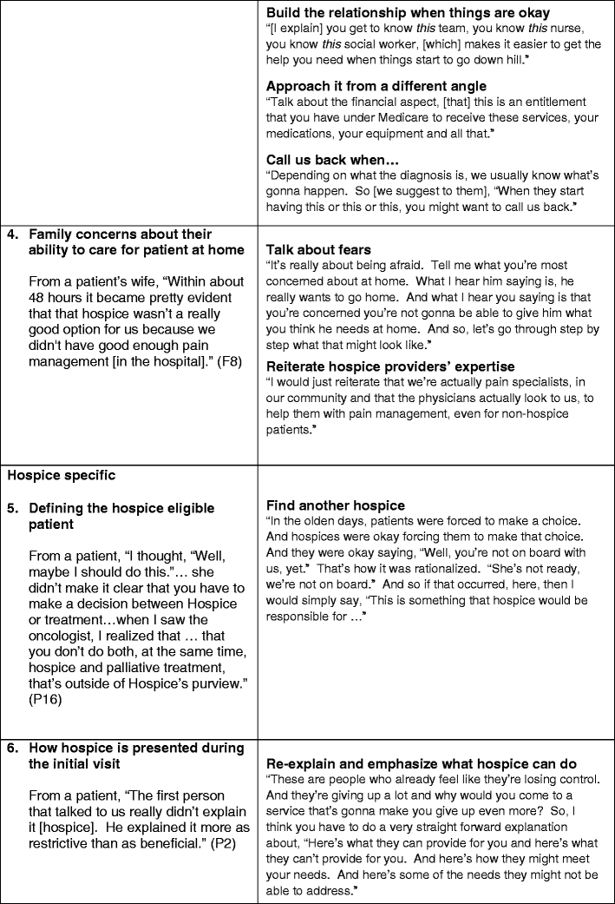

Slide 24
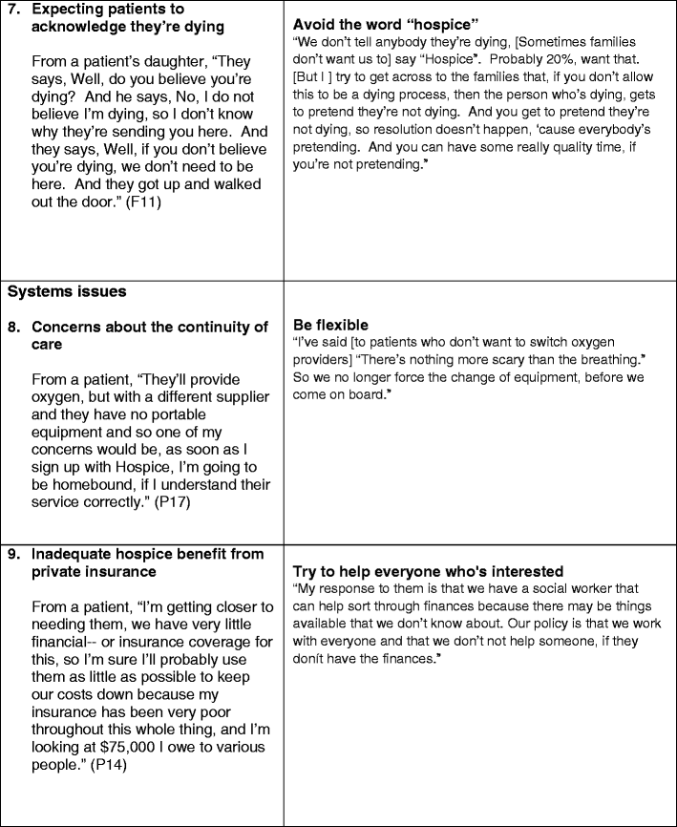
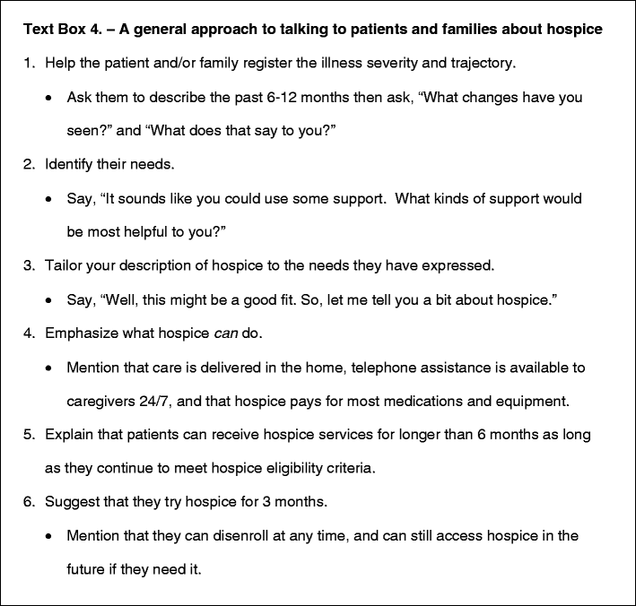

Slide 25
Why don’t people transition to hospice?
“These folks with COPD are married to their [oxygen providers]...‘Cause the same guy comes and sees them once a week and so, giving that up is symbolically asking them to give up so many other things...[They may think] ‘You know what? Finally I have a good reason not to take these people. I have good reason not to deal with end of life and I’m gonna make it my oxygen.’ You know it’s a transitional object, just like chemo.”

Slide 26
Why don’t people transition to hospice?
Discussion:

Slide 27
Sources
Rowlands, Julie, and Simon Noble. "How does the environment impact on the quality of life of advanced cancer patients? A qualitative study with implications for ward design." Palliative medicine 22, no. 6 (2008): 768-774.
Zadeh, Rana Sagha, Paul Eshelman, Judith Setla, Laura Kennedy, Emily Hon, and Aleksa Basara. "Environmental design for end-of-life care: An integrative review on improving the quality of life and managing symptoms for patients in institutional settings." Journal of pain and symptom management 55, no. 3 (2018): 1018-1034.
Buss, Mary K., Laura K. Rock, and Ellen P. McCarthy. "Understanding palliative care and hospice: a review for primary care providers." In Mayo Clinic Proceedings, vol. 92, no. 2, pp. 280-286. Elsevier, 2017.
Vig, Elizabeth K., Helene Starks, Janelle S. Taylor, Elizabeth K. Hopley, and Kelly Fryer-Edwards. "Why don’t patients enroll in hospice? Can we do anything about it?." Journal of General Internal Medicine 25 (2010): 1009-1019.

