Slide 1
HCMI 3243: Economics of Obesity
BUSN 203: Mon/Wed 9:30 PM – 10:45 AM
Shane Murphy – shane@uconn.edu

Slide 2
Causes of rise in obesity
Small energy surplus – 200 calories per day
Smaller than “noise” in consumption and exertion data!
Large set of explanations
Decreased sleep
Exposure to endocrine disruptors
Decreased exposure to extreme heat (due to AC)
Increased consumption of pharmaceuticals
Increased maternal age at birth
Higher rate of reproduction among individuals with genetic predisposition to obesity
Viruses
Gut Microbes
Price of food
Cutler 2003
Notes:
https://www.cornell.edu/video/john-cawley-economics-of-obesity

Slide 3
Prices, income, and education
No to limited evidence that unhealthy food prices affect consumption of unhealthy food
No to limited evidence that fast food prices affect consumption of fast food
No to limited evidence that increase in low income welfare support increased obesity
Social security, EITC, Native American Casino windfalls
Education has no or limited effect on male weight, may reduce risk of obesity for women
Notes:
https://www.cornell.edu/video/john-cawley-economics-of-obesity

Slide 4
Peer effects
Recent research has found living in high-income neighborhoods leads to many positive economic outcomes for low- and high-income individuals
Education
Employment
Wages
And Health including Obesity
Women roomates but not men?
Notes:
https://www.cornell.edu/video/john-cawley-economics-of-obesity

Slide 5
Misuses of cost effectiveness?
Being anti-death penalty is murder?
Sunstein, Cass R., and Adrian Vermeule. "Is Capital Punishment Morally Required? The Relevance of Life-Life Tradeoffs." SSRN non-peer reviewed research paper (March 2005).
Being anti-AI is murder
“opposition to artificial intelligence is tantamount to murder” – Marc Andreessen
Measured effects smaller than noise in data

Slide 6
Misuses of cost effectiveness?
Problems to look out for:
Unreasonably large conclusions
Can very few executions drive large outcome effects?
Measured effects smaller than noise in data
200 calories a day
Correlation is not causation
No, smoking is not good for you
No, wasting (losing weight because of malnutrition or illness) is not good for you

Slide 7
Body positivity vs health?
Science can be used to justify:
Discrimination
Misogyny
Paternalism
Is paternalism ok?
the policy or practice on the part of people in positions of authority of restricting the freedom and responsibilities of those subordinate to them in the subordinates' supposed best interest.
Behavioral economics
Sin taxes
Opt-in vs opt-out
Educational marketing campaigns

Slide 8
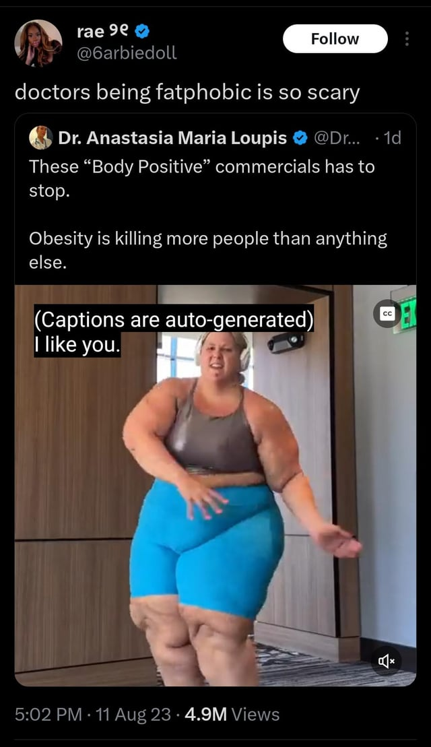
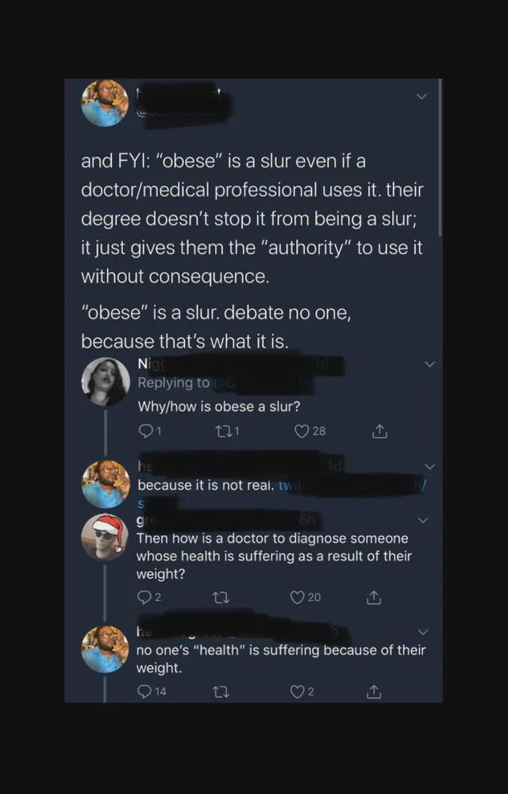
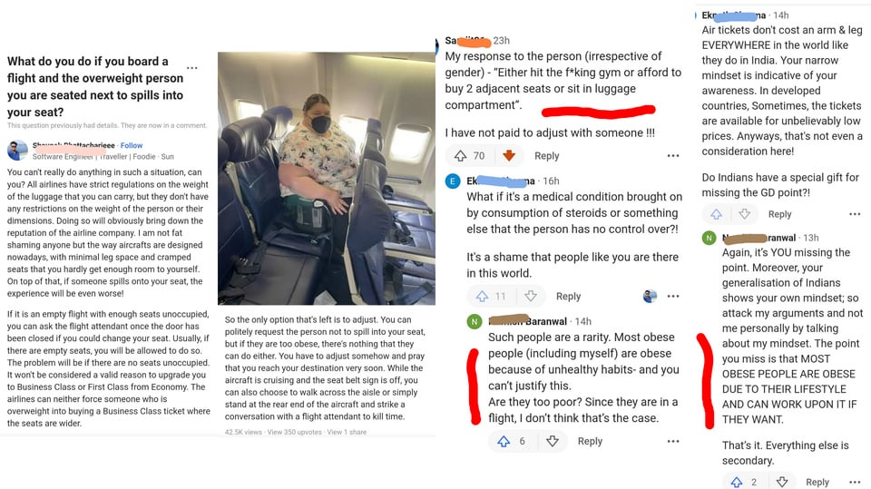
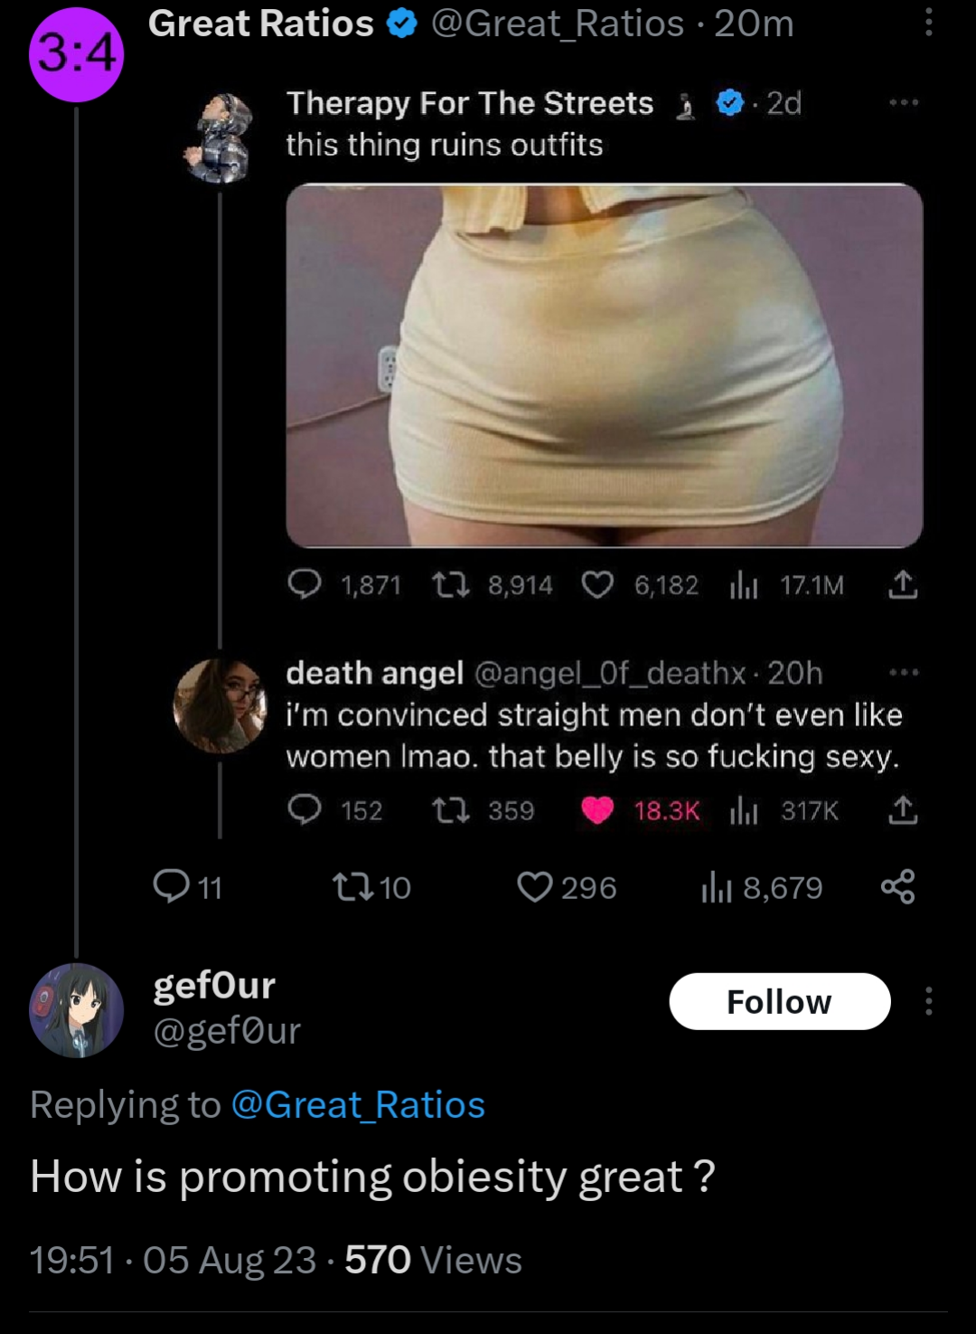
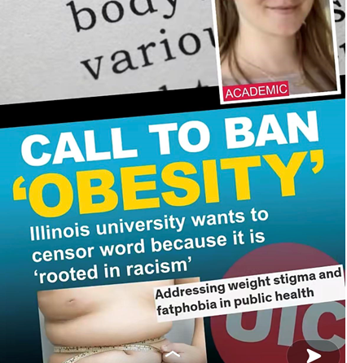
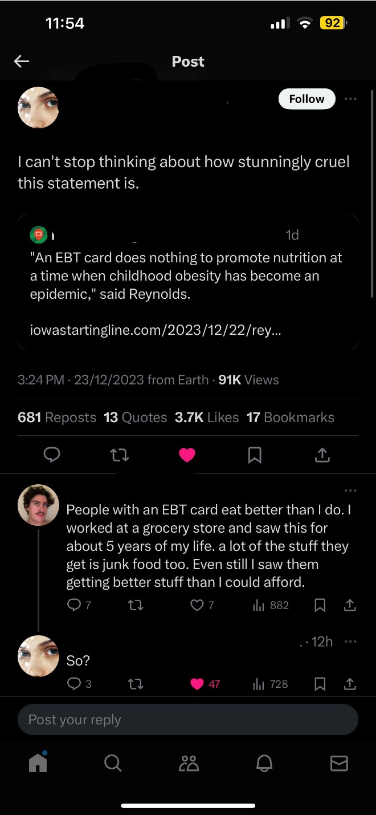
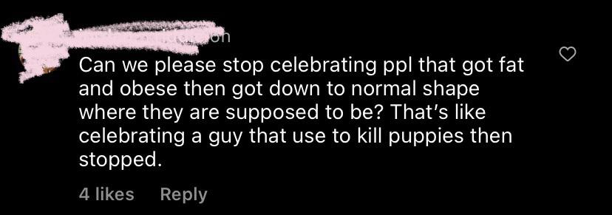
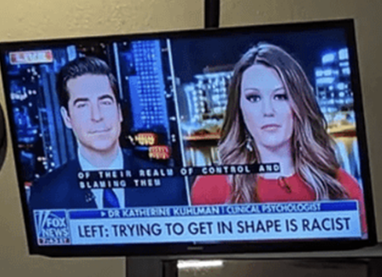
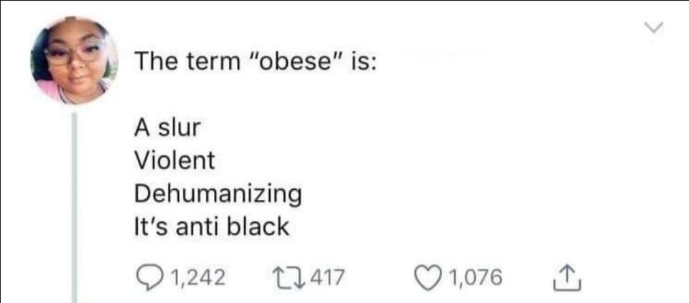
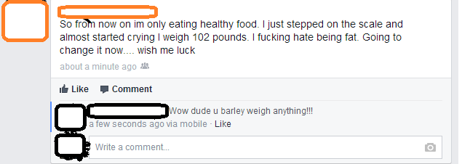
Notes:
https://www.youtube.com/watch?v=A295YT2yd_A&ab_channel=TheFinancialDiet

Slide 9
Body positivity vs health?
“You’re Not Ugly, You’re Just Poor”
https://youtu.be/A295YT2yd_A?si=YJRR7ciyvkhTBVRl&t=2333

Slide 10
Technology, causal mechanism
If obesity costs more in medical care, what are the pathways through which obesity drives increased illness?
Why is obesity bad for you?

Slide 11
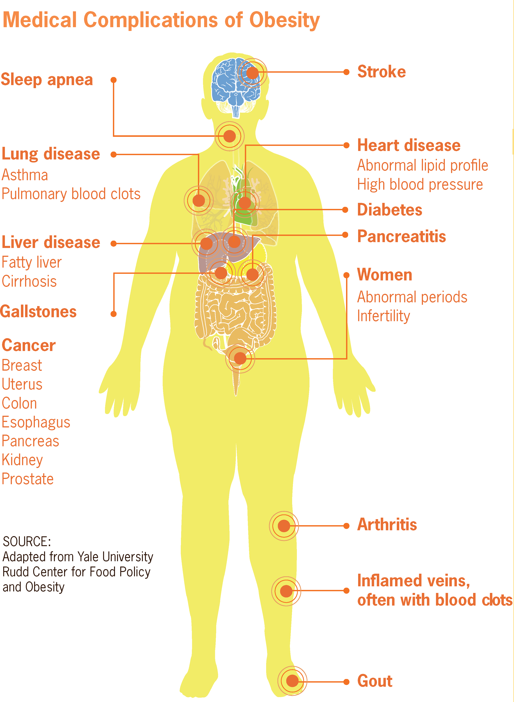
Medical Complications of Obesity
Fat is part of the endocrine and metabolic system – releases hormones
Free fatty acids, resistin (hormone), and TNFα (hormone) are insulin resistant (causing Type II diabetes)
Type II diabetes
Leptin (hormone) is inflammatory
CVD, osteoarthritis
Insulin and insulin-like growth factor binding protein 1 may lead to cell proliferation and reduced apoptosis
Cancer
Non-alcoholic fatty liver disease
Non-alchoholic steatohepatitis
Cirrhosis
Hepatocellular carcinoma (cancer)

Slide 12
Medical Complications of Obesity
61% of all Type II diabetes
17.3% of all CVD
24% of all osteoarthritis
Cancer:
42.5% of kidney cancer
35.4% and 20.8% of men and women colorectal cancer
22.6% of female breast cancer
56.8% of endometrial (uterine lining) cancer
52.4% of esophageal cancer
26.9% of pancreatic cancer
35.5% of gallbladder and gastric cardia cancer
Liver, maybe ovarian, maybe prostate, maybe haematopeietic
Not lung, not cervical

Slide 13
Detour: VSL and Cost Effectiveness
Economists use various methods to estimate the value of a statistical life
We’ll discuss this in detail later in the semester
This is NOT the value of a life, but it is used to estimate the benefit of an intervention for policy makers
The value of a statistical life year in the United States is roughly $150,000
The value of a statistical life in the United States is roughly $12 Million
VSL used is thinking about tradeoffs between cost and risk
Think about the health costs of poor water quality and the expected cost of better purification

Slide 14
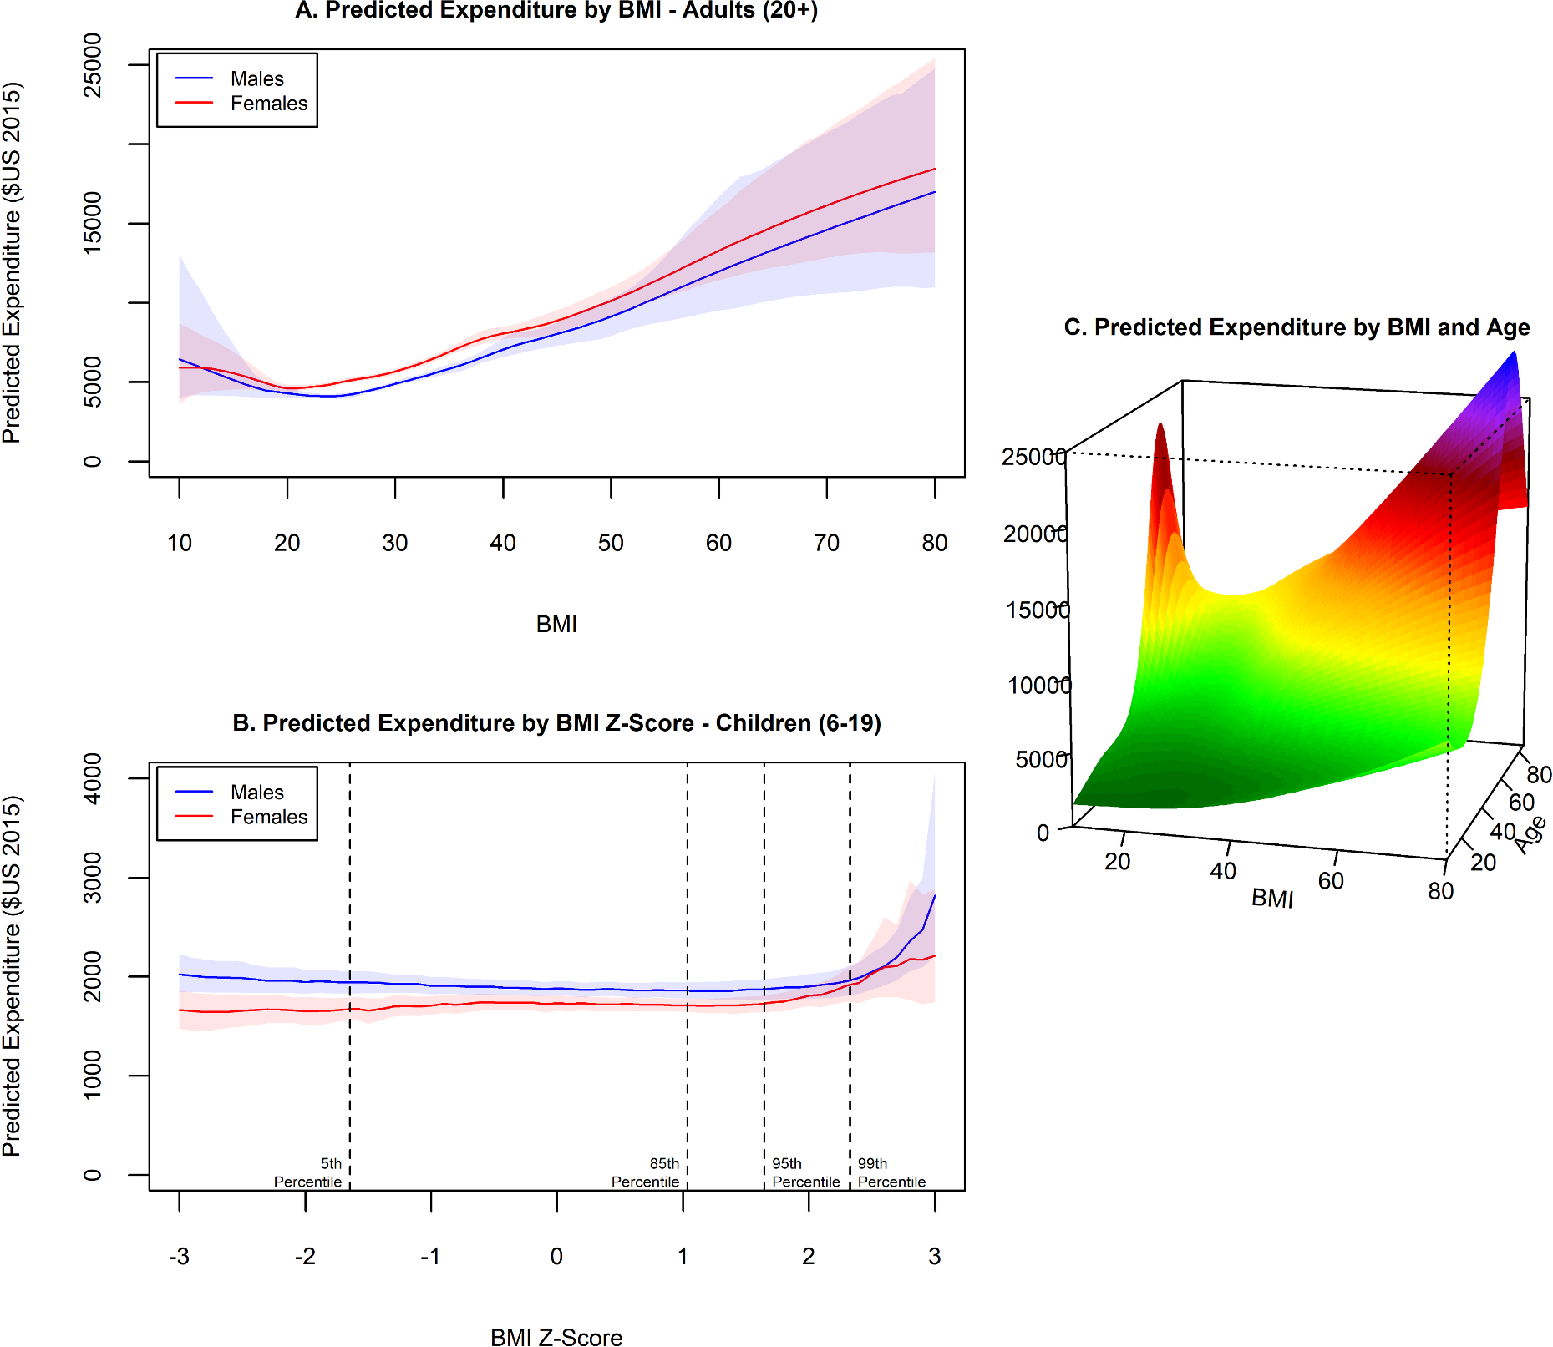

Slide 15
Medical Cost of Obesity
Medical Expenditure Panel Survey (MEPS)
2021 study
2011-2016 data

Slide 16
Growth in cost with age
Normal weight correlated with lowest expenditure across most ages
Difference become more significant around age 30
Study does not consider effect past weight, only current weight
Does obesity in 20s or 30s affect outcomes in 50s or 60s, even if the person loses weight?

Slide 17
Economics of eating disorders
2015 Study (2007-2011 data) of: anorexia nervosa, bulimia nervosa or binge eating, pica, rumination disorder, and psychogenic vomiting
Individuals with eating disorders generally cost health system about $1900 more than individuals without eating disorders
Also heave decreased employment and wage outcomes
Mental health comorbidities may double health costs, and have even larger effects on wages

Slide 18
Employment effects of obesity
Lowers wages for women (10lbs lowers wages 2%)
Effect starts at very low weights
No effect on men
Portly banker effect - Historic
Likely caused by discrimination, not worse health or productivity

Slide 19
Cawley, John. "An economy of scales: A selective review of obesity's economic causes, consequences, and solutions." Journal of health economics 43 (2015): 244-268.
Cohen, Joel W., Steven B. Cohen, and Jessica S. Banthin. "The medical expenditure panel survey: a national information resource to support healthcare cost research and inform policy and practice." Medical care (2009): S44-S50.
Samnaliev, Mihail, H. LeAnn Noh, Kendrin R. Sonneville, and S. Bryn Austin. "The economic burden of eating disorders and related mental health comorbidities: An exploratory analysis using the US Medical Expenditures Panel Survey." Preventive medicine reports 2 (2015): 32-34.
Calle, Eugenia E., and Rudolf Kaaks. "Overweight, obesity and cancer: epidemiological evidence and proposed mechanisms." Nature Reviews Cancer 4, no. 8 (2004): 579-591.
Cawley, John. "The impact of obesity on wages." Journal of Human resources 39, no. 2 (2004): 451-474.

