Slide 1
HCMI 3243: Externalities
BUSN 106: Tue/Thur 9:30 AM – 10:45 AM
Shane Murphy – shane@uconn.edu

Slide 2
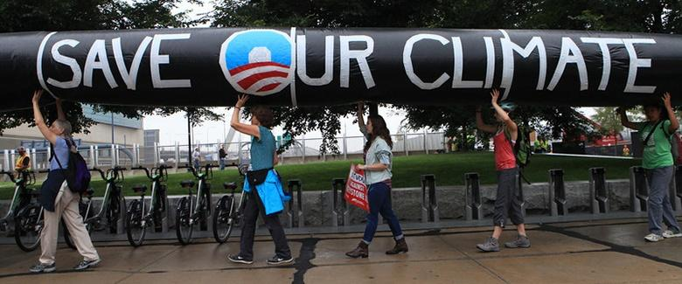
Environmental Debate
Across the country, countless people have protested, even risking arrest, against the Keystone XL Pipeline.
(Credit: modification of "People Risk Arrest at State Department Office in Boston Protesting Keystone XL Pipeline" by NoKXL/Flickr, CC BY 2.0)

Slide 3
12.1 The Economics of Pollution
Since the 1970s the United States, using a variety of anti-pollution policies, has made genuine progress against a number of pollutants.
Despite the gradual reduction in emissions from fossil fuels, many important environmental issues remain.
Along with the still high levels of air and water pollution, other issues include:
hazardous waste disposal,
destruction of wetlands and other wildlife habitats,
and the impact on human health from pollution.

Slide 4
Externalities
The effect of a market exchange on a third party who is outside or “external” to the exchange is called an externality or spillover.
Externalities can be negative or positive.
Negative externality - a situation where a third party, outside the transaction, suffers from a market transaction by others.
Positive externality - a situation where a third party, outside the transaction, benefits from a market transaction by others.

Slide 5
Pollution as a Negative Externality
Pollution is a negative externality.
Additional external costs - additional costs incurred by third parties outside the production process when a unit of output is produced.
Social costs - costs that include both the private costs incurred by firms and also additional costs incurred by third parties outside the production process.

Slide 6
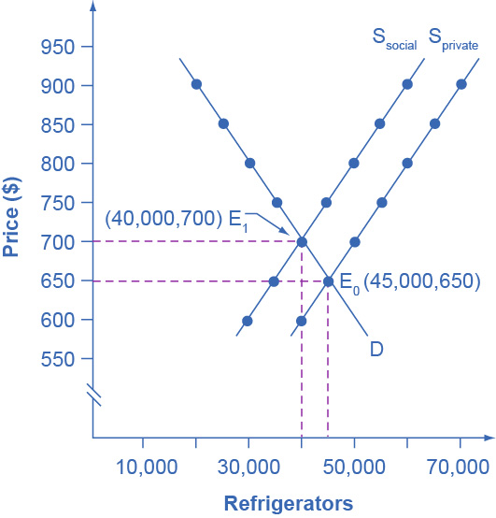
Taking Social Costs into Account: A Supply Shift
If the firm takes only its own costs of production into account, then its supply curve will be S_{private}, and the market equilibrium will occur at E₀.
Accounting for additional external costs of $100 for every unit produced, the firm’s supply curve will be S_{social}. The new equilibrium will occur at E₁.

Slide 7
Externalities in health
What are some positive externalities in health care?
What are some negative externalities in health care?

Slide 8
Market Failure
Market failure - when the market, on its own, does not allocate resources efficiently in a way that balances social costs and benefits; externalities are one example of a market failure.
If firms were required to pay the social costs of pollution, they would create less pollution but produce less of the product and charge a higher price.

Slide 9
12.2 Command-and-Control Regulation
Command-and-control regulation - laws that specify allowable quantities of pollution and that also may detail which pollution-control technologies one must use.
Requires that firms increase their costs by installing anti-pollution equipment.
Thus, firms are required to account for the social costs of pollution in deciding how much output to produce.

Slide 10
Difficulties with Command-and-Control Environmental Regulation
3 difficulties with command-and-control environmental regulation:
Regulation offers no incentive to improve the quality of the environment beyond the standard set by a particular law.
No incentive to do better.
Inflexible.
Requires the same standard for all polluters, and often the same pollution-control technology as well.
Subject to compromises in the political process.
Full of fine print, loopholes, and exceptions.

Slide 11
12.3 Market-Oriented Environmental Tools
Pollution charge - tax imposed on the quantity of pollution that a firm emits.
Gives a profit-maximizing firm an incentive to determine the least expensive technologies for reducing pollution.
Firms that can reduce pollution cheaply and easily will do so to minimize their pollution taxes.

Slide 12
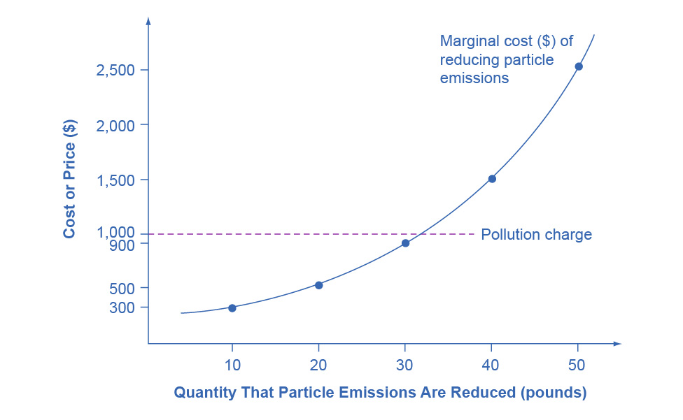
A Pollution Charge Example
If a pollution charge is set equal to $1,000, then the firm will have an incentive to reduce pollution by 30 pounds,
Because the $900 cost of these reductions would be less than the cost of paying the pollution charge.

Slide 13
Marketable Permits
Marketable permit program (e.g., cap-and-trade) - a permit that allows a firm to emit a certain amount of pollution.
Firms with more permits than pollution can sell the remaining permits to other firms

Slide 14
Better-Defined Property Rights
Property rights - the legal rights of ownership on which others are not allowed to infringe without paying compensation.
Property rights issues are highly relevant in cases involving endangered species on privately owned land.

Slide 15
12.4 The Benefits and Costs of U.S. Environmental Laws
Benefits of a cleaner environment:
(1) people may stay healthier and live longer;
(2) certain industries that rely on clean air and water, such as farming, fishing, and tourism, may benefit;
(3) property values may be higher;
(4) people may simply enjoy a cleaner environment in a way that does not need to involve a market transaction.

Slide 16
Marginal Benefits and Marginal Costs
Tools of marginal analysis can be used to illustrate the marginal costs and the marginal benefits of reducing pollution.
Reducing pollution is costly - resources must be sacrificed.
The marginal costs of reducing pollution are generally increasing,
The least expensive and easiest reductions can be made first, leaving the more expensive methods for later.
The marginal benefits of reducing pollution are generally declining,
The steps that provide the greatest benefit can be taken first, and steps that provide less benefit can wait until later.

Slide 17
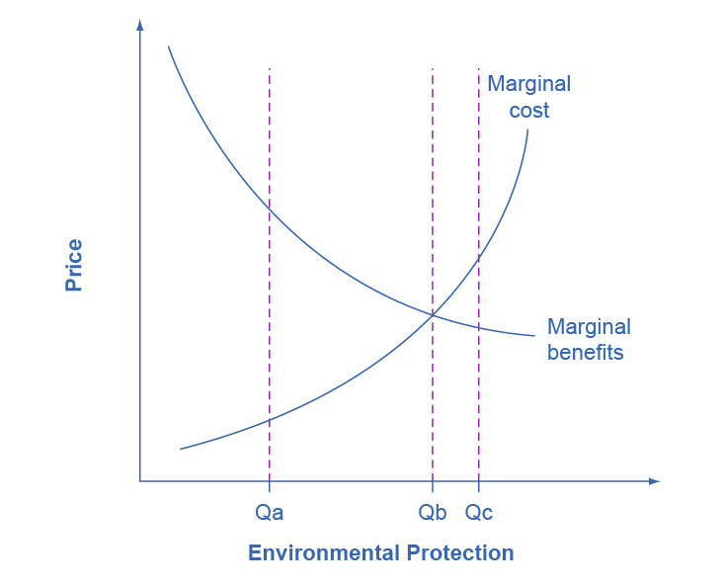
Marginal Costs and Marginal Benefits of Environmental Protection
When the quantity of environmental protection is low:
Pollution is extensive (Q_{A}),
There are cheap and easy ways to reduce pollution.
So, the marginal benefits of doing so are quite high.
At Q_{A}, it makes sense to allocate more resources to fight pollution.

Slide 18
Marginal Costs and Marginal Benefits of Environmental Protection, Continued
As the environmental protection increases:
the cheap and easy ways of reducing pollution begin to decrease, and one must use more costly methods.
the marginal cost curve rises.
the largest marginal benefits happen first, followed by reduced marginal benefits.

Slide 19
Marginal Costs and Marginal Benefits of Environmental Protection, Continued
As the quantity of environmental protection increases to Q_{B}, the gap between marginal benefits and marginal costs narrows.
At point Q_{C} the marginal costs > marginal benefits.
At this level of environmental protection, society is not allocating resources efficiently.
It may be forfeiting too many resources to reduce pollution.

Slide 20
12.5 International Environmental Issues
No nation acting alone can solve certain environmental problems which spill over national borders.
No nation by itself can reduce emissions of carbon dioxide and other gases by enough to solve the problem of global warming.
Biodiversity - the full spectrum of animal and plant genetic material.
International externalities - externalities that cross national borders and that a single nation acting alone cannot resolve.

Slide 21
Fossil Fuels and Climate Change
High-income countries have historically been the primary contributors to greenhouse warming by burning fossil fuels - and still are today.
Paris Climate Agreement - committed participating countries to significant limits on CO₂ emissions.

Slide 22
Details of an International System
The practical details of an international system and how it would operate across international borders are complex.
It seems unlikely that some form of world government will or can impose a detailed system of environmental command-and-control regulations around the world.
As a result, a decentralized and market-oriented approach may be the only practical way to address international issues such as global warming and biodiversity.

Slide 23
13.1 Investments in Innovation
Market competition can provide an incentive for discovering new technology, because a firm can earn higher profits:
by finding a way to produce products more cheaply
by creating products with characteristics consumers want.
In some cases competition can discourage new technology, especially when other firms can quickly copy a new idea.
Studies by economists have found that the original inventor receives 1/3 to 1/2 of the total economic benefits from innovations, while other businesses and new product users receive the rest.

Slide 24
The Positive Externalities of New Technology
Private benefits - the benefits a person who consumes a good or service receives, or a new product's benefits or process that a company invents that the company captures.
Social benefits - the value of all the positive externalities of the new idea or product (whether enjoyed by other companies or society as a whole), as well as the private benefits the firm that developed the new technology receives.
= private benefits + external benefits
Positive externalities or benefits - beneficial spillovers to a third party or parties.

Slide 25
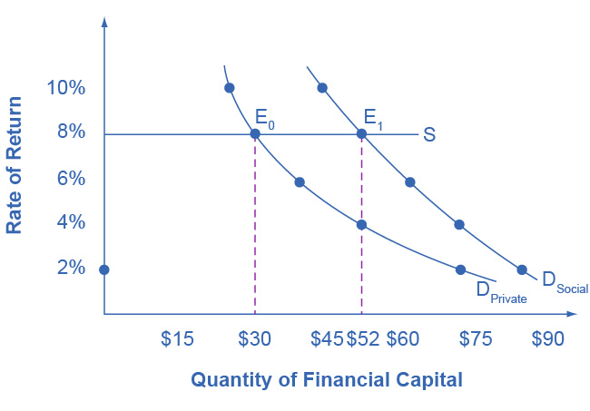
Positive Externalities and Technology
Big Drug faces a cost of borrowing of 8%.
If the firm receives only the private benefits of investing in R&D, then we show its demand curve for financial capital by D_{Private}, and the equilibrium will occur at $30 million.
Because there are spillover benefits, society would find it optimal to have $52 million of investment.

Slide 26
Positive Externalities and Technology, Continued
If the firm could keep the social benefits of its investment for itself, its demand curve for financial capital would be D_{Social} and it would be willing to borrow $52 million. (The firm’s private demand curve would be the same as society’s demand curve.)
But, unless there is a way for the company to fully enjoy the total benefits, then it will borrow less than the socially optimal level of $52 million.

Slide 27
Why Invest in Human Capital?
The investment in education, or human capital, requires a certain upfront cost with an uncertain future benefit.
The idea is that higher levels of educational attainment will eventually serve to increase the person’s future productivity and subsequent ability to earn.
Economists have found though several studies that the rate of return of a college education to that person, in the United States, is approximately 10-15%.
Private rates of return - the estimated rates of return go primarily to an individual; for example, earning interest on a savings account.

Slide 28
Society Gains When People Learn
Society also gains from investing in the education of another student.
The social rate of return on schooling is also positive:
better health outcomes for the population
lower levels of crime
a cleaner environment
a more stable, democratic government
Social rate of return - when the estimated rates of return go primarily to society.

Slide 29
Positive Externalities Response
The appropriate public policy response to a positive externality, like a new technology, is to help the party creating the positive externality receive a greater share of the social benefits.

Slide 30
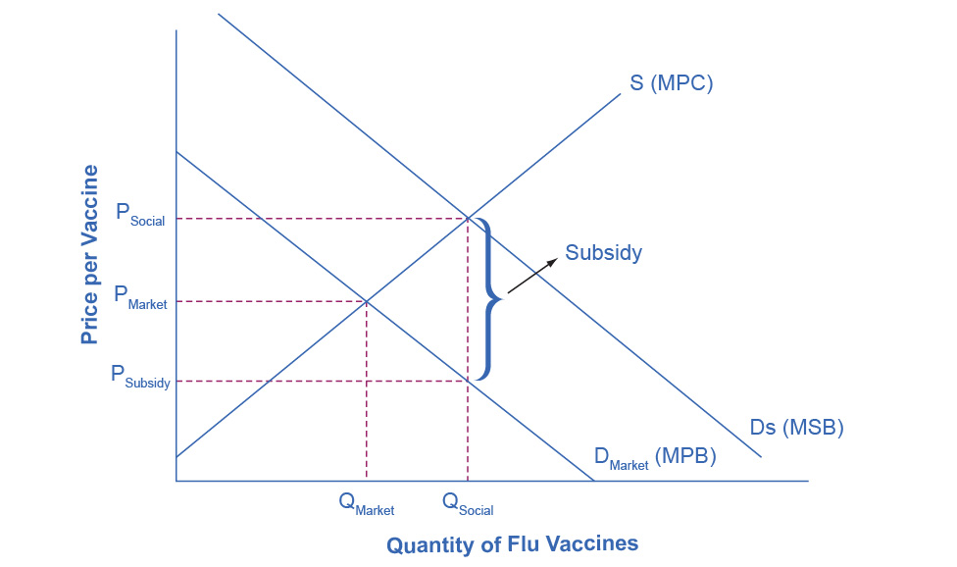
The Market for Flu Shots with Spillover Benefits (A Positive Externality)
The equilibrium quantity of flu shots produced in the market, where MPB = MPC, is Q_{Market} and the price of flu shots is P_{Market}.
The market demand curve does not reflect the positive externality of flu vaccinations, so only Q_{Market} will be exchanged.
This outcome is inefficient because the marginal social benefit exceeds the marginal social cost.

Slide 31
The Market for Flu Shots with Spillover Benefits (A Positive Externality), Cont.
If the government provides a subsidy to consumers of flu shots, equal to the MSB - MPB, the level of vaccinations can increase to the socially optimal quantity of Q_{Social}.

Slide 32
13.2 How Governments Can Encourage Innovation
Different government policies can increase the incentives to innovate:
guaranteeing intellectual property rights
government assistance with the costs of research and development (R&D)
cooperative research ventures between universities and companies.
Intellectual property rights: the body of law including patents, trademarks, copyrights, and trade secret law that protect the right of inventors to produce and sell their inventions.
Patents - give the inventor the exclusive legal right to make, use, or sell the invention for a limited time.
Copyright laws - give the author an exclusive legal right over works of literature, music, film/video, and pictures.

Slide 33
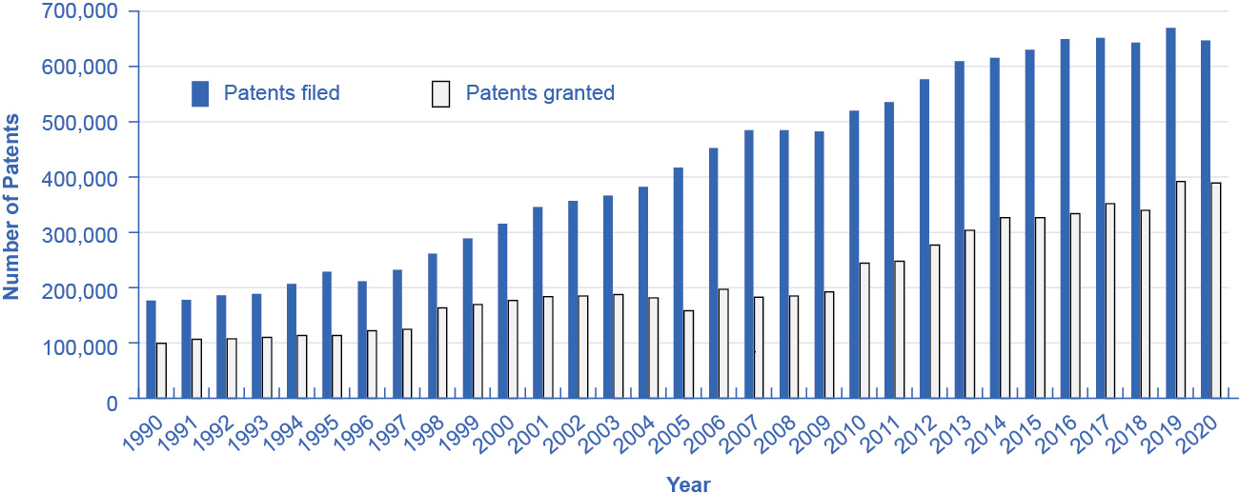
Patents Filed and Granted, 1990–2020
The number of applications filed for patents increased substantially from the mid-1990s into the first years of the 2000s, due in part to the invention of the Internet, which has led to many other inventions and to the 1998 Copyright Term Extension Act.
(Source: http://www.uspto.gov/web/offices/ac/ido/oeip/taf/us_stat.htm)

Slide 34
Government Spending on Research and Development
If the private sector does not have sufficient incentive to carry out R&D, one possibility is for the government to fund such work directly.
Government spending can provide direct financial support for R&D conducted at:
colleges and universities
nonprofit research entities
sometimes by private firms
government-run laboratories

Slide 35
Tax Breaks for Research and Development
A complementary approach is to give firms a reduction in taxes depending on how much R&D they do.
The federal government refers to this policy as the research and experimentation (R&E) tax credit.
Studies find that each dollar of foregone tax revenue through the R&E Tax Credit causes firms to invest at least a dollar or more in R&D.

Slide 36
Cooperative Research
State and federal governments support research in a variety of ways, such as through partnerships and grants for innovative projects.
Examples: National Institutes of Health, National Academy of Sciences, and the Agriculture and Food Research Initiative.
Cooperation between government-funded universities, academies, and the private sector can spur product innovation and create whole new industries.

Slide 37
13.3 Public Goods
Public good - good that is nonexcludable and non-rival, and is difficult for market producers to sell to individual consumers.
Nonexludable - it is costly or impossible to exclude someone from using the good, and thus hard to charge for it.
Non-rival - even when one person uses the public good, another can also use it.
Examples: fire and police service and national defense

Slide 38
The Free Rider Problem of Public Goods
Free rider - those who want others to pay for the public good and then plan to use the good themselves.
If many people act as free riders, the public good may never be provided.
The free rider problem can be expressed in similar terms as the prisoner’s dilemma game.

Slide 39
The Role of Government in Paying for Public Goods
The key to paying for public goods is to assure that everyone will make a contribution and to prevent free riders.
This is done through government spending and taxes.
In some cases, markets can produce public goods.
Creates an indirect way of “charging” for it.
Example: radio is a public good, but revenue is made by selling advertising, and “charging” listeners by taking up some of their time.
Social pressures and personal appeals can also reduce the number of free riders and to collect resources for the public good.

Slide 40
Positive Externalities in Public Health Programs
Advances in public health have all been closely linked to positive externalities and public goods.
Rise in life expectancy seems to stem from three primary factors related to public health programs/goods:
Public sanitation systems - providing clean water and disposing of human waste help to prevent the transmission of many diseases.
Medical discoveries from government or university-funded research, such as:
Immunizations
Antibiotics
High blood pressure reducers
Changes in public behavior through government health campaigns. Examples:
Hand washing
Food storage and protection
Reducing tobacco smokers
Precautions against sexually transmitted diseases

Slide 41
11.1 Corporate Mergers
Merger - when two formerly separate firms combine to become a single firm.
Acquisition - when one firm purchases another.

Slide 42
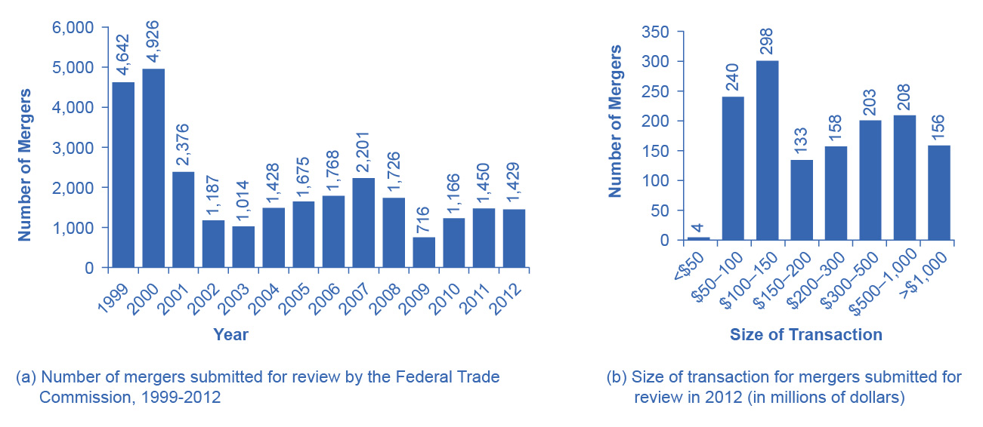
Number and Size of Mergers
The number of mergers in 1999 and 2000 were relatively high compared to the annual numbers seen from 2001–2012.
While 2001 and 2007 saw a high number of mergers, these were still only about half the number of mergers in 1999 and 2000.
In 2012, the greatest number of mergers submitted for review was for transactions between $100 and $150 million.
(a)
(b)

Slide 43
Regulations for Approving Mergers
Antitrust laws - laws that give government the power to block certain mergers, and even in some cases to break up large firms into smaller ones.
Historical antitrust laws:
Sherman Antitrust Act
Clayton Antitrust Act
Celler-Kefauver Act

Slide 44
Measuring Degree of Monopoly Power - Old Way
Regulators have tried to measure the degree of monopoly power in an industry.
(Four-Firm) Concentration ratio - an earlier tool which measures what share of the total sales in the industry are accounted for by the largest firms, typically the top four to eight firms.
Market share - each firm’s proportion of total sales in that market.

Slide 45
The Herfindahl-Hirshman Index
The Herfindahl-Hirshman Index (HHI) - approach to measuring market concentration by adding the square of the market share of each firm in the industry.

Slide 46
Defining A Market in Current Times
Now, defining a market is often difficult and controversial.
In recent decades, there have been two important shifts affecting how markets are defined:
technology
globalization

Slide 47
Measuring Degree of Monopoly Power - New Way
The new approach to antitrust regulation involves detailed analysis of specific markets and companies, instead of defining a market and counting up total sales. It is done by:
estimating the demand curves and supply curves the firms proposing a merger face.
building a statistical model that estimates the likely outcome for consumers if the two firms are allowed to merge.

Slide 48
11.2 Regulating Anticompetitive Behavior
Under U.S. antitrust laws, monopoly itself is not illegal.
But, U.S. antitrust laws include rules against some restrictive practices.
Restrictive practices - practices that do not involve outright agreements to raise prices or to reduce the quantity produced, but that might have the effect of reducing competition.

Slide 49
Types of Restrictive Practices
Types of restrictive practices:
Minimum resale price maintenance agreement - requires a dealer who buys from a manufacturer to sell for at least a certain minimum price.
Exclusive dealing - an agreement that a dealer will sell only products from one manufacturer.
Tying sales - a situation where a customer is allowed to buy one product only if the customer also buys another product.
Bundling - a situation in which multiple products are sold as one.

Slide 50
11.3 Regulating Natural Monopolies
Most true monopolies today in the U.S. are regulated, natural monopolies.
Natural monopoly arises when average costs are declining over the range of production that satisfies market demand.
Typically happens when fixed costs are large relative to variable costs.

Slide 51
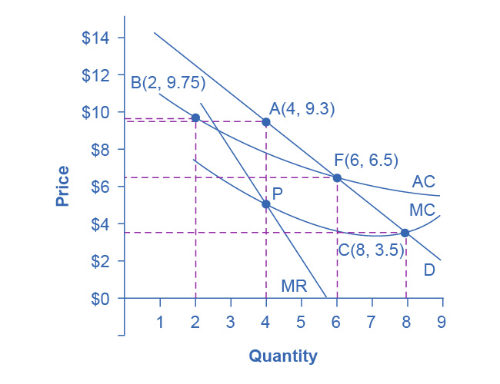
Regulatory Choices in Dealing with Natural Monopoly
A natural monopoly will maximize profits by producing at the quantity where MR = MC, and by then looking to the market demand curve to see what price to charge for this quantity.
This monopoly will produce at point A, with a quantity of 4 and a price of 9.3.

Slide 52
Regulatory Choices in Dealing with Natural Monopoly
If antitrust regulators split this company exactly in half, then each half would produce at point B, with average costs of 9.75 and output of 2.
The regulators might require the firm to produce where MC = D at point C.
However, if the firm is required to produce at a quantity of 8 and sell at a price of 3.5, the firm will incur losses.
The most likely choice is point F, where the firm is required to produce a quantity of 6 and charge a price of 6.5.

Slide 53
Cost-Plus versus Price Cap Regulation
Cost-plus regulation - when regulators permit a regulated firm to cover its costs and to make a normal level of profit.
Price cap regulation - when the regulator sets a price that a firm cannot exceed over the next few years.

Slide 54
11.4 The Great Deregulation Experiment
Deregulation - removing government controls over prices and quantities.
Regulatory capture - when the supposedly regulated firms end up playing a large role in setting the regulations that they will follow and as a result, they “capture” the people usually through the promise of a job in that “regulated” industry once their term in government has ended.

Slide 55
The Effects of Deregulation
Sarbanes-Oxley Act - designed to increase confidence in financial information provided by public corporations to protect investors from accounting fraud.
Dodd-Frank Act - “To promote the financial stability of the United States by improving accountability and transparency in the financial system, to end “too big to fail,” to protect the American taxpayer by ending bailouts, [and] to protect consumers from abusive financial services practices…”

Slide 56
Airline Deregulation
1926 - 1st U.S. government regulation of airline industry, giving airlines permission to fly certain routes based on mail delivery needs.
1934 - Antitrust authorities charged the Postmaster General with colluding with the major airlines to monopolize the nation’s airways.
1938 - U.S. government created the Civil Aeronautics Board (CAB) to regulate airfares and routes instead.
1978 - Airline Deregulation Act took the government out of the business of determining airfares and schedules.
Following 30 years: greater competition from deregulation, reduced airfares, increased efficiency, offered more service, increased jobs.
Discussion questions: Since deregulation, how has a string of mergers raised concerns over how competition might be compromised? Has it affected the consumer product and demand for it?

