Slide 1
HCMI 3243: Econometrics
BUSN 106: Tue/Thur 9:30 AM – 10:45 AM
Shane Murphy – shane@uconn.edu

Slide 2
Today’s Task
Subject this week is productivity – health and productivity – fertility relationships
But the task is to understand how economic models are tested in academic papers
Today we will try to understand the statistical output and how it is expressed in a paper
Thursday we will use statistical software and data to replicate parts of an academic paper
So Thursday bring your computers or sit next to someone with theirs!

Slide 3
Stature and status: Height, ability, and labor market outcomes
Income and height are positively correlated
Height difference between men and women does not explain difference in incomes
Height is a marker or proxy for other variables
Height and cognitive ability are positively correlated
Height and economic status of father are positively correlated
Height and early growth spirt are positively effected
Conclusion/Discussion
Health and nutrition interventions have the biggest impact in utero
Policy relevance – growth hormones are not a solution

Slide 4
Key result
For both men and women, the relationship is striking: a one-inch increase in height is associated on average with a 1.4 percent to 2.9 percent increase in weekly earnings, and a 1.0 percent to 2.3 percent increase in average hourly earnings.
Height is associated positively with work hours, so that the height coefficient for weekly earnings is somewhat larger than that for average hourly earnings.

Slide 5
Models
$Y=α+βX+ε$
Intercept, Coefficient (effect), error term
Error term – uncertainty in model
Missing variables
A change of 1 in X is associated with a change in Y of $β$
$Y=α+βf\left(X\right)+ε$
What happens if we transform a variable?
It depends, maybe we want to take the square root of X, maybe we want to change its units (from inches to meters), etc

Slide 6
Logarithms in models
$Y=α+β\ln\left(X\right)+ε$
A change of 1% in X is associated with a change in Y of $β$
$ln⁡(Y)=α+βX+ε$
A change of 1 in X is associated with a change in Y of $β percent$
$ln⁡(Y)=α+β\ln\left(X\right)+ε$
A change of 1% in X is associated with a change in Y of $β percent$
$β$ is the elasticity between X and Y!
What variables is percent change important?

Slide 7
Logarithms in models
$Y=α+β\ln\left(X\right)+ε$
A change of 1% in X is associated with a change in Y of $β$

Slide 8
Logarithms in models
$Y=α+β\ln\left(X\right)+ε$
A change of 1% in X is associated with a change in Y of $β$
$ln⁡(Y)=α+βX+ε$
A change of 1 in X is associated with a change in Y of $β percent$
$ln⁡(Y)=α+β\ln\left(X\right)+ε$
A change of 1% in X is associated with a change in Y of $β percent$
$β$ is the elasticity between X and Y!
What variables is percent change important?
Usually: Money (income, wealth), Long Distances
Maybe: Weight, Height,
Binary variables are handled differently

Slide 9
Key result
For both men and women, the relationship is striking: a one-inch increase in height is associated on average with a 1.4 percent to 2.9 percent increase in weekly earnings, and a 1.0 percent to 2.3 percent increase in average hourly earnings.
Height is associated positively with work hours, so that the height coefficient for weekly earnings is somewhat larger than that for average hourly earnings.

Slide 10
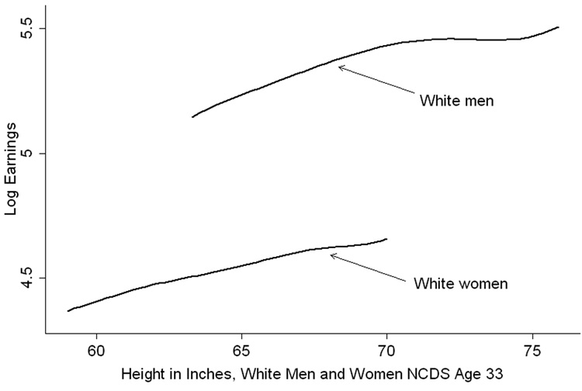
Best illustration is (almost?) always graphical

Slide 11
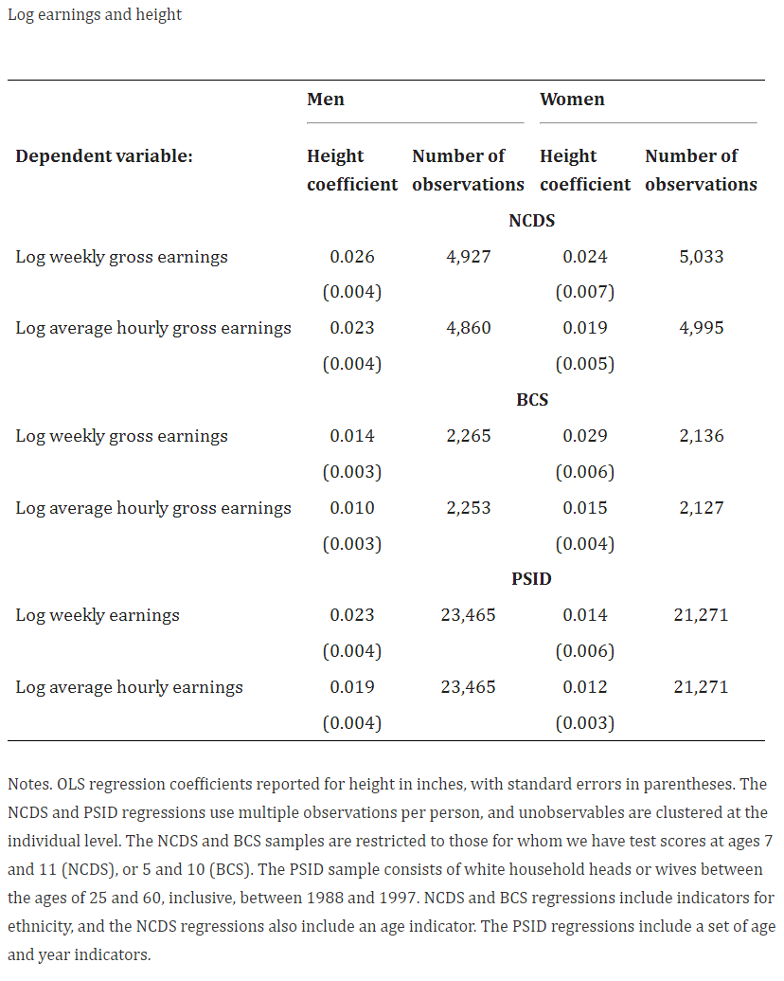
Let’s look at table 1:
Main thing being shown is coefficients
0.026, 0.024, 0.023m 0.019, …
Number of observations
Uncertainty
Standard errors
Note:
Describes model, data
Control variables, sample methodology

Slide 12
Control variables in model
$Y=α+β_{1}X_{1}+ε$ vs $Y=α+β_{1}X_{1}+β_{2}X_{2}+ε$
Multiple regression or multivariate regression
$X_{2}$ may be an additional factor to take into consideration when trying to understand the relationship between $X_{1}$and Y.
Control variables in the height-income relationship included in the paper:
Gender, ethnicity, age
Others?

Slide 13
Uncertainty
A statistic is an estimate derived from data
Average (mean, median, mode), correlation
We may be interested in how applicable the estimate is to a different situation
So we estimate uncertainty
(Uncertainty is also a statistic, we’ll ignore this wrinkle)
More data means less uncertainty
More uniform population means less uncertainty estimated from sample
Standard error
Can be used to express confidence in estimated relationships, $β$

Slide 14
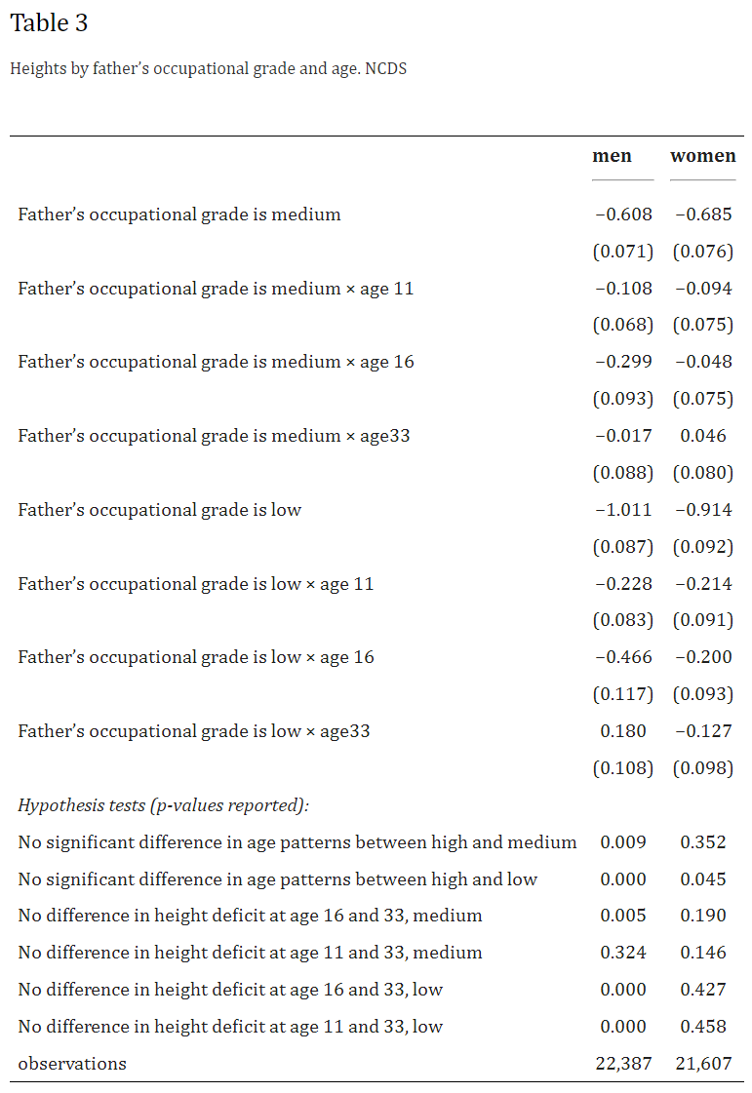
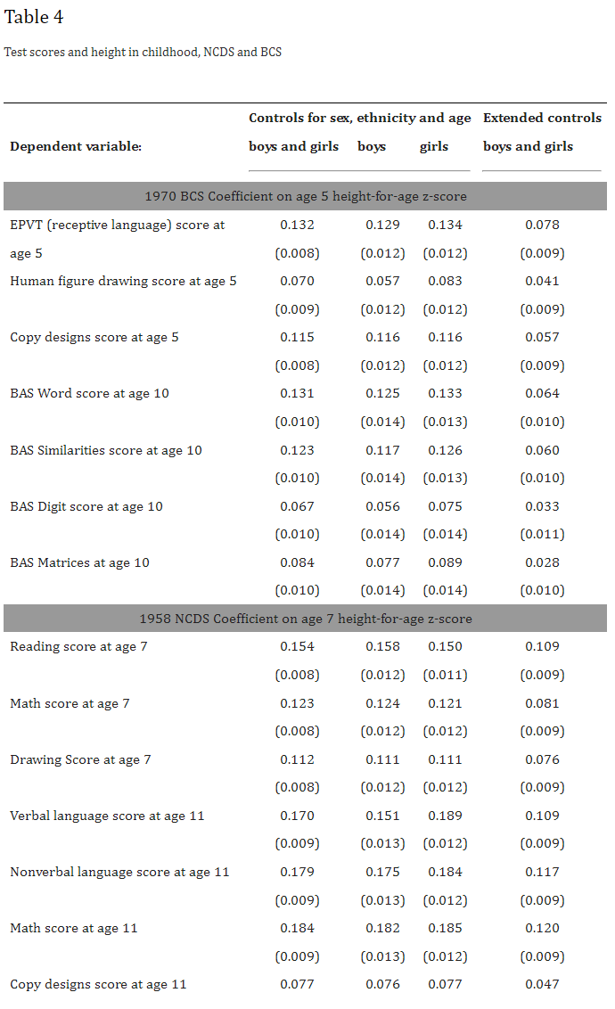

Slide 15
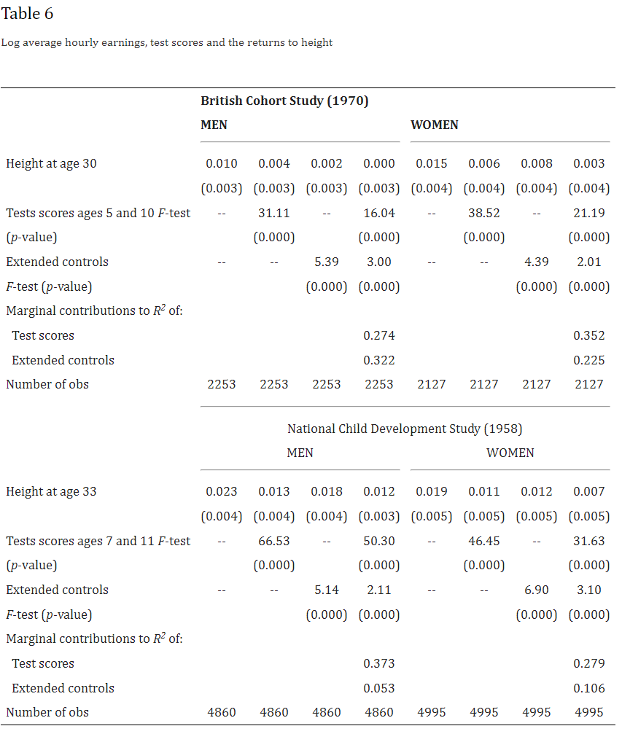
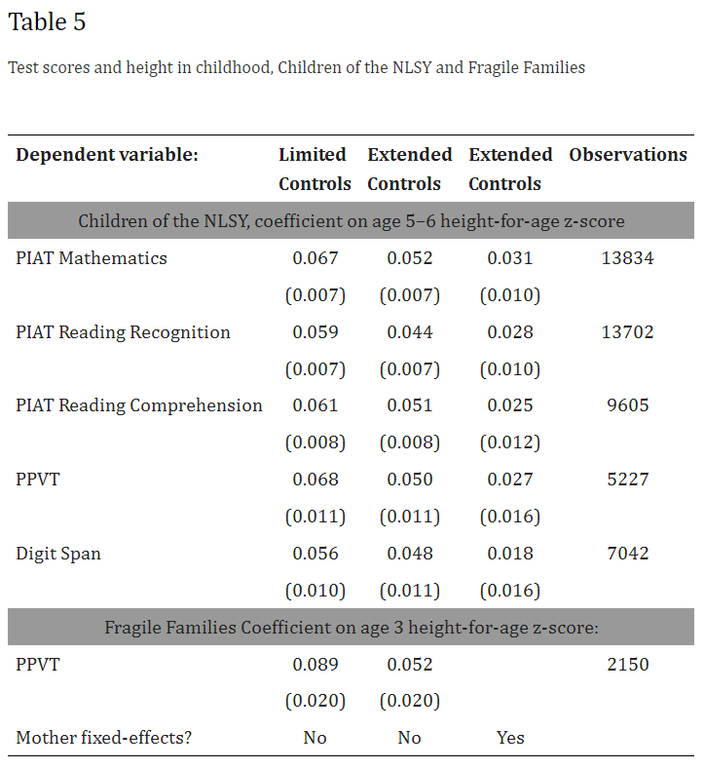

Slide 16
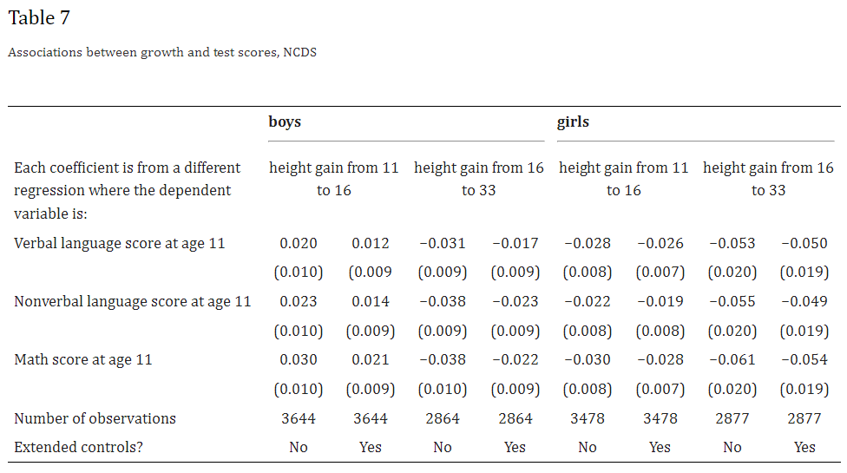

Slide 17
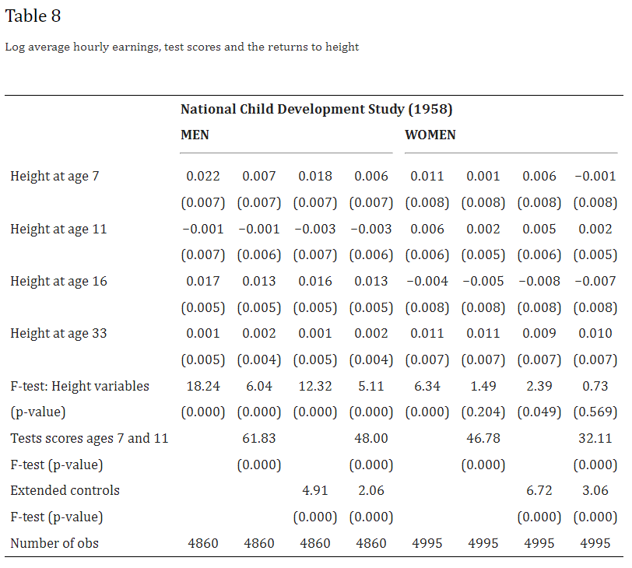

Slide 18
Sources
Case, Anne, and Christina Paxson. "Stature and status: Height, ability, and labor market outcomes." Journal of political Economy 116, no. 3 (2008): 499-532.
Angrist, Joshua, and William N. Evans. "Children and their parents' labor supply: Evidence from exogenous variation in family size." (1996).

