Slide 1
HCMI 4225: The ACA and legal and legislative challenges to the ACA
Tue/Thur 9:30 AM – 10:45AM
Shane Murphy – shane@uconn.edu

Slide 2
1990s Medicaid expansion
After failing to get extensive health care reform passed, the Clinton administration promoted more insurance regulation (HIPAA 1996) and worked with states to expand Medicaid under existing law
Ex. Oregon expanded to all individuals under FPL
Tennessee expanded to all families under 400% FPL
This increased interest in cutting Medicaid by fiscal conservatives
SCHIP/CHIP - State Children’s Health Insurance Program of 1997
Provide insurance to children in families earning up to 200% of FPL (with more generosity allowed)

Slide 3
2006 Massachusetts Health Care Reform Plan
Heritage Foundation designed plan
State exchange
Employer and individual mandate
Fully subsidized coverage for individuals up to 150% FPL

Slide 4
Path to the ACA
Presidential Primaries
John Edwards first candidate to make proposal
Medicare-based public option supported by activist/academic Jacob Hacker
Clinton and Obama followed suit
Exchanges with public option
Kucinich was only candidate supporting Universal Coverage plan (M4A-like)
Edwards and Clinton supported a mandate
Republican Proposals – tax incentives for individual marketplace and deregulation
Healthy Americans Act (2007 and 2009)
Mandate plus end of pre-tax status of employer based plans
Joe Lieberman (I-CT)
Senator from 1989-2013
Killed the public option
Effects of the public option:
Accountability, cost, market
National vs federated pool
Notes:
https://www.pbs.org/wgbh/frontline/film/obamasdeal/
https://www.youtube.com/watch?v=w_Q_x3BaY6U&t=41s

Slide 5
Edward Kennedy and Conference Committees
Kennedy died August 25, 2009
Replaced by conservative Scott Brown in election in January and was seated in February
Senate passed the bill in November 2009 with Kennedy’s seat still vacant
If the house bill was not identical to the Senate bill, there would have needed to be a conference committee
Pelosi and the house managed to pass an identical bill in December
Avoiding conference led to a more liberal bill than otherwise may have existed
For instance the Independent Payment Advisory Board would likely have been cut

Slide 6
Major provisions of the ACA
Individual mandate
Fines on employers
Standard benefits package
Bans on denying medical coverage for preexisting conditions
Establishes state-based exchanges/purchasing groups
Offers subsidies for low-income people to buy insurance
Improves efficiency of health care system
Equalizes tax treatment for insurance of self-employed
Reduces growth in Medicare spending
Controls high-cost health plans Yes (taxes plans over $8,500 for single coverage, $23,000 for family plan)
Prohibits insurance company from canceling coverage
Prohibits insurers from setting lifetime spending caps
Expands Medicaid
Extends coverage to dependents (up to age 26)
Notes:
https://www.youtube.com/watch?v=KoTOzNRw8bg

Slide 7
Note about the IPAB
Question of cost control fundamental to health insurance
Moral Hazard
Limits on high cost care
Effectiveness and cost-effectiveness
Rationing and regulation
IPAB called death panels (importantly by Republican VP candidate Palin)
Different from crisis standard of care
https://www.youtube.com/watch?v=MQsaAuwYAfE

Slide 8
ACA, March 23, 2010
900 pages and 10 titles
Clarity v vagueness:
Clarity: “Title 1: Quality Affordable Health Care for All Americans”
Vagueness: 150 times “the secretary shall” and 50 times “the secretary may”
Empowering bureaucracy and rule-making
Shared federal and state responsibility
State: insurance exchanges, premium stabilization, consumer protections…

Slide 9
Center for Medicare and Medicaid Innovation (CMMI), 2010
Tasked with designing, implementing, and testing new health care payment models to address growing concerns about rising costs, quality of care, and inefficient spending
Medicare, Medicaid, and the Children’s Health Insurance Program (CHIP)
Organizes accountable care organizations (ACOs), bundled payment models, and medical homes models
Two CMMI models have met the statutory criteria to be eligible for expansion by reducing program spending while preserving or enhancing quality.
Diabetes Prevention Program model and the Pioneer ACO model.

Slide 10
National Federation of Independent Business v. Sebelius (2012)
Consolidated suits by the NFIB and by the State of Florida
Other suits by the state of Virginia, Liberty University (Liberty University v. Geithner), a group of people with religious objections in DC (Mead V. Holder), a law group in Michigan (Thomas More Law Center v. Obama), and Seven-Sky v. Holder (as CoA judge, Kavanaugh dissented – see http://www.scotusblog.com/2018/07/kavanaugh-on-the-affordable-care-act-seven-sky-v-holder/)
Kathleen Sebelius
Secretary of Health and Human Services (2009-2014)

Slide 11
National Federation of Independent Business v. Sebelius (2012)
Constitutional:
Anti-Injunction Act – individuals can’t sue to avoid paying taxes
Court found that since the act is a penalty and not a tax, suits were allowed
Congress taxing power
The individual mandate was a valid exercise of taxing power
Medicaid Expansion
Roberts, Breyer, and Kagan felt states should be allowed to opt out
Scalia, Kennedy, Thomas, and Alito felt Medicaid expansion (and the entire ACA) was unconstitutional
Ginsburg and Sotomayor dissented, would have upheld Medicaid expansion in all states
Commerce Clause and the Necessary and Proper Clause
“As for the Medicaid expansion, that portion of the Affordable Care Act violates the Constitution by threatening existing Medicaid funding. Congress has no authority to order the States to regulate according to its instructions. Congress may offer the States grants and require the States to comply with accompanying conditions, but the States must have a genuine choice whether to accept the offer.” – John Roberts

Slide 12
NFIB v Sibelius, 2012
John Roberts Biography: The Chief by Joan Biskupic
https://youtu.be/ESse04SnSU0?t=2038
Notes:
historic three days of oral arguments back in March of 2012 over President Obama's major domestic achievement this this law the Affordable Care Act that was signed in March of 2010 so they they have these arguments they go into their private conference and the initial vote led by the chief is five to four to strike down what we've all called the individual mandate and that was the requirement that everyone buy health insurance so that the the health insurance structure is supported by people who are healthy not just people who are ill you know it's the the idea that this cost should be borne by everyone and the the law established the new marketplaces and had many many other provisions another provision was the Medicaid expansion for people near the poverty line so there are two major planks of this thing and they vote 5-2 for that Congress lacked the power under its Commerce Clause power to to demand this individual insurance requirement and that's where everybody was paying attention all the attention at the time was on and there were the five conservatives led by the chief voted to strike it down and the four liberals said no but meanwhile they also took a vote on the Medicaid expansion and they voted to uphold it and the chief was with them to uphold it they don't vote in any way on this taxing power issue which again becomes relative becomes relevant in the very end because that's what the chief hangs on the question coming out of the conference conference as they call their private sessions is what's going to fall with the individual mandate because all these different parts were intertwined and Justice Kennedy who's normally in the middle on these things was adamant that the whole law had to fall this major you know nearly a thousand page law that had all sorts of other provisions that were popular with people would have to would have to be overturned because of how intertwined it was and Congress had not written in any kind of so-called severability clause and the Chief Justice starts having second thoughts about that the consequences of that and you remember this was an election year there's so much pressure on the court and there's a presumption among some commentators that the Republican controlled Supreme Court is going to invalidate the signature domestic achievement of President Barack Obama and the chief the chief is trying to figure out a middle ground on this and he's not getting any cooperation or assistance or you know help it all from Anthony Kennedy who he usually deals with who he was usually dealing with any kind of compromise meanwhile over to the far right our justices Alito Scalia and Clarence Thomas and they're they're not going to play they're not in play at all on the far left Justice Ginsburg and justice Sotomayor are not going to be in play either and they they are traditionally the ones who are always over to the far left and not working with the chief that much but justices Kagan and Breyer on the left but open to trying to take down the temperature try to find some compromise with the chief begin to work with him after he decides that he can find legitimate grounds for the individual mandate to be upheld on taxing power and what makes the conservative so angry is first of all even though the taxing power was completely briefed by the Obama administration it was even subject to arguments it was never voted on in conference they they never took an up or down vote on that so they were they felt you know in Scalia's word that it was you know fly-by-night briefing that was just was not a fair fair thing to suddenly turn to and the the liberal justices our want want this to unfold this way but they're also worried that the chief is going to you know possibly shift back again because you know they're they're feeling their original feeling coming out of that conference was complete de moron demoralisation because they're thinking it's gonna be five to four this big law is gonna go down and there's nothing we can do about it but all of a sudden the Chiefs show some flexibility but at the same time that he decides to find grounds to pull the mandate he decides that the Medicaid expansion should be killed and this is again and what didn't get a lot of attention at the time but this was really important for millions of Americans near the poverty line but the problem with it as the chief then decided was that the way Congress had written the expansion law it was it was essentially coercing the states into doing this program Medicaid is almost entirely funded by the federal government but it with that comes a lot of strings and the federal government was Congress said in the Medicaid expansion if you're if you don't expand the clientele the reach of the Medicaid all of your Medicaid funding is going to disappear and as the chief ends up writing this was essentially like holding a gun to the head of the state's the justices Breyer and Kagan decide to change their votes and go with the chief on that to show a certain amount of cooperation and feeling that the chief himself was making this big compromise that was going to get lots of criticism among his conservative brethren which it did so as a show of cooperation and sort of moving toward him that's why they changed their votes but they also figured that this was essentially free money for the state's weren't all the states going to adopt the expansion but lo and behold so many Republican governors did not want anything to do with the Obama expansion there and said no it that that has changed over the years but that turned out to be a bit of a surprise to the justices I'm left ok so I'm gonna make a strong statement just for the sake of it I'd like your reaction yeah John Roberts gets huge credit for this decision yes his hero is John Marshall Chief Justice John Marshall who he admires for committing acts of judicial jujitsu engaging in judicial statesmanship avoiding battles in the short term in order to shore up the courts power in the long term and by visibly struggling with the most polarized question of his age by pulling the court back from the point of really narrowing federal power in the most significant way since the New Deal he preserved the courts bipartisan legitimacy and proved that he meant when he said when he cared said that he would put legitimacy above politics discuss that's right no I think he should he people come up to him still and thank him and that decision has again you know going with that part of the decision that decision has really held in people's minds to define John Roberts as a moderate it's a one-of-a-kind decision but it was a hugely important decision and Charles freed a Reagan Solicitor General who succeeded Rex Lee who was seen as much more ideological actually gives him credit to says look it wasn't pretty the the ruling was shot through with uh with all sorts of problems people could rightly complain about the taxing rationale because it wasn't consistent with other parts of the ruling but it it got the job done it got the job done so I would say that yes this was an important ruling that he did and that the the grief he has gotten and continues to get from conservatives and and got at the time from then businessman Donald Trump and continues to get from President Donald Trump probably for the country was worth it but inside the way he went about it I think it still puzzles and confuses his colleagues but your point is well-taken for the country it's it made a big difference in people's lives and it still does and and the the Affordable Care Act is coming back to the court and I cannot imagine that John Roberts would now suddenly want to do what a judge down in Texas did invalidates the whole thing all over again

Slide 13
Employer mandate delays, 2013-2016
Play or Pay
Obama decision to delay mandate until 2016
Attempted further delays
Authority for Mandate Delay Act of 2013
Save American Workers Act of 2013, 2014, 2015, 2017, 2018
Additional compliance mandates delayed since 2014

Slide 14
Cadillac Tax delays
designed to disincentivize high-cost employer-sponsored coverage
Would have created a 40 percent excise tax on employer plans that exceed an estimated $10,800 in annual premiums for individuals and $29,050 for families
Protecting Americans from Tax Hikes (PATH) Act of 2015 delayed implementation from 2018 to 2020.
Also made tax deductible
Further postponed to 2022 by The Tax Cut and Jobs Act of 2018

Slide 15
Burwell v. Hobby Lobby Stores, Inc. 2014
Allowing closely held for-profit corporations to be exempt from a regulation its owners religiously object to, if there is a less restrictive means of furthering the law's interest, according to the provisions of the Religious Freedom Restoration Act (RFRA) of 1993
Struck down the contraceptive mandate in the ACA
May have broader implications for RFRA applications
Definition of “closely held” has possible liability implications

Slide 16
Compliance of employer-provided plans delays, 2014-present

Slide 17
Transitional Risk Corridor Program, 2014-2016
The Risk Corridors program set a target for exchange participating insurers to spend 80% of premium dollars on health care and quality improvement.
Medical Loss Ratio
Insurers with costs less than 3% of the target amount must pay into the risk corridors program;
the funds collected were used to reimburse plans with costs that exceed 3% of the target amount.
No provision for excess high cost insurers
Moda Health Plan v. United States (2018) – Federal circuit court found:
government does not have to pay health insurers that offered qualified health plans (QHPs) the full amount owed to them in risk corridors payments.

Slide 18
Medicare Access and CHIP Reauthorization Act of 2015
Repealed Sustainable Growth Rate model for controlling growth in physician payments
Significant effect on payment models
Beginning July 1, 2015, clinicians will begin receiving a 0.5 percent payment increase to Medicare payments.
This payment increase will continue annually until Dec. 31, 2018.
Starting in 2019, clinicians will choose from one of two pathways: the Merit-based Incentive Payment System (MIPS) or Alternative Payment Models (APMs).

Slide 19
King v. Burwell, 2015
Challenged subsidies to plans purchased on national exchanges
Theory that ACA meant only to subsidize state exchanges
Standing
Plaintiffs argue that they have standing because, without the subsidies, they would be exempt from the individual mandate because the cost of the cheapest insurance plan exceeded 8% of their income, but, with the subsidies, the subsidized cost was low enough to require plaintiffs to purchase insurance or pay a penalty.
Plaintiffs may have been eligible for free care or otherwise exempt
Plaintiffs won in circuit court, lost in supreme court (6-3)

Slide 20
Trump (2017-2020) policy overview
1 – Frequent overt criticism of ACA
2 – Enforcement of letter of law
Example: Refusal to let Idaho authorize plans in violation
3 – Improving parts of the law
Example: Political appointees not interfering with CMS civil services
4 – Prioritize individual options
Example: Supported short-term plans
5 – Undermined law where possible
Example: Terminating cost-sharing payments

Slide 21
Trump inauguration day executive order, 2017
"It is the policy of my Administration to seek the prompt repeal“
"exercise all authority and discretion available to them to waive, defer, grant exemptions from, or delay“
"minimizing the economic burden [of Obamacare] pending repeal”

Slide 22
Tax Cuts and Jobs Act of 2017
Zeroed the penalty of the individual mandate – left all other provisions in place
Massachusetts has had it own health coverage mandate since 2006
New Jersey passed a state-wide mandate that took effect in 2019
Vermont passed a health coverage mandate that will take effect in 2020

Slide 23
Cases challenging the ACA risk adjustment transfer formula
Minuteman Health, Inc v. U.S. Dept of HHS et al.
New Mexico Health Connections et al. v. U.S. Dept of HHS et al.
Evergreen Health Cooperative, Inc. v. U.S. Dep’t. of Health and Human Services et al.
Cases in progress
Challenges risk adjustment methods
Court rarely overturns administrative decisions of this nature

Slide 24
Texas v Azar, 2018-present
Judge Reed O’Connor of the Northern District of Texas holds that the ACA is unconstitutional in its entirety
Removal of mandate invalidates the law
AG Willian Barr suggested the DOJ may not defend the ACA in appeal
In a letter signed by assistant AG Joseph H. Hunt, the DOJ confirmed its decision to do just that
California Attorney General Xavier Becerra is now leading the defense of the ACA as the case moves to the circuit level.

Slide 25
Biden Marketplace expansion
American Rescue Plan Act of 2021
Marketplace subsidy expansion
Medicaid private option
Increased subsidy
More people eligible for subsidy
Expire at end of 2022
Medicaid expansion covers up to 138% FPL
Non-Medicaid expansion state residents now eligible for subsidized marketplace insurance coverage
No subsidy cliff at 400% FPL
Table 1: Percent of Income Paid for Marketplace Benchmark Silver Premium, by Income
Income (% of poverty) | Affordable Care Act (before legislative change) | COVID-19 Relief (current law 2021-2022)
Under 100% | Not eligible for subsidies* | Not eligible for subsidies**
100% – 138% | 2.07% | 0.0%
138% – 150% | 3.10% – 4.14% | 0.0%
150% – 200% | 4.14% – 6.52% | 0.0% – 2.0%
200% – 250% | 6.52% – 8.33% | 2.0% – 4.0%
250% – 300% | 8.33% – 9.83% | 4.0% – 6.0%
300% – 400% | 9.83% | 6.0% – 8.5%
Over 400% | Not eligible for subsidies | 8.5%
NOTES: *Lawfully present immigrants whose household incomes are below 100% FPL and are not otherwise eligible for Medicaid are eligible for tax subsidies through the Marketplace if they meet all other eligibility requirements. **In the COVID-19 relief law, lawfully present immigrants in states that have not expanded Medicaid would continue to be eligible for marketplace subsidies. In addition, people receiving Unemployment Insurance (UI) are treated as though their income is no more than 133% of poverty for the purposes of the premium tax credit. This could extend premium tax credits to some individuals with incomes below poverty. SOURCE: KFF

Slide 26
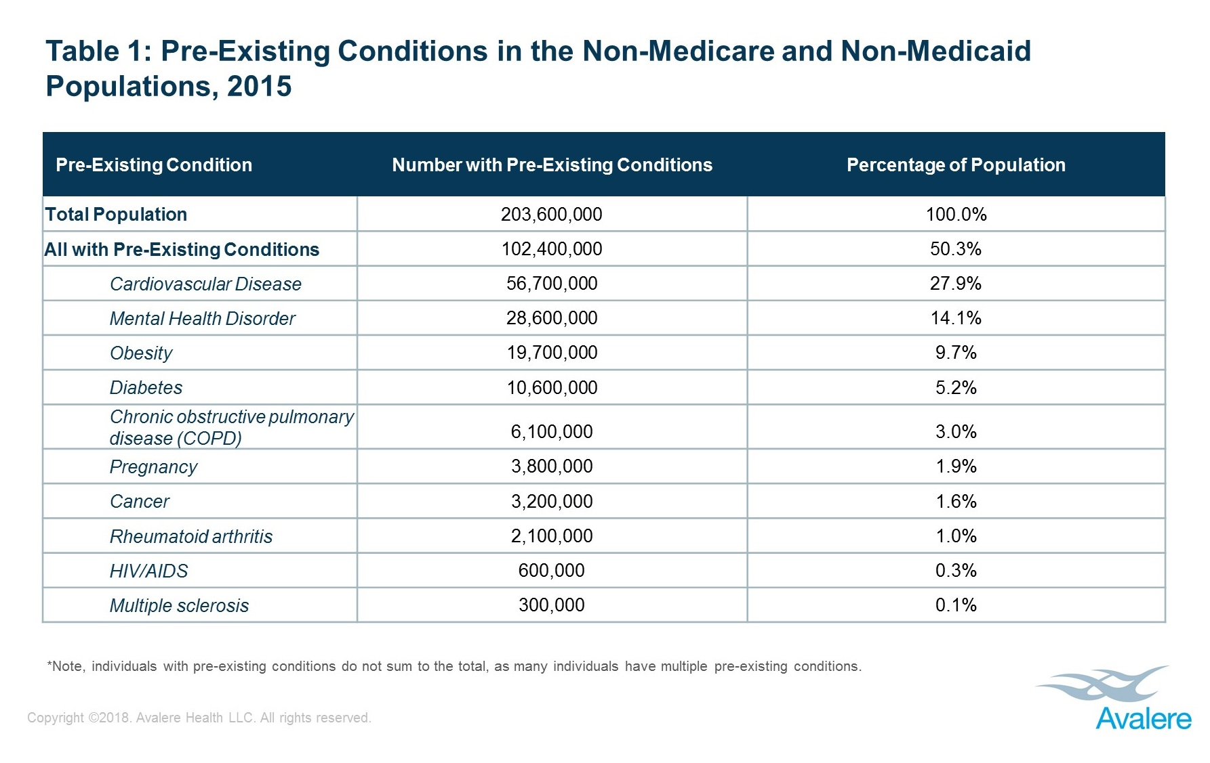
Bonus slide: Pre-existing conditions

Slide 27
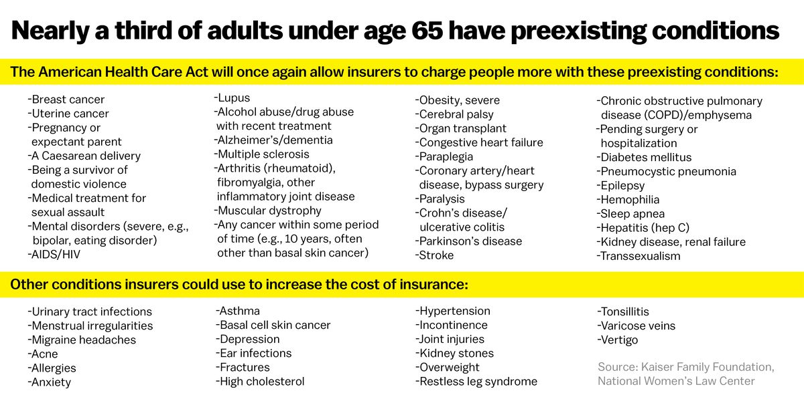
Bonus slide: Pre-existing conditions

Slide 28
Sources
Berkowitz, Edward. "Getting to the Affordable Care Act." Journal of Policy History 29, no. 4 (2017): 519-542.
Halpin, Helen A., and Peter Harbage. "The Origins And DemiseOf The Public Option." Health Affairs29, no. 6 (2010): 1117-1124.

Slide 29
HCMI 4225: The ACA today
Tue/Thur 9:30 AM – 10:45AM
Shane Murphy – shane@uconn.edu

Slide 30
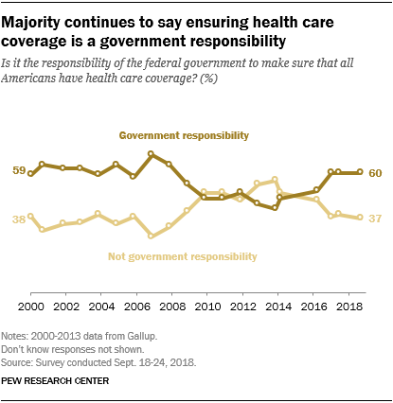
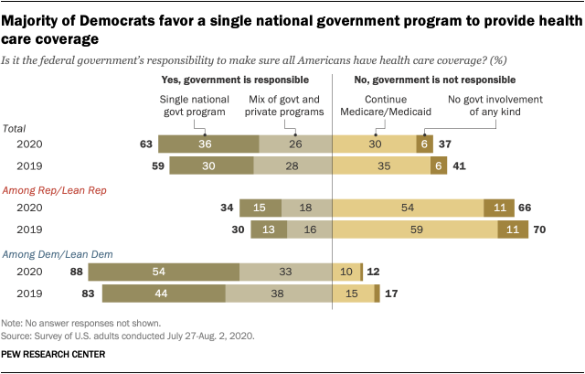
Opinion Polling
Pew and Kaiser are main health policy opinion pollsters
March 2017, ¼ of people thought ACA was repealed (Pew)
September 2017, ½ of people thought ACA marketplaces collapsing (Kaiser)

Slide 31
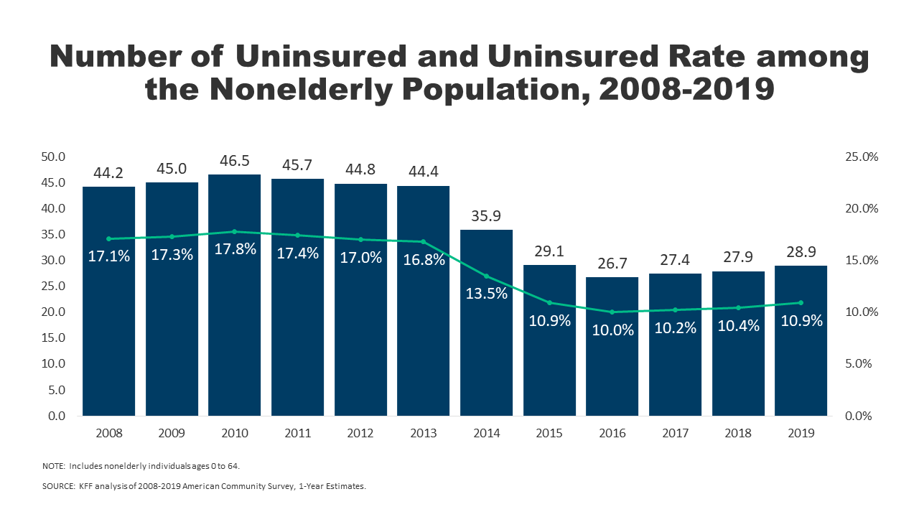
Effects on health and coverage
Largest effect on coverage was due to Medicaid expansion, not the exchanges
Largest effect on health comes from self-perceived health, mental health, financial stability
These three factors are all closely interrelated
Benefits of wellness visits are difficult to measure
Health benefits for chronic conditions require large samples sizes, studies are hard to perform

Slide 32
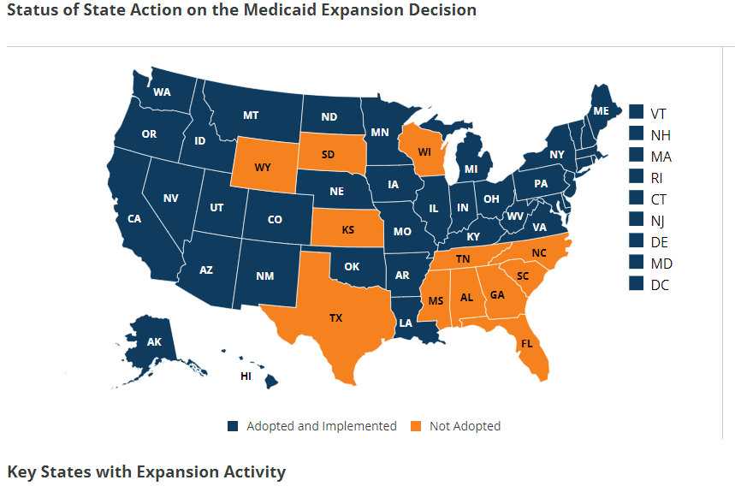
Coverage: Medicaid expansion
All US citizens and legal residents with income up to 138% FPL qualify for coverage in participating states
Led to large growth in enrollment in participating states, smaller growth in non-participating states
Reduction in uninsured rates, especially among low-income individuals
Partial Woodwork effect/welcome mat effect
Growth among individuals who were previously eligible

Slide 33
Coverage: Medicaid expansion: criticism
Crowding out of private insurance
Mixed results, although there has been some decline in private coverage in participating states

Slide 34
Cost Sharing Reductions (CSR)
Another provision of the ACA is that consumers with incomes below 250% FPL are entitled to CSRs
Lower deductibles, copays, and other cost-sharing for low-income consumers
Increases the actuarial value of the plan
HHS was then required to reimburse insurance companies for the CSRs
Reimbursement was opposed by the conservative-majority House of Representatives
House v Burwell -> House v Azar
CSR reimbursement payments stopped
Drove up premiums on the marketplace

Slide 35
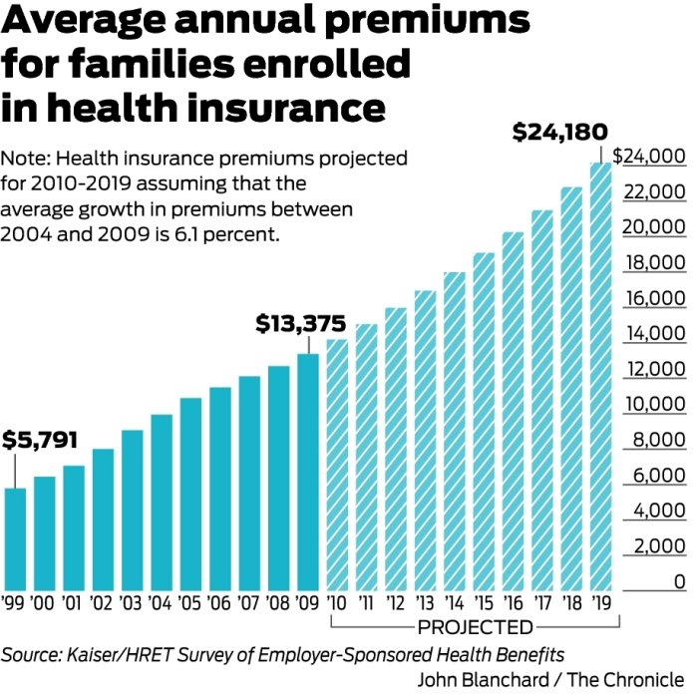
Health Insurance Premiums: Skyrocketing?
Premiums grew by over 6% between 2004 and 2009
If such growth continued, the cost for a family would grow to:
2010 | 14190.88
2011 | 15056.52
2012 | 15974.97
2013 | 16949.44
2014 | 17983.35
2015 | 19080.34
2016 | 20244.24
2017 | 21479.14
2018 | 22789.37
2019 | 24179.52

Slide 36
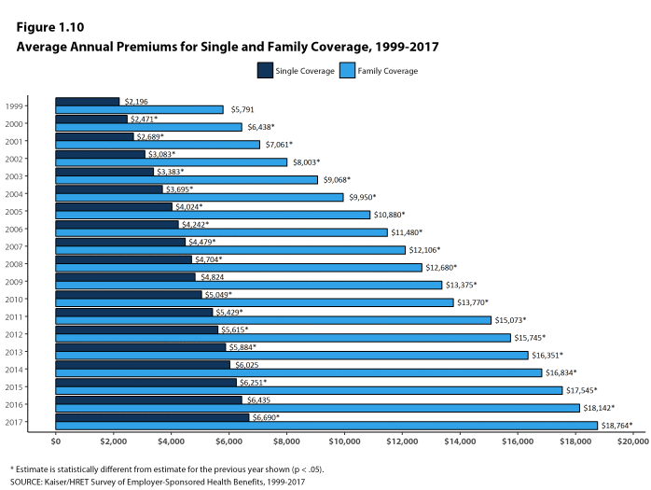
Health Insurance Premiums: Skyrocketing?
Actual growth rate has ben about 4.3%

Slide 37
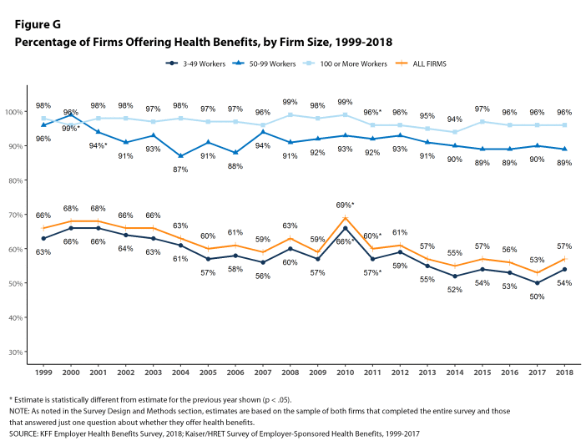

Slide 38
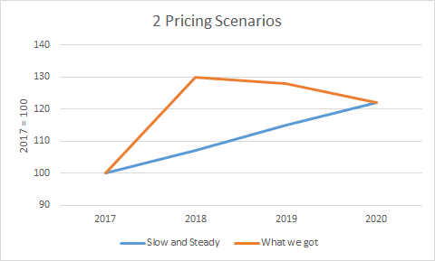
MLR and premiums
Increases in premiums will be tied to increases in healthcare spending by MLR regulations

Slide 39
Title 1: Quality, Affordable Health Care for All Americans.
The largest title of the ACA, measured in number of key provisions or in total spending and revenue
Title I focuses on the private health insurance sector.
Forty-nine provisions,
$509 billion in spending, $81 billion in revenue,
88 percent implemented.
High-profile provisions such as the creation of health insurance marketplaces, premium tax credits, employer and individual mandates, community rating requirements, and the ban on lifetime caps on coverage, among others.
As of 2019, 11.4 million Americans are covered by marketplace health insurance plans, down slightly from the peak of 12.7 million in 2016 (Kaiser Family Foundation 2019).

Slide 40
Title II: The Role of Public Programs
Medicaid expansion
Seventeen provisions, $459 billion in spending, $53 billion in revenue,
78 percent implemented
Meant to cover all adults ages nineteen through sixty-four living in families with income below 138 percent of the federal poverty level on January 1, 2014.
Instead, a Supreme Court ruling rendered this expansion effectively optional for states.
Twenty-four states plus the District of Columbia chose to expand Medicaid on or before January 2014;
about half of the target population of low-income nonelderly adults.
As of 2019, 64 percent of the adults in the expansion population live in states in which Medicaid expansion has been implemented or in which implementation is pending.

Slide 41
Title III: Improving the Quality and Efficiency of Health Care
Thirty-five key provisions, $54 billion in spending, $450 billion in revenue,
96 percent implemented.
Intended to improve the quality of care (or at least not degrade it) while reducing federal payments,
Aka delivery-system reform.
Cuts in Medicare payments to Medicare Advantage plans and to hospitals; together, CBO scored these cuts as achieving $290 billion in savings over the 2010 to 2019 scoring window.
Expanded quality measurement and value-based purchasing initiatives, and also created the Center for Medicare and Medicaid Innovation to facilitate the development and diffusion of innovations in Medicare policy
Introduced innovative payment models for Medicare such as the Shared Savings Program
spurred the growth of accountable care organizations, and expanded pilot projects of bundled payments.
Created (but not implemented) the Independent Payment Advisory Board

Slide 42
Title IV: Prevention of Chronic Disease and Improving Public Health.
$18 billion in spending and $1 billion in revenue, 19 provisions
85 percent implemented.
Creation of the Prevention and Public Health Fund.
Regulation expansions
Nutrition labeling for restaurant menus
Large firms provide break time and lactation space for employees who are nursing mothers

Slide 43
Title V: Health Care Workforce.
$18 billion in spending and zero revenue,
Eight of its nine key provisions— 94 percent—were implemented.
Grant programs and residency regulation
Unimplemented provision established a National Health Care Workforce Commission, and members were appointed in September 2010. Congress, however, never appropriated the money for the commission, which has therefore never met

Slide 44
Title VI: Transparency and Program Integrity.
$3 billion spending and $7 billion in revenue,
90 percent implemented
43 provisions
prevent fraud, including the creation of provider data banks for Medicare and Medicaid
Elder Justice Act, intended to prevent abuse, neglect, and exploitation of older Americans;
Physician Payments Sunshine Act, which requires pharmaceutical companies and drug manufacturers to report payments to physicians;
Creation of the Patient-Centered Outcomes Research Institute.
Could have been implemented separately, but included in part to provide revenue

Slide 45
Title VII: Improving Access to Innovative Medical Therapies.
zero spending and $7 billion in revenue
Seven key provisions, fully implemented
Adopted the Biologics Price Competition and Innovation Act of 2009 (BPCI Act), intended to create a simplified path for the approval of “biosimilar” therapies—essentially, generic versions of biological products approved by the Food and Drug Administration (FDA).
Only limited success
Expanded the 340B Drug Pricing Program in Medicaid, effectively increasing the number of hospitals that receive drug rebates from manufacturers.

Slide 46
Title VIII: Community Living Assistance Services and Supports.
The CLASS Act
zero spending and a stated $70 billion in forecast revenue
One provision, not implemented.
Intended to create an insurance-like program that would cover expenses for services required to help disabled individuals remain living in the community rather than having to move to a nursing home.

Slide 47
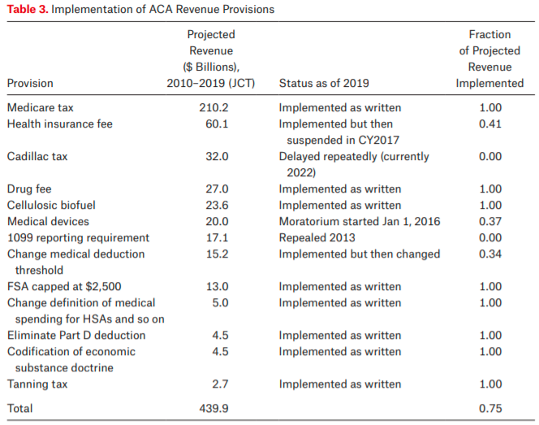
Title IX: Revenue Provisions.
Projected to raise $438 billion between 2010 and 2019, 19 provisions, 79% implemented
Medicare tax on high income individuals and on unearned income
property income, inheritance, pensions, and payments received from public welfare

Slide 48
Legal challenges
Medicaid expansion
National Federation of Independent Business v. Sebelius
Cost-sharing reductions
House v. Burwell
Payments meant to reimburse insurers for adhering to ACA rules that require them to limit the out-of-pocket costs of their low-income enrollees
Money never appropriated
Trump scrapped attempts to appropriate money
Lead to “silver loading”
Contraceptive coverage
Burwell v. Hobby Lobby

Slide 49
Born to fail
1099 reporting provision
Repealed by congress in April 2011
Community Living Assistance Services and Supports (CLASS) Act
Required to be self-sustaining
Capped premiums for low income and student enrollees
Premiums go into 10-year CBO window, outlays come later
Co-ops
Proposed loans to co-op insurance plans
23 programs initially took part, political failure to support and difficult market led to failure

Slide 50
Interest group pressure
Cadillac tax
Medical device tax
IPAB
DSH cuts
Free Choice vouchers
Allow low income employees to buy subsidized marketplace insurance rather than get employer based insurance
Menu labeling

Slide 51
Failure to thrive
Multistate compacts and multistate plans
Allows plans to be sold across state lines – no state has legalized such actions
Biosimilars
the generic drug industry works as well as it does because small-molecule compounds are easy to copy and cheap to manufacture. Biologics, in contrast, are large-molecule, protein based drugs that are much harder to copy
Antidiscrimination rules
Section 1557 of the ACA prohibits discrimination in “any health program or activity” that receives federal funds on the grounds of race, color, national origin, sex, age, or disability (see Grogan 2017, Rosenbaum and Schmucker 2017).
Ruled against by Reed O’Connor
Prevention and Public Health Fund
Funds chronically redirected by congress

Slide 52
Executive branch sabotage
Zeroing out the individual mandate
Back to Texas v Azar (aka Texs v US aka Texas v California)
Medicaid work requirements
Currently in courts
Short-term, limited duration insurance
Create 364 day plans to allow for a separating equilibrium
Increases chance that marketplace fails via death spiral
In courts
Association health plans
Also meant to divide pool
In courts

Slide 53
Effects of the ACA
There has been a lot of research on the health and coverage outcomes of the Affordable Care Act
KFF summary for Medicaid expansion (Antonisse as lead author) - https://www.kff.org/medicaid/report/the-effects-of-medicaid-expansion-under-the-aca-updated-findings-from-a-literature-review/
Mazurenko, Olena, Casey P. Balio, Rajender Agarwal, Aaron E. Carroll, and Nir Menachemi. "The effects of Medicaid expansion under the ACA: a systematic review." Health Affairs 37, no. 6 (2018): 944-950.
Courtemanche, Charles, James Marton, Benjamin Ukert, Aaron Yelowitz, Daniela Zapata, and Ishtiaque Fazlul. "The three‐year impact of the Affordable Care Act on disparities in insurance coverage." Health services research 54 (2019): 307-316.
Soni, Aparna, Laura R. Wherry, and Kosali I. Simon. "How Have ACA Insurance Expansions Affected Health Outcomes? Findings From The Literature: A literature review of the Affordable Care Act's effects on health outcomes for non-elderly adults." Health Affairs 39, no. 3 (2020): 371-378.
Courtemanche, Charles, James Marton, Benjamin Ukert, Aaron Yelowitz, and Daniela Zapata. "Early effects of the Affordable Care Act on health care access, risky health behaviors, and self‐assessed health." Southern Economic Journal 84, no. 3 (2018): 660-691.
…

Slide 54
Effects on health and coverage
Largest effect on coverage was due to Medicaid expansion, not the exchanges
Largest effect on health comes from self-perceived health, mental health, financial stability
These three factors are all closely interrelated
Benefits of wellness visits are difficult to measure
Health benefits for chronic conditions require large samples sizes, studies are hard to perform

Slide 55
Coverage: Medicaid expansion
All US citizens and legal residents with income up to 138% FPL qualify for coverage in participating states
Led to large growth in enrollment in participating states, smaller growth in non-participating states
Reduction in uninsured rates, especially among low-income individuals
Partial Woodwork effect/welcome mat effect
Growth among individuals who were previously eligible

Slide 56
Coverage: Medicaid expansion: subgroups
Coverage gains in expansion versus non-expansion states for specific vulnerable populations:
young adults, prescription drug users, people with HIV, veterans, parents, mothers, women of reproductive age (with and without children), children, lesbian, gay, and bisexual adults, newly diagnosed cancer patients, women diagnosed with a gynecologic malignancy, low-income workers, low-educated adults, early retirees, and childless adults with incomes under 100% FPL
Disproportionately positive impact in rural areas in expansion states
Gains can be found across racial/ethnic categories
Reduced disparities by income and age
Possibly reducing disparities by race/ethnicity

Slide 57
Coverage: Medicaid expansion: Alternative approaches
Section 1115 gave states the option of expanding Medicaid in alternative ways
These states (especially Arkansas, Michigan, and Indiana) have shown similar gains in coverage rates
Indiana instituted monthly contributions which have created enrollment and continuing coverage issues

Slide 58
Access, Utilization
Many studies find improvements in access to care
Increases in cancer diagnosis rates (especially early stage)
Earlier presentation for common surgical conditions – lowering complications
Increase listing for heart transplants among African Americans
Increased access for treatment of behavioral and mental health conditions
Increase in prescriptions for opioid use disorder and overdose
Increase in prescriptions for smoking cessation drugs

Slide 59
Access, Utilization
Many studies find improvements in access to care
Reduction in disparities by race, income, education, and employment status in access and affordability
Increased rates of optimal care for patients with common surgical conditions
Improved quality of care for common community health care treated conditions:
Asthma, Pap testing, BMI assessment, hypertension control
Declines in uninsured ED visits, but mixed evidence and no significant change in total ED volume
Reduced LOS for Medicaid patients
Improvements in care and quality in areas with primary care shortages

Slide 60
Access, Utilization: Criticism
Confusion in non-waiver states
Failures to follow up with new patients
Longer wait times

Slide 61
Affordability and Financial Security
Possible reduced patients with unmet medical need because of cost
Reduction in OOP
Average reduction in 2014 of about $205
Greater reductions among Medicaid expansion covered individuals than subsidized marketplace coverage individuals
Declines in unpaid bills and financial stress over future bills
In Ohio, percentage of expansion enrollees with medical debt fell by nearly half since enrolling in Medicaid (55.8% had debt prior to enrollment, 30.8% had debt at the time of the study)

Slide 62
Health Outcomes
Possible improvements in self-reported health
Improved outcomes for cardiac patients
Infant Mortality Rate Reductions for expansion states between 2014 and 2016, a period where the rate rose slightly for non-expansion states
Effect largest among African Americans
Limited of no effect on drug overdoses or alcohol poisonings

Slide 63
Economic effects
Federal matching for expansion population provided large spending savings for expansion states
No significant increase in state spending on Medicaid, including savings in some states
Possible reduction in overall spending due to spillovers
State costs related to behavioral health services, crime and the criminal justice system, and Supplemental Security Income program costs.
Lower Medicaid spending per enrollee
New enrollees generally less expensive than existing enrollees
First year of enrollment generally more expensive than subsequent years
Medicaid expansion lowers marketplace premiums
Marketplace enrollees younger and healthier in expansion states

Slide 64
Impacts on providers
Reduction in uninsured visits and uncompensated care costs
Decline in uninsured ED visits and increase in Medicaid-covered ED visits
Increase in Medicaid-covered substance use disorder treatment facility visits
Reduced disparity in uninsured visits between hospitals that treat a disproportionate share of low-income patients (DSH hospitals/safety net hospitals) and those that do not
Improved overall hospital financial performance, reduced probability of closure
Especially in rural areas

Slide 65
Labor Market Effects
Increased jobs
Did not reduce employment for low-income workers
Enrollees looking for work reported Medicaid enrollment made it easier to seek employment, those employed reported it made it easier to continue working
Increase volunteering

Slide 66
Reading
Grogan, Colleen M. "How the ACA addressed health equity and what repeal would mean." Journal of Health Politics, Policy and Law 42, no. 5 (2017): 985-993.
Levy, Helen, Andrew Ying, and Nicholas Bagley. "What’s Left of the Affordable Care Act? A Progress Report." RSF: The Russell Sage Foundation Journal of the Social Sciences 6, no. 2 (2020): 42-66.
Rosenbaum, Sara, and Sara Schmucker. "Viewing Health Equity through a Legal Lens: Title VI of the 1964 Civil Rights Act." Journal of Health Politics, Policy and Law 42, no. 5 (2017): 771-788.

