Slide 1
HCMI 4225: Effects of Medicare and Medicaid
Tue/Thur 9:30 AM – 10:45AM
Shane Murphy – shane@uconn.edu

Slide 2
Effects of the ACA
There has been a lot of research on the health and coverage outcomes of the Affordable Care Act
KFF summary for Medicaid expansion (Antonisse as lead author) - https://www.kff.org/medicaid/report/the-effects-of-medicaid-expansion-under-the-aca-updated-findings-from-a-literature-review/
Mazurenko, Olena, Casey P. Balio, Rajender Agarwal, Aaron E. Carroll, and Nir Menachemi. "The effects of Medicaid expansion under the ACA: a systematic review." Health Affairs 37, no. 6 (2018): 944-950.
Courtemanche, Charles, James Marton, Benjamin Ukert, Aaron Yelowitz, Daniela Zapata, and Ishtiaque Fazlul. "The three‐year impact of the Affordable Care Act on disparities in insurance coverage." Health services research 54 (2019): 307-316.
Soni, Aparna, Laura R. Wherry, and Kosali I. Simon. "How Have ACA Insurance Expansions Affected Health Outcomes? Findings From The Literature: A literature review of the Affordable Care Act's effects on health outcomes for non-elderly adults." Health Affairs 39, no. 3 (2020): 371-378.
Courtemanche, Charles, James Marton, Benjamin Ukert, Aaron Yelowitz, and Daniela Zapata. "Early effects of the Affordable Care Act on health care access, risky health behaviors, and self‐assessed health." Southern Economic Journal 84, no. 3 (2018): 660-691.
…

Slide 3
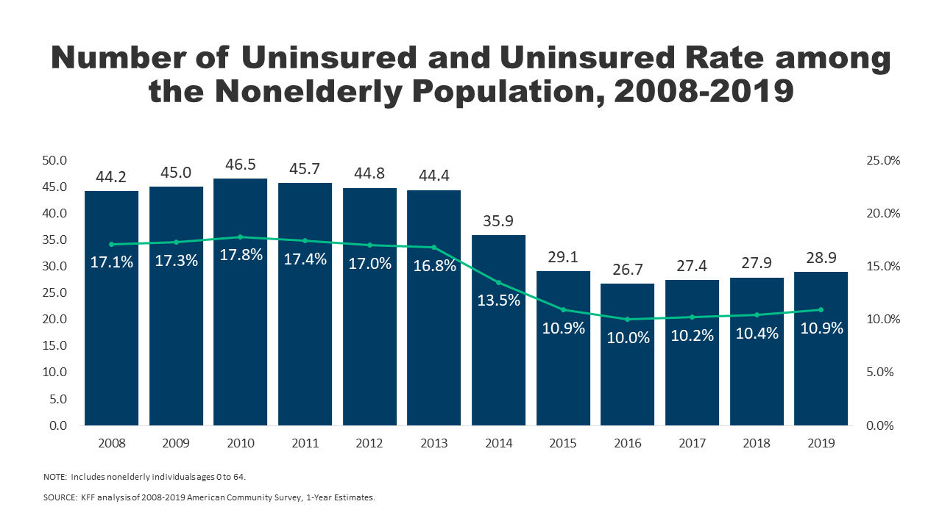
Effects on health and coverage
Largest effect on coverage was due to Medicaid expansion, not the exchanges
Largest effect on health comes from self-perceived health, mental health, financial stability
These three factors are all closely interrelated
Benefits of wellness visits are difficult to measure
Health benefits for chronic conditions require large samples sizes, studies are hard to perform

Slide 4
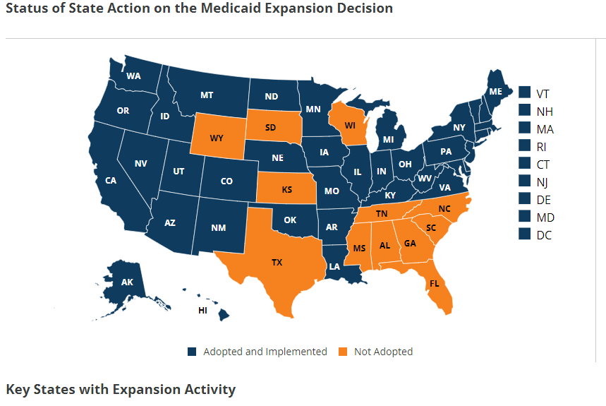
Coverage: Medicaid expansion
All US citizens and legal residents with income up to 138% FPL qualify for coverage in participating states
Led to large growth in enrollment in participating states, smaller growth in non-participating states
Reduction in uninsured rates, especially among low-income individuals
Partial Woodwork effect/welcome mat effect
Growth among individuals who were previously eligible

Slide 5
Coverage: Medicaid expansion: subgroups
Coverage gains in expansion versus non-expansion states for specific vulnerable populations:
young adults, prescription drug users, people with HIV, veterans, parents, mothers, women of reproductive age (with and without children), children, lesbian, gay, and bisexual adults, newly diagnosed cancer patients, women diagnosed with a gynecologic malignancy, low-income workers, low-educated adults, early retirees, and childless adults with incomes under 100% FPL
Disproportionately positive impact in rural areas in expansion states
Gains can be found across racial/ethnic categories
Reduced disparities by income and age
Possibly reducing disparities by race/ethnicity

Slide 6
Coverage: Medicaid expansion: Alternative approaches
Section 1115 gave states the option of expanding Medicaid in alternative ways
These states (especially Arkansas, Michigan, and Indiana) have shown similar gains in coverage rates
Indiana instituted monthly contributions which have created enrollment and continuing coverage issues

Slide 7
Access, Utilization
Many studies find improvements in access to care
Increases in cancer diagnosis rates (especially early stage)
Earlier presentation for common surgical conditions – lowering complications
Increase listing for heart transplants among African Americans
Increased access for treatment of behavioral and mental health conditions
Increase in prescriptions for opioid use disorder and overdose
Increase in prescriptions for smoking cessation drugs

Slide 8
Access, Utilization
Many studies find improvements in access to care
Reduction in disparities by race, income, education, and employment status in access and affordability
Increased rates of optimal care for patients with common surgical conditions
Improved quality of care for common community health care treated conditions:
Asthma, Pap testing, BMI assessment, hypertension control
Declines in uninsured ED visits, but mixed evidence and no significant change in total ED volume
Reduced LOS for Medicaid patients
Improvements in care and quality in areas with primary care shortages

Slide 9
Access, Utilization: Criticism
Confusion in non-waiver states
Failures to follow up with new patients
Longer wait times

Slide 10
Affordability and Financial Security
Possible reduced patients with unmet medical need because of cost
Reduction in OOP
Average reduction in 2014 of about $205
Greater reductions among Medicaid expansion covered individuals than subsidized marketplace coverage individuals
Declines in unpaid bills and financial stress over future bills
In Ohio, percentage of expansion enrollees with medical debt fell by nearly half since enrolling in Medicaid (55.8% had debt prior to enrollment, 30.8% had debt at the time of the study)

Slide 11
Health Outcomes
Possible improvements in self-reported health
Improved outcomes for cardiac patients
Infant Mortality Rate Reductions for expansion states between 2014 and 2016, a period where the rate rose slightly for non-expansion states
Effect largest among African Americans
Limited of no effect on drug overdoses or alcohol poisonings

Slide 12
Economic effects
Federal matching for expansion population provided large spending savings for expansion states
No significant increase in state spending on Medicaid, including savings in some states
Possible reduction in overall spending due to spillovers
State costs related to behavioral health services, crime and the criminal justice system, and Supplemental Security Income program costs.
Lower Medicaid spending per enrollee
New enrollees generally less expensive than existing enrollees
First year of enrollment generally more expensive than subsequent years
Medicaid expansion lowers marketplace premiums
Marketplace enrollees younger and healthier in expansion states

Slide 13
Impacts on providers
Reduction in uninsured visits and uncompensated care costs
Decline in uninsured ED visits and increase in Medicaid-covered ED visits
Increase in Medicaid-covered substance use disorder treatment facility visits
Reduced disparity in uninsured visits between hospitals that treat a disproportionate share of low-income patients (DSH hospitals/safety net hospitals) and those that do not
Improved overall hospital financial performance, reduced probability of closure
Especially in rural areas

Slide 14
Labor Market Effects
Increased jobs
Did not reduce employment for low-income workers
Enrollees looking for work reported Medicaid enrollment made it easier to seek employment, those employed reported it made it easier to continue working
Increase volunteering

Slide 15
Reading
Grogan, Colleen M. "How the ACA addressed health equity and what repeal would mean." Journal of Health Politics, Policy and Law 42, no. 5 (2017): 985-993.
Levy, Helen, Andrew Ying, and Nicholas Bagley. "What’s Left of the Affordable Care Act? A Progress Report." RSF: The Russell Sage Foundation Journal of the Social Sciences 6, no. 2 (2020): 42-66.
Rosenbaum, Sara, and Sara Schmucker. "Viewing Health Equity through a Legal Lens: Title VI of the 1964 Civil Rights Act." Journal of Health Politics, Policy and Law 42, no. 5 (2017): 771-788.

