Slide 1
HCMI 4448: Clinical and Social Issues in Health Care
Busn 203: Wed 6:00 PM – 8:50 PM
Shane Murphy – shane@uconn.edu
Office Hours: Wed 4:00 PM – 6:00 PM

Slide 2
Better Call Saul – Allergy to Electricity:
https://www.youtube.com/watch?v=PuZ34IeY_L0&ab_channel=BreakingBad%26BetterCallSaul
Youtuber Physics Girl – Long Covid
https://www.youtube.com/watch?v=vydgkCCXbTA&ab_channel=PhysicsGirl

Slide 3
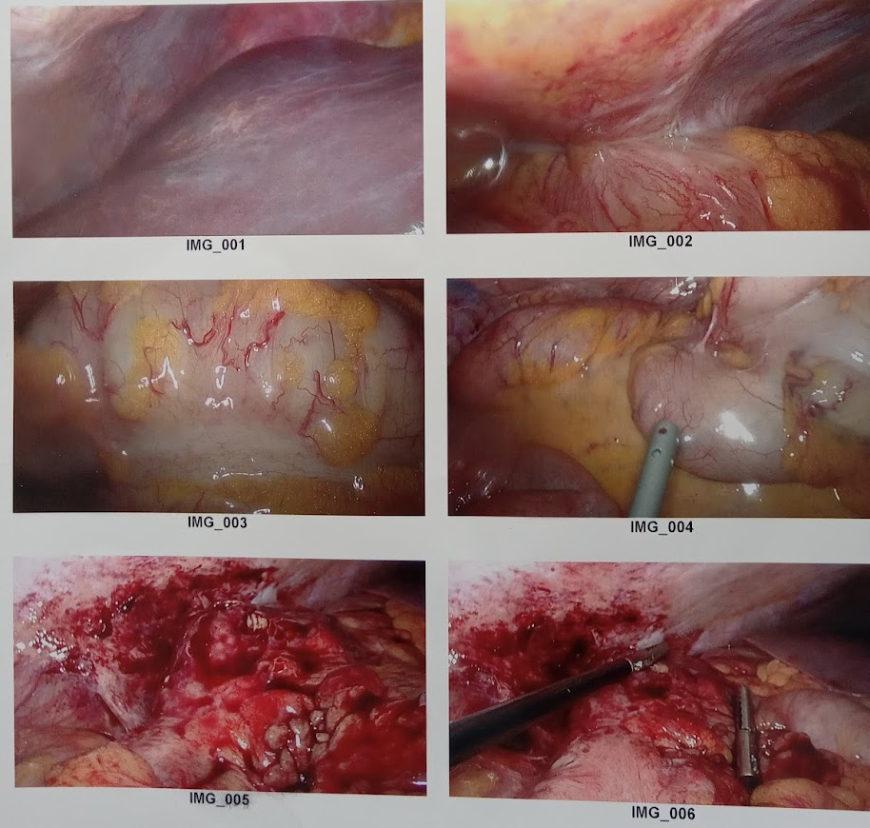
Discussion part 1: Personal experience
Urgent Care – Pain at McBurney’s point, no fever, no elevated hr, mild pain for seven days, normal activity
ED – no elevated WBC, uncertain CT with IV Contrast, observe overnight, CT with oral and IV contrast consistent with appendicitis and possible disease in colon
Surgery

Slide 4
Discussion part 1: Personal experience
Urgent Care – Pain at McBurney’s point, no fever, no elevated hr, mild pain for seven days, normal activity
ED – no elevated WBC, uncertain CT with IV Contrast, observe overnight, CT with oral and IV contrast consistent with appendicitis and possible disease in colon
Surgery

Slide 5
Chronic, invisible illnesses
irritable bowel syndrome, myalgic encephalomyeletis/chronic fatigue syndrome, fibromyalgia, Lyme disease, postural orthostatic tachycardia syndrome (POTS), multiple sclerosis, temporomandibular disorders, Ehlers Danlos, encapsulating peritoneal sclerosis, chronic Lyme disease, complex regional pain syndrome/reflex sympathetic dystrophy, Epstein-Barr, vulvodynia, long Covid
These conditions remain contexts comprising largely vague, nonspecific symptoms.
exceptions multiple sclerosis, endometriosis, systemic lupus erythematosus (lupus), low back pain, endometriosis, etc

Slide 6
Key Terms
Mental Health – mental functioning facilitates adaptive and productive activities with purpose and meaning, fulfilling relationships and the capacity to enjoy the activities of life, the capacity to contend with adversity, and the mental flexibility to adapt to changing life circumstances (US Surgeon General’s Mental Health Report)
Mental Illness – aka psychiatric illness and mental disorder - “a syndrome characterized by clinically significant disturbance in an individual’s cognition, emotion regulation, or behavior that reflects a dysfunction in the psychological, biological, or developmental processes underlying mental functioning” (APA DSM-5)

Slide 7
Mental Illness
Result of cognitive (cortical), emotional (limbic), and vegetative (brain stem) impairments
Many associated with dysregulated and excessive, aversive emotional states
environmental phobias (agoraphobia, claustrophobia, acrophobia, etc.);
interpersonal (paranoia, social anxiety, body dysmorphic disorder, pathological jealousy, etc.);
body integrity (somatic symptom disorder, illness anxiety disorder);
traumatic reactivity (posttraumatic stress disorder);
alarm (panic disorder);
doubt (obsessive compulsive disorder);
grooming disorders (trichotillomania, excoriation disorder, onychophagia, rhinotillexomania, body cleaning compulsiveness);
depression (futility)

Slide 8
Somatic symptom disorder (previously somataform disorder)
Somatic = physical
Disorder is diagnosed when symptoms persist over a long period of time
May or may not be explained
Symptoms can vary (even by culture)
Associated with other psychological illnesses
Depression, anxiety, drug abuse
Diagnosis replaced:
Somatization disorder
Undifferentiated somatoform disorder
Hypochondriasis
somatic symptom disorder, illness anxiety disorder, functional neurological symptom disorder, factitious disorder, psychological factors affecting other medical conditions
somatic complaints must have also been serious enough to interfere significantly with a person’s ability to perform important activities, such as work, school, or family and social responsibilities, or lead the person experiencing the symptoms to seek medical treatment

Slide 9
Psychosomatic disorder
Somatic illness caused or exacerbated by mental stress and distress
Many diseases can be made worse by stress and istress:
Heart disease/CVD and IBS
Illnesses previously considered to be purely psychosomatic include:
Tuberculosis, hypertension, and stomach ulcers

Slide 10
Somatopsychic disorders
Somatopsychic disorders are mental disorders caused or exacerbated by somatic disorders.
Examples:
Endocrine disorders
Tumors
Autoimmune disorders
Infections
viral, venereal, etc

Slide 11
Key Terms
Multisystem disorders
multiple systems include the nervous system, the immune system, the endocrine system, etc.
Medical Uncertainty
Subjective – inability to explain
May always exist
Medically Unexplained Symptoms
No longer used, replaced with:
Functional Neurological Symptom Disorder
Illness Anxiety Disorder (previously hypochondriasis)
Factitious Disorders (sometimes called Munchausen’s)
Factitious disorder imposed on another (aka Munchausen’s by proxy)

Slide 12
Munchausen’s by proxy and children
False allegations of factitious disorder imposed on another usually involve a child with an orphan disease or a complex disease not adequately understood by the physician giving the diagnosis.
Example:
Physicians unfamiliar with Lyme patients’ shifting, seemingly vague, emotional, and/or bizarre-sounding complaints, frequently know little about late-stage spirochetal disease
Consequently, they may accuse mothers of fabricating their children’s symptoms—the so-called Munchausen’s by proxy ‘diagnoses’…Many such cases involve an unrecognized Lyme borreliosis causation that mothers may insist is valid despite negative tests
Many children sick from complex diseases have been forcibly removed from their parents who insist, contrary to the pediatrician’s evaluation, that their children are ill.

Slide 13
Key Terms
Functional disorders
A medical condition that impairs normal functioning of bodily processes and remains largely undetected under physical examination, dissection, or by microscopic examination.
Psychogenic disorders
Physical illnesses that are believed to have been caused by emotional or mental stressors or consequences of psychiatric or psychological disorders. In addition, it can be a physical abnormality or other biomarker that cannot be identified or cannot be explained by confirmatory testing within the capabilities of the examining physician.
“Compensation Neurosis”
“Neurosis” associated with wanting compensation from an insurance company
Not validated

Slide 14
Key Terms
Psychogenic Seizures (aka psychogenic nonepileptic attacks, psychogenic nonepileptic seizures, dissociative seizures, and pseudoseizures)
complex partial seizure activity, but seizure activity is not demonstrated on electroencephalograms (advanced EEG approaches may be necessary to differentiate)
Psychogenic pain
Pain disorder that is associated with psychological factors. A patient who is given this diagnosis is viewed as having complaints of pain that do not match the symptoms recognized by the evaluating physician.
Delusional Parasitosis

Slide 15
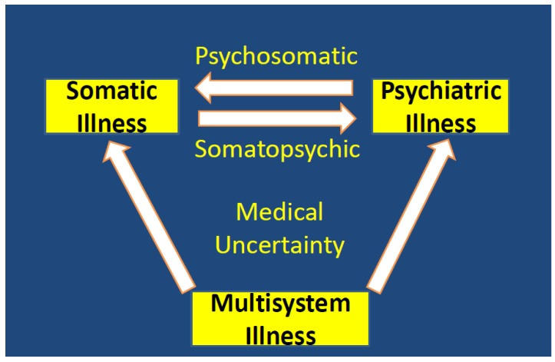
Terminology abuse
Maintaining respect for the patient, protecting the integrity of the physician–patient relationship, and preserving individualized healthcare are high priorities in healthcare.
Issues that have the potential to undermine the adequacy of assessment and medical judgment include third party intrusions with pressure for adherence to dogmatic, third-party controlled diagnostic and treatment guidelines, an incorrect application of research findings to individualized situations, flawed guidelines, and economic pressures that limit the adequacy of assessment.
Guidelines based upon inaccurate terms and concepts harm patients, especially when they are accompanied by efforts to convert the guidelines into standards of care.
Failures in these areas can result in misdiagnosing someone who has a multisystem disorder with an erroneous diagnosis of somatic symptom disorder or some other error

Slide 16
Diagnosing psychosomatic conditions
The diagnosis of a psychosomatic condition requires a causal psychodynamic explanation, and it is never a diagnosis of exclusion based upon a failure to confirm some other diagnosis.
Difficulty stresses physicians and especially patients
One survey of over 12,000 participants found the average patient with Lyme disease was seen by five physicians before they were properly diagnosed
Many insurance companies have barriers and limitations of what they cover, and patients with complex, chronic, and costly diseases incur significant out-of-pocket costs. A significant number of medical bankruptcies occur among both insured and uninsured individuals
Invalidation, normalization, minimization
Patients not feeling they will be heard reduces patient reporting of symptoms

Slide 17
Sexism and psychosomatic diagnosis
Women are more often given an incorrect psychosomatic diagnosis,
gender-based bias and lack of research/understanding on how the female body responds to biological illness
Examples:
Being discharged from a hospital emergency department mid-heart attack with a prescription for anti-anxiety meds
Having autoimmune diseases and being labeled “chronic complainers” for years before being properly diagnosed, and having endometriosis
Being told they are just overreacting to “normal” menstrual cramps
Illnesses such as chronic fatigue syndrome and fibromyalgia are “contested” illnesses. They are considered psychosomatic and not “real” illnesses.
“hysteria”, “hypochondriacal”, or “all in their head”

Slide 18
Break (fifteen minutes?)
Five minute break followed by ten minutes to read case study
After break
Economic mini lecture
Discussion

Slide 19
GBD of CFS/ME
CFS/ME – 0.89% of population
22% more healthcare services, experience twice as much lost income, and informal caregivers (i.e. family and friends) will likely provide four times more support.
In Europe (EU-28), cost around €40 billion per year
Productivity loss due to adults with CFS/ME discontinuing employment prior to accessing CFS/ME specialist assessment is estimated to cost the UK economy over £100 million per year
Parents of children with CFS/ME experience a loss in monthly income and increase in monthly expenditure, for example travel/transport, diet, leisure, educational items and complementary/other therapies.

Slide 20
Economics: Problems
Low rate of physician follow-up for mental health care and high rates of ongoing non–mental health system use suggest that a diagnosis in and of itself is not sufficient to lead to a shift in the treatment trajectory toward what might potentially be more effective care for the presenting signs and symptoms
Studies of adults with an SSRD have reported a mean of 12.8 outpatient physician or nurse practitioner visits per year with nonspecific symptoms
Per capita costs for these patients are 6 to 8 times the costs for age-related peers

Slide 21
Economics
medically unexplained symptoms are associated with relevant annual excess costs in health care, ranging from 432 to 5,353 USD per patient in prices of 2006. Recent reviews found comparable annual excess costs per patient of up to 5,871 USD for depression, and of up to 3,042 USD for anxiety disorders.
Indirect costs were 3 times the direct costs and were much more reduced by the intervention than direct costs
Cost-effective interventions include:
Interventions targeting PCPs intended to strengthen PCPs’ abilities to identify and manage patients with medically unexplained symptoms.
Interventions targeting patients based on cognitive behavioral therapy (CBT).

Slide 22
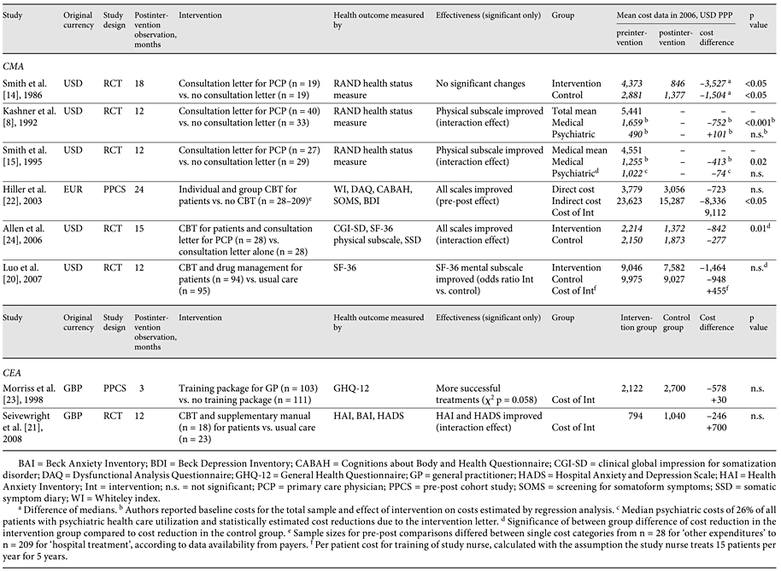

Slide 23
Discussion part 1: Personal experience

Slide 24
Discussion part 2: Personal experience

Slide 25
Discussion part 3: Case study

Slide 26
Sources
Bransfield, Robert C., and Kenneth J. Friedman. "Differentiating psychosomatic, somatopsychic, multisystem illnesses and medical uncertainty." In Healthcare, vol. 7, no. 4, p. 114. MDPI, 2019.
Konnopka, Alexander, Rainer Schaefert, Sven Heinrich, Claudia Kaufmann, Melanie Luppa, Wolfgang Herzog, and Hans-Helmut König. "Economics of medically unexplained symptoms: a systematic review of the literature." Psychotherapy and psychosomatics 81, no. 5 (2012): 265-275.
Saunders, Natasha Ruth, Sima Gandhi, Simon Chen, Simone Vigod, Kinwah Fung, Claire De Souza, Hana Saab, and Paul Kurdyak. "Health care use and costs of children, adolescents, and young adults with somatic symptom and related disorders." JAMA network open 3, no. 7 (2020): e2011295-e2011295.

Slide 27
Economics Studies
Skaer, Tracy L. "Fibromyalgia: disease synopsis, medication cost effectiveness and economic burden." Pharmacoeconomics 32 (2014): 457-466.
D'Onghia, Martina, Jacopo Ciaffi, Piero Ruscitti, Paola Cipriani, Roberto Giacomelli, Jacob N. Ablin, and Francesco Ursini. "The economic burden of fibromyalgia: a systematic literature review." In Seminars in Arthritis and Rheumatism, p. 152060. WB Saunders, 2022.
Canavan, Caroline, Joe West, and Timothy Card. "The economic impact of the irritable bowel syndrome." Alimentary pharmacology & therapeutics 40, no. 9 (2014): 1023-1034.
Nellesen, Dave, Kimberly Yee, Anita Chawla, Barbara Edelman Lewis, and Robyn T. Carson. "A systematic review of the economic and humanistic burden of illness in irritable bowel syndrome and chronic constipation." Journal of Managed Care Pharmacy 19, no. 9 (2013): 755-764.
Cochrane, M., E. Mitchell, W. Hollingworth, E. Crawley, and D. Trépel. "Cost-effectiveness of interventions for chronic fatigue syndrome or Myalgic encephalomyelitis: a systematic review of economic evaluations." Applied health economics and health policy 19 (2021): 473-486.

