Slide 1
HCMI 4448: Clinical and Social Issues in Health Care
Busn 203: Wed 6:00 PM – 8:50 PM
Shane Murphy – shane@uconn.edu
Office Hours: Wed 4:00 PM – 6:00 PM

Slide 2
Chronic diseases
Asthma
COPD
Diabetes
Heart Failure
Hypertension
Lipid disorder
Osteoarthritis

Slide 3
Response to decreases in utilization
Chronic care is “non-essential”
Utilization dropped during Covid crisis
Identifying population-based registries of patients with gaps in care, specifically targeting the gaps
Create options and ensuring insurance coverage for non-traditional lab collection options, such as neighborhood pharmacy, other specimen collection centers, or home testing kits.

Slide 4
Community Resources
Exercise programs
Self help groups
Senior centers
Patient education classes
Connect patients to case managers
Train patients in self management

Slide 5
Clinical Information Systems
Reminder system to improve compliance with guidelines
Feedback on performance measures
Registries for planning the care for chronic disease

Slide 6
Patient Care Teams
Nurse case managers
Based at senior centers or hospitals
Medical specialist
Care team such as nutritional or diabetes expert and nurse educator
Clinical pharmacists
More rare
Social workers
Acquisition of community resources
Integration of patients back into the community
Lay health workers
Health aids
Volunteers
Hospice support

Slide 7
Lay health workers
Home visits, phone calls, email
Education
Action plans
“Engineering”
Medication management
Symptom recognition
Home care provision

Slide 8
Self management
self-care, self-regulation, patient education, and patient counseling
Focusing on illness needs
Activating resources
Living with chronic illness
Most chronic conditions are related to lifestyle
Prevention spectrum
Establishing a pattern for health early in life (primary prevention)
Providing strategies for mitigating illness (secondary prevention)
managing it in later life (tertiary prevention)

Slide 9
Self management, interrupted
Do everyday problems of people with chronic illness interfere with their disease management?
Everyday problems | Number | Percent
No problems | 1087 | 63 %
Basic problems | 351 | 20 %
Finances | 208 | 12 %
Housing | 84 | 5 %
Work | 147 | 9 %
Social problems | 485 | 28 %
Leisure pursuit | 149 | 9 %
Partner | 129 | 8 %
Children | 89 | 8 %
Friends | 138 | 8 %
Sex | 238 | 14 %

Slide 10
Self management, interrupted
These associations indicate that the older people are, or the higher they rate their general health, the less likely it is that they encounter basic and social problems in their everyday life
People with chronic illness are more likely to experience everyday problems when they have physical limitations and when they perceive their health as poor.
Having social problems could be a sign of a lack of social support. Studies have shown that good social support has a positive effect on self-management

Slide 11
Telecare for chronic disease
Telemedicine interactions can be
in real time (e.g. videoconferencing)
asynchronously (e.g. store-and-forward transmission of data from a home glucose meter).
Monitoring applications can be:
entirely automatic (e.g. passive monitoring of activity using room sensors)
require the patient to do something (e.g. transmit bodyweight values using the buttons on a telephone)
Educational applications can:
employ specially designed home devices
depended on web access from PCs or smart phones

Slide 12
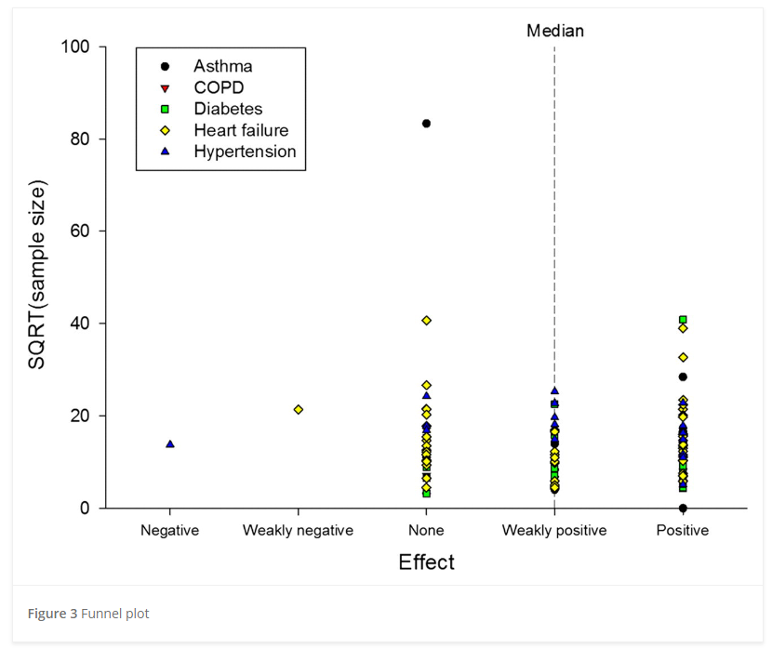
Effectiveness of telemedicine
“Weakly positive” overall
No significant benefit to many particular methods:
Tele monitoring, routine voice contact, videoconferencing
Hospitalizations decrease but health outcomes do not change very much
Systematic reviews not always consistent

Slide 13
Chronic Disease in pop culture
John Oliver on dialysis
Short Version: https://www.youtube.com/watch?v=ZsQ_EYXwTzg&ab_channel=SEIUCalifornia
Long Version: https://www.youtube.com/watch?v=yw_nqzVfxFQ&ab_channel=LastWeekTonight

Slide 14
Dialysis discussion
Comparing to Taco Bell
Kickbacks
Residual wastage
Payments issue (fee-for-service)
Dialysis prognosis
vs Kidney transplant
DaVita center becomes community

Slide 15
Sources
Wootton, Richard. "Twenty years of telemedicine in chronic disease management–an evidence synthesis." Journal of telemedicine and telecare 18, no. 4 (2012): 211-220.
Raphael, Jean L., Anna Rueda, K. Casey Lion, and Thomas P. Giordano. "The role of lay health workers in pediatric chronic disease: a systematic review." Academic pediatrics 13, no. 5 (2013): 408-420.
Grady, Patricia A., and Lisa Lucio Gough. "Self-management: a comprehensive approach to management of chronic conditions." American journal of public health 104, no. 8 (2014): e25-e31.
Van Houtum, Lieke, Mieke Rijken, and Peter Groenewegen. "Do everyday problems of people with chronic illness interfere with their disease management?." BMC public health 15, no. 1 (2015): 1-9.

Slide 16
Final Paper
Topic:
Anything related to clinical and social issues in health care management
Length 7-12 pages, aim for 8 or 9, doubles spaced/1.5 spaced, use a normal font, just be cool ok
Requirements:
6 peer reviewed/academic sources (use pub med/google scholar, if you are unsure, just ask)
Bibliography correctly formatted, any style is fine but must be consistent
Don’t use a crappy format manager, use a good one, I recommend google scholar
At least one chart, figure, or table
Title and note also required, these should make information stand alone
Organize, use section headers
Group size: one, two, or three people per group
Meetings
Must schedule and attend an in-person or online 15 minute meeting with me to discuss, meeting schedules for week after spring break, but ad hoc early meetings are fine
At meeting, we will discuss your topic and make sure the topic is appropriate and I’ll help find some sources to get you started.

