Slide 1
HCMI 4448: Clinical and Social Issues in Health Care
Busn 203: Wed 6:00 PM – 8:50 PM
Shane Murphy – shane@uconn.edu
Office Hours: Wed 4:00 PM – 6:00 PM

Slide 2
Pre-care patient interactions
Insurance pre-approval, precertification, prior authorization
Medical necessity
Changing medical landscape
Lower cost alternatives
Duplication of services
Ongoing/recurrent services
More common with managed care patients
Gatekeeping

Slide 3
Scheduling
Collect patient demographic and insurance information
Minimal time costs
Pre-registration
Hospital care often requires pre-registration, pre-authorization, or pre-certification
Some cases can be handled within 24 hours, most need 3-5 days
Manual review of patient charts and response to payer questions through online interfact
Required for all inpatient stays and surgeries
Also for radiology, cardiology, oncology, neurology, PT, OT, and speech pathology
Some urgent/emergent cases (occasionally via retro-authorization)

Slide 4
Pre-approval
Differs across insurance systems
Medicare and Commercial lowest
Workers compensation highest
Tricare (active duty military insurance) and Medicaid in the middle
Can lead to delays even for highly qualified patients
Can be based on patient status
Consider bariatric surgery – BMI requirement, attempted alternative treatments, additional comorbidity (CVD, HBP, High Cholesterol, diabetes), prior procedure, 2nd opinion, age (adolescents may not qualify)

Slide 5
Registration
Insurance verification, co-payment, paperwork (often payer-specific)
Longer for inpatient care
Note: these are high turnover jobs that serve as entryways into health careers
Physician Billing tasks:
Documenting review of systems
Filling in data elements for billing
Often these two are beyond what is clinically necessary
Obtaining authorization from payers
Conversations with billing organizations
Utilization management phone calls
Responding to coding enquiries
Charge entry is generally automated

Slide 6
Pre-care patient interactions
Continuity of care and having/knowing primary care provider
Preventative care highly sensitive to having a relationship with PCP
Decreased utilization
Readmission, ED visits, acute visits after outpatient car
Better outcomes
Increased satisfaction
Increased adherence?
Prior bad experience -> increased ED utilization
Overall continuity of care may be declining

Slide 7
Post-care patient interactions
Follow-up interactions
Increasing utilization of virtual visits
Effective, efficient
Patient motivation
Surveillance
Recurrence, comorbidity
Adherence
Education opportunity
Unplanned readmission
In-hospital vs 28 day mortality

Slide 8
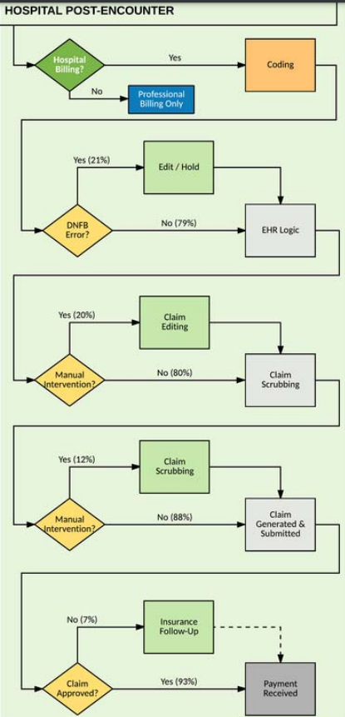
Hospital Post-Encounter Data Entry

Slide 9
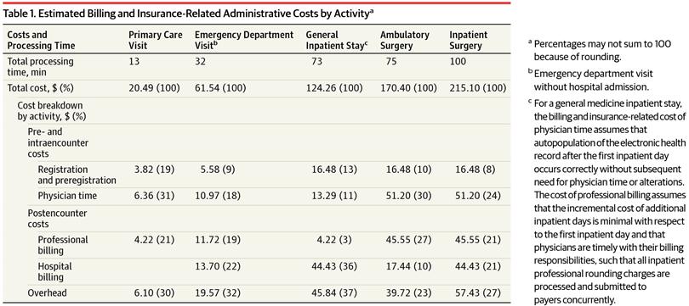
Cost of billing times

Slide 10
Pre- and Post-care discussion

Slide 11
Adherence
Broad concept
Medication
Refill, taking pills
Not well determined by sociodemographic predictors
This is not the assumption of care-givers
Physical activity
Judgement
Organizational barriers to adherence include:
Lack of access to health care,
High out-of-pocket prescription costs
Copayments for necessary medications after acute care
Inconvenience of obtaining refills
Pharmacy policies that limit prescription size and require frequent refills
Women who received 12-month supplies of oral contraceptives rather than 3-month supplies had a 30% decrease in the risk for unintended pregnancies and a 46% decrease in the risk for abortion

Slide 12
Pandemic Fatigue
Discussion:

Slide 13
Managed Care
Medical Home Models
ACOs
Bundled Payments

Slide 14
Incentives Matter
Incentives – things that motivate people to take certain actions
Extrinsic – the motivation is some outside demand or reward
i.e. a reward or monetary payment, avoiding a penalty/fine, etc.
Intrinsic – the motivation is internal, or for its own sake
i.e. feelings of personal fulfillment or personal satisfaction
What role do incentives play in understanding how health insurance affects people’s behaviors?
Notes:
Key idea in economics – incentives matter

Slide 15
Traditional Methods of Payment (Health Provider Reimbursement Models)
Per Diem
The hospital is paid for all services delivered to a patient during 1 day (private insurance, PPOs/HMOs).
Fee-For-Service
The physician or hospital is paid a fee for each service (for example, medication, IV fluids, ECG, surgical procedure) provided (uninsured, some private insurance).
Capitation
One payment is made for each patient’s treatment during a month or year (has now virtually disappeared; previously, largely HMOs).
Diagnosis-Related Groups (DRGs)
Physician or hospital is paid one sum for all services delivered during one illness; there is a different set case-price for each of approximately 750 distinct DRGs (Medicare).

Slide 16
Traditional models of Health insurance
Also called “Fee for Service” (FFS) models of health insurance
Most common type of health insurance before the 1980’s
Physicians operated in solo practices rather than network of providers
Premiums determined by a community rating
Relatively low or no deductible and copayment amounts, indemnity
Typically consumers have free choice of healthcare provider
Main function of insurer: Manage financial risk associated with medical care
Insurer pays the lowest of the Usual, Customary, or Reasonable (UCR) charge for any medical services given by physicians
Argument against FFS models: Physicians have an incentive to “overutilize” medical services
Notes:
Pre 1980’s – HI easy to define b/c consumer, insurer, health care provider relationships were easier to define.
Community rating – premium based on risk characteristics of the entire membership.
Experience rating – individuals/groups into different risk categories (risk pools) based on identifiable characteristics (age, gender, industry, prior illness)
UCR – lowest of: Usual = actual charge of the Dr. – Customary charge of the Dr. – or the Prevailing charge in the local area.
Traditional fee-for-service gives physicians incentive to “overutilize” medical services.

Slide 17
Managed Care model of health insurance
New in the 1970’s: Managed Care Organization (MCO) were developed with the goal to control the utilization and costs of medical care
Premiums determined by an experience rating
Relatively higher deductible and copayment amounts than traditional
Emphasize cost-effective methods of providing comprehensive services
Main functions of insurer: Integrate financing and delivery of health care
Maintaining networks of providers
Utilization review
Quality control
Alternative compensation schemes
Notes:
The original goals of MCO’s were to eliminate the high-cost, low-benefit medicine associated with traditional fee-for-service indemnity insurance (the moral hazard problem). Proponents thought MCO’s would reduce the need for more expensive specialty and inpatient care.
Experience rating – individuals/groups into different risk categories (risk pools) based on identifiable characteristics (age, gender, industry, prior illness)
delivery of health care – this includes Maintaining networks of providers and reviewing providers
Traditional fee-for-service gives physicians incentive to “overutilize” medical services.

Slide 18
Managed Care and Physician Incentives
Health Maintenance Organization (HMO)
A Primary care provider (PCP) acts as a gatekeeper
Four distinct types of HMO:
Staff model: Physicians employed by HMO on a salary basis
→ no incentive to over-provide care
Group model: HMO contracts with one group practice, paid by capitation
→ Physicians incentivized to limit services/use of medical services
Network model: HMO contracts with multiple group practices, paid by capitation
Individual Practice Association (IPA) model: HMO contracts with multiple doctors in various practices, paid by a discounted fee-for-service
→ Some incentive to overutilize exists
Notes:
Capitation pays a set amount for each enrolled person assigned to them, per period of time, whether or not that person seeks care. The amount of remuneration is based on the average expected health care utilization of that patient, with payment for patients generally varying by age and health status.
Under capitation there is an incentive to consider the cost of treatment. Pure capitation pays a set fee per patient, regardless of their degree of infirmity, giving physicians an incentive to avoid the most costly patients
Providers who work under such plans focus on preventive health care, as there is a greater financial reward in the prevention of illness than in the treatment of the ill. Such plans divert providers from the use of expensive treatment options.

Slide 19
Managed Care and Physician Incentives, ctd.
Preferred Provider Organization (PPO)
Insurer contracts w/ multiple physicians, pays by discounted FFS
Some incentive for over-utilization exists
Enrollees pay higher deductible or copay to see physicians outside of network
Point-of-Service (POS) plans
Like a PPO: Insurer contracts w/ multiple physicians & Enrollees pay higher deductible or copay to see physicians outside of network
Like an HMO: Enrollees also assigned a primary caregiver to act as gatekeeper for specialists and inpatient care.
Note: Some of these distinctions have become blurred in practice/over time
Notes:
Note: Some of these distinctions have become blurred in practice/over time; for example:
-- Now conventional insurance plans usually involve some type of utilization review program
--
Note: Now we have a few more types of plans –
-- Exclusive provider organizations (EPOs) – no coverage at all for out-of-network providers
Consumer-driven healthcare plans (CDHPs) – in contrast with patient-driven healthcare of the traditional models and payer-driven healthcare of the HMO’s
-- Catastrophic coverage plans – eligible if under age 30 – lower premium but very high deductibles, 1st 3 primary care visits do not count towards deductible
-- High-deductible health plans (HDHPs), which may be linked to health savings accounts (HSAs) -- lower premium but much higher deductibles and out of pocket costs
Note: Following the ACA, we also classify plans based on levels of coverage – Bronze, Silver, Gold, Platinum (this is a separate classification from the plan types/structures we are talking about here).

Slide 20
Medicaid Managed Care
Over 70 percent of Medicaid recipients were receiving their care via private health plans
Managed care plans can do things that state Medicaid agencies cannot:
Use sophisticated network contracting, information technology, and utilization management systems to squeeze out low-value care and improve the health of beneficiaries.
States with Medicaid MCOs often have to administer Medicaid in geographic areas the MCOs don't operate
So while MCOs reduce state administrative overhead, this can be limited
States seeking budget predictability may set per-member-per-month before MCO contracts are created
CMS requirement that rates be "actuarially sound" provides limited protection
Managed care can reduce utilization
but state Medicaid single payer pays lower per-unit costs
Notes:
https://www.healthaffairs.org/do/10.1377/hblog20180430.387981/full/
https://www.healthaffairs.org/do/10.1377/hblog20180430.510086/full/

Slide 21
Bundled Payments and ACOs
Bundled payment
An accountable provider is established for each episode of care
A price is established which should account for all payments involved in the episode
Providers, including the accountable provider and other possible providers such as clinics, therapists, etc. are reimbursed during the episode.
The total cost of the episode of care is compared to the established price
If the total cost is greater than the price, the accountable provider reimburses the insurance company/Medicare
If the total cost is less than the price, the accountable provider receives the difference
The accountable provider may reimburse other providers involved in care a share of the total savings
Notes:
https://catalyst.nejm.org/aco-bundled-payment-coexist/

Slide 22
Bundled Payments and ACOs
Accountable Care Organizations
“An organization of health care practitioners that agrees to be accountable for the quality, cost, and overall care of Medicare beneficiaries who are enrolled in the traditional fee-for-service program who are assigned to it“ –CMS definition
Similar to an HMO but provider led rather than payer led
ACOs are composed mostly of hospitals, physicians and other healthcare professionals, but may include health departments, social security departments, safety net clinics and home care services
Notes:
https://catalyst.nejm.org/aco-bundled-payment-coexist/

Slide 23
Bundled Payments and ACOs
Coexistence is based on separate lanes for the two models
ACO to enhance primary care
Grown from 27 in 2012 to more than 550 in 2018
Bundled payment model to improve specialty care.
Bundled payments currently mostly used for joint replacement care
The Affordable Care Act includes provisions that encourage bundled payments and ACOs
Some concern this will catalyze mergers and vertical integration
Mixed evidence for reduced cost and improved quality so far
Notes:
https://catalyst.nejm.org/aco-bundled-payment-coexist/

Slide 24
Accountable Care Organizations
Definition: A group of physicians (possibly including a hospital) that assumes responsibility for annual Medicare spending for a defined patient population. (defined by the Medicare Payment Advisory Commission – MedPAC)
MedPAC reimbursements to ACOs combines Fee-for-service and P4P.
The idea of ACOs existed prior to the ACA, but the ACA is now seen as creating ACOs through this reimbursement strategy
Idea originated with Pete Welch in 1989

Slide 25
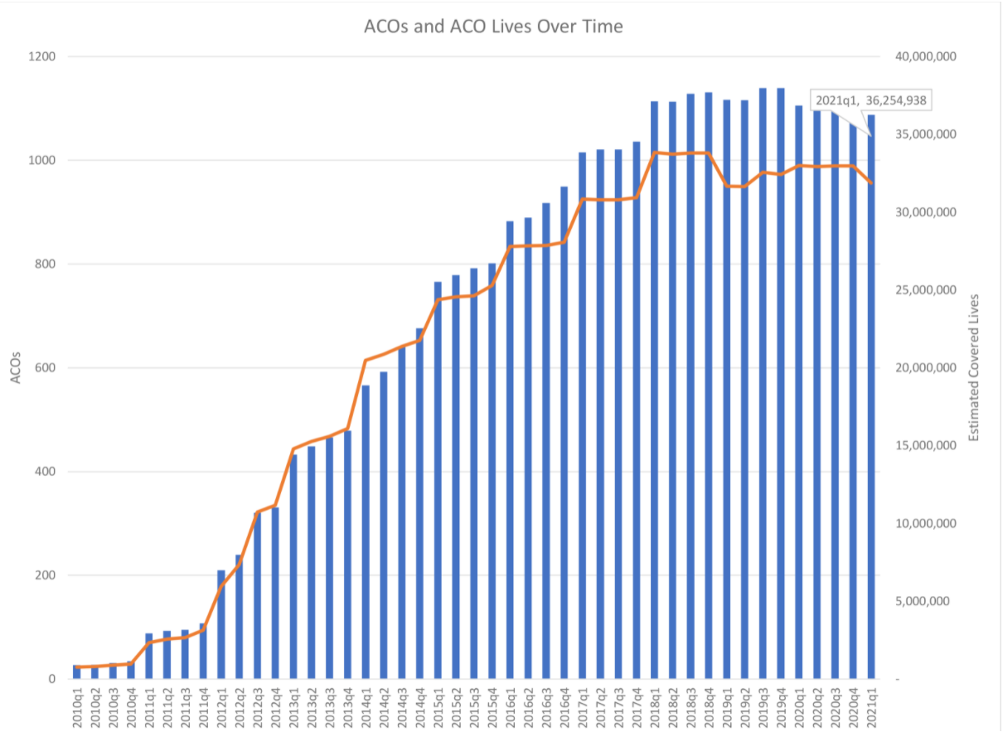
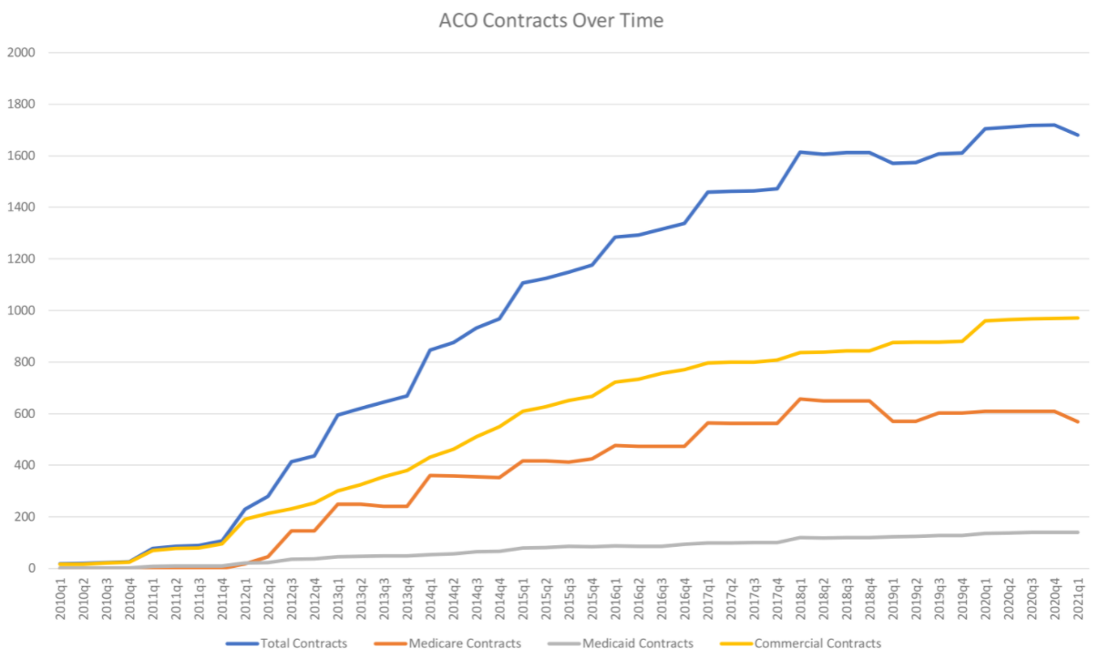
Growth in ACOs
As of 2021, ~950 ACO contracts cover 36 million people (>10% of the US population)
Commercial and Medicare contracts both significant

Slide 26
So, Are MCO’s “good” or not?
Ideally, MCOs should encourage preventive and coordinated primary care, which reduces the need for more expensive specialty/inpatient care.
But often most MCOs are concerned with short-term profitability.
Why pay for cholesterol-lowering pills when the enrollee is likely to leave your HMO years before he has a heart attack?
In general, studies show that HMOs provide medical cost savings of 15-20%, mostly through reduced hospital care.
The impact of HMOs on quality of care is less definite.
Health care providers treat patients belonging to a variety of plans.
Notes:
MCO’s were designed with the problem of moral hazard in mind, and focused in changing patient and provider incentives to reduce wasteful/unnecessary medical care. However if we think about what incentives MCO’s are facing -- Perhaps there is moral hazard involved there as well?
We have been debating the effect of MCOs on the cost and quality of medical care for some time now.

Slide 27
Sources
Tseng, Phillip, Robert S. Kaplan, Barak D. Richman, Mahek A. Shah, and Kevin A. Schulman. "Administrative costs associated with physician billing and insurance-related activities at an academic health care system." Jama 319, no. 7 (2018): 691-697.
Butler, Rachel, Mauricio Monsalve, Geb W. Thomas, Ted Herman, Alberto M. Segre, Philip M. Polgreen, and Manish Suneja. "Estimating time physicians and other health care workers spend with patients in an intensive care unit using a sensor network." The American journal of medicine 131, no. 8 (2018): 972-e9.
Himmelstein, David U., Terry Campbell, and Steffie Woolhandler. "Health care administrative costs in the United States and Canada, 2017." Annals of internal medicine 172, no. 2 (2020): 134-142.
Cutler, David M., and Dan P. Ly. "The (paper) work of medicine: understanding international medical costs." Journal of Economic Perspectives 25, no. 2 (2011): 3-25.
Shrank, William H., Teresa L. Rogstad, and Natasha Parekh. "Waste in the US health care system: estimated costs and potential for savings." Jama 322, no. 15 (2019): 1501-1509.

Slide 28
Sources
Baker, Richard, George K. Freeman, Jeannie L. Haggerty, M. John Bankart, and Keith H. Nockels. "Primary medical care continuity and patient mortality: a systematic review." British Journal of General Practice 70, no. 698 (2020): e600-e611.
Steiner, John F. "Rethinking adherence." Annals of internal medicine 157, no. 8 (2012): 580-585.
Reicher, Stephen, and John Drury. "Pandemic fatigue? How adherence to covid-19 regulations has been misrepresented and why it matters." bmj 372 (2021).

Slide 29
Final Paper
Topic:
Anything related to clinical and social issues in health care management
Length 7-12 pages, aim for 8 or 9, doubles spaced/1.5 spaced, use a normal font, just be cool ok
Requirements:
6 peer reviewed/academic sources (use pub med/google scholar, if you are unsure, just ask)
Bibliography correctly formatted, any style is fine but must be consistent
Don’t use a crappy format manager, use a good one, I recommend google scholar
At least one chart, figure, or table
Title and note also required, these should make information stand alone
Organize, use section headers
Group size: one, two, or three people per group
Meetings
Must schedule and attend an in-person or online 15 minute meeting with me to discuss, meeting schedules for week after spring break, but ad hoc early meetings are fine
At meeting, we will discuss your topic and make sure the topic is appropriate and I’ll help find some sources to get you started.

