Slide 1
HCMI 3243: Experiments in Health Insurance
BUSN 106
Shane Murphy – shane@uconn.edu

Slide 2
Experiment design: randomization
Randomized evaluations can provide clear answers
Without knowing why two groups differ, hard to know what to attribute the differences to
Can get perverse “findings” (e.g. health insurance makes you sicker)
Randomly assign individuals to different treatments (programs) or control (status quo continues)
By construction, the treatment group and the control group will have the same characteristics, on average
Observable: age, income, measured health…
Unobservable: motivation, social networks, unmeasured health…

Slide 3
Experiments in Health Insurance
RAND Health Insurance Experiment
Ran from 1971-1982
Oregon Health Study

Slide 4
Rand Health Insurance Experiment (HEI)
Research questions:
How does cost sharing affect demand for personal health care services?
How does cost sharing affect demand for particular services, e.g., hospital care, dental services?
Does use of personal health care services improve health?
How does a change from fee-for-service payment to capitation affect demand for personal health care services?

Slide 5
Study design
Enrolled 2,750 non-elderly (<=61) families, 7,700 individuals for from 3-5 years across 6 sites throughout the US
Families randomly assigned to 1 of 14 insurance plans differing in cost sharing rates and in maximum dollar expenditures per year (MDE or stop loss)
Five basic types:
Free care, 25% cost sharing, 75% cost sharing, and 95% cost sharing, HMO-style
Income adjusted for poor families
OOP capped at $1,000 ($3,000 at 2005 US$)
At enrollment, families exchanged their existing health insurance policy for HIE plan—held harmless for medical expenditure higher than they would have experienced if they had not enrolled in HIE
Some participants randomly assigned to capitation plan
Participation in HIE voluntary for families
Ran from 1971-1982

Slide 6
Results
More cost sharing -> less utilization and les cost

Slide 7
Results
Utilization rates decreased for cost sharing individuals across illness type

Slide 8
Health Outcomes
The poorest and sickest 6 percent of the sample at the start of the experiment had better outcomes under the free plan for 4 of the 30 conditions measured.
Serious symptoms were less prevalent for poorer people on the free plan.
Free care improved the control of hypertension.
Free care marginally improved vision for the poorest patients.
Free care also increased the likelihood among the poorest patients of receiving needed dental care.
Cost sharing also had some beneficial effects. Participants in cost sharing plans worried less about their health and had fewer restricted-activity days (including time spent in seeking medical care).

Slide 9
Key Result
For 94 percent of persons in HIE, not with low income and not in poor health at baseline, having health insurance coverage had no effect on health.
In a large-scale, multiyear experiment, participants who paid for a share of their health care used fewer health services than a comparison group given free care.
Cost sharing reduced the use of both highly effective and less effective services in roughly equal proportions. Cost sharing did not significantly affect the quality of care received by participants.
Cost sharing in general had no adverse effects on participant health, but there were exceptions: free care led to improvements in hypertension, dental health, vision, and selected serious symptoms. These improvements were concentrated among the sickest and poorest patients.

Slide 10
Oregon Medical Experiment
Research Question: What are the effects of expanding access to public health insurance for low income adults?
Oregon’s Medicaid expansion program covers those financially but not categorically eligible for Medicaid
Low-income (below 100% of federal poverty line), uninsured, able-bodied adults
Covers doctors, hospitals, drugs, mental health, etc. with no consumer cost sharing and low or no premiums
In 2008: Oregon had money to cover some but not all of those eligible… so chose to run a lottery for fairness
Asked interested individuals to sign up
Randomly assigned ~30,000 out of 75,000 ability to apply for Medicaid
After about 2 years, find money to offer the remainder coverage.

Slide 11
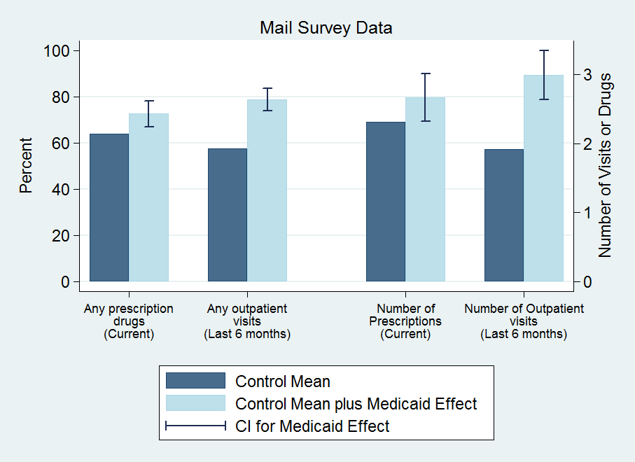
Results: Utilization

Slide 12
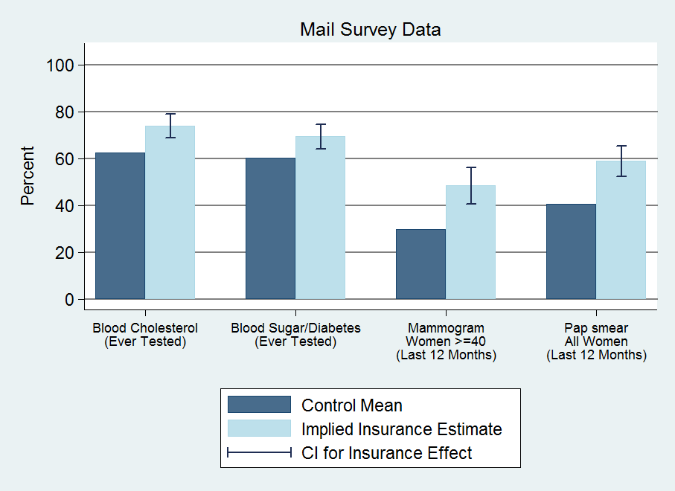
Results: Preventive Care

Slide 13
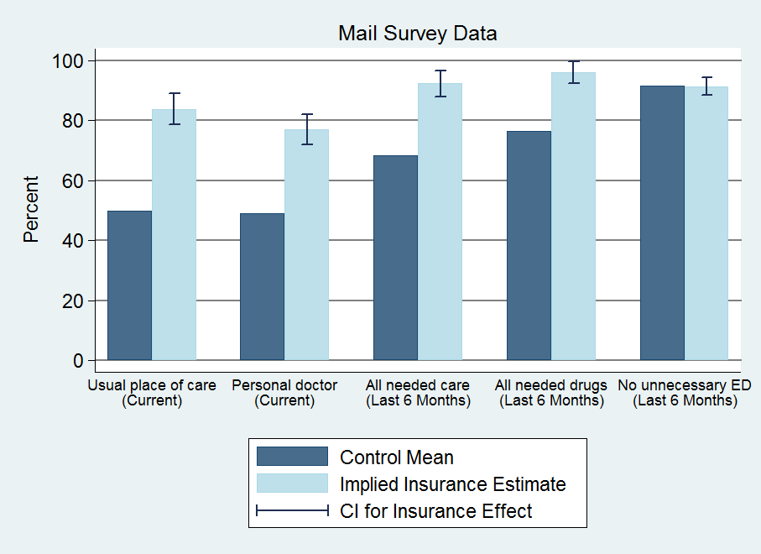
Results: Access

Slide 14
Hospitalizations (discharge data)
30%↑probability of hospital admission
40% ↑number of ER visits
Substantial (but imprecise) increase in total resource use
By condition: increase in heart disease use (not shown)
No change in mix of private/public use; no power to detect change in quality of hospitals used
Other use (self-reports)
35% ↑ probability of outpatient visit
15% ↑ probability of taking prescription drugs
0.3 standard dev ↑ in compliance with recommended preventive care
No discernable change in ER use (imprecise)
Implied $777 increase in spending for insured
25% increase

Slide 15
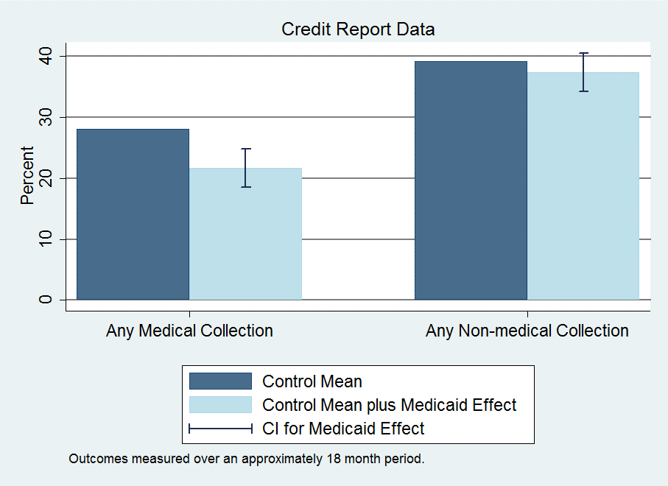
Results: Financial

Slide 16
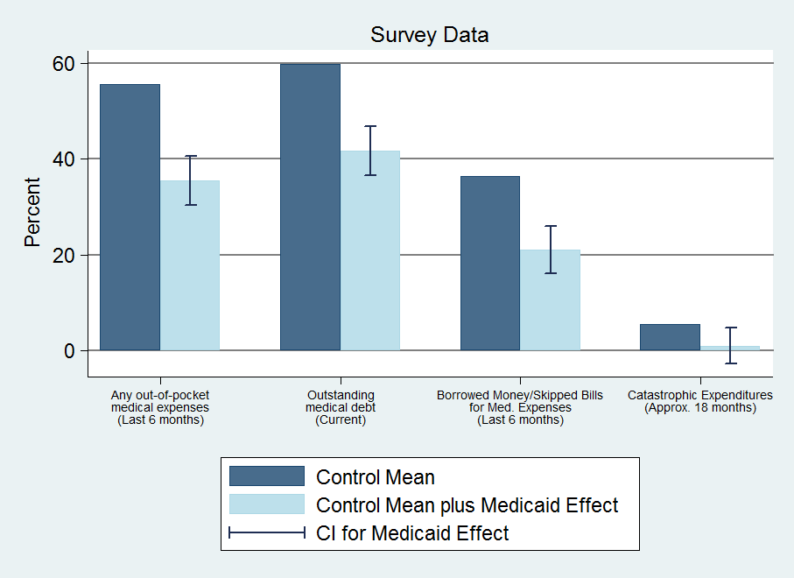
Results: Financial

Slide 17
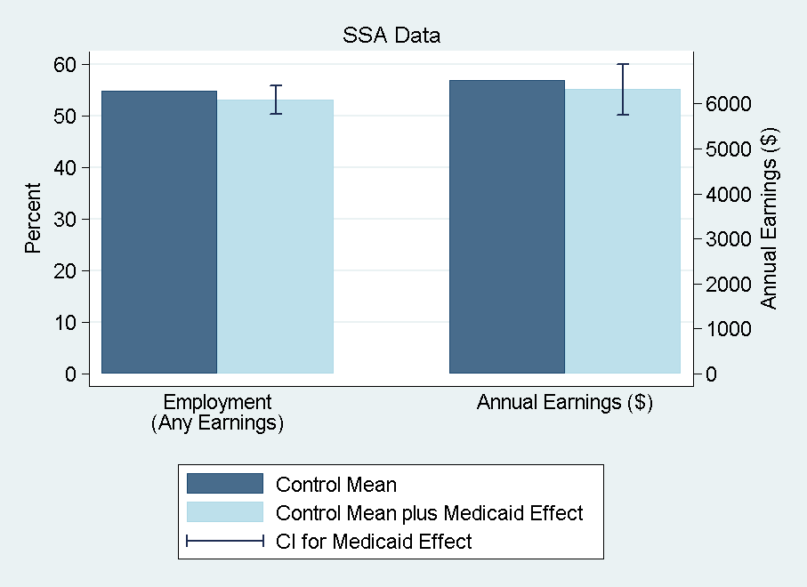
Results: Financial

Slide 18
Results: Financial
Reduction in collections (credit reports)
25% ↓ probability of unpaid medical bills sent to collection
No observed effects on other measures
Limitations: time lags, extreme events, lack of data on informal channels (more heavily used by poor)
Reduction in strain, OOP, money owed (self-reports)
Substantial reduction across measures
Captures additional channels
Implications for distribution of burden/benefits
Some borne by patients, some by providers (or those to whom passed through) – only 2% of bills sent to collection ever paid

Slide 19
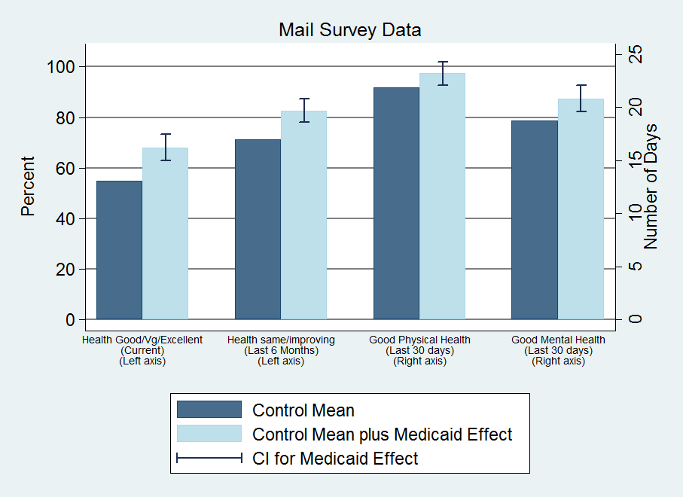
Results: Health

Slide 20
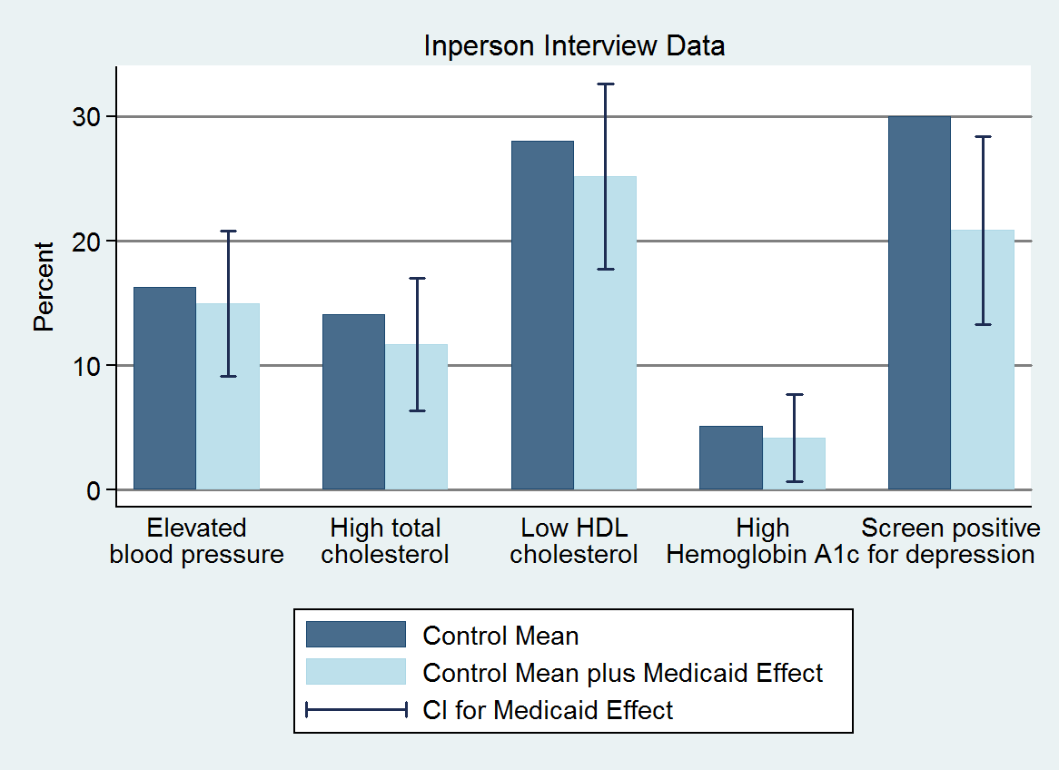
Results: Health

Slide 21
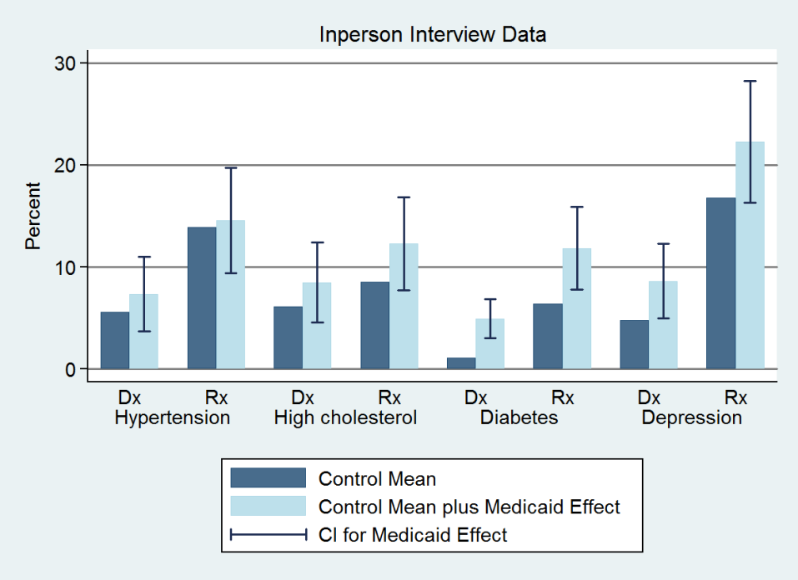
Results: Health

Slide 22
Results: Health
Health benefits from Medicaid
Improves self-reported health
Reduces depression (by ~9 pctg pts or 30%)
No detectable impact on blood pressure, cholesterol, or blood sugar
Chosen because they are important, measurable health problems in this population and have been shown in clinical trials to be modifiable with effective treatment within our time frame
Cannot reject decline in blood sugar predicted by the effect we see on diabetes medication + clinical trials of effects of such medication
Can reject declines in blood pressure found in quasi-experimental Medicaid studies

Slide 23
Large improvements in self-reported physical and mental health
Mental health indices correlate well with clinical diagnoses
Reduces depression (by ~9 pctg pts or 30%)
Physical health measures open to several interpretations
Improvements consistent with increased utilization
Also see reports of improved quality and access
Usual place of care; reported quality of care
But these results appear shortly after insurance coverage
~2/3 magnitude, in advance of changes in utilization
Although lottery selection “glow” may be stronger earlier
Suggestive of increase in perceived overall well-being
Also substantial improvements in reported happiness
Possible decline in blood sugar for individuals with diabetes
Unlikely that it had an effect on blood pressure for people with hypertension

Slide 24
Results: Summary
Increased health care use across the board
Hosp, ER, primary care, drugs, preventive care
~25% ↑ total, annual spending (hospital, outpatient, drugs)
Reduced out-of-pocket costs and financial strain
Virtually eliminated “catastrophic” out-of-pocket spending
No detectable effect on earnings and employment
Health
Improved self-reported health
Reduced depression
No/Limited detectable effects on measured physical health

Slide 25
Myth vs reality
“Insurance/Medicaid is worthless or worse than no insurance”
Not true: Increases in utilization, perceived access and quality, reductions in financial strain, and improvement in self-reported health
“Covering the uninsured will get them out of the Emergency Room”
Not true: Medicaid increases use of ER (overall and for a broad range of visit types)
“Health insurance expansion saves money”
Not true in short run: increases in health care use
In long run, remains to be seen: increases in preventive care and improvements in self-reported health

Slide 26
Power and effect size in the Oregon Healthcare experiment
The Oregon study was aimed at expanding coverage for roughly half of the 75,000 newly eligible individuals for Medicaid
But 12,229 people responded to the surveys and were analyzed, about half in treatment and control
And most of the treatment group (all of whom were offered Medicaid in the experiment) didn’t even sign up for Medicaid
So the treatment group actually was about 1,500 people!!!!
The majority of whom did not have any given chronic condition
There are claims that the Oregon Healthcare experiment was too small and therefore was underpowered
The power of an experiment expresses whether an experiment has enough subjects to estimate with statistical significance an effect size of interest to the researchers

Slide 27
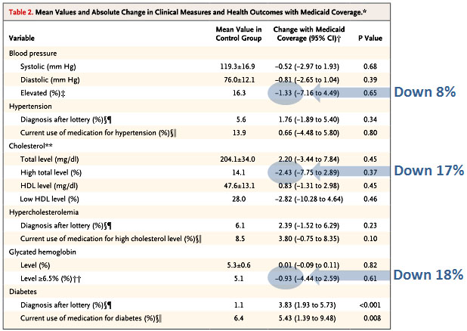
Total health effect sizes estimated by the Oregon Experiement
Notes:
https://www.motherjones.com/kevin-drum/2013/05/what-we-know-oregon-medicaid-study/

Slide 28
Power and effect size in the Oregon Healthcare experiment
5.1% of the control group had elevated glycated hemoglobin levels (common marker for diabetes)
5.1% of 1,500 is roughly 80 people
Assume the treatment group has the same numbers.
The reduction in people with elevated GH was roughly 20%, about 16 people.
Any experiment on a treatment group of 80 people that shows success in 16 (and no success in the other 64 or in the 80 people in the control group) is underpowered
The power of an experiment expresses whether an experiment has enough subjects to estimate with statistical significance an effect size of interest to the researchers
But a 20% reduction in the number of people with elevated GH would be a great success!!
Notes:
https://www.motherjones.com/kevin-drum/2013/05/what-we-know-oregon-medicaid-study/

Slide 29
Power and effect size in the Oregon Healthcare experiment
Before randomization, there were 2225 people with hypertension. If we assume that half got randomized to each arm, and then take the 24.1 percentage point increase in coverage the study reports, that means there were only 280 people with hypertension who got Medicaid, and who could be studied for this outcome. Further, those people had a baseline average blood pressure of 130/83. That’s remarkably well controlled! So there’s not nearly the room for improvement that you might assume.
Before randomization, there were 872 patients with diabetes. Half to each group, and then the 24.1% who actually got new Medicaid, and you’ve got about 110 patients with diabetes in the Medicaid group. And again, their average baseline A1c was 6.7%, which is pretty well controlled. How much could the Medicaid do? With respect to the percentage of patients with a A1C>=6.5, there appears to be so much imprecision in the measurement that it’s in the 95% confidence interval that they got every single person in Medicaid with diabetes under control: the baseline percentage of A1C>=6.5 was 54.0, and the reduction in the Medicaid group was -27.0 (95% CI -71.91 to 17.92).
Notes:
https://theincidentaleconomist.com/wordpress/oregon-medicaid-power-problems-are-important/

Slide 30
Average health outcomes and the Oregon Experiment
“Average blood pressure was a bizarre thing to measure. You have to remember that most people who get health insurance are healthy. They’re not going to get “healthier”. The average blood pressure in the control group was 119/76. That’s normal! You would only expect that it might improve in those with a high blood pressure. So I might have looked for an effect in those patients with hypertension. 16.3% of people in the control group had a systolic over 140 or a diastolic over 90. In the Medicaid group, that dropped to 15%. If they wanted to look at average pressures, why didn’t they single out the hypertensive people?”
Notes:
https://theincidentaleconomist.com/wordpress/additional-thoughts-on-the-new-oregon-medicaid-results/

Slide 31
Readings:
Brook, Robert H., Emmett B. Keeler, Kathleen N. Lohr, Joseph P. Newhouse, John E. Ware, William H. Rogers, A. Ross Davies et al. "The health insurance experiment: A classic RAND study speaks to the current health care reform debate." Santa Monica. RAND Corporation (2006). (https://www.rand.org/content/dam/rand/pubs/research_briefs/2006/RAND_RB9174.pdf)
“The Oregon Health Insurance Experiment, " Health Affairs Health Policy Brief, July 16, 2015. (https://www.healthaffairs.org/do/10.1377/hpb20150716.236899/full/)

Slide 32
HCMI 3243: Medicare and Medicaid
BUSN 106
Shane Murphy – shane@uconn.edu

Slide 33
LBJ and the Great Society
Civil Rights
Civil Rights Act of 1964 outlawed discrimination based on race, color, religion, sex, or national origin
Voting Rights Act of 1965
Section 5 largely struck down by Shelby County v. Holder (2013)
War on Poverty
1964 creation of the Office of Economic Opportunity
Job corps and work training programs
Head Start
1965 Elementary and Secondary Education Act
Housing and Urban Development Act of 1965
National Endowment for the Humanities and the National Endowment for the Arts
1965 National Foundation on the Arts and Humanities Act
Environmental legislation
Pro-immigration legislation
https://youtu.be/nXVAOcs5oVA?t=24

Slide 34
1965: Social Security Amendments of 1965 (Medicare and Medicaid)
Major issue in 1962 Kennedy Campaign (Kennedy was assassinated in 1963)
Johnson strongly supported legislation
Initial proposal failed in 1964
Supported by the AFL-CIO, both parties

Slide 35
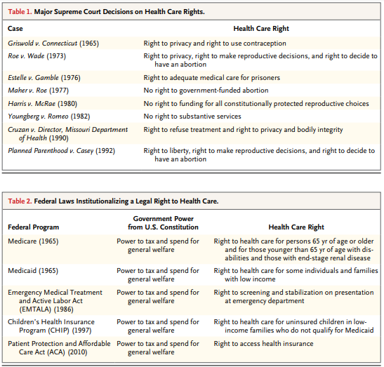
Federal Laws
Expanding public role in healthcare since the 1960s

Slide 36
Hillarycare: the Health Security Act of 1993
Universal coverage
Most people would get insurance plans from their employers because all employers were required to provide health insurance coverage to every employee.
People without jobs could purchase health insurance on their own from the regional health alliances.
The Federal government would subsidize the costs for low-income people.

Slide 37
Hillarycare: the Health Security Act of 1993
Regional health alliances
Regional Health Alliances were state-based health insurance purchasing groups.
The alliances would control costs by setting the prices for health care providers based on a fee-per-service.
Companies with more than 5,000 full-time employees could provide their own insurance outside the alliances.

Slide 38
Hillarycare: the Health Security Act of 1993
National health board
The National Health Board was a new federal agency.\It set a cap on total health care spending for the nation.
That meant it regulated health insurance premiums. For individuals, it set limits on maximum annual out-of-pocket costs.
It also determined minimum coverage requirements.

Slide 39
Comparing Hillarycare and Obamacare
Feature | Hillarycare | Obamacare
Universal coverage | All employers | Most employers
Pre-existing conditions covered | Yes | Yes
Non-employer coverage | Regional health alliances | Health insurance exchanges
Reliance on insurance | Yes | Yes
Universal mandate | Yes | Yes
Required coverage | Yes | 10 essential health benefits
Low-income subsidies | Provided by federal government | Expanded Medicaid
Tax on high-end insurance | Income tax | Cadillac tax on businesses
Focus on Preventive Care | Yes | Yes
Funded by | Deficit spending | Obamacare taxes
Doctors paid on | Fee-for-service | Patient wellness
Medicare | "Doughnut hole" did not exist | Eliminate "doughnut hole"

Slide 40
Defeat
Association of American Physicians and Surgeons opposition
Doctors opposed losing control over pricing, care and treatment
Congressional concern over the deficit
1990-1991 Recession was over and workers felt confident about future employer-based insurance prospects
Labor unions didn’t support the initiative.
They were angry at the President for signing NAFTA.

Slide 41
HIPAA: Health Insurance Portability and Accountability Act of 1996
Title I of HIPAA protects health insurance coverage for workers and their families when they change or lose their jobs.
Title II of HIPAA, known as the Administrative Simplification (AS) provisions, requires the establishment of national standards for electronic health care transactions and national identifiers for providers, health insurance plans, and employers.
Title III sets guidelines for pre-tax medical spending accounts.
Title IV sets guidelines for group health plans.
Title V governs company-owned life insurance policies.

Slide 42
1990s Medicaid expansion
After failing to get extensive health care reform passed, the Clinton administration promoted more insurance regulation (HIPAA 1996) and worked with states to expand Medicaid under existing law
Ex. Oregon expanded to all individuals under FPL
Tennessee expanded to all families under 400% FPL
This increased interest in cutting Medicaid by fiscal conservatives
SCHIP/CHIP - State Children’s Health Insurance Program of 1997
Provide insurance to children in families earning up to 200% of FPL (with more generosity allowed)

Slide 43
2006 Massachusetts Health Care Reform Plan
Heritage Foundation (right leaning think tank) designed plan
State exchange
Employer and individual mandate
Fully subsidized coverage for individuals up to 150% FPL

Slide 44
Path to the ACA
Presidential Primaries
John Edwards first candidate to make proposal
Medicare-based public option supported by activist/academic Jacob Hacker
Clinton and Obama followed suit
Exchanges with public option
Kucinich was only candidate supporting Universal Coverage plan (M4A-like)
Edwards and Clinton supported a mandate
Republican Proposals – tax incentives for individual marketplace and deregulation
Healthy Americans Act (2007 and 2009)
Mandate plus end of pre-tax status of employer based plans
Joe Lieberman (I-CT)
Senator from 1989-2013
Killed the public option
Effects of the public option:
Accountability, cost, market
National vs federated pool
Notes:
https://www.pbs.org/wgbh/frontline/film/obamasdeal/
https://www.youtube.com/watch?v=w_Q_x3BaY6U&t=41s

Slide 45
Edward Kennedy and Conference Committees
Kennedy died August 25, 2009
Replaced by conservative Scott Brown in election in January and was seated in February
Senate passed the bill in November 2009 with Kennedy’s seat still vacant
If the house bill was not identical to the Senate bill, there would have needed to be a conference committee
Pelosi and the house managed to pass an identical bill in December
Avoiding conference led to a more liberal bill than otherwise may have existed
For instance the Independent Payment Advisory Board would likely have been cut

Slide 46
Major provisions of the ACA
Individual mandate
Fines on employers
Standard benefits package
Bans on denying medical coverage for preexisting conditions
Establishes state-based exchanges/purchasing groups
Offers subsidies for low-income people to buy insurance
Improves efficiency of health care system
Equalizes tax treatment for insurance of self-employed
Reduces growth in Medicare spending
Controls high-cost health plans Yes (taxes plans over $8,500 for single coverage, $23,000 for family plan)
Prohibits insurance company from canceling coverage
Prohibits insurers from setting lifetime spending caps
Expands Medicaid
Extends coverage to dependents (up to age 26)
Notes:
https://www.youtube.com/watch?v=KoTOzNRw8bg

Slide 47
Note about the IPAB
Question of cost control fundamental to health insurance
Moral Hazard
Limits on high cost care
Effectiveness and cost-effectiveness
Rationing and regulation
IPAB called death panels (importantly by Republican VP candidate Palin)
Different from crisis standard of care
https://www.youtube.com/watch?v=MQsaAuwYAfE

Slide 48
ACA, March 23, 2010
900 pages and 10 titles
Clarity v vagueness:
Clarity: “Title 1: Quality Affordable Health Care for All Americans”
Vagueness: 150 times “the secretary shall” and 50 times “the secretary may”
Empowering bureaucracy and rule-making
Shared federal and state responsibility
State: insurance exchanges, premium stabilization, consumer protections…

Slide 49
Center for Medicare and Medicaid Innovation (CMMI), 2010
Tasked with designing, implementing, and testing new health care payment models to address growing concerns about rising costs, quality of care, and inefficient spending
Medicare, Medicaid, and the Children’s Health Insurance Program (CHIP)
Organizes accountable care organizations (ACOs), bundled payment models, and medical homes models
Two CMMI models have met the statutory criteria to be eligible for expansion by reducing program spending while preserving or enhancing quality.
Diabetes Prevention Program model and the Pioneer ACO model.

Slide 50
National Federation of Independent Business v. Sebelius (2012)
Consolidated suits by the NFIB and by the State of Florida
Other suits by the state of Virginia, Liberty University (Liberty University v. Geithner), a group of people with religious objections in DC (Mead V. Holder), a law group in Michigan (Thomas More Law Center v. Obama), and Seven-Sky v. Holder (as CoA judge, Kavanaugh dissented – see http://www.scotusblog.com/2018/07/kavanaugh-on-the-affordable-care-act-seven-sky-v-holder/)
Kathleen Sebelius
Secretary of Health and Human Services (2009-2014)

Slide 51
National Federation of Independent Business v. Sebelius (2012)
Constitutional:
Anti-Injunction Act – individuals can’t sue to avoid paying taxes
Court found that since the act is a penalty and not a tax, suits were allowed
Congress taxing power
The individual mandate was a valid exercise of taxing power
Medicaid Expansion
Roberts, Breyer, and Kagan felt states should be allowed to opt out
Scalia, Kennedy, Thomas, and Alito felt Medicaid expansion (and the entire ACA) was unconstitutional
Ginsburg and Sotomayor dissented, would have upheld Medicaid expansion in all states
Commerce Clause and the Necessary and Proper Clause
“As for the Medicaid expansion, that portion of the Affordable Care Act violates the Constitution by threatening existing Medicaid funding. Congress has no authority to order the States to regulate according to its instructions. Congress may offer the States grants and require the States to comply with accompanying conditions, but the States must have a genuine choice whether to accept the offer.” – John Roberts

Slide 52
NFIB v Sibelius, 2012
John Roberts Biography: The Chief by Joan Biskupic
https://youtu.be/ESse04SnSU0?t=2038
Notes:
historic three days of oral arguments back in March of 2012 over President Obama's major domestic achievement this this law the Affordable Care Act that was signed in March of 2010 so they they have these arguments they go into their private conference and the initial vote led by the chief is five to four to strike down what we've all called the individual mandate and that was the requirement that everyone buy health insurance so that the the health insurance structure is supported by people who are healthy not just people who are ill you know it's the the idea that this cost should be borne by everyone and the the law established the new marketplaces and had many many other provisions another provision was the Medicaid expansion for people near the poverty line so there are two major planks of this thing and they vote 5-2 for that Congress lacked the power under its Commerce Clause power to to demand this individual insurance requirement and that's where everybody was paying attention all the attention at the time was on and there were the five conservatives led by the chief voted to strike it down and the four liberals said no but meanwhile they also took a vote on the Medicaid expansion and they voted to uphold it and the chief was with them to uphold it they don't vote in any way on this taxing power issue which again becomes relative becomes relevant in the very end because that's what the chief hangs on the question coming out of the conference conference as they call their private sessions is what's going to fall with the individual mandate because all these different parts were intertwined and Justice Kennedy who's normally in the middle on these things was adamant that the whole law had to fall this major you know nearly a thousand page law that had all sorts of other provisions that were popular with people would have to would have to be overturned because of how intertwined it was and Congress had not written in any kind of so-called severability clause and the Chief Justice starts having second thoughts about that the consequences of that and you remember this was an election year there's so much pressure on the court and there's a presumption among some commentators that the Republican controlled Supreme Court is going to invalidate the signature domestic achievement of President Barack Obama and the chief the chief is trying to figure out a middle ground on this and he's not getting any cooperation or assistance or you know help it all from Anthony Kennedy who he usually deals with who he was usually dealing with any kind of compromise meanwhile over to the far right our justices Alito Scalia and Clarence Thomas and they're they're not going to play they're not in play at all on the far left Justice Ginsburg and justice Sotomayor are not going to be in play either and they they are traditionally the ones who are always over to the far left and not working with the chief that much but justices Kagan and Breyer on the left but open to trying to take down the temperature try to find some compromise with the chief begin to work with him after he decides that he can find legitimate grounds for the individual mandate to be upheld on taxing power and what makes the conservative so angry is first of all even though the taxing power was completely briefed by the Obama administration it was even subject to arguments it was never voted on in conference they they never took an up or down vote on that so they were they felt you know in Scalia's word that it was you know fly-by-night briefing that was just was not a fair fair thing to suddenly turn to and the the liberal justices our want want this to unfold this way but they're also worried that the chief is going to you know possibly shift back again because you know they're they're feeling their original feeling coming out of that conference was complete de moron demoralisation because they're thinking it's gonna be five to four this big law is gonna go down and there's nothing we can do about it but all of a sudden the Chiefs show some flexibility but at the same time that he decides to find grounds to pull the mandate he decides that the Medicaid expansion should be killed and this is again and what didn't get a lot of attention at the time but this was really important for millions of Americans near the poverty line but the problem with it as the chief then decided was that the way Congress had written the expansion law it was it was essentially coercing the states into doing this program Medicaid is almost entirely funded by the federal government but it with that comes a lot of strings and the federal government was Congress said in the Medicaid expansion if you're if you don't expand the clientele the reach of the Medicaid all of your Medicaid funding is going to disappear and as the chief ends up writing this was essentially like holding a gun to the head of the state's the justices Breyer and Kagan decide to change their votes and go with the chief on that to show a certain amount of cooperation and feeling that the chief himself was making this big compromise that was going to get lots of criticism among his conservative brethren which it did so as a show of cooperation and sort of moving toward him that's why they changed their votes but they also figured that this was essentially free money for the state's weren't all the states going to adopt the expansion but lo and behold so many Republican governors did not want anything to do with the Obama expansion there and said no it that that has changed over the years but that turned out to be a bit of a surprise to the justices I'm left ok so I'm gonna make a strong statement just for the sake of it I'd like your reaction yeah John Roberts gets huge credit for this decision yes his hero is John Marshall Chief Justice John Marshall who he admires for committing acts of judicial jujitsu engaging in judicial statesmanship avoiding battles in the short term in order to shore up the courts power in the long term and by visibly struggling with the most polarized question of his age by pulling the court back from the point of really narrowing federal power in the most significant way since the New Deal he preserved the courts bipartisan legitimacy and proved that he meant when he said when he cared said that he would put legitimacy above politics discuss that's right no I think he should he people come up to him still and thank him and that decision has again you know going with that part of the decision that decision has really held in people's minds to define John Roberts as a moderate it's a one-of-a-kind decision but it was a hugely important decision and Charles freed a Reagan Solicitor General who succeeded Rex Lee who was seen as much more ideological actually gives him credit to says look it wasn't pretty the the ruling was shot through with uh with all sorts of problems people could rightly complain about the taxing rationale because it wasn't consistent with other parts of the ruling but it it got the job done it got the job done so I would say that yes this was an important ruling that he did and that the the grief he has gotten and continues to get from conservatives and and got at the time from then businessman Donald Trump and continues to get from President Donald Trump probably for the country was worth it but inside the way he went about it I think it still puzzles and confuses his colleagues but your point is well-taken for the country it's it made a big difference in people's lives and it still does and and the the Affordable Care Act is coming back to the court and I cannot imagine that John Roberts would now suddenly want to do what a judge down in Texas did invalidates the whole thing all over again

Slide 53
Employer mandate delays, 2013-2016
Play or Pay
Obama decision to delay mandate until 2016
Attempted further delays
Authority for Mandate Delay Act of 2013
Save American Workers Act of 2013, 2014, 2015, 2017, 2018
Additional compliance mandates delayed since 2014

Slide 54
Cadillac Tax delays
designed to disincentivize high-cost employer-sponsored coverage
Would have created a 40 percent excise tax on employer plans that exceed an estimated $10,800 in annual premiums for individuals and $29,050 for families
Protecting Americans from Tax Hikes (PATH) Act of 2015 delayed implementation from 2018 to 2020.
Also made tax deductible
Further postponed to 2022 by The Tax Cut and Jobs Act of 2018

Slide 55
Burwell v. Hobby Lobby Stores, Inc. 2014
Allowing closely held for-profit corporations to be exempt from a regulation its owners religiously object to, if there is a less restrictive means of furthering the law's interest, according to the provisions of the Religious Freedom Restoration Act (RFRA) of 1993
Struck down the contraceptive mandate in the ACA
May have broader implications for RFRA applications
Definition of “closely held” has possible liability implications

Slide 56
Trump (2017-2020) policy overview
1 – Frequent overt criticism of ACA
2 – Enforcement of letter of law
Example: Refusal to let Idaho authorize plans in violation
3 – Improving parts of the law
Example: Political appointees not interfering with CMS civil services
4 – Prioritize individual options
Example: Supported short-term plans
5 – Undermined law where possible
Example: Terminating cost-sharing payments

Slide 57
Trump inauguration day executive order, 2017
"It is the policy of my Administration to seek the prompt repeal“
"exercise all authority and discretion available to them to waive, defer, grant exemptions from, or delay“
"minimizing the economic burden [of Obamacare] pending repeal”

Slide 58
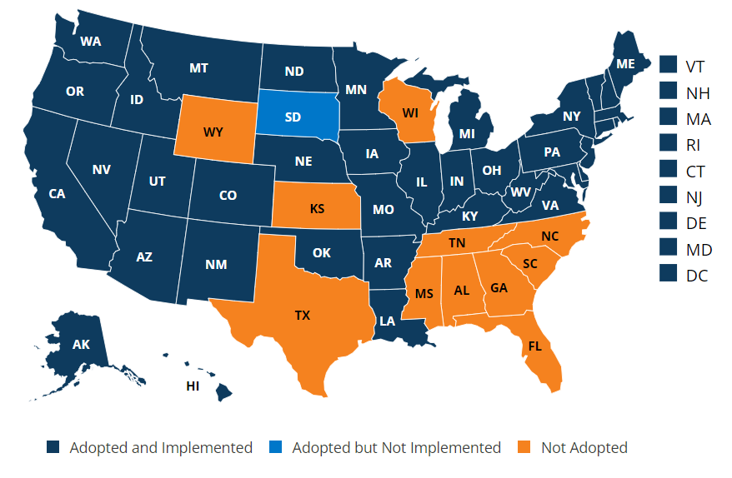
Medicaid Expansion
In all states: You can qualify for Medicaid based on income, household size, disability, family status, and other factors. Eligibility rules differ between states.
In states that have expanded Medicaid coverage: You can qualify based on your income alone. If your household income is below 133% of the federal poverty level, you qualify. (Because of the way this is calculated, it turns out to be 138% of the federal poverty level. A few states use a different income limit.)

Slide 59
Tax Cuts and Jobs Act of 2017
Zeroed the penalty of the individual mandate – left all other provisions in place
Massachusetts has had it own health coverage mandate since 2006
New Jersey passed a state-wide mandate that took effect in 2019
Vermont passed a health coverage mandate that will take effect in 2020

Slide 60
Biden Marketplace expansion
American Rescue Plan Act of 2021
Marketplace subsidy expansion
Medicaid private option
Increased subsidy
More people eligible for subsidy
Expire at end of 2022
Medicaid expansion covers up to 138% FPL
Non-Medicaid expansion state residents now eligible for subsidized marketplace insurance coverage
No subsidy cliff at 400% FPL
Table 1: Percent of Income Paid for Marketplace Benchmark Silver Premium, by Income
Income (% of poverty) | Affordable Care Act (before legislative change) | COVID-19 Relief (current law 2021-2022)
Under 100% | Not eligible for subsidies* | Not eligible for subsidies**
100% – 138% | 2.07% | 0.0%
138% – 150% | 3.10% – 4.14% | 0.0%
150% – 200% | 4.14% – 6.52% | 0.0% – 2.0%
200% – 250% | 6.52% – 8.33% | 2.0% – 4.0%
250% – 300% | 8.33% – 9.83% | 4.0% – 6.0%
300% – 400% | 9.83% | 6.0% – 8.5%
Over 400% | Not eligible for subsidies | 8.5%
NOTES: *Lawfully present immigrants whose household incomes are below 100% FPL and are not otherwise eligible for Medicaid are eligible for tax subsidies through the Marketplace if they meet all other eligibility requirements. **In the COVID-19 relief law, lawfully present immigrants in states that have not expanded Medicaid would continue to be eligible for marketplace subsidies. In addition, people receiving Unemployment Insurance (UI) are treated as though their income is no more than 133% of poverty for the purposes of the premium tax credit. This could extend premium tax credits to some individuals with incomes below poverty. SOURCE: KFF

Slide 61
Medicare Solvency Timeline
Recessions reduce payroll tax revenue: Nov 1973–Mar 1975 Oil Crisis, Jan 1980–July 1980 double dip, July 1981–Nov 1982 Iran revolution, July 1990–Mar 1991 ending Bush’s presidency, Mar 2001–Nov 2001 dot-com bubble, Dec 2007–June 2009 great recession, Feb 2020–June 2020 Covid recession
The Tax Equity and Fiscal Responsibility Act of 1982: The prospective payment system required Medicare to pay for most inpatient care using diagnosis-related groups. This significantly reduced federal outlays, quickly leading to an increase in the life span of the trust fund, which remained relatively stable through the end of the 1980s.
Balanced Budget Act of 1997: various measures including reductions in the growth of payments to providers, expansion of prospective payments to post acute care facilities, and increased cost sharing for beneficiaries.
Reduced revenues from the dot-com bubble triggered the Sustainable Growth Rate (SGR) provisions of the 1997 Balanced Budget Act, requiring a significant cut in Medicare payments. These cuts were canceled by legislation, leading to continued reduction in Trust Fund balance.
Expected revenue generators such as the “Cadillac Tax,” medical device tax, and other parts of the ACA did not end up becoming reality. A year after the ACA went into effect, a fiscal crisis led to the Budget Control Act of 2011, which cut Medicare payments by 2 percent.
The Medicare Access and CHIP Reauthorization Act of 2015 permanently repealed the SGR and provided temporary increases in payments for a variety of providers, including ambulance services and home health services in rural areas. The effect has been a depletion of the trust fund at faster than expected rates. Over the past five years, the expected year of exhaustion shortened from 2030 to 2026.

Slide 62
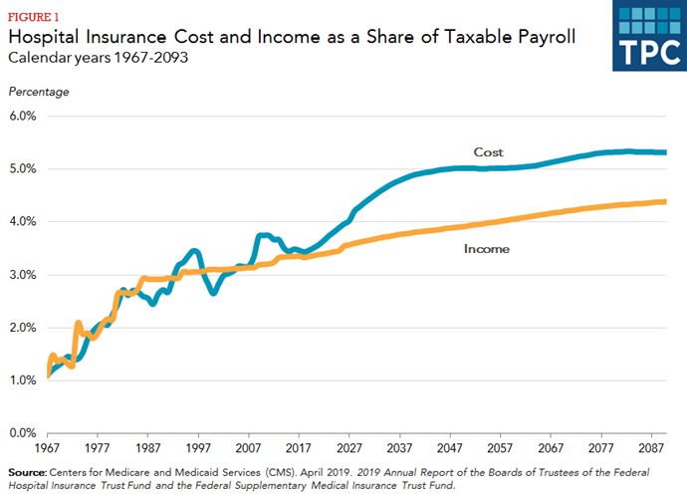
Medicare solvency

Slide 63
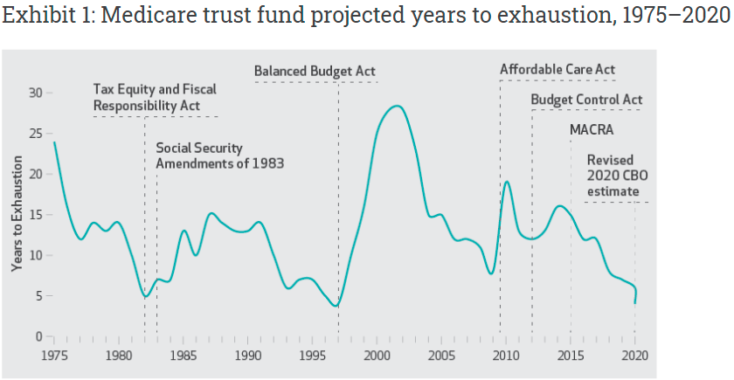
Never the first time, not the last(?)

Slide 64
Future
Current Law if Fund runs out
Payments may be delayed
Or reduced
New legislation likely
Revenue enhancing
Cost cutting
Radical changes
Medicare buy-in with ACA subsidies
Push generics
Increase payroll tax
Cost cutting legislation
Policy Option | Potential Savings
Expand Bundled Payments and Promote New Payment Models | $5 to $50 billion
Reduce Preventable Readmissions and Unnecessary Complications | Up to $10 billion
Reduce Payments to Post-Acute Providers | $25 to $50 billion
Reform and Reduce Payments for Graduate Medical Education | $15 to $40 billion
Reduce Medicare's Coverage of Bad Debts | $15 to $50 billion
Expand Medicare and Medicaid Drug Rebates | $50 to $150 billion
Reduce the Price and Use of High-Cost Drugs | Up to $30 billion
Adopt Competitive Bidding for Medicare Advantage | $25 to $75 billion
Limit Medicare Cost-Sharing Rules | Up to $20 billion
Restrict Supplemental Coverage | $50 to $125 billion
Limit Medical Malpractice Claims | $50 to $70 billion

Slide 65
Real world estimates of the effect of public insurance

Slide 66
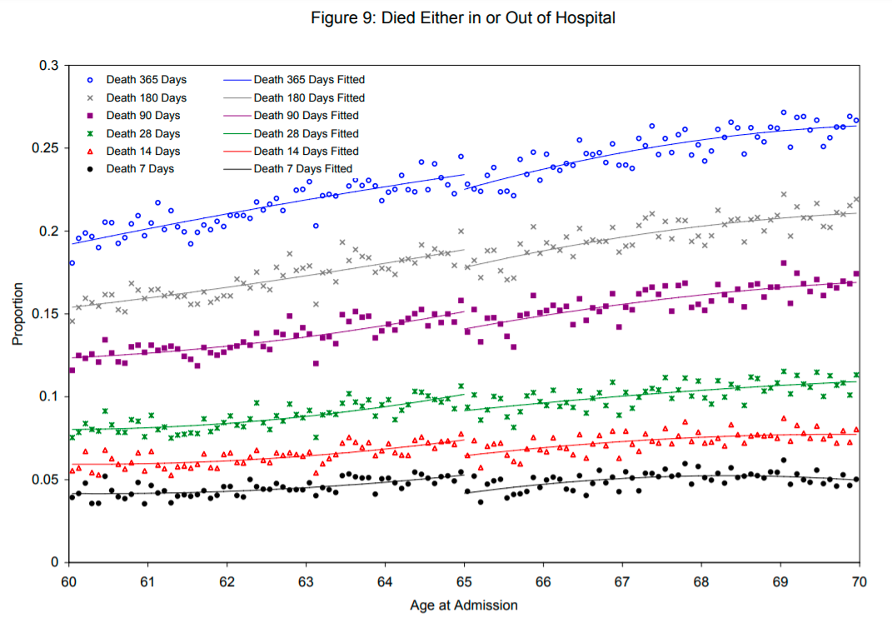
Medicare saves lives
We estimate a nearly 1 percentage point drop in 7-day mortality for patients at age 65, implying that Medicare eligibility reduces the death rate of this severely ill patient group by 20 percent. The mortality gap persists for at least two years following the initial hospital admission.

Slide 67
Effects of the ACA
There has been a lot of research on the health and coverage outcomes of the Affordable Care Act
KFF summary for Medicaid expansion (Antonisse as lead author) - https://www.kff.org/medicaid/report/the-effects-of-medicaid-expansion-under-the-aca-updated-findings-from-a-literature-review/
Mazurenko, Olena, Casey P. Balio, Rajender Agarwal, Aaron E. Carroll, and Nir Menachemi. "The effects of Medicaid expansion under the ACA: a systematic review." Health Affairs 37, no. 6 (2018): 944-950.
Courtemanche, Charles, James Marton, Benjamin Ukert, Aaron Yelowitz, Daniela Zapata, and Ishtiaque Fazlul. "The three‐year impact of the Affordable Care Act on disparities in insurance coverage." Health services research 54 (2019): 307-316.
Soni, Aparna, Laura R. Wherry, and Kosali I. Simon. "How Have ACA Insurance Expansions Affected Health Outcomes? Findings From The Literature: A literature review of the Affordable Care Act's effects on health outcomes for non-elderly adults." Health Affairs 39, no. 3 (2020): 371-378.
Courtemanche, Charles, James Marton, Benjamin Ukert, Aaron Yelowitz, and Daniela Zapata. "Early effects of the Affordable Care Act on health care access, risky health behaviors, and self‐assessed health." Southern Economic Journal 84, no. 3 (2018): 660-691.
…

Slide 68
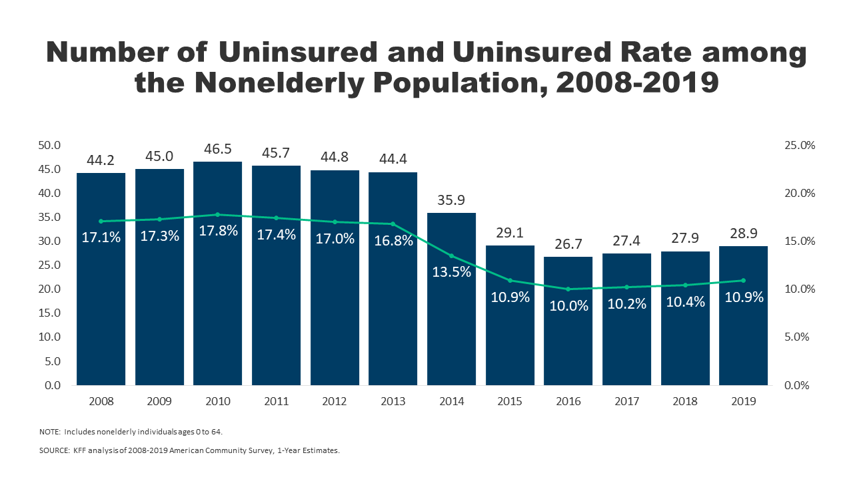
Effects on health and coverage
Largest effect on coverage was due to Medicaid expansion, not the exchanges
Largest effect on health comes from self-perceived health, mental health, financial stability
These three factors are all closely interrelated
Benefits of wellness visits are difficult to measure
Health benefits for chronic conditions require large samples sizes, studies are hard to perform

Slide 69
Coverage: Medicaid expansion
All US citizens and legal residents with income up to 138% FPL qualify for coverage in participating states
Led to large growth in enrollment in participating states, smaller growth in non-participating states
Reduction in uninsured rates, especially among low-income individuals
Partial Woodwork effect/welcome mat effect
Growth among individuals who were previously eligible

Slide 70
Coverage: Medicaid expansion: subgroups
Coverage gains in expansion versus non-expansion states for specific vulnerable populations:
young adults, prescription drug users, people with HIV, veterans, parents, mothers, women of reproductive age (with and without children), children, lesbian, gay, and bisexual adults, newly diagnosed cancer patients, women diagnosed with a gynecologic malignancy, low-income workers, low-educated adults, early retirees, and childless adults with incomes under 100% FPL
Disproportionately positive impact in rural areas in expansion states
Gains can be found across racial/ethnic categories
Reduced disparities by income and age
Possibly reducing disparities by race/ethnicity

Slide 71
Coverage: Medicaid expansion: Alternative approaches
Section 1115 gave states the option of expanding Medicaid in alternative ways
These states (especially Arkansas, Michigan, and Indiana) have shown similar gains in coverage rates
Indiana instituted monthly contributions which have created enrollment and continuing coverage issues

Slide 72
Coverage: Medicaid expansion: criticism
Crowding out of private insurance
Mixed results, although there has been some decline in private coverage in participating states

Slide 73
Access, Utilization
Many studies find improvements in access to care
Increases in cancer diagnosis rates (especially early stage)
Earlier presentation for common surgical conditions – lowering complications
Increase listing for heart transplants among African Americans
Increased access for treatment of behavioral and mental health conditions
Increase in prescriptions for opioid use disorder and overdose
Increase in prescriptions for smoking cessation drugs

Slide 74
Access, Utilization
Many studies find improvements in access to care
Reduction in disparities by race, income, education, and employment status in access and affordability
Increased rates of optimal care for patients with common surgical conditions
Improved quality of care for common community health care treated conditions:
Asthma, Pap testing, BMI assessment, hypertension control
Declines in uninsured ED visits, but mixed evidence and no significant change in total ED volume
Reduced LOS for Medicaid patients
Improvements in care and quality in areas with primary care shortages

Slide 75
Access, Utilization: Criticism
Confusion in non-waiver states
Failures to follow up with new patients
Longer wait times

Slide 76
Affordability and Financial Security
Possible reduced patients with unmet medical need because of cost
Reduction in OOP
Average reduction in 2014 of about $205
Greater reductions among Medicaid expansion covered individuals than subsidized marketplace coverage individuals
Declines in unpaid bills and financial stress over future bills
In Ohio, percentage of expansion enrollees with medical debt fell by nearly half since enrolling in Medicaid (55.8% had debt prior to enrollment, 30.8% had debt at the time of the study)

Slide 77
Health Outcomes
Possible improvements in self-reported health
Improved outcomes for cardiac patients
Infant Mortality Rate Reductions for expansion states between 2014 and 2016, a period where the rate rose slightly for non-expansion states
Effect largest among African Americans
Limited of no effect on drug overdoses or alcohol poisonings

Slide 78
Economic effects
Federal matching for expansion population provided large spending savings for expansion states
No significant increase in state spending on Medicaid, including savings in some states
Possible reduction in overall spending due to spillovers
State costs related to behavioral health services, crime and the criminal justice system, and Supplemental Security Income program costs.
Lower Medicaid spending per enrollee
New enrollees generally less expensive than existing enrollees
First year of enrollment generally more expensive than subsequent years
Medicaid expansion lowers marketplace premiums
Marketplace enrollees younger and healthier in expansion states

Slide 79
Impacts on providers
Reduction in uninsured visits and uncompensated care costs
Decline in uninsured ED visits and increase in Medicaid-covered ED visits
Increase in Medicaid-covered substance use disorder treatment facility visits
Reduced disparity in uninsured visits between hospitals that treat a disproportionate share of low-income patients (DSH hospitals/safety net hospitals) and those that do not
Improved overall hospital financial performance, reduced probability of closure
Especially in rural areas

Slide 80
Labor Market Effects
Increased jobs
Did not reduce employment for low-income workers
Enrollees looking for work reported Medicaid enrollment made it easier to seek employment, those employed reported it made it easier to continue working
Increase volunteering

Slide 81
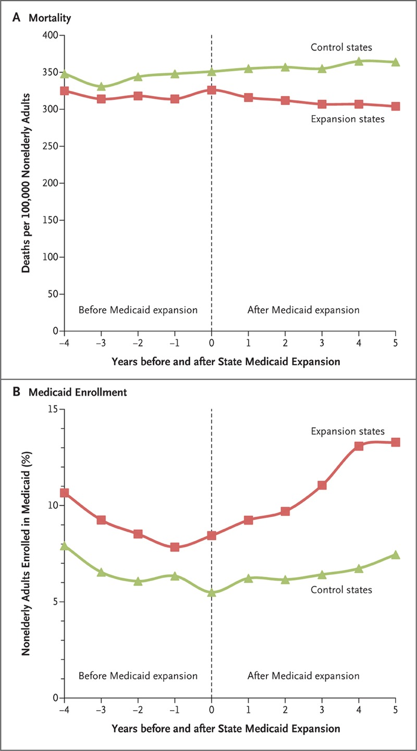
Medicaid Expansion
Medicaid expansions were associated with a significant reduction in adjusted all-cause mortality (by 19.6 deaths per 100,000 adults, for a relative reduction of 6.1%; P=0.001). Mortality reductions were greatest among older adults, nonwhites, and residents of poorer counties. Expansions increased Medicaid coverage (by 2.2 percentage points, for a relative increase of 24.7%; P=0.01), decreased rates of uninsurance (by 3.2 percentage points, for a relative reduction of 14.7%; P<0.001), decreased rates of delayed care because of costs (by 2.9 percentage points, for a relative reduction of 21.3%; P=0.002), and increased rates of self-reported health status of “excellent” or “very good” (by 2.2 percentage points, for a relative increase of 3.4%; P=0.04).

Slide 82
Muhlestein, David. "The Coming Crisis For The Medicare Trust Fund" Health Affairs Blog, December 15, 2020
Quadagno, Jill. "Why the United States has no national health insurance: Stakeholder mobilization against the welfare state, 1945-1996." Journal of Health and Social Behavior (2004): 25-44.
Freed, Gary L., and Anup Das. "Nixon or Obama: Who Is the Real Radical Liberal on Health Care?." Pediatrics 136, no. 2 (2015): 211-214.
Skocpol, Theda. Protecting soldiers and mothers: The political origins of social policy in the United States. Harvard University Press, 1995.
Sommers, Benjamin D., Katherine Baicker, and Arnold M. Epstein. “Mortality and access to care among adults after state Medicaid expansions.” New England Journal of Medicine 367, no. 11 (2012): 1025-1034.
Card, David, Carlos Dobkin, and Nicole Maestas. “Does Medicare save lives?.” The quarterly journal of economics 124, no. 2 (2009): 597-636.

