Slide 1
HCMI 4448: Clinical and Social Issues in Health Care
Busn 203: Wed 6:00 PM – 8:50 PM
Shane Murphy – shane@uconn.edu
Office Hours: Wed 4:00 PM – 6:00 PM

Slide 2
Discussion
Kate Middleton:
Had undisclosed abdominal procedure a couple months ago
Announced would be on break from public role
Rumors arose about her possible death, William’s possible infidelity
Announcement that she had been diagnosed with cancer last week
Discussion
Pros and cons of criticizing royal silence before announcement
Comedians, journalists, and paparazzi
Pros and cons of vagueness in reporting diagnosis
Balancing modeling behavior, right to know, royal prerogative, privacy

Slide 3
Women’s Health
Why separate unit for women?
Inequality
Unique problems expose interesting issues in system that help understand system
Child bearing is really important
What about men?
Understanding difference is 100% applicable for men’s health
Many issues overwhelmingly affect women, but also affect men!
Medical models usually men, so many lessons so far derived from “men’s health”
Yes

Slide 4
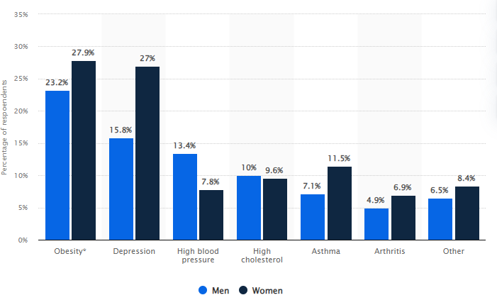
Chronic Diseases
Prevalence, US, 18-34 years
Particular etiology
CHD
Women experience less chest pain
more atypical symptoms
COPD
Parkinson’s
…
Difference in role of estrogen and testosterone in cell function
Differences in epidemiology
BMI, fat, and obesity
Men more likely to have overweight, obesity
Weight independent of height
CFS (3x more likely in women)

Slide 5
Cancers
Cervical cancer (lifetime risk: 0.7% of women)
Pap smears
Controversies
Gynecological Cancers
Cervical, ovarian (lifetime risk: 1.1%), uterine (lifetime risk: 3.1%), vaginal (lifetime risk: .06%), vulvar (lifetime risk: 0.3%), and fallopian tube cancer
Breast cancer (lifetime risk: 12.9%)
100x more common for women
BRCA1 and BRCA2 (tumor suppressing genes)
Increases Breast and Ovarian risk
Prophylactic mastectomies and salpingo-oophorectomy

Slide 6
Plastic Surgery
Breast reconstructive surgery
Cognitive interventions still useful
Cultural attitudes strong among some providers
Skin issues (Scar prevention and revision, etc)
Cosmetic surgery
92% women (~85% male doctors)
Patients less interested in gender of provider than experience
Including being more uncomfortable with resident observation
Notes:
Al-Taha, Mona, Sarah Al Youha, Becher Al-halabi, Jill Stone, Helene Retrouvey, Osama Samargandi, Johnny Ionut Efanov et al. "Barriers and attitudes to research among residents in plastic and reconstructive surgery: a national multicenter cross-sectional study." Journal of Surgical Education 74, no. 6 (2017): 1094-1104.
Marín-Gutzke, Martina, and Alberto Sánchez-Olaso. "Reconstructive surgery in young women with breast cancer." Breast cancer research and treatment 123 (2010): 67-74.

Slide 7
Anemia
Iron and blood
CFS
Multivitamins

Slide 8
Sexual Violence
FGM (~0.2%)
Rate unclear, evidence is it has more than doubled since 2000
Medical forensic exam
Diagnosing and treating injuries
Emergency contraception
Post-exposure sti prophylaxis
Sexual assault evidence collection kit
SAK is taken into custody by law enforcement
Backlogs regularly reported in media
Endthebacklog.org
Resources vs investigative efficacy
Exam can be uncomfortable and invasive
Notes:
Mather, Mark, and Charlotte Feldman-Jacobs. "Women and girls at risk of female genital mutilation/cutting in the United States." Population Reference Bureau 17 (2015).
Campbell, Rebecca, Hannah Feeney, Giannina Fehler-Cabral, Jessica Shaw, and Sheena Horsford. "The national problem of untested sexual assault kits (SAKs): Scope, causes, and future directions for research, policy, and practice." Trauma, Violence, & Abuse 18, no. 4 (2017): 363-376.

Slide 9
OB/GYN
Obstetrics vs gynecology
Gynecology is the care of a woman's reproductive organs and health.
Obstetrics involves the treatment of pregnant women, including the delivery of babies
PCP
~20% of women consider their OB/GYN to be their PCP
Especially pregnant women, new mothers, and women without chronic conditions
Concordance (55% women)
Changes in practice
Care inequalities by race/ethnicity, income, disability significant
Notes:
Mazzoni, Sara, Sarah Brewer, Josh Durfee, Jennifer Pyrzanowski, Juliana Barnard, Amanda F. Dempsey, and Sean T. O'Leary. "Patient perspectives of obstetrician-gynecologists as primary care providers." J Reprod Med 62, no. 1-2 (2017): 3-8.
Rivera Drew, Julia A., and Susan E. Short. "Disability and Pap smear receipt among US women, 2000 and 2005." Perspectives on Sexual and Reproductive Health 42, no. 4 (2010): 258-266.

Slide 10
Maternal Health
Pregnancy care
Visit schedule
4+ visits
Genetic testing becoming common around week 12
Anatomy scan around week 20
Gestational diabetes test around week 24-30
Common issues
Folic acid (B9)
Delivery care
Developing/changing trends
Child care training
Notes:
Rivera Drew, Julia A., and Susan E. Short. "Disability and Pap smear receipt among US women, 2000 and 2005." Perspectives on Sexual and Reproductive Health 42, no. 4 (2010): 258-266.

Slide 11
Rate vs relative risk

Slide 12
Fertility
Technical term – means ability to bear children and how many
Fertility care

Slide 13
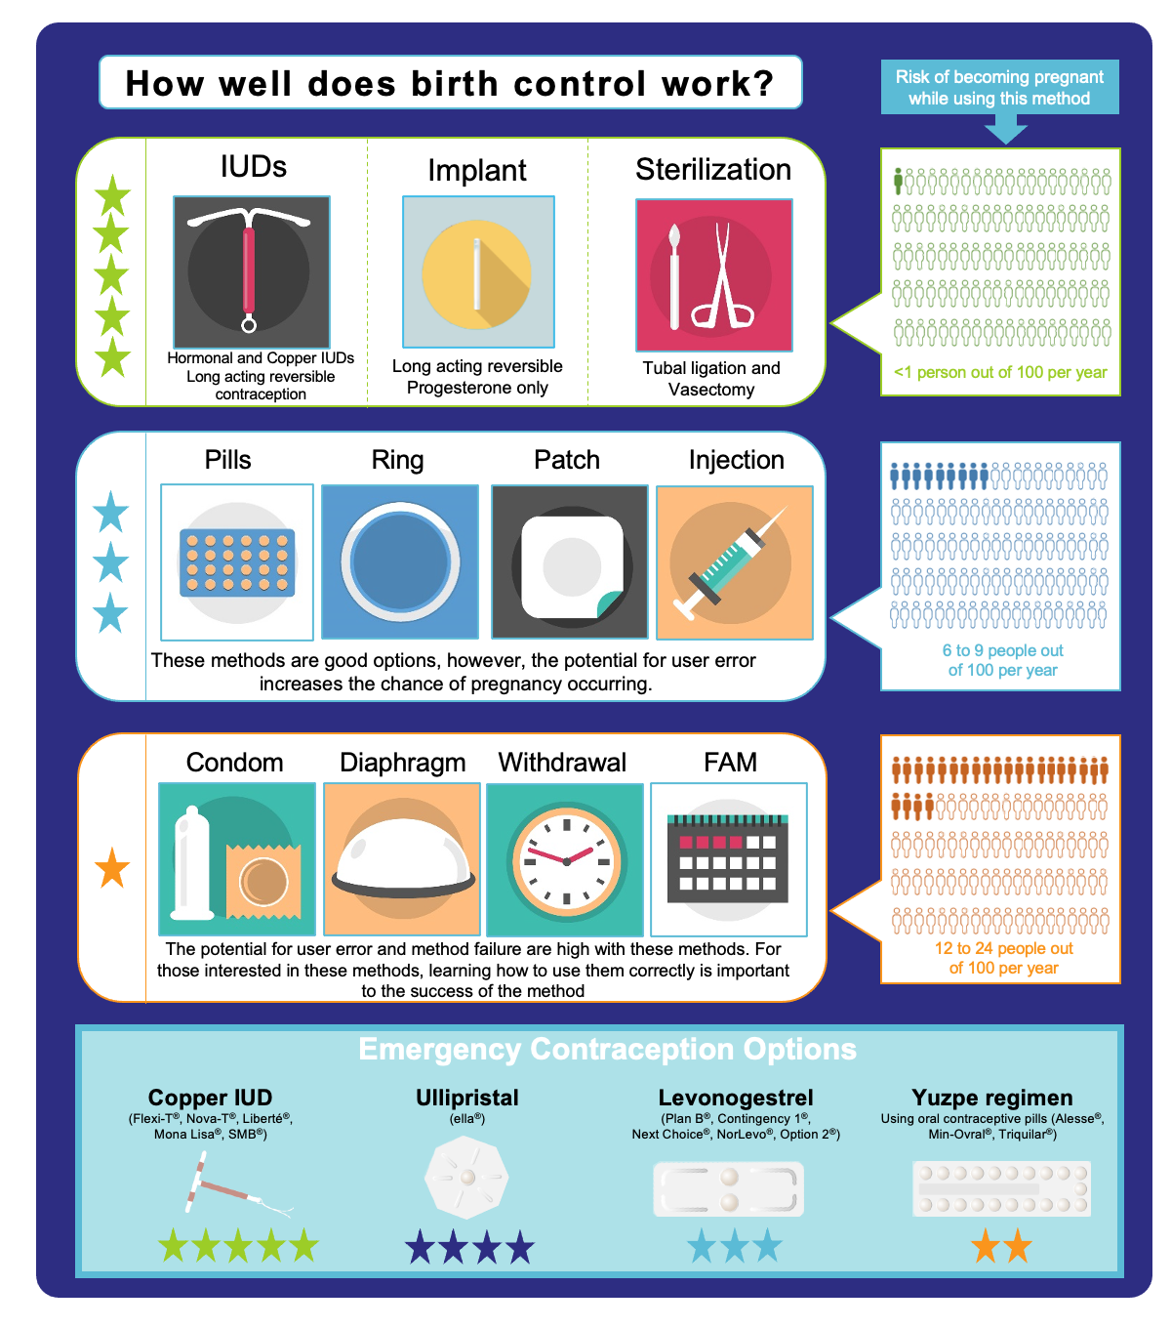
Birth Control
Types
Emergency contraceptive
Pregnancy termination?
Risks
Knowledge
Knowledge seeking/retention a function of comfort/interest
Not a function of sexual activity
Laws
Griswold v. Connecticut (1965) and Eisenstadt v. Baird (1972)
Notes:
https://www.kff.org/womens-health-policy/issue-brief/the-right-to-contraception-state-and-federal-actions-misinformation-and-the-courts/

Slide 14
STDs
Skip?

Slide 15
Abortion
Types
Medication
Mifepristone (RU-486)
In-Clinic
Vacuum aspiration
Dilation and evacuation (D&E)
Dilation and extraction (D&X)
Risks
Among all abortions, 1 of 16 (6.4%, n=3,531) was followed by an ED visit within 6 weeks but only 1 of 115 (0.87%, n=478) resulted in an ED visit for an abortion-related complication. Approximately 1 of 5,491 (0.03%, n=15) involved ambulance transfers to EDs on the day of the abortion. The major complication rate was 0.23% (n=126, 1/436): 0.31% (n=35) for medication abortion, 0.16% (n=57) for first-trimester aspiration abortion, and 0.41% (n=34) for second-trimester or later procedures. The total abortion-related complication rate including all sources of care including EDs and the original abortion facility was 2.1% (n=1,156): 5.2% (n=588) for medication abortion, 1.3% (n=438) for first-trimester aspiration abortion, and 1.5% (n=130) for second-trimester or later procedures. (ICD-9 635.xx)
Laws
Notes:
Upadhyay, Ushma D., Sheila Desai, Vera Zlidar, Tracy A. Weitz, Daniel Grossman, Patricia Anderson, and Diana Taylor. "Incidence of emergency department visits and complications after abortion." Obstetrics & Gynecology 125, no. 1 (2015): 175-183.
White, Kari, Erin Carroll, and Daniel Grossman. "Complications from first-trimester aspiration abortion: a systematic review of the literature." Contraception 92, no. 5 (2015): 422-438.

Slide 16
Abortion research
Planned Pregnancies research group is called Guttmacher Institute
About 1 million abortions per year
Gone up slightly after Dobbs
Woodwork effect?
Pill legalized in 1960, sparking “sexual revolution” of that decade, culminating in Title X (1970) and Roe v. Wade (1973)
Harris, Emily. "65 000 rape-related pregnancies took place in US states with abortion bans." JAMA (2024).

Slide 17
Economists research and abortion
Abortion impacted birth rates, particularly among young women and Black woman, improving long term social and economic outcomes for these women
Women use access to abortion in planning their reproductive, economic, and social lives
Contraception does not eliminate demand for abortion
Unwanted pregnancy and motherhood are economic burdens
Travel distance to clinic has significant negative effect on access to abortions
https://www.supremecourt.gov/DocketPDF/19/19-1392/193084/20210920175559884_19-1392bsacEconomists.pdf

Slide 18
Do fetuses have rights?
Rights need not mean humans rights, nor need it mean a right to life
Did someone say rights – that’s my favorite thing to talk about (I have lots of favorites)! Let me know if you want to talk about it!
Specific to a pregnancy intended to be carried to term.
When choosing medication, we choose the one least likely to harm the fetus even if it’s less effective, because a fetus intended for birth has the right to minimal harm.
If the fetus is not intended to be born, then they have the right to be terminated in the most humane was possible, and that goes for the mother’s experience as well.
Fetus rights never override mothers’ rights (all humans are equal, fetuses cannot be more equal)
Parents have a right to have their relationship with their fetus and treated as real and meaningful

Slide 19
Way’s to protect fetus rights
The fetus does has the right to a safe environment to develop normally
It is us, the health care provider, who supports the parent in making educated decisions to ensure the fetus will survive pregnancy without any environmental harm.
As the fetus isn't a separate entity from the carrying parent, it is not autonomous.
Parents right to decide how they treat their body.
It's discussing the importance of using condoms while pregnant to prevent the transmission of an STI in someone with multiple partners.
It's ensuing that someone who is homeless and pregnant has access to a safe place to sleep and nutrition.
It means someone who is a drug user has access to clean items.
It means that someone who is in an abusive relationship is supported and has an escape plan.
It means that someone who is depressed or suicidal has access to resources that benefit them.
It means that, if the decision is to have an abortion, that person experiencing the abortion is safely provided healthcare, with dignity and respect, and so is their fetus.

Slide 20
Women Providers
Rates by discipline
https://www.aamc.org/data-reports/workforce/data/active-physicians-sex-and-specialty-2017
Are women better? Are men better? Qualitative results:
Women may improve patient-centered care models
Patient satisfaction higher with men doctors
Patients report better outcomes for men doctors providing patient-centered care
Multiple women in a practice are better than one
Cost of lack of gender diversity: Quantitative results
Women physicians are more likely to care:
for women
For patients with complex psychosocial issues, and provide more preventive care and counseling regardless of the sex of the patient.
Female patients were two to three times more likely to survive a heart attack—the leading cause of death among women—if their emergency room physician was a woman.
Medicare patient hospital mortality and readmission rates were lower for patients treated by women hospitalists than those treated by men
Women have been found to be less likely to be sued for malpractice.24
Notes:
Roter, Debra L., and Judith A. Hall. "Women doctors don’t get the credit they deserve." Journal of general internal medicine 30 (2015): 273-274.
Jogulu, Uma, and Lavanya Vijayasingham. "Women doctors, on working with each other." Gender in Management: An International Journal 30, no. 2 (2015): 162-178.
Silver, Julie K., Allison C. Bean, Chloe Slocum, Julie A. Poorman, Adam Tenforde, Cheri A. Blauwet, Rebecca A. Kirch et al. "Physician workforce disparities and patient care: a narrative review." Health equity 3, no. 1 (2019): 360-377.

Slide 21
Burnout in women physicians
42% of more than 15,000 physicians across 29 specialties reported symptoms of burnout, with more women physicians (48%) reporting burnout than men (38%).
PCP Women report burnout nearly twice as much as men
Women more likely to report emotional exhaustion
Similar career satisfaction, but less satisfaction in work-life balance, advancement opportunities
Women work more hours to get similar levels of compensation, promotion
Primary care physicians had incomes 18% lower than men—up from 16% in 2017—and the gap increased to 36% for women specialists (even adjusting for hours, specialty, age, race, etc.)
Leading to more family/home conflict and lower job satisfaction

Slide 22
40–50% of female medical students experience sexual harassment from academic faculty or staff. The report noted, “When women experience sexual harassment in the workplace, the professional outcomes include declines in job satisfaction; withdrawal from their organization (i.e., distancing themselves from the work either physically or mentally without actually quitting, having thoughts or intentions of leaving their job, and actually leaving their job); declines in organizational commitment (i.e., feeling disillusioned or angry with the organization); increases in job stress; and declines in productivity or performance.”

Slide 23
Gender affirming care

Slide 24
Discussion
What do you want to discuss?

Slide 25
Discussion

Slide 26
Sources

Slide 27
Final Paper
Topic:
Anything related to clinical and social issues in health care management
Length 7-12 pages, aim for 8 or 9, doubles spaced/1.5 spaced, use a normal font, just be cool ok
Requirements:
6 peer reviewed/academic sources (use pub med/google scholar, if you are unsure, just ask)
Bibliography correctly formatted, any style is fine but must be consistent
Don’t use a crappy format manager, use a good one, I recommend google scholar
At least one chart, figure, or table
Title and note also required, these should make information stand alone
Organize, use section headers
Group size: one, two, or three people per group
Meetings
Must schedule and attend an in-person or online 15 minute meeting with me to discuss, meeting schedules for week after spring break, but ad hoc early meetings are fine
At meeting, we will discuss your topic and make sure the topic is appropriate and I’ll help find some sources to get you started.

