Slide 1
HCMI 4448: Clinical and Social Issues in Health Care
Busn 203: Wed 6:00 PM – 8:50 PM
Shane Murphy – shane@uconn.edu
Office Hours: Wed 4:00 PM – 6:00 PM

Slide 2
Employee health and productivity
Absenteeism
Illness-related loss of productivity due to absence from work
Presenteeism
Illness-related loss of productivity while at work

Slide 3
Wellness Programs
Health promotion and disease prevention strategies
Primary and secondary prevention
Primary prevention addresses health-related behaviors and risk factors
encouraging a diet with lower fat and caloric content to prevent the onset of diabetes mellitus.
Secondary prevention attempts to improve disease control
promoting medication adherence for patients with asthma to avoid symptom exacerbations that can lead to hospitalization

Slide 4
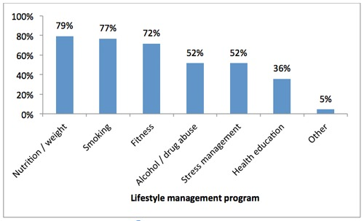
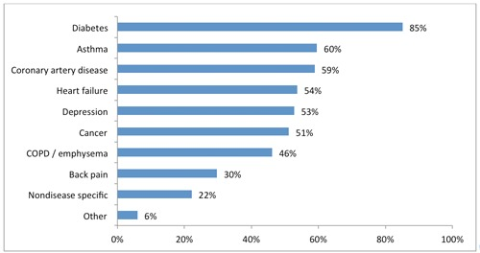
Wellness Programs
By 2013, half of US employers offer wellness programs, by 2019, 50 million US workers enrolled

Slide 5
Health effects
Early analysis including RAND study published in early days of ACA found positive effects
Small effects
Generally focusing on programs known to be effective
Smoking cessation programs
Voluntary weight reduction programs
2010 meta-analysis in HA found:
medical costs fall by about $3.27 for every dollar spent on wellness programs and that absenteeism costs fall by about $2.73 for every dollar spent
2012 study in AJManCare found:
“The validity of those findings is reduced by the lack of rigorous evaluation designs. Further, the body of publications is in stark contrast to the widespread use of such programs, and research on the effect of incentives is lacking.”

Slide 6
Health effects
2021 Lancet: Public Health meta-analysis found improved behaviors and outcomes
2021 AJPrevM meta-analysis controlling for quality of study disagreed
“The highest-quality studies do not support the hypothesis that worksite wellness programs deliver a positive return on investment within the first few years of initiation.”
2016-2018 U of Illinois program
2020 JAMA study found no significant differences in biometrics, medical diagnoses, or medical use relative to the control group.
Increased self-reports of having a primary care physician and improved a set of employee health beliefs among the treatment group.

Slide 7
Wellness program features
Screenings – bp, cholesterol, bmi
On-site gym access
Self-help educational materials
Individual or group counseling with healthcare professionals
incentives

Slide 8
Wellness program incentives
Payments to employees
Savings on health insurance premium
Increased utilization of programs
Smoking programs more commonly had results-based incentives
Other programs more commonly had participation-based incentives
Diet, fitness

Slide 9
Facilitators of program success
Effective communication strategies
Opportunity for employees to engage
making wellness activities convenient and easily accessible
Leadership engaged at all levels
Use of existing resources and relationships
Continuous evaluation
Formal evaluation very uncommon
Needs assessments more likely

Slide 10
Concerns
Many feel pressure to join wellness programs
Privacy concerns

Slide 11
2016-2018 U of Illinois program
2020 JAMA study found no significant differences in biometrics, medical diagnoses, or medical use relative to the control group.
administrative claims related to medical diagnoses (diabetes, hypertension, and hyperlipidemia) and medical use (office visits, inpatient visits, and emergency department visits)
Increased self-reports of having a primary care physician and improved a set of employee health beliefs among the treatment group
Participant beliefs about their chance of having a body mass index greater than 30, high cholesterol, high blood pressure, and impaired glucose level
Increased health screening rates

Slide 12
2016-2018 U of Illinois program
Adverse(?) selection
Prior to participation, program participants had lower medical expenditures and healthier behaviors than nonparticipants
Health people earn rewards for continuing healthy lifestyles
Implication
If healthy people are getting reimbursed for being healthy, then who is paying?
This is a shift of costs more onto unhealthy employees
Often lower-income on average
Indeed lower-income workers less likely to enroll

Slide 13
Wellness program failure consistent with HI
Analysis of health effects of health insurance generally estimate small to no health improvement
Exception, mental health
Health improvement only possible if person initially has ill health
People with uncontrolled illness often aren’t working (65+ have Medicare)
For any given illness, few people eligible to enroll in experiments
Health improvement may be different in long term, but business might not get this benefit

Slide 14
Popularity of wellness programs
HR
Optics
Peer/network effects
Selection
Theoretical effects

Slide 15
Sources
Mattke, Soeren, Hangsheng Liu, John Caloyeras, Christina Y. Huang, Kristin R. Van Busum, Dmitry Khodyakov, and Victoria Shier. "Workplace wellness programs study." Rand health quarterly 3, no. 2 (2013).
Baicker, Katherine, David Cutler, and Zirui Song. "Workplace wellness programs can generate savings." Health affairs 29, no. 2 (2010): 304-311.
Reif, Julian, David Chan, Damon Jones, Laura Payne, and David Molitor. "Effects of a workplace wellness program on employee health, health beliefs, and medical use: a randomized clinical trial." JAMA internal medicine 180, no. 7 (2020): 952-960.
Jones, Damon, David Molitor, and Julian Reif. "What do workplace wellness programs do? Evidence from the Illinois workplace wellness study." The Quarterly Journal of Economics 134, no. 4 (2019): 1747-1791.
Peñalvo, José L., Diana Sagastume, Elly Mertens, Irina Uzhova, Jessica Smith, Jason HY Wu, Eve Bishop et al. "Effectiveness of workplace wellness programmes for dietary habits, overweight, and cardiometabolic health: a systematic review and meta-analysis." The Lancet Public Health 6, no. 9 (2021): e648-e660.
Baid, Drishti, Edward Hayles, and Eric A. Finkelstein. "Return on investment of workplace wellness programs for chronic disease prevention: a systematic review." American journal of preventive medicine 61, no. 2 (2021): 256-266.
Osilla, Karen Chan, Kristin Van Busum, Christopher Schnyer, Jody Wozar Larkin, Christine Eibner, and Soeren Mattke. "Systematic review of the impact of worksite wellness programs." The American journal of managed care 18, no. 2 (2012): e68-81.

Slide 16
Final Paper
Topic:
Anything related to clinical and social issues in health care management
Length 7-12 pages, aim for 8 or 9, doubles spaced/1.5 spaced, use a normal font, just be cool ok
Requirements:
6 peer reviewed/academic sources (use pub med/google scholar, if you are unsure, just ask)
Bibliography correctly formatted, any style is fine but must be consistent
Don’t use a crappy format manager, use a good one, I recommend google scholar
At least one chart, figure, or table
Title and note also required, these should make information stand alone
Organize, use section headers
Group size: one, two, or three people per group
Meetings
Must schedule and attend an in-person or online 15 minute meeting with me to discuss, meeting schedules for week after spring break, but ad hoc early meetings are fine
At meeting, we will discuss your topic and make sure the topic is appropriate and I’ll help find some sources to get you started.

