Slide 1
HCMI 4448: Clinical and Social Issues in Health Care
Busn 203: Wed 6:00 PM – 8:50 PM
Shane Murphy – shane@uconn.edu
Office Hours: Wed 4:00 PM – 6:00 PM

Slide 2
Mental Health
https://www.youtube.com/watch?v=xYnZ1BDWMfM&ab_channel=TheUnplannedPodcast – 72:25-75:15
https://www.lawyersgunsmoneyblog.com/2024/03/maine-mass-killer-had-severe-brain-damage-from-routine-military-training
https://www.reddit.com/r/MadeMeSmile/comments/jxlmv9/wholesome_lgbt_bookstore/

Slide 3
Primary care serves as the de facto mental health delivery system in the US
Most depressed patients seek treatment in primary care settings
Under-treated
Training focuses on diagnosis and pharmacology
Part of primary care training – rotations and lectures

Slide 4
Holes in primary care training
Majority of residents (62%) received little to no exposure working with couples or families
Psychotherapy skills like motivational interviewing and psychoeducation less common than cognitive behavioral or solution-focused therapy
Almost 20% of residents reported deficits
Medication management
Especially beyond SSRIs and SNRIs
Treatment of substance abuse, ADHD, schizophrenia, ASD, depression
Lack of diversity of clinic types and modalities

Slide 5
Mental health of (mental health) providers
Be able to express negative emotions around patients and care situations, in an accepting, validating and non-judgemental environment.
‘I liked the fact that the session felt genuinely supportive and insightful. Good to hear the acceptance of others thoughts, feelings and emotions evoked by distressing experiences’.
‘Recognition that we can be angry and frustrated with patients/at their situation and express it authentically, honestly and constructively to benefit them’. ‘Pat’ ‘I think it’d give you chance to vent in a safe environment...you’ve got a chance to vent your positive and your negative feelings in quite a protective place’.
‘Liz’ ‘When you found it useful it’s about actually speaking about the experience and what you’ve been through, as opposed to this is what I’ve done’.

Slide 6
Mental health of (mental health) providers
Listen to experiences of others
‘Enjoyed reflecting on emotions and hearing different professions very similar view points. Sharing experiences, validating emotions, talking openly’.
‘The Round today brought back some memories of a similar incident I was involved in myself and helped me to reflect’.
‘...the content of that Round had resonance with everybody there, having faced similar situations’.
‘his reflections helped us to think about if we had been in that situation how we’d sort of coped with it and things’.

Slide 7
Mental health of (mental health) providers
Regularity of services to providers
‘It’s a ventilation but it’s unstructured, it’s not frequent enough to go anywhere or to do anything other than to be an experience of itself... there’s never the same set of people there, there’s never a chance to develop cohesion, a sense of group, a sense of support’.
‘This is a starting point and it’s helping us to start to think about some of these issues and I think it’s good that it’s brought it to the forefront but it hasn’t massively changed what I’m doing or how I’m approaching things on a day to day basis’.
Lack of time to process
‘because of timing, I was in charge of the afternoon shift so I had to go fifteen minutes before the end so we didn’t see the end of it and a student nurse came with me and when we both left and said, ‘whoah, that was quite powerful and emotional’ but you had to go back to the ward and that was it, get back into the hustle and bustle of it all’.
Lack of time using group sessions
‘I think it can be quite intimidating to speak up in a room where there’s lots of people from lots of different teams. If this sort of thing was happening within the team that you worked in, you might feel more comfortable to put your point of view across but you might think “I don’t know if this is going to come across right or there’s lots of people looking at me, is it ok for me to say this?”’

Slide 8
Mental health of (mental health) providers
Conflict between humanity and professionalism
Need to present a veneer of calm
Guilt over negative feelings towards patients
Emotional cost of caring
There were many instances of staff talking about the costs of caring including self-criticism; self-blame; guilt; taking anger and worry home; loneliness and isolation; and stress

Slide 9
Mental Health First Aid
ALGEE approach
Assess for risk for suicide or harm
Listen nonjudgmentally
Give reassurance and information
Encourage appropriate professional help
Encourage self-help and other support strategies
Modified approach
Look for warning signs, Ask how they are, Listen up, Help them connect with an adult, and Your Friendship is important
Limited effectiveness

Slide 10
988 and suicide prevention
Substance Abuse and Mental Health Services Administration
National and local numbers, routed to local centers
Helpers are trained to provide emotional support, assessment, crisis intervention, and/or linkages to necessary community resources
Imminent risk issues
Cases where suicide attempt has just occurred, is in process, or imminent

Slide 11
Lifeline Policy for Helping Callers at Imminent Risk of Suicide
Practice active engagement with callers and make efforts to establish sufficient rapport so as to promote the caller's collaboration in securing his/her own safety
Use the least invasive intervention and consider involuntary emergency interventions as a last resort, except for in circumstances as described below
Initiate lifesaving services for attempts in progress—guidelines shall not require the individual's consent to initiate medically necessary rescue services
Initiate active rescue to secure the immediate safety of the individual at risk if the caller remains unwilling and/or unable to take action to prevent his/her suicide and remains at imminent risk
Practice active engagement with persons calling on behalf of someone else (“third-party callers”) toward determining the least invasive, most collaborative actions to best ensure the safety of the person at risk
Have supervisory staff available during all hours of operations for timely consultation in determining the most appropriate intervention for any individual who may be at imminent risk of suicide
Maintain caller ID or other method of identifying the caller's location that is readily accessible to staff
Staff must seek to confirm that emergency services have successfully made contact with the at-risk individual and, if not successful, take additional steps to address the safety needs of the at-risk individual.

Slide 12
Stigmas in care
Social distance increased when sick person is stigmatized
Social network key in healing for all disease, even more so for mental health and substance use related diseases
Explicit bias
Directly expressed, provider is aware of action
Implicit bias
Indirectly expressed, provider is unaware of action
Navigating bias
Public awareness campaigns

Slide 13
Neurodiversity paradigm
Movement which started within the autistic community
Note difference in language to represent self-perceived culture vs external diagnosis
More common in some conditions (ADHD, dyslexia, dyspraxia, Tourettes)
Skeptical of treatment which promotes behaviors seen as masking
Contrast with the pathology paradigm
Activism and controversy

Slide 14
Language in Substance Use Care
General public and providers stigmatize individuals with substance use and mental health disorders
Public support and individual behaviors impacted by language choice
Negative terms:
Substance abuser, addict, alcoholic, opioid addict, clean, dirty, alcoholic
Relapse, medication-assisted treatment, untreated
Mixed: Recurrence of Use
Positive terms
Person with substance use disorder, person with opioid use disorder
Pharmacotherapy, medication-assisted recovery, long-term recovery

Slide 15
How language use is studied:
Table 2. Sample vignette randomly assigned to participants.
Group | Vignette
Control | Mary is a white woman who has completed college. She has experienced the usual ups and downs of life, but managed to get through the challenges she has faced. Mary lives with her family and enjoys spending time outdoors and taking part in various activities in her community. She works at a local store.
Substance Abuser | Mary is a white woman who has completed college. She is also a substance abuser but has managed to get through the challenges she has faced. As a recovering addict, she lives with her family and enjoys spending time outdoors and taking part in various activities in her community. She also works at a local store.
Substance Use Disorder | Mary is a white woman who has completed college. She also has a substance use disorder but has managed to get through the challenges she has faced. As a woman in recovery, she lives with her family and enjoys spending time outdoors and taking part in various activities in her community. She also works at a local store.

Slide 16
Substance Use - Empathy
https://www.youtube.com/watch?v=5L6-O3tW4WE&ab_channel=HBO – The Wire

Slide 17
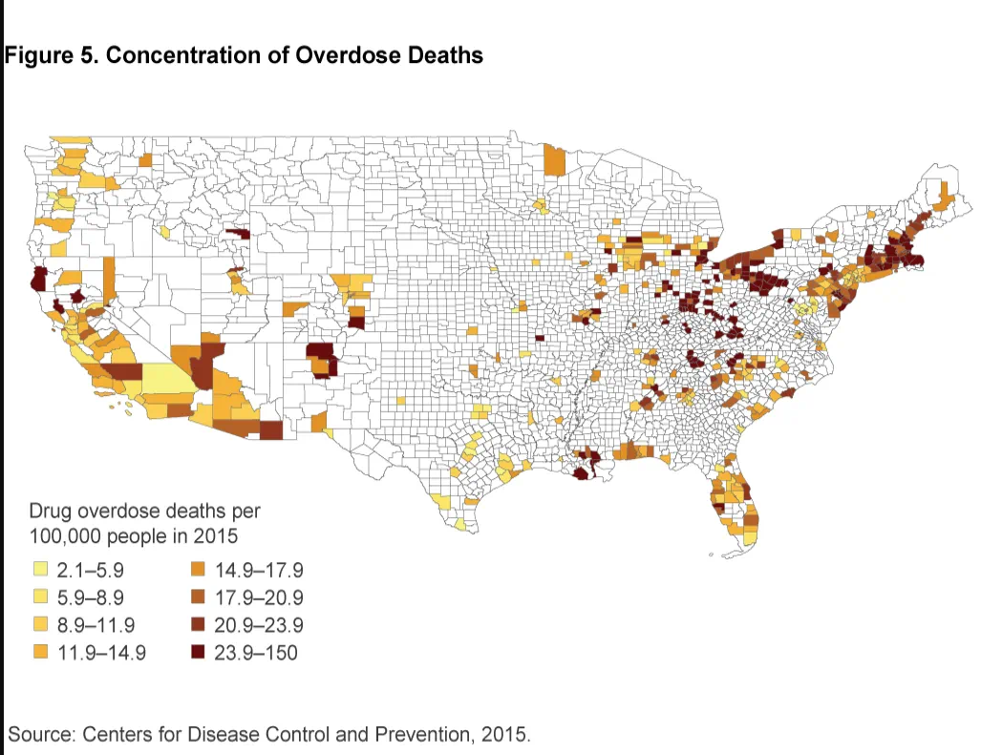
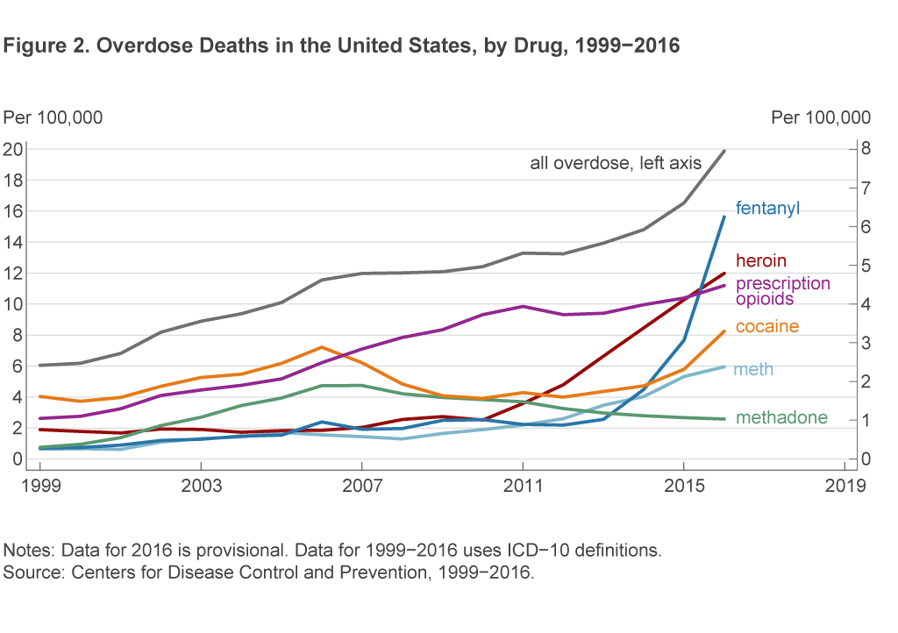
Addictive drugs

Slide 18
Substance use treatment
Multiple aspects multiple sites
Pharmacological
reduces cravings
μ-opioid antagonist (Naltrexone – alcohol, opioids, others)
Serotonergic agents like SSRIs (meth, alcohol, coke, nicotine, opioids)
Block effect of drug (Gaba agents?)
Withdrawal reducing (Dopaminergic agents)
Induce negative physical reaction to drugs (Disulfiram for alcohol)
Non-pharmacological
CBT
Motivational enhancement therapy
Conditioning based behavioral therapy
Group therapy
12 step programs
Sponsor/buddy system
Co-occurring mental health and substance use

Slide 20
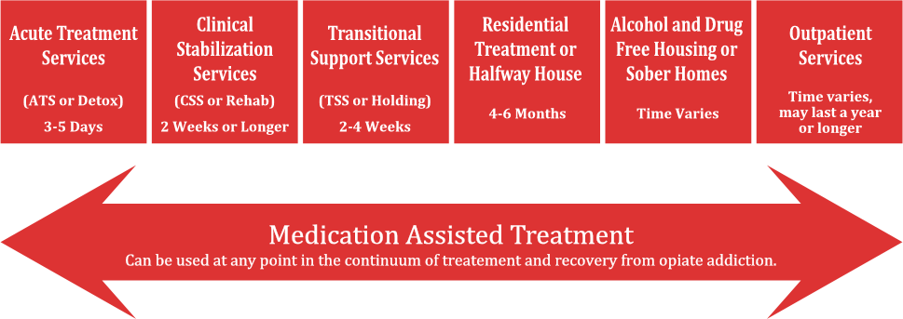

Slide 21
Co-occurring mental health and substance use
Can include depression, psychosis, stress disorders, ADHD, …
Facilities should be equipped to manage comorbidities
Treatment plans should have broad focus
Practitioners should have broad skill sets

Slide 22
Substance Use Awareness
Patient care:
https://www.youtube.com/watch?v=h4oDbDcKWnM&ab_channel=JeffersonHealth
Recognizing and treating:
https://www.youtube.com/watch?v=u8YpPB19tl0&ab_channel=WWLTV

Slide 23
Why fentanyl
Fentanyl is potent, which makes it cheap
Transportation is more expensive than production
Fentanyl is a cheap opioid, so used directly as an opioid
A dilute dose of another drug, cut with mostly an inert substance (talc?) and a tiny bit of fentanyl can give a stronger effect than an undiluted dose of the original drug
Uppers and downers can mix

Slide 24
Sources
Zubatsky, Max, Jay Brieler, and Christine Jacobs. "Training experiences of family medicine residents on behavioral health rotations." Fam Med 49, no. 8 (2017): 635-639.
Bauer, Nerissa S., Paula D. Sullivan, Anna M. Hus, and Stephen M. Downs. "Promoting mental health competency in residency training." Patient Education and Counseling 85, no. 3 (2011): e260-e264.
Ashford, Robert D., Austin M. Brown, and Brenda Curtis. "Substance use, recovery, and linguistics: The impact of word choice on explicit and implicit bias." Drug and alcohol dependence 189 (2018): 131-138.
Forthal, Sarah, Karolina Sadowska, Kathleen M. Pike, Manya Balachander, Kristina Jacobsson, and Sabrina Hermosilla. "Mental health first aid: A systematic review of trainee behavior and recipient mental health outcomes." Psychiatric services 73, no. 4 (2022): 439-446.
Draper, John, Gillian Murphy, Eduardo Vega, David W. Covington, and Richard McKeon. "Helping callers to the National Suicide Prevention Lifeline who are at imminent risk of suicide: The importance of active engagement, active rescue, and collaboration between crisis and emergency services." Suicide and Life‐Threatening Behavior 45, no. 3 (2015): 261-270.

Slide 25
Final Paper
Topic:
Anything related to clinical and social issues in health care management
Length 7-12 pages, aim for 8 or 9, doubles spaced/1.5 spaced, use a normal font, just be cool ok
Requirements:
6 peer reviewed/academic sources (use pub med/google scholar, if you are unsure, just ask)
Bibliography correctly formatted, any style is fine but must be consistent
Don’t use a crappy format manager, use a good one, I recommend google scholar
At least one chart, figure, or table
Title and note also required, these should make information stand alone
Organize, use section headers
Group size: one, two, or three people per group
Meetings
Must schedule and attend an in-person or online 15 minute meeting with me to discuss, meeting schedules for week after spring break, but ad hoc early meetings are fine
At meeting, we will discuss your topic and make sure the topic is appropriate and I’ll help find some sources to get you started.

