Slide 1
HCMI 3243: Health Policy
Shane Murphy – shane@uconn.edu

Slide 2
The problem in two graphs
Costs are growing, particularly administrative costs, prices, and overutilization
I prefer to focus on administrative costs
Health isn’t improving and for many it is getting worse
This may not be the fault of the medical health system, but rather the behavioral health system

Slide 3
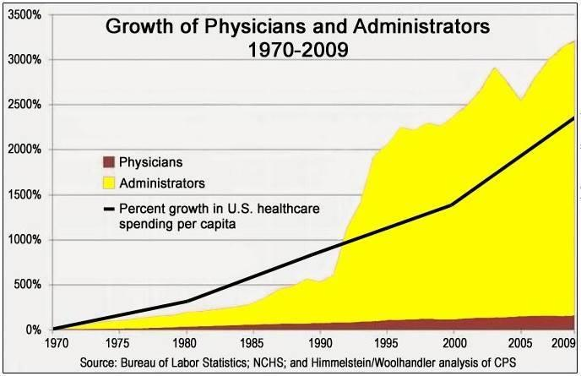
A famous & misleading graph
Notes:
https://www.motherjones.com/kevin-drum/2019/06/join-me-on-a-dive-down-the-rabbit-hole-of-health-care-admin-costs/
https://marginalrevolution.com/marginalrevolution/2019/08/are-health-administrators-to-blame.html

Slide 4
Deaton and Case 2015 (corrected by Gelman 2016)

Slide 5
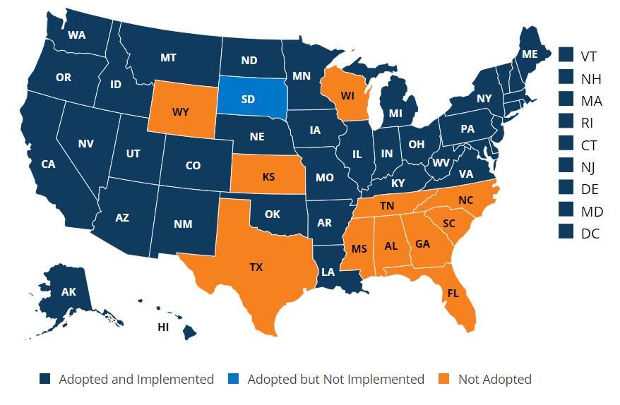
State of Medicaid Expansion

Slide 6
Some Polls
People like their insurance
But not as much as they like their coverage
And they don’t like the healthcare industry
People think the government should play a role
But aren’t sure what that role should be
Notes:
https://news.gallup.com/poll/4708/healthcare-system.aspx
https://news.gallup.com/poll/245195/americans-rate-healthcare-quite-positively.aspx

Slide 7
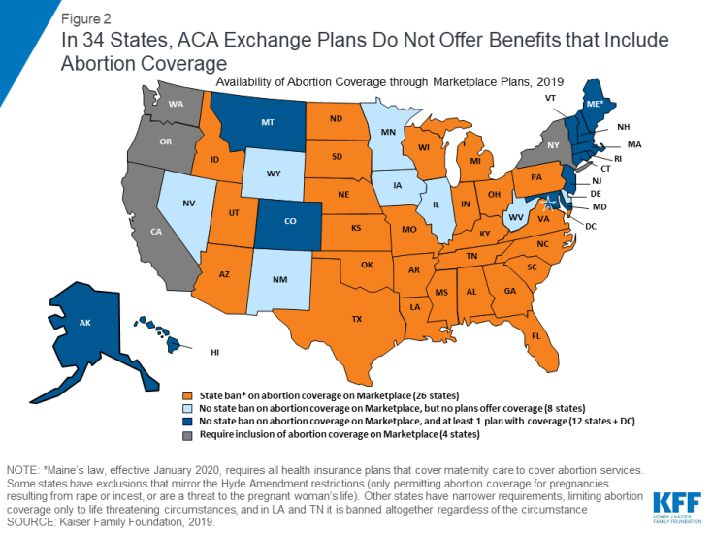
Abortion Coverage Regulations
Hyde Amendment
Applies to subsidies for plans bought on exchange
Does not apply to abortions in cases of rape, incest, or endangerment of life of woman
States may fund abortion care for Medicaid recipients

Slide 8
Inflation Reduction Act of 2022
Medicare may negotiate the cost of prescription drugs.
Caps the amount seniors pay at $2,000 annually, and the cost of insulin at $35 a month
Penalizes companies that unfairly hike prices by requiring them to pay a rebate to Medicare.
Expanding premium and co-pay assistance for low-income seniors in the Medicare Part D drug program
Extending enhanced Affordable Care Act Marketplace premium subsidies, which were set to expire at the end of this year, through the end of 2025
Making all vaccines free for Medicare beneficiaries
Not an inflation reducing bill, its just a name for a budget bill
Recent budget reconciliation bills include Tax Cuts and Jobs Act of 2017 and the American Rescue Plan of 2021.
Inflation is a lagging indicator of problems and the lag is long
So while this act does little or nothing to address inflation in 2022, its effect on long-term inflation is not necessarily zero

Slide 10
Democratic proposals focus on:
Coverage for all
The ACA cut uninsured rates in half, but no further
And purchase of bronze plans and interest in high deductible plans suggests markets are going to lead to less complete coverage
Most democratic plans propose a single payer without copayments or deductible available for everyone
Notes:
Based on the Kip Sullivan plan

Slide 11
Democratic proposals focus on:
Costs
ACA cost control measures have little or no evidence behind them
HMOs create possibly only short term cost improvements
Gaming the system has increased
Gaming measurement
Gaming caase-mix
Gaming costs
Single payer would shrink administrative costs and reduce corruption/gaming
Single payer would negotiate with pharmaceutical companies

Slide 12
Democratic proposals focus on:
Payment
Less emphasis or detail on payment, similar proposals to Medicare Part A and B
Physicians: FFS
Hospitals: Capitation
Choice
Removal of networks used by HMOs/PPOs/POSs

Slide 13
Republican criticisms of Democratic plans
Complexity
The ACA was 2,300 pages long and now entails 16,000 pages of regulations
Cost
Government organizations are known for waste
Physician incentives
Physician pay will have to go down
Insuree choice
People prefer the public option, so that they could keep their current plan

Slide 14
Republican proposals focus on
Liberalize Health Savings Accounts
Increase tax deductible contribution maximums
Permit broader usage
Allow tax-free rollover to survivors
Notes:
Based on the Scott Atlas plan

Slide 15
Republican proposals focus on
Tax Treatment and Incentives
Either remove tax deduction for employer sponsored care or allow deduction for non-employer sponsored care
Remove tax deductions for non-high deductible plans
Ie treat most plans as Cadillac plans

Slide 16
Republican proposals focus on
Reduce regulations on insurance
Allow high-deductible plans with fewer coverage mandates
Reduce or remove use of employer sponsored health insurance
Permit insurers to adjust premiums for obesity and other health risks and pre-existing conditions

Slide 17
Republican proposals focus on
Increase Medicare privatization
Add private options for Medicare enrollees
Include drug benefits in plans
Regulate private plans to ensure out-of-pocket limits
Combine A, B, and D into one, simplified Medicare public option
Promote HSAs for Medicare recipients
Increase eligibility age

Slide 18
Republican proposals focus on
Increase Medicaid privatization
Allow high-deductible private Medicaid plans
Seed fund HSAs for Medicaid recipients
Use federal funds incentives to push states to encourage enrollees onto high-deductible plans

Slide 19
Republican proposals focus on
Reduce regulatory burden
Allow nurse practitioners and physician assistants to take a higher role
Reduce the power of medical specialty societies restricting supply of doctors
Repeal taxes on medical devices and brand-name drugs
Reduce bureaucracy in the FDA for device and drug approvals

Slide 20
Texas v Azar -> Texas v US
Notes:
https://www.kff.org/health-reform/fact-sheet/potential-impact-of-texas-v-u-s-decision-on-key-provisions-of-the-affordable-care-act/?utm_source=hs_email&utm_medium=email&utm_content=2&_hsenc=p2ANqtz-_037l8tBxCjsxUijA0INwupseSA0XA0fYwXLCVUgAn08z0nBGg2egu9vDkAhM8FxmmRzkRaJKdRDb5v-4XisZ7tNXt_g

Slide 21
Democratic criticism of Republican plans
Introducing low cost high deductible plans won’t lead to universal coverage and will reduce necessary utilization
Health Savings Accounts, depending on implementation, will be a regressive tax break
Regulations improve care and are necessary
Privatizing Medicare and Medicaid is unpopular and may not lead to improvements

Slide 22
Compromises? Proposals with mixed appeal?
Limited Medicaid expansion
To 100% FPL rather than 138%
People eligible for no-cost Medicaid or ACA no-cost plans should be automatically enrolled
Encourage state reinsurance risk pools to expand the size of pools
Increase transparency in prices
Limit monopoly power, including patent-based monopoly
Notes:
http://www.aei.org/publication/the-health-reforms-the-g-o-p-should-embrace-but-probably-wont/

Slide 23
Proposals with broad appeal include:
Limit the tax exclusion of employer-sponsored insurance
Ensure effective anti-trust enforcement
Encourage all-payer claims databases – reversing Gobeille v. Liberty Mutual and ERISA rules against these
Expand site-neutral payments where clinically feasible – hospital outpatient departments shouldn’t receive higher payments than stand-alone clinics
Balancing incentives in Medicare Physician Fee Schedule to incentivize med students to become PCPs
Notes:
http://www.aei.org/publication/cost-reducing-health-policies/

Slide 24
Proposals with broad appeal include:
Limit the tax exclusion of employer-sponsored insurance
Ensure effective anti-trust enforcement
Encourage all-payer claims databases – reversing Gobeille v. Liberty Mutual and ERISA rules against these
Expand site-neutral payments where clinically feasible – hospital outpatient departments shouldn’t receive higher payments than stand-alone clinics
Balancing incentives in Medicare Physician Fee Schedule to incentivize med students to become PCPs
Reforming Medigap cost sharing and Medicare benefit design
Reforming protected classes in Medicare Part D
Remove incentive to prescribe higher cost drugs in Medicare Part B
Remove regulations that restrict generic drugs
Notes:
http://www.aei.org/publication/cost-reducing-health-policies/

Slide 25
Other proposals
Repeal any willing provider laws – insurance plans don’t need to offer so generous out-of-network coverage

Slide 26
Modern Republican Party
Two pressures
Lower taxes and lessen regulation
“Dismantle the Administrative State”
“Starve the beast”
Inflation and recessions

