Slide 1
HCMI 4225: Comparing Health Systems
Shane Murphy – shane@uconn.edu

Slide 2
Understanding major health systems indicators
Beds per capita
World average – 2.9 per 1000
US average – 2.9 per 1000
Physicians per capita
World average – 1.8 per 1000
US average – 2.6 per 1000
Nurses per capita
World average – 4 per 1000
US average – 15.7 per 1000
Universal Health Coverage
The proportion of a population that can access essential quality health services
Measures?
The proportion of the population that spends a large amount of household income on health
Measures?
Notes:
https://data.worldbank.org/indicator/

Slide 3
Two issues: Financing and Governance
Focus is often on financing
Provision depends on both financing and governance

Slide 4
Types of health care systems by provision and funding

Slide 5
Governance issues
Governance of Consumption
Extent of public access to care
Extent of public control of costs
Governance of provision
Extent of control of hospitals
Extent of constraints on private interests and doctors
Governance of Production
Extent of public constraints on medical innovation

Slide 6
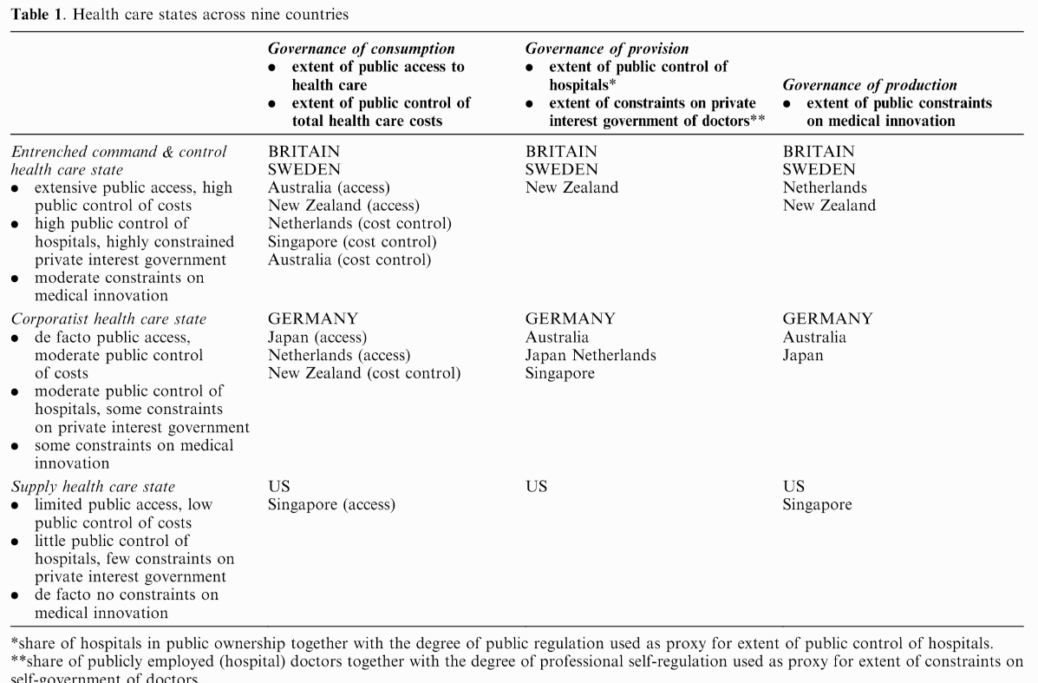

Slide 7
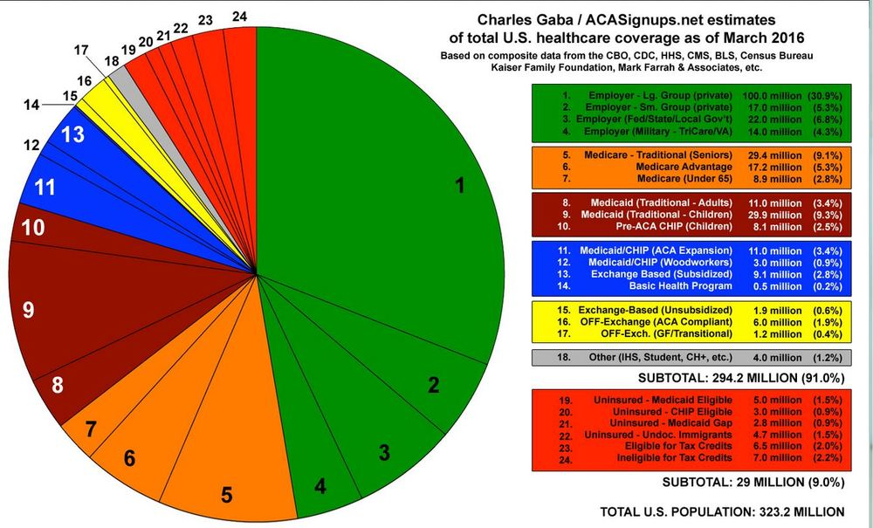
United States Health System
Approximate coverage (2016)
47% employer
17% Medicare
23% Medicaid
3% Self
1% Other
9% Uninsured

Slide 8
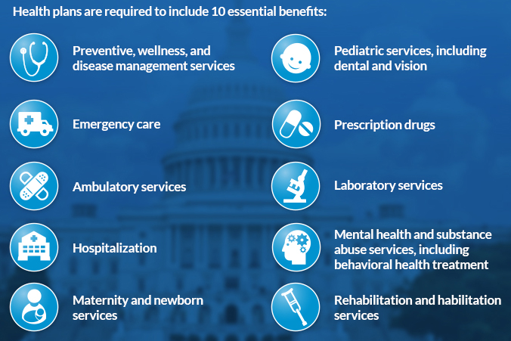
Essential benefits
Essential Health Benefits
Conflict over cost to plans and religious objections
Major holes include: pharmaceutical coverage, dental, and vision care

Slide 9
Health provider management
Primary Care mostly private, registration not required
56% of hospitals are private non-profit, rest are mixed public and for profit
Non-profit vs profit
Consortiums
Medical education is through mostly public institutions but high tuition (average about $40,000 per year)

Slide 10
Major health indicators
Life Expectancy
World – 73, US – 77
Child Mortality
World – 37 per 1,000, US – 6 per 1,000
Maternal Mortality
World – 211 per 100,000 births, US – 19 per 100,000 births
Obesity Rate
World – 13% of population aged over 20, US – 36.2%
Diabetes Rate
World – 9.8% of population aged 20-79, US – 10.7%
Notes:
https://data.worldbank.org/indicator
Obesity: https://www.thelancet.com/journals/lancet/article/PIIS0140-6736(17)32129-3/fulltext

Slide 11
State-level single payer
2011 Vermont passed a law that in theory would lead to single payer insurance in the state
Cost estimated to be $2.5 billion on top of current spending
Vermont’s total tax revenue in 2014 was $2.7 billion
So state taxes would nearly double, payroll taxes increase 11.5%, income tax increase 9%
Vermont’s population is about 623,900 people
$2.5 billion / 623,900 = $4000 tax per person
Medicare and Medicaid would reimburse Vermont for qualified individuals
$2.5 billion needed to pay for non-reimbursed care
Vermont’s governor Shumlin was politically weak

Slide 12
All payer-systems
AKA State Hospital Rate Setting
Goal (same as single payer):
Increase efficiency and reduce insurer overhead in the health care system.
Sets one price that every health insurer pays for any given medical procedure.
Removes job of billing clerk, among others
Currently, bigger plans tend to negotiate deeper discounts.
Private insurance plans pay the most, Medicare pays slightly less, and Medicaid pays the lowest rates.
Con: may lower incentive for innovation and lower provider profits which could be used for experiments.

Slide 13
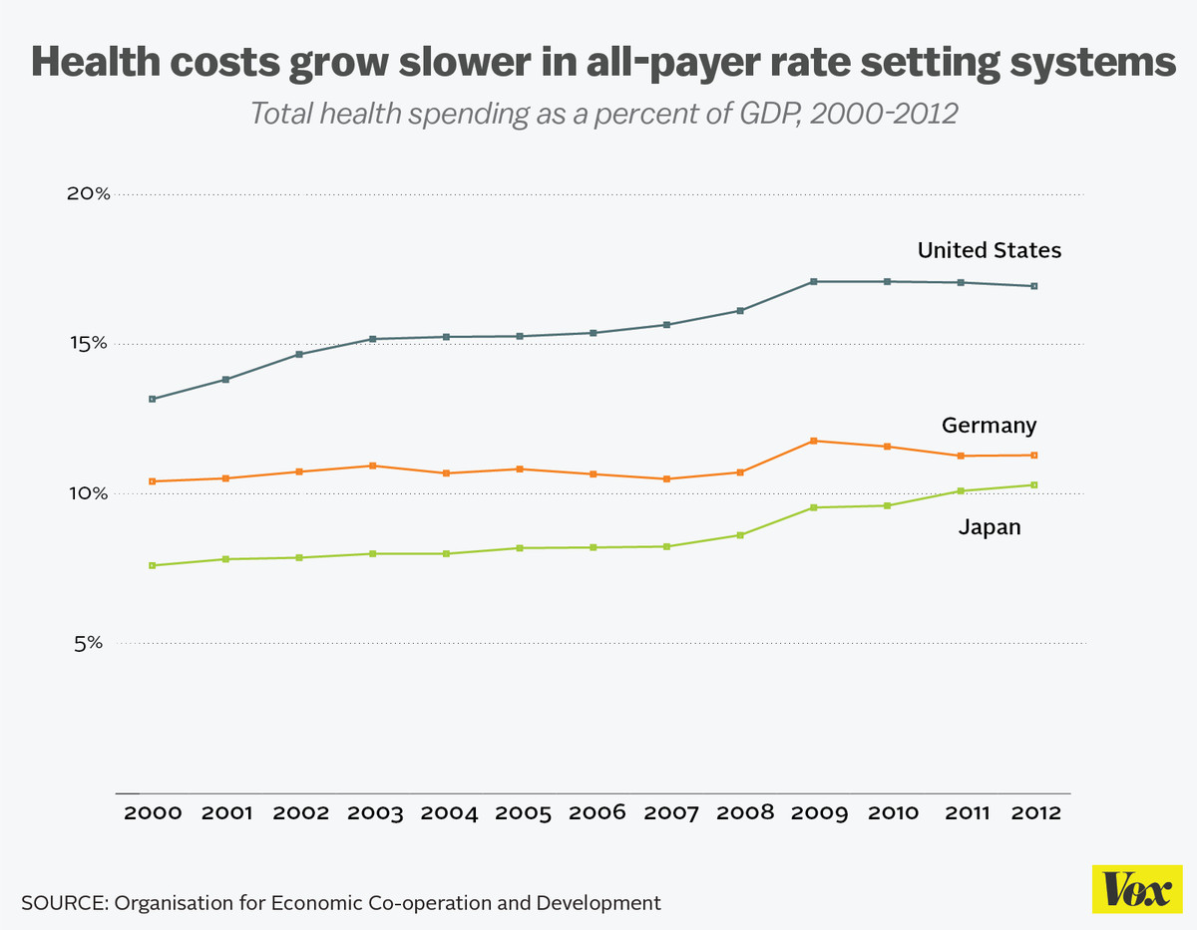
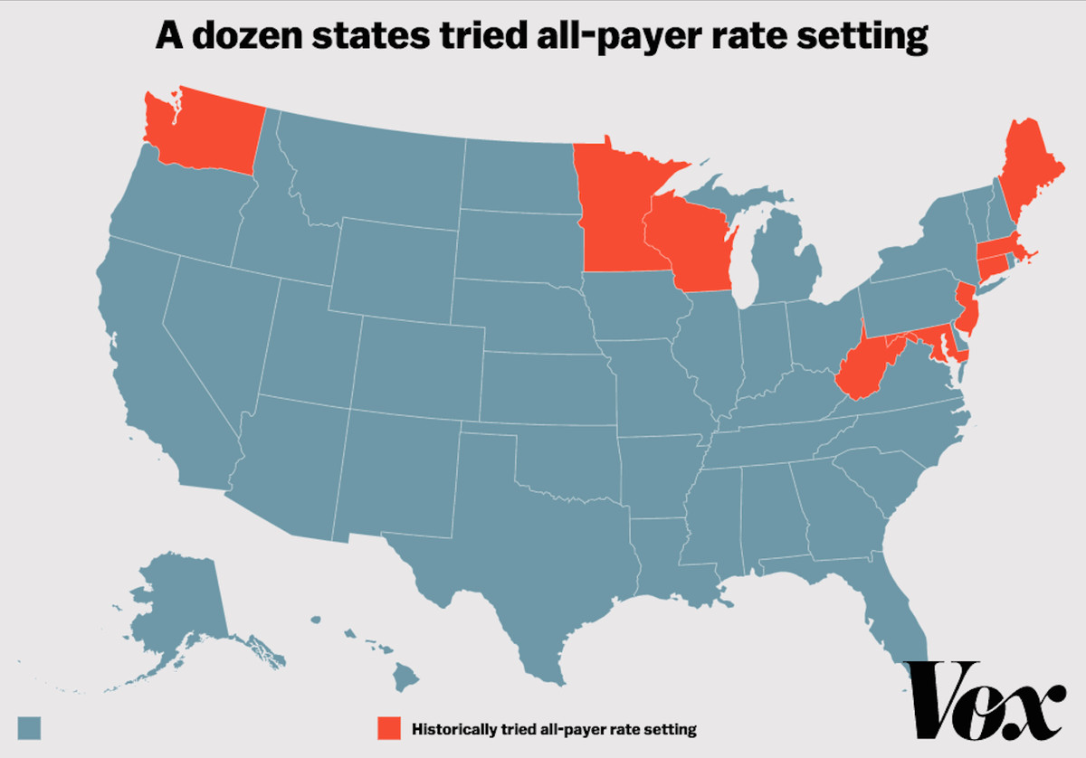
All payer-systems
France, Germany, Japan, the Netherlands, and Switzerland
12 States in the 1970s and 1980s
Killed by HMOs
Only Maryland still uses all-payer
Maryland
Not success story (but not a failure)
Prices have come down substantially
But utilization has increased
Added spending cap in 2014

Slide 14
Stories and myths in the US
Nursing Shortage/physician shortage
Google scholar search for term
Compare to teacher shortage, “no one wants to work anymore” (https://twitter.com/paulisci/status/1549527748950892544)
Nation of uninsured
9%
Private system
Majority public finance, majority of hospitals non-profit or public
Non-profit does not mean altruism first
Socialist
1/3 Medicare are Medicare advantage and 2/3 Medicaid are Medicaid Managed Care
Republicans oppose universal coverage
3:30 of https://www.youtube.com/watch?v=_A0O7IVsVhY
Reagan at https://www.youtube.com/watch?v=56gbHNtd4Is

Slide 15
Problems facing any health care system
1. How does one reconcile the need for regional or national coordination with the ability to respond to local needs?
2. How does one reconcile urban with rural needs and the problems of maldistribution?
3. How does one devise a national health care system and yet honor and foster the energies, creativity, and resources of the voluntary sector?
4. How does one reconcile public accountability with professional autonomy and expertise?
5. How shall primary care be integrated with specialty and hospital care?
6. How shall individualistic principles and patterns of practice be reconciled with national standards and a national system?
7. How is a system to reconcile a focus on the patient with a focus on community and population health?

Slide 16
Canada
Federal single payer system – health under provincial jurisdiction
Public administration, private provision
Providers required to be non-profit
Comprehensive coverage, Universal, Portable, Accessible

Slide 17
Canada: Issues
Financing crisis since the 1980s
Lead to cost controls – cost of care lower in 1997 than 1989
Some support for moving to a privatized single payer system

Slide 18
United Kingdom
National Health Services
Health care should be “free at the point of service,” a founding principle of the NHS.
Funded through income taxes
Focus on:
Primary care
Reducing inequalities
Incentivizing prevention
Uniform salary scale across subspecialists
Cost control, especially for drugs

Slide 19
UK: Managed Competition
Under Thatcher, the UK experimented with reducing regulations and cost controls, allowing providers to control funds, especially for elective services
Experiment failed, largely because providers did not build up the administrative structure to successfully bargaining between providers and provider groups called GP fundholers.
Ended in 1997

Slide 20
France
Fee-for-service private provision reimbursed by the NHI (liberalism)
Famously #1 in 2000 WHO ranking
Slightly over half funded by payroll taxes
Funding system is complex
Some care is paid out of pocket and then reimbursed
Some is fee-for-service
Some is based on estimated annual budgets

Slide 21
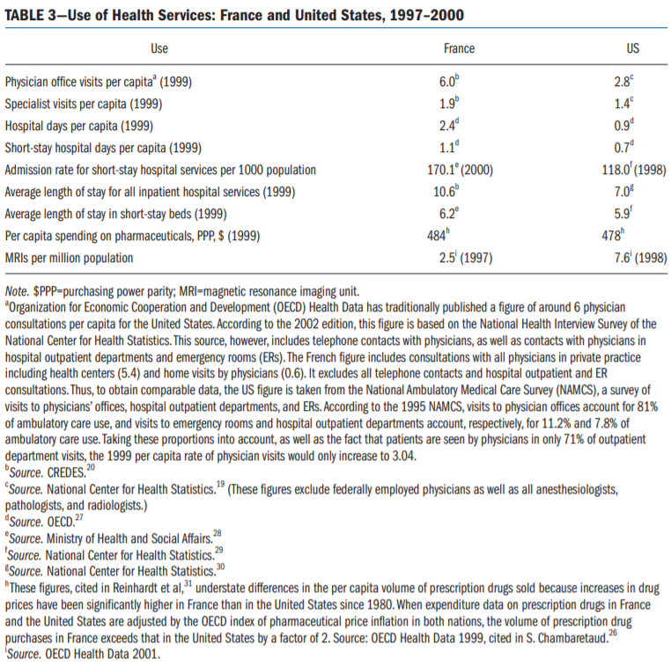

Slide 22
France: Issues
Significant inequalities of resources, outcomes, and quality
Relatively high spending

Slide 23
Germany
Statutory Health Insurance – 92% coverage, rest private or wealthy
Professional autonomy for providers with self-governing bodies
Financed with payroll taxes and regional or occupation based funds

Slide 24
Four Models
Beveridge
Socialized Medicine
UK, Italy, Spain, Norway, Denmark, Finland, Sweden, New Zealand, Cuba
Bismarck
Employer based universal mandated heavily regulated or government controlled insurance
Germany, France, Switzerland, the Netherlands, Japan
National Health Insurance
Public financing, private provision
Canada, Taiwan, South Korea
Other: Out of Pocket, Private Insurance, Mixed Models
US

Slide 25
Visualization
Who pays?
https://vizhub.healthdata.org/fgh/
Videos:
Taiwan - https://www.youtube.com/watch?v=MCDiFIyW0tQ
France - https://www.youtube.com/watch?v=_yF69KVbUaQ
UK - https://www.youtube.com/watch?v=qMNuxPByEW0
Notes:
https://www.youtube.com/playlist?list=PLkfBg8ML-gIngk82SUbTp6Og_KkYfJ6oF

Slide 26
Readings and Sources
January 2003 edition of the American Journal of Public Health
Burau, Viola, and Robert H. Blank. "Comparing health policy: an assessment of typologies of health systems." Journal of comparative policy analysis 8, no. 01 (2006): 63-76.
McDonough, John E. "Tracking the demise of state hospital rate setting." Health Affairs 16, no. 1 (1997): 142-149.
Pauly, Mark, and Robert Town. "Maryland exceptionalism? All-payers regulation and health care system efficiency." Journal of health politics, policy and law 37, no. 4 (2012): 697-707.

