Slide 1
HCMI 4225: Consumer and Insurance Company Behavior
BUSN 202: Mon/Wed 12:30 PM – 1:45 PM
Shane Murphy – shane@uconn.edu

Slide 2
Challenges for Private Health Insurance Companies derived from Changing Public Policy Landscape
Re-insurance
Providing low premiums in a changing regulatory environment
Cost Sharing Reductions for low income individuals
Lowers out of pocket maximums
Increases Actuarial Value (increasing coverage amounts)
Federal funding cut – Insurance companies have chosen to continue to provide
Advanced Premium Tax Credits
Gaming System
Silver Gapping
Silver Spamming
Accommodating New Models of Health Insurance
Accountable Care Organizations
Medical Home and Bundled Payment Models
Managed Care Organizations

Slide 3
Re-insurance pools
Two flavors
State run external money
External source of state based money is added to the pool of money collected by premiums.
Only adopted in few states
CMS run catastrophic reinsurance
Funded by premiums
High-cost risk pool
Reimburses issuers for 60 percent of an enrollee’s aggregated paid claims costs exceeding $1 million.
Reinsurance reduces overall premiums
Reduces high premiums more than low premiums
Reduces non-subsidized premiums and raises subsidized premiums

Slide 4
Advanced Premium Tax Credits (APTC) (and Gold gapping aka silver loading)
Advanced Premium Tax Credits (APTC) are how people get subsidized to buy Qualified Health Plans on Exchange.
Based on an individual’s income as determined by their family unit’s FPL percentage and the cost of the second least expensive Silver plan offered on Exchange in their area.
Second least expensive plan is called the benchmark plan
The subsidy arrangement means that individuals with the same exact financial situation will pay the same amount post-APTC subsidy for the second lowest cost Silver plan across the country.
Zero premium plans happen when a plan is priced below the silver benchmark and the relative premium spread is bigger than the individual’s expected personal contribution.
For the 100-138% cohort, the personal contribution for a single individual ranges from $22/month to about $55 per month for the benchmark silver plan.
The goal is for premiums of cheapest plans not to exceed 9.66% of income

Slide 5
Silver gapping (and Gold gapping)
Advanced Premium Tax Credits (APTC) are how people get subsidized to buy Qualified Health Plans on Exchange.
Based on an individual’s income as determined by their family unit’s FPL percentage and the cost of the second least expensive Silver plan offered on Exchange in their area.
Second least expensive plan is called the benchmark plan
The subsidy arrangement means that individuals with the same exact financial situation will pay the same amount post-APTC subsidy for the second lowest Silver plan across the country.
Zero premium plans happen when a plan is priced below the silver benchmark and the relative premium spread is bigger than the individual’s expected personal contribution. For the 100-138% cohort, the personal contribution for a single individual ranges from $22/month to about $55 per month for the benchmark silver plan. The benchmark plan is a silver plan with 94% AV CSR benefits. That translates into a deductible ranging from zero to a few hundred dollars and an out of pocket max of less than $2,000. Compared to a baseline silver, this is a great improvement in the quality of the benefit. It is still significantly worse than Medicaid if we assume appointments can be found.
Silver gapping is the measure of the spread between the least expensive Silver plan in a county and the benchmark Silver plan.
The bigger the spread, the better the deal that subsidized folks may be able to get.
The smaller the spread, the worse (comparative) deal subsidized buyers get.
Silver gapping is only about the relative differences in price and not about the absolute price levels.
Increase in premiums from cancelling CSR reimbursement is thus partially offset by increasing APTC to consumers
Although Insurance companies must be aware of an use this strategy
Total payments from the government and receipts by insurance companies are less affected by cancelling CSR reimbursement

Slide 6
Silver Gapping
Maximizing silver gap maximizes the relative value of the APTC subsidy
Carriers offer a low price Silver and then a higher priced Silver as the benchmark
Drive people to the #1 Silver plan as it will be comparatively cheaper than the #2 Silver. It will also have the ability to drive people to very low premium Bronze plans.
Example in CA:
Region 16 that Molina made its play and gained its share. Molina put up both the cheapest silver and the cheapest bronze plans in that region — massively undercutting the benchmark silver plan, and thus offering buyers a major discount on the Cost Sharing Reduction (CSR) subsidies available only with silver. For a 40 year-old earning $23,000, a shared under 200% of the Federal Poverty Level (FPL), Molina silver is just $74 per month in Region 16 in 2016, vs. the benchmark silver’s $119 (Health Net). Molina’s bronze plan at that age and income level is just $1 per month, vs. $55 for the nearest competitor.

Slide 7
Silver Spamming
The goal of an insurer in the Silver Spam strategy is to offer the #1 and #2 silver plans in the region with a very small gap between those two.
Furthermore if they can keep the price of the second Silver significantly lower than the price of the first Silver plan offered by a competitor, they’ll capture a large segment of the market.
The objective of the Silver Spam strategy is to take away choice.
The relative value of the APTC when applied to the purchase of the 1st Silver is not much higher than it is when applied to the #2 benchmark Silver.
If there is a large gap between the Silver Spammer’s Silver plans and the next best offer, the Silver Spammer will capture a large proportion of the market for Silver and should (all else being equal) capture a decent proportion of the Bronze market.
Example in Chicago:
For a 40 year old non-smoker, Celtic/Ambetter offers the 1st and 2nd Silver at $195 and $198, as well as the next four Silvers. The first non Celtic/Ambetter Silver is priced at $249.
The Celtic/Ambetter Silvers are all HMOs, and they all are sharing the same very narrow network. The benefit configuration (deductibles and co-insurance) change, but the out of pocket maximums are all tightly clustered. These six plans are functionally similar plans. The business decision to introduce these six plans, and more importantly the #2 Silver at just a few bucks more than #1 is a membership recruitment decision.
Both these “APTC hacking” strategies capitalize on regions with a small number of insurers

Slide 8
Advantages of zero premium plans
Research suggests the main mechanism why zero-premium matters is it helps low-income households begin coverage sooner
Deadlines matter
People sign up for insurance the day of the deadline (Dec 15 for ACA marketplace)
First premiums are often due soon after (Jan 1 for ACA marketplace plans)
Notes:
Drake, Coleman, David Anderson, Sih-Ting Cai, and Daniel W. Sacks. "Financial transaction costs reduce benefit take-up evidence from zero-premium health insurance plans in Colorado." Journal of Health Economics 89 (2023): 102752.

Slide 9
ACA marketplace Metals

Slide 10
Cost Sharing Reductions
Lower enrollees’ out-of-pocket cost due to deductibles, copayments, and coinsurance
Eligibility up to 250% FPL
Applies only to silver plans, but transforms cost sharing into a more gold or platinum model
Silver plans with the most generous level of cost sharing reductions are sometimes called CSR 94 silver plans
With 94 percent actuarial value, which represents the average share of health spending paid by the health plan, compared to 70 percent actuarial value for a silver plan with no cost sharing reductions

Slide 11
Customer behavior
Efforts to get customers to shift health insurance plans, even when such a shift is good for them, is very hard.
Informing people that they are eligible for CSR 94 plans causes some to switch
But many do not
Why?
Notes:
Lovchikova, Marina, Andrew Feher, and Langou Lian. "Health Plan Switching and Health Care Utilization: A Randomized Clinical Trial." In JAMA Health Forum, vol. 5, no. 3, pp. e240324-e240324. American Medical Association, 2024.

Slide 12
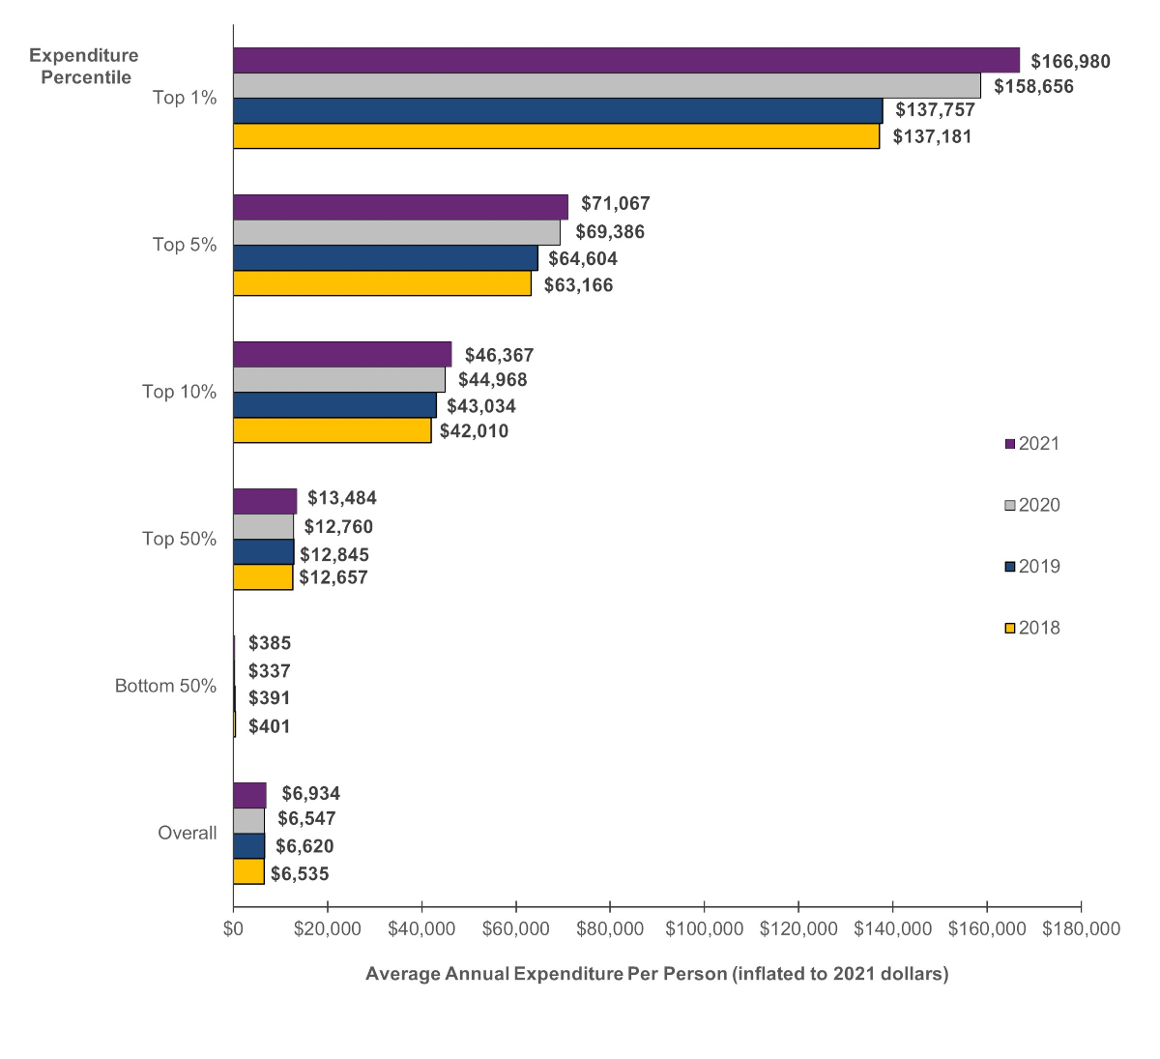
Remember, most people do not use much healthcare
The bottom 50% of spenders spend under $400 per year on health care
Notes:
https://meps.ahrq.gov/data_files/publications/st556/stat556.shtml

Slide 13
Customer behavior
First! Getting onto the first page matters
https://www.accesshealthct.com/AHCT/official/famInfo/loadFamilyInfo
Cost sharing expenses are unknown to patients until after care
So cost sharing financial risk is pushed onto the patient
Does this affect moral hazard?

Slide 14
Customer behavior
The effect of cost sharing vs premium subsidies:
Since most people are low users of health care, cost sharing reductions don’t help them
If cost sharing reductions increase average premiums, then cost sharing reductions will make care more affordable for high utilizers, but will make insurance less affordable for the majority, who are low utilizers

Slide 15
Quick note about failure of Medicaid expansion
47% of the ACA marketplace enrollment is from North Carolina, Georgia, Florida, and Texas
~10 Million people
Over a quarter of 18 to 64 year olds in Florida have an on-market ACA plan.
Medicaid expansion close to passing in Mississippi (work requirement?)
State | Platform | Enrollees | National Share
Florida | HealthCare.gov | 4,211,902 | 19.8%
Georgia | HealthCare.gov | 1,305,114 | 6.1%
North Carolina | HealthCare.gov | 1,027,930 | 4.8%
Texas | HealthCare.gov | 3,484,632 | 16.4%

Slide 16
VA cost savings compared to Medicare
The VA can credibly threaten to exclude numerous drugs
The VA pays 40% less than Medicare plans for prescription drugs.
Medicare plans cover about 85% of the most popular 200 drugs on average (ranging from a low of 68% to a high of 93%).
The VA’s national formulary includes 59% of the most popular 200 drugs.
Canada can do the same
This is why importing drugs from Canada is appealing
Florida currently developing program to import for its Medicaid program
If it works, likely to spread

