Slide 1
HCMI 4448: Clinical and Social Issues in Health Care
Busn 203: Wed 6:00 PM – 8:50 PM
Shane Murphy – shane@uconn.edu
Office Hours: Wed 4:00 PM – 6:00 PM

Slide 2
Types of nurses
Certified Nursing Assistant (CNA)
Median salary: $36,220 per year or $17.41 per hour
Career outlook: 4% growth from 2022 to 2032
Education requirements: State-approved training program
Job duties: Gathering bedside supplies, assisting patients with ADLs, assisting with medical procedures, answering patient calls, and obtaining vital signs.
Licensed Practical Nurse (LPN)
Median salary: $54,620 per year or $26.26 per hour
Career outlook: 5% growth from 2022 to 2032.
Education requirements: Accredited practical nursing certificate program, which is usually offered at community colleges and takes about a year to complete.
Job duties: Provide patients with essential care, including eating, drinking, and bathing, as well as taking blood pressure, inserting catheters, and recording vital signs.
Registered Nurse (RN)
Median salary: $81,220 per year or $39.05 per hour
Career outlook: 6% growth from 2022 to 2032.
Education requirements: ADN, BSN, or RN diploma.
Job duties: Care, education, and coordination of sick and dying patients. Responsibilities include assessing patients, administering medications and treatments, and collaborating with other healthcare providers. Responsibilities include assessing patients, administering medications and treatments, collaborating with other healthcare providers, educating patients and families on disease processes and management, and assisting with procedures.
Nurse Practitioner (NP)
Median salary: $124,680 per year or $59.94 per hour
Career outlook: 45 percent growth from 2022 to 2032.
Education requirements: MSN from an NP program.
Job duties: Varies by NP specialty, but generally, they prescribe medication, examine patients, order diagnostic tests, diagnose illnesses, and provide treatment.

Slide 3
Specialties
No or optional certification
Labor/Obstetrics
Pediatrics
Neonatal ICU
Oncology
ER RN
Less optional or required certification
ICU RN
Surgical RN
OR RN
Post-Anesthesia CU RN
Trama RN
MSN required
NP
Certified Nurse Midwife
Certified Registered Nurse Anesthetist
Clinical Nurse Specialist
Nurse Educator
Nurse Administrator
Clinical Nurse Leader

Slide 4
Measuring Nurse staffing
patient-to-nurse ratios
number of full-time equivalent (FTE) nursing staff per patient day
number of nursing hours per patient day (HPPD)
skill mix of nursing personnel, usually registered nurse (RN) skill mix, measured by the proportion of hours provided by RNs in the total nursing staff
perceived staffing adequacy
RN ratio – RN to aid skill mix (85% is common goal, other targets include 70%)

Slide 5
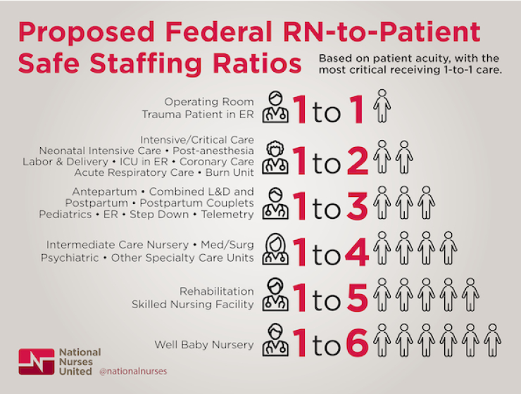

Slide 6
Measuring Nurse staffing
Indirect vs direct patient care
Supervisory nurses and coordinators of patient care
Productive or non-productive care
Time spent in vacation, sick leave, or continuing education
Work-to-paid ratio

Slide 7
Measures of nursing quality
Decubitus ulcer – bed sore
Failure to rescue (FTR) – death from complications after surgery due to:
Omission of care
Failure to recognize change in patient condition
Failure to communicate change in patient condition
Poor clinical decision making
Hospital acquired infections

Slide 8
Nursing Care Delivery Models
Patient Focused Care
RNs as care managers and aids/assistants in expanded roles, possibly including drawing blood, performing EKGs, and other assessments
Primary or Total Nursing Care
All-RN staff for all direct care, allows RN to care for same patient throughout stay
Team or Functional Nursing Care
RN is team leader, aids perform activities such as bathing and feeding, nurses’ duties may be split into “medication nurse” and “treatment nurse”
Magnet Hospital Environment
High RN autonomy, MD-RN collaboration, shared governance/decision making between RNs and managers

Slide 9
Effects on patients of different models
Limited effects across the board
In general, RNs are better than aids
But hospitals do not implement disastrous models
Garden of forking paths
Butler, Michelle, Timothy J. Schultz, Phil Halligan, Ann Sheridan, Leigh Kinsman, Thomas Rotter, Jonathan Beaumier, Robyn Gail Kelly, and Jonathan Drennan. "Hospital nurse‐staffing models and patient‐and staff‐related outcomes." Cochrane Database of Systematic Reviews 4 (2019).

Slide 10
Effects on nurses of different models
Nurse staffing shortages increase risk of intent-to-leave, burnout, and job dissatisfaction
And maybe needlestick injury
Shin, Sujin, Jin-Hwa Park, and Sung-Heui Bae. "Nurse staffing and nurse outcomes: A systematic review and meta-analysis." Nursing outlook 66, no. 3 (2018): 273-282.

Slide 11
Occupational Burnout
Chronic workplace stress that hasn't been successfully managed
Symptoms characterized by
feelings of energy depletion or exhaustion
increased mental distance from one’s job
feelings of negativism or cynicism related to one's job
reduced professional efficacy
Maslach Burnout Inventory-Human Service Scale
The 22-item measure comprises 3 subscales: emotional exhaustion (9 items), depersonalization (5 items), and personal accomplishment (8 items).
The items are framed as statements of job-related feelings (eg, "I feel burned out from my work," "I feel confident that I am effective at getting things done"), and are rated on a 7-point frequency scale (ranging from "never" to "daily").
Burnout is reflected in higher scores on emotional exhaustion and depersonalization and lower scores on personal accomplishment.

Slide 12
Needle-stick injury
High frequency event
Infections rare
Prior Vaccination and Post-exposure prophylaxis (PEP) important
HIV
Risk of transmission from a single percutaneous needle stick or cut with a scalpel from an HIV-infected individual is about 0.3%
Hepatitis B (and C)
100x more common than HIV in absence of vaccine, but vaccine has greatly reduced risk
PEP within 24 hours key
Hep C more dangerous, no PEP, no vaccine, but rarer
Safety devices less effective than proper policies and disposal
Notes:
https://www.ncbi.nlm.nih.gov/books/NBK493147/

Slide 13
Reducing Early-career burnout
Programs
Mentoring programs, Preceptorship, Orientation, Clinical ladder/advancement programs
Residency, Externship
Mechanism
Peer support, relationship
Commitment to career development
Teaching/training -> Increase competence and confidence

Slide 14
Nursing Shortage
Growing demand
20th century
Increasing number of hospitals, increasing medical technology
21st century
Aging population
Decreasing supply
20th century
Low salary and poor conditions/treatment
Decrease in financing of nursing students after WWII
Shift to aids: Estimates of the proportion of patient care provided by professional nurses declined from over 70 percent in 1941 to only 30 or 40 percent in 1951.
Increase in tuition late in century and into 21st century
21st century
Wages
Everywhere (check Gscholar)
Compare to teaching, “no one wants to work anymore”
Notes:
https://www.nursing.upenn.edu/nhhc/workforce-issues/where-did-all-the-nurses-go/

Slide 19
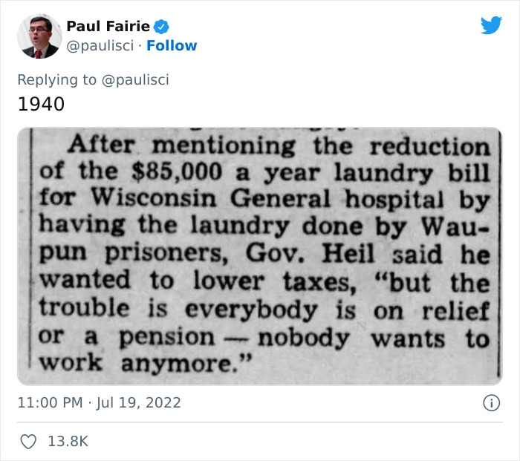
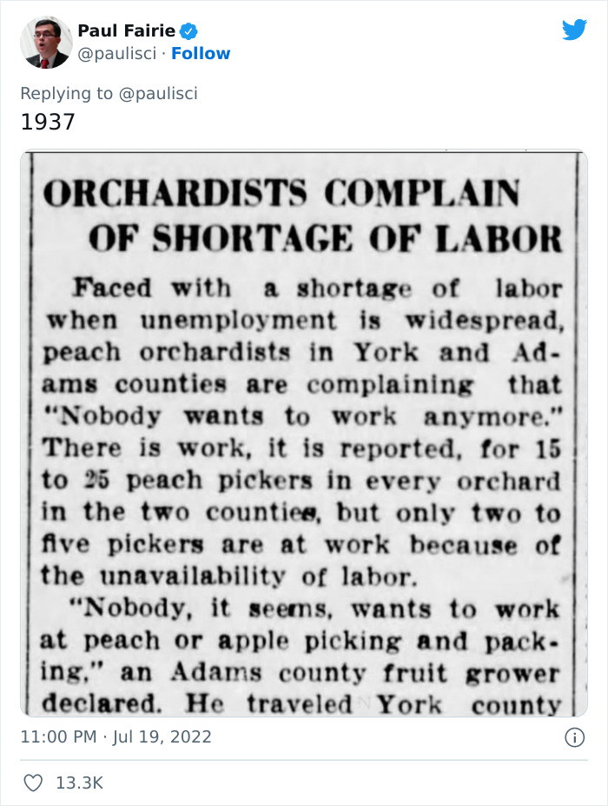

Slide 20
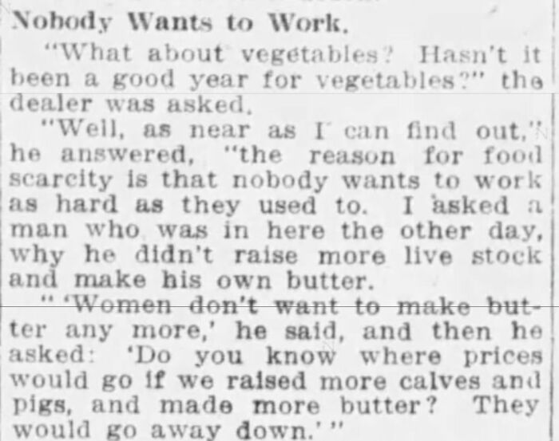

Slide 21
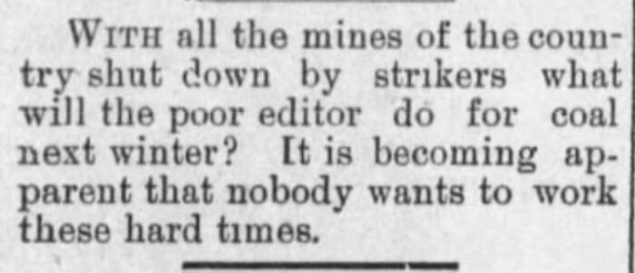

Slide 22
Nursing retention
What can increase nurse retention?
Work environment
Adequate, qualified staffing
Wages
Autonomy and governance
Quality patient care

Slide 23
Nursing retention: Work environment
Lower workload (improved patient to nurse ratio)
Educated workforce
Why?
Nurses given flexibility to make decisions in an environment of trust and respect
Promoting the status of nursing as independent practitioners by clearly defining the role and improving salaries
Encourage education, support specialty certification with salary increases
Clinical career ladder programs
Staffing and resource adequacy
Adequate numbers of staff, appropriate skill mix, Retention of experienced staff
Collaborative nurse–physician relationships

Slide 24
Nursing retention: Governance
Empowering work structures, characterised by access to information, support, opportunity and resources, enhanced meaning in work
Increase employees understanding of the rationale behind decision making
Nurse advocates on major committees
Nursing grand rounds
Journal clubs, professional conferences, workshops
Magnet
Acknowledgement
Access to hospital executive

Slide 25
Nursing retention: Leadership
Managers should aim to be visible, accessible and responsive to their staff
Key attributes of a clinical leader: “…expert clinical skills, patient-focus, vision, stamina, innovation, dynamism, confidence, selflessness, assertiveness and collaboration with other health professionals”
Stability in leadership positions
Encourage collaborative relationships
Mentorship, supervision programmes and involvement in professional societies

Slide 26
Quick note about cost-effectiveness
$80,000 to $200,000 per life year
$10M to $20M per life saved

Slide 27
Cost-effectiveness of nurse staffing and training
Increasing staff from 8 patients per nurse to 7:
$56,394 to $30,593 per life saved
Increasing staff from 5 patients per nurse to 4:
$174,464 to $86,864 per life saved
Increasing nursing hours per patient day to the 75th percentile compared with a ‘do nothing’ approach was associated with an ICER of US$25,702 per avoided death and US$2,572 per life year gained
Daily cost of $4,030 for a survival rate of 976·2/1000 patients (8 PTN ratio/20% RNs) to a daily cost of $7,746 for a survival rate of 983·5/1000 patients (4 PTN ratio/80% RNs).
Increasing training may be cost-benafitial
Increasing the RN proportion to the 75th percentile

Slide 28
Cost-effectiveness of nurse staffing and training
Societal benefits larger than benefits for hospital
Hospitals generally see higher costs
Incentive to provide good care, but maybe not best possible care
Offset only partially by decline in readmissions/ED visits
Non-linear effect/diminishing returns
Effect declines as nursing ratio improves

Slide 29
More Issues in Optimal Staffing
Planning for average demand can be inefficient because of the high cost of being understaffed during rushes
“over-staffing” much less costly than understaffing
Nurse shortage may be largest and most detrimental in middle pay bands

Slide 30
Travel nursing
AKA temporary nurses, agency nurses, or contract nurses
Travel nursing began in the 1980s (hovering around 4% up until 2008)
Grew to 10% from 2021-2023 (Covid)
Recently declining
Can cost 3x to 4x, recently pay is declining
Mixed estimates on effect on patient outcomes
Travel nurses may have broader experience and skill
But come with disruption and may be less experienced overall
6, 8, 13 week contracts common

Slide 31
Pediatric Travel Nurse Experience
Theme | Subcategory | Definition
Financial | • Advancement • Advocating • Uncertainty | • Salary is 2-3 times higher than a permanent staff nurse. • Asking for a raise in salary • Salaries can vary; there is a certain risk to leaving a permanent job. Contracts can be canceled at any time.
Flexibility | • Schedule • Clinical practice | • Have control over days off and time off in between contracts • Can try different types of nursing units
Searching for healthy work environments | • Impact of COVID-19 • Short staffing • Burnout • A way out • Impact of travel nursing on environment | • Nurse constantly under stress from short staffing • Feeling mentally and physically exhausted • Poor leadership • Not locked into a unit; can leave after the contract • Negative impact of travel nurses with permanent staff
Just nursing care | • Just patient care • Less acute patients | • Responsible for only patient care; no other committee or unit responsibilities • Patient assignment
Solutions | • Improving retention of the bedside role | • Improved pay • More flexibility with time off • Decreased workload • Healthy work environment • The role as a career
Notes:
https://www.youtube.com/watch?v=rVN4p6ebIXk&ab_channel=JerineNicole

Slide 32
Career strategizing
Movement between jobs is natural part of career path
Increases in education/role/pay often come with job changes
Create pathway for employees within organization
Advocate employees self-identify desire to increase role
Including growing within and beyond organization
Work-life and family-life issues
Family and medical leave
Extended leave of absence

Slide 33
Discussion
Experience with nurses
CNAs
Cost-effectiveness and management
Travel Nursing

Slide 34
Sources
Park, Shin Hye, Mary A. Blegen, Joanne Spetz, Susan A. Chapman, and Holly A. De Groot. "Comparison of nurse staffing measurements in staffing-outcomes research." Medical Care 53, no. 1 (2015): e1-e8.
Hall, Linda McGillis, Diane Doran, G. Ross Baker, George H. Pink, Souraya Sidani, Linda O’Brien-Pallas, and Gail J. Donner. "Nurse staffing models as predictors of patient outcomes." Medical care 41, no. 9 (2003): 1096-1109.
Hall, Linda McGillis, Diane Doran, and George H. Pink. "Nurse staffing models, nursing hours, and patient safety outcomes." JONA: The Journal of Nursing Administration 34, no. 1 (2004): 41-45.
Twigg, Di, and Kylie McCullough. "Nurse retention: A review of strategies to create and enhance positive practice environments in clinical settings." International journal of nursing studies 51, no. 1 (2014): 85-92.
Brook, Judy, Leanne Aitken, Rebecca Webb, Julie MacLaren, and Debra Salmon. "Characteristics of successful interventions to reduce turnover and increase retention of early career nurses: A systematic review." International journal of nursing studies 91 (2019): 47-59.
Twigg, Diane E., Helen Myers, Christine Duffield, Margaret Giles, and Gemma Evans. "Is there an economic case for investing in nursing care–what does the literature tell us?." Journal of advanced nursing 71, no. 5 (2015): 975-990.
Jones, Cheryl Bland, and R. N. Michael Gates. "The costs and benefits of nurse turnover: A business case for nurse retention." Online Journal of Issues in Nursing 12, no. 3 (2007): N_A.
Saville, Christina E., Peter Griffiths, Jane E. Ball, and Thomas Monks. "How many nurses do we need? A review and discussion of operational research techniques applied to nurse staffing." International journal of nursing studies 97 (2019): 7-13.
Vander Weerdt, Candice, Jessica A. Peck, and Tracy Porter. "Travel nurses and patient outcomes: A systematic review." Health care management review 48, no. 4 (2023): 352-362.
Hickey, Patricia A., Jean Anne Connor, Jon Whiting, and Laura J. Wood. "The Voice of Travel Nurses: Facilitating Effective Staffing During Pandemic and Expansion-Related Demands in a Children's Hospital." JONA: The Journal of Nursing Administration 54, no. 4 (2024): 213-219.

