Slide 1
HCMI 4448: Clinical and Social Issues in Health Care
Busn 203: Wed 6:00 PM – 8:50 PM
Shane Murphy – shane@uconn.edu
Office Hours: Wed 4:00 PM – 6:00 PM

Slide 2
Definition and Measurement of Obesity
Body Mass Index (BMI) = kg/m^2
Definition of obesity
Youth: BMI > historic 95th percentile
Adult: BMI > 30 (for person 5’9”, this is 203 lbs, person 5’4”, this is 175 lbs)
Ignores difference in density of muscle vs fat
BMI’s relationship with health outcomes differ by important factors including race
Alternative: Percent body fat or fat mass
But most literature uses BMI – ease of use

Slide 3
Fat is an Organ
Fat is not just passive tissue.
Its an endocrine organ
Secretes two major hormones
leptin, which controls appetite (decrease in leptin stimulates appetite)
adiponectin, which is connected to blood sugar levels
In this way, obesity is an organ disease
leading to an excess in hormone leptin resistance
A decrease level of adiponectin, which decreases insulin sensitivity

Slide 4
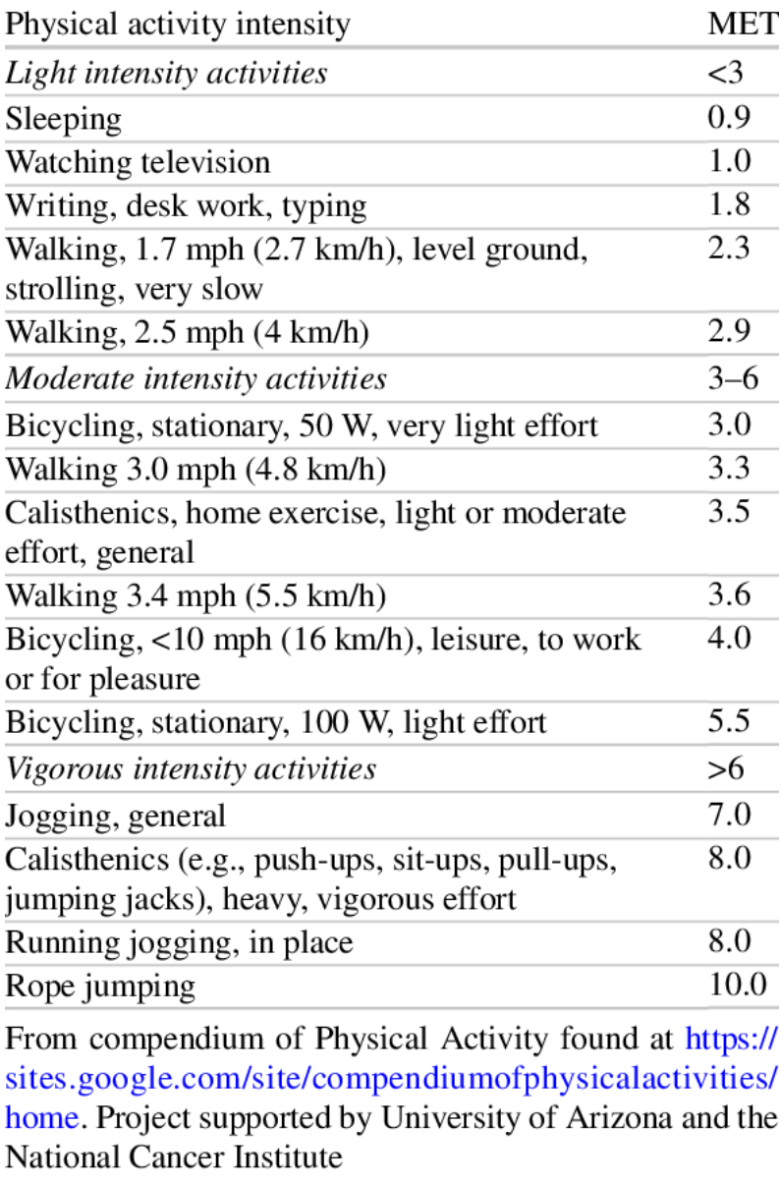
Metabolic Equivalents (METs)
Measure of physical exertion of different activities
1 MET is resting exertion
Calculated by considering oxygen consumption by the body during different activities
Assumptions?
METS X 3.5 X BW (KG) / 200 = KCAL/MIN
Compendium of physical activities:
https://sites.google.com/site/compendiumofphysicalactivities/home

Slide 5
Weight equals calories in minus calories out(?)
Calories out hadn’t changed as of 2003
Recent evidence suggests some groups now exercise more
Labor intensity of jobs changed?
Increased caloric intake for men and women from the late 1970s to the late 1990s

Slide 6
Calories
Approximately 3500 calories is one pound
Basal metabolism and calories burned during exercise increase with weight
Changes with age and sex
As a result, there is a equilibrium weight associated with any calorie consumption level
Increase in average weight in the US from 1977-1995 result from an average increase of 100-150 calories. Increase from 1977-2015 from 220 calories.
Denoting K as daily calories consumed:

Slide 7
Obesity is a small change in habits
Schofield, Schofield and James, 1985; Whitney and Cataldo, 1983 estimate the 10- to 12-pound increase in median weight occurring in the past two decades requires a net caloric imbalance of about 100 to 150 calories per day
One hundred and fifty calories per day is three Oreo cookies or one can of Pepsi.
It is about a mile and a half of walking

Slide 8
~200 Calories of Food!
100-150 calories and 220 calories is not very much food
Note: there are implications of this for individual dieting, but this class is not seeking to give dieting advice
Notes:
https://height-weight-chart.com/
https://www.strava.com/athletes/75382103

Slide 9
Causes of rise in obesity
Small energy surplus – 200 calories per day
Smaller than “noise” in consumption and exertion data!
Large set of explanations
Decreased sleep
Exposure to endocrine disruptors
Decreased exposure to extreme heat (due to AC)
Increased consumption of pharmaceuticals
Increased maternal age at birth
Higher rate of reproduction among individuals with genetic predisposition to obesity
Viruses
Gut Microbes
Price of food
Cutler 2003
Notes:
https://www.cornell.edu/video/john-cawley-economics-of-obesity

Slide 10
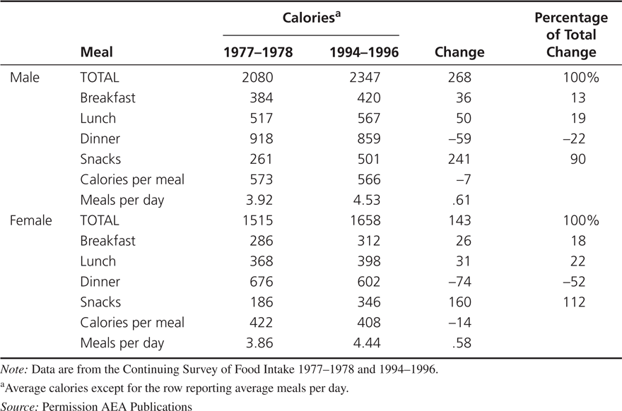
Why Has Obesity Increased?
Increased caloric intake for men and women from the late 1970s to the late 1990s and no significant change in caloric expenditure.
Changes in Food Consumption, 1977-1978 to 1994-1996

Slide 11
Technological innovation in food
Vacuum packing
Improved preservatives
Deep freezing
Artificial flavors
Microwaves
Enable food manufacturers to cook food centrally and ship it to consumers for rapid consumption

Slide 12
Technological innovation in food
Vacuum packing
Improved preservatives
Deep freezing
Artificial flavors
Microwaves
These methods do not in themselves necessarily contribute to obesity
Economic studies generally do not find things like preservatives unhealthy
Exceptions exist

Slide 13
But the food environment is driving obesity
Vacuum packing
Improved preservatives
Deep freezing
Artificial flavors
Microwaves
plus
Marketing
Ubiquity
Wealth

Slide 14
Potato: The social scientists favorite food
High nutrition and calorie value
Easy to grow
Played role in population and urbanization growth in the past 300 years
Shift from baked, boiled, or mashed to fried forms
Raw potatoes store well
Pealed, cut, cooked, and flash frozen to be fried the most common current form
Potato consumption from 1977-1995 up 30%

Slide 15
Why Has Obesity Increased?
Increased caloric intake for men and women from the late 1970s to the late 1990s and no significant change in caloric expenditure.
Changes in Food Consumption, 1977-1978 to 1994-1996

Slide 16
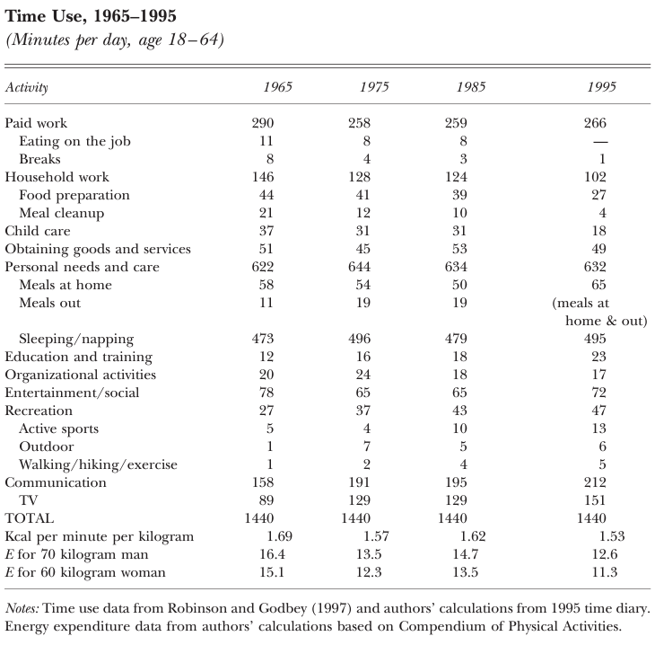
Time Use
Large changes in time use
Decrease in paid and household work times
Particularly meal cleanup
Increase in Recreation, TV
E declined by about 25%
4 points

Slide 17
Possible explanations
Increase in income
But incomes are negatively associated with obesity in general
Decrease in price of food relative to other goods
Relative decrease in food prices limited
Rise of mass production
See next slides

Slide 18
Food technologies
Technology often most important factor in economic change over time
Controlled and modified atmosphere processing
Slow ripening and prevent spoilage
Hydrogen peroxide sterilization and stretch-wrap films
Flavor barrier technology
Artificial flavors
Polyethylene packaging for moisture control
Increase in microwave ownership (1978: 8%; 1999: 83%)

Slide 19
Implications of the time-cost theory of obesity
The lower costs of food preparation mean that individuals should consume a wider range of products at more times during the day.
The increase in food consumption should come mostly in foods that had an improvement in mass preparation technology (and complements to those foods).
Individuals who have taken the most advantage of the new technologies should have had the biggest increase in obesity.
Obesity rates should be higher in countries with greater access to technological changes in food consumption.

Slide 20
Prices, income, and education
No to limited evidence that unhealthy food prices affect consumption of unhealthy food
No to limited evidence that fast food prices affect consumption of fast food
No to limited evidence that increase in low income welfare support increased obesity
Social security, EITC, Native American Casino windfalls
Education has no or limited effect on male weight, may reduce risk of obesity for women
Notes:
https://www.cornell.edu/video/john-cawley-economics-of-obesity

Slide 21
Peer effects
Recent research has found living in high-income neighborhoods leads to many positive economic outcomes for low- and high-income individuals
Education
Employment
Wages
And Health including Obesity
Women roommates but not men?
Notes:
https://www.cornell.edu/video/john-cawley-economics-of-obesity

Slide 22
New hotness - Ozempic
Semaglutide (Ozempic®) is a new once-weekly agonist of glucagon-like peptide-1 receptors (GLP-1 AR)
Second/third gen, including GLP-2 agonists are possible
Wasting – technical term for losing weight, particularly muscle mass
Common in aging individuals
Can be treated with HGH
FDA approved for diabetes treatment, off-label use for weight loss
Equally effective in terms of kgs lost across weights (this is not necessarily a good thing)
Critiqued as starvation weight loss
1.7% of Americans prescribed by end of 2023
Notes:
Ghusn, Wissam, Alan De la Rosa, Daniel Sacoto, Lizeth Cifuentes, Alejandro Campos, Fauzi Feris, Maria Daniela Hurtado, and Andres Acosta. "Weight loss outcomes associated with semaglutide treatment for patients with overweight or obesity." JAMA Network Open 5, no. 9 (2022): e2231982-e2231982.

Slide 23
Science-y science
Direct effect on blood sugar (this is why it was initially a good candidate for Type II diabetes treatment)
“Semaglutide stimulates insulin secretion from beta-pancreatic cells and reduces glucagon production from alpha-pancreatic cells, in a glucose-dependent way for both, thus decreasing fasting and postprandial plasma glucose. Gastric emptying can also be delayed following semaglutide administration.”
Direct effect on appetite
“Semaglutide treatment was associated with lower ad libitum energy intake during all the subsequent meals after a standardized breakfast, resulting in reduced ad libitum total energy intake, with no effect on resting metabolic rate. The observed decreased total energy intake appeared to be attributed to the suppression of appetite, rather than to nausea or food aversion. With regard to reduced appetite, semaglutide treatment induced less hunger and food craving, as well as a lower preference for high-fat foods, while it was associated with a better control of eating and meal portion size.”
Ad libitum – food is always available
Mechanism in the brain, liraglutide vs semaglutide
“Taking into account that the weight loss efficacy of the long-acting GLP-1 RA liraglutide has been shown to be mediated in rodents mainly through the activation of proopiomelanocortin and cocaine- and amphetamine-regulated transcript neurons within arcuate nucleus of the hypothalamus and not via any peripheral action on the gastrointestinal vagal nerves, the above-mentioned effects of semaglutide on appetite suppression may be mediated through a relevant central mechanism involving hypothalamus. On the contrary, native GLP-1-induced decrease in food intake appears to be mediated mainly through a peripheral mechanism, since native GLP-1 has been found to delay both gastric emptying and gut motility with the subsequent activation of gastric mechano-receptors to produce satiation signals, which are relayed via the vagal nerves to the nucleus of the solitary tract in the brainstem.”
Notes:
Shah, Meera, and Adrian Vella. "Effects of GLP-1 on appetite and weight." Reviews in Endocrine and Metabolic Disorders 15 (2014): 181-187.

Slide 24
Wonder drug?
Wang, William, Nora D. Volkow, Nathan A. Berger, Pamela B. Davis, David C. Kaelber, and Rong Xu. "Association of semaglutide with reduced incidence and relapse of cannabis use disorder in real-world populations: a retrospective cohort study." Molecular Psychiatry (2024): 1-12.
Wang, William, Nora D. Volkow, Nathan A. Berger, Pamela B. Davis, David C. Kaelber, and Rong Xu. "Association of semaglutide with risk of suicidal ideation in a real-world cohort." Nature Medicine (2024): 1-9.
Patton, Chelsi, Amanda E. Brooks, Benjamin D. Brooks, and Karma McKelvey. "Semaglutide: A Promising Treatment for Alcohol Use Disorder." (2023).
Angarita, Gustavo A., David Matuskey, Brian Pittman, Jessica L. Costeines, Marc N. Potenza, Ania M. Jastreboff, Heath D. Schmidt, and Robert T. Malison. "Testing the effects of the GLP-1 receptor agonist exenatide on cocaine self-administration and subjective responses in humans with cocaine use disorder." Drug and alcohol dependence 221 (2021): 108614.
Zhang, Liping, LingYu Zhang, Lin Li, and Christian Hölscher. "Semaglutide is neuroprotective and reduces α-synuclein levels in the chronic MPTP mouse model of Parkinson’s disease." Journal of Parkinson's disease 9, no. 1 (2019): 157-171.
Mahapatra, Manoj K., Muthukumar Karuppasamy, and Biswa M. Sahoo. "Therapeutic potential of semaglutide, a newer GLP-1 receptor agonist, in abating obesity, non-alcoholic steatohepatitis and neurodegenerative diseases: A narrative review." Pharmaceutical Research 39, no. 6 (2022): 1233-1248.
Du, Haiyang, Xiaoyu Meng, Yu Yao, and Jun Xu. "The mechanism and efficacy of GLP-1 receptor agonists in the treatment of Alzheimer’s disease." Frontiers in Endocrinology 13 (2022): 1033479.
Gomes, Daniel A., João Presume, Pedro de Araújo Gonçalves, Manuel Sousa Almeida, Miguel Mendes, and Jorge Ferreira. "Association between the magnitude of glycemic control and body weight loss with GLP-1 receptor agonists and risk of atherosclerotic cardiovascular disease: a systematic review and meta-analyses of randomized diabetes cardiovascular outcomes trials." Cardiovascular Drugs and Therapy (2024): 1-9.
Laurindo, Lucas Fornari, Sandra Maria Barbalho, Elen Landgraf Guiguer, Maricelma da Silva Soares de Souza, Gabriela Achete de Souza, Thiago Marques Fidalgo, Adriano Cressoni Araújo et al. "GLP-1a: going beyond traditional use." International Journal of Molecular Sciences 23, no. 2 (2022): 739.
Blum, Dani. "What Else Is Ozempic Capable Of?." The New York Times (2023): D6-D6.

Slide 25
Body positivity vs health?
Science can be used to justify:
Discrimination
Misogyny
Paternalism
Is paternalism ok?
the policy or practice on the part of people in positions of authority of restricting the freedom and responsibilities of those subordinate to them in the subordinates' supposed best interest.
Behavioral economics
Sin taxes
Opt-in vs opt-out
Educational marketing campaigns

Slide 26
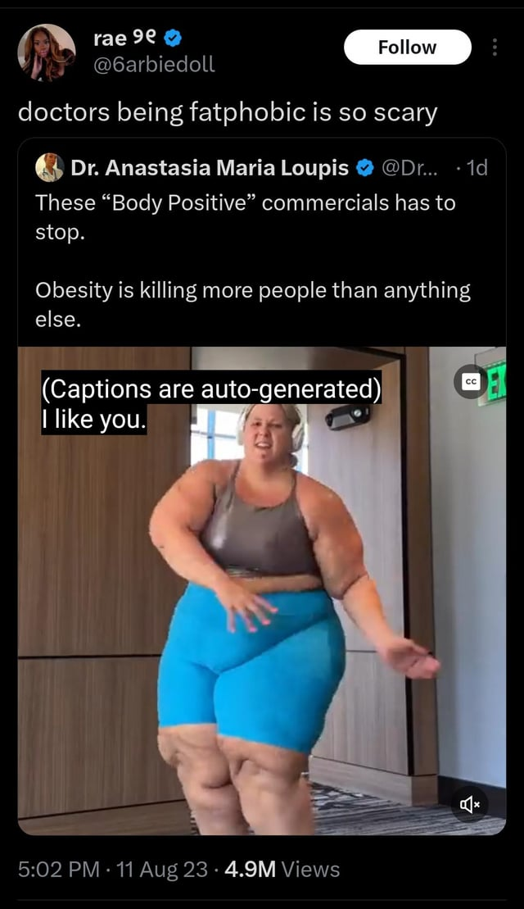
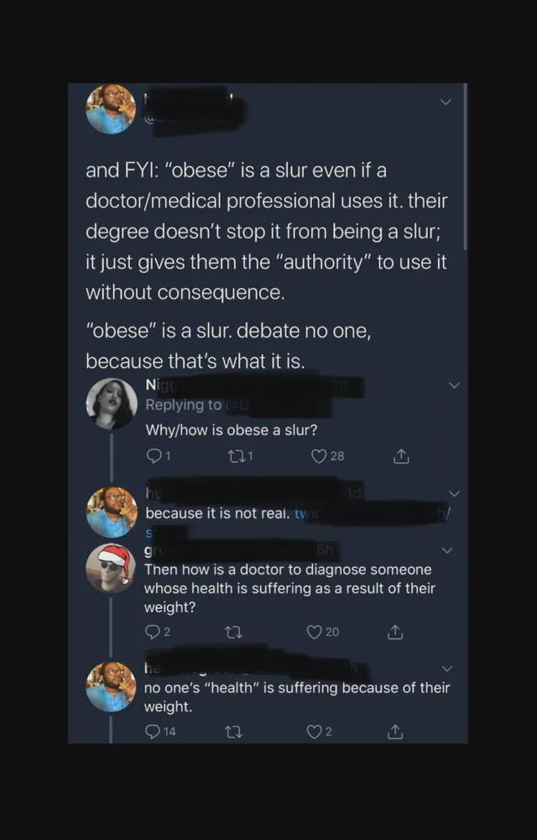
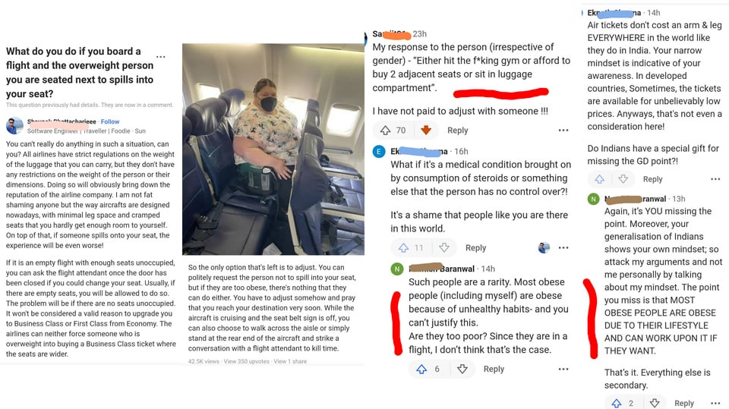
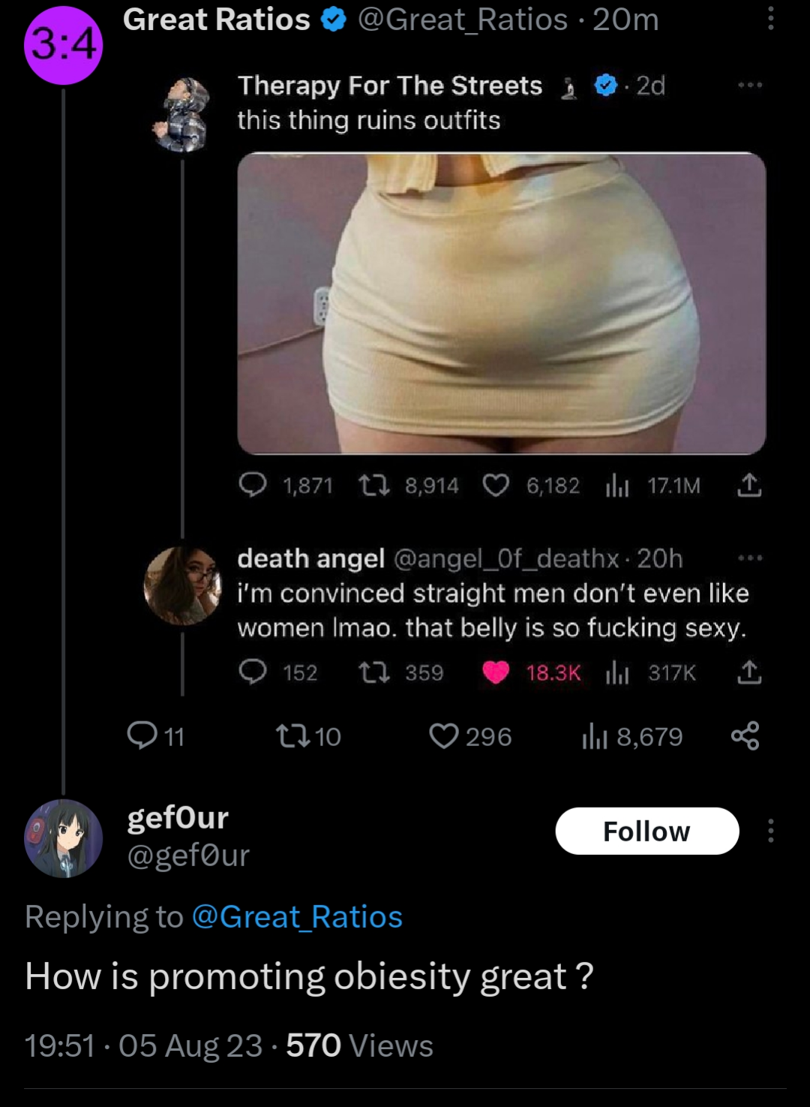
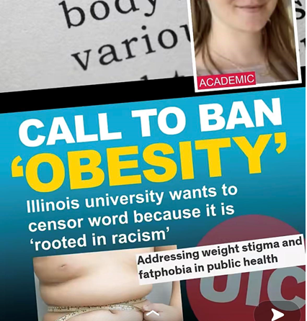
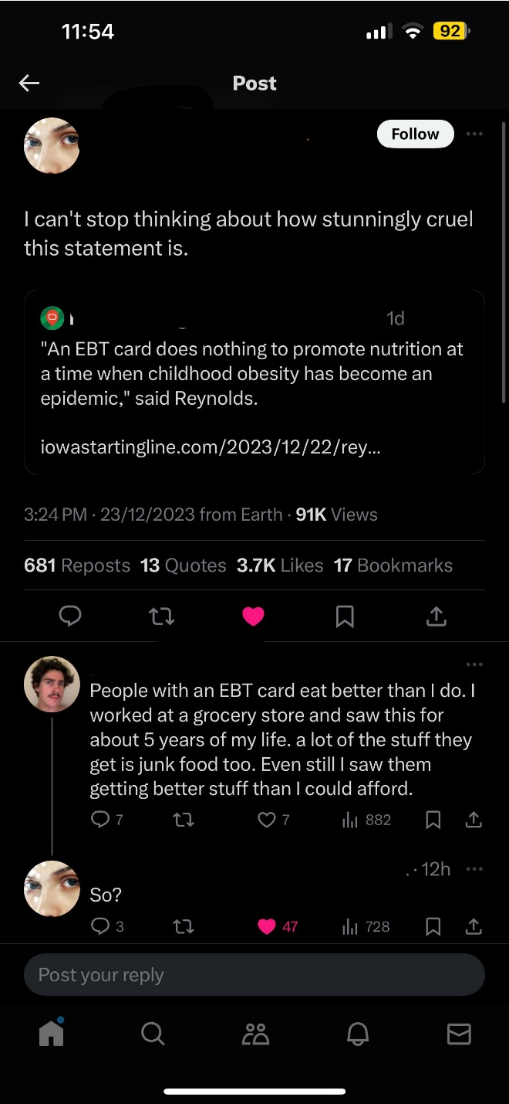
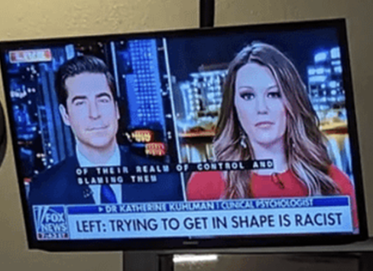
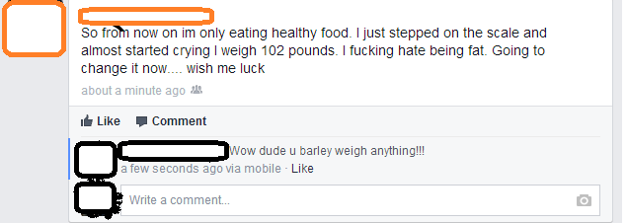
Notes:
https://www.youtube.com/watch?v=A295YT2yd_A&ab_channel=TheFinancialDiet

Slide 27
Body positivity vs health?
“You’re Not Ugly, You’re Just Poor”
https://youtu.be/A295YT2yd_A?si=YJRR7ciyvkhTBVRl&t=2333

Slide 28
Technology, causal mechanism
If obesity costs more in medical care, what are the pathways through which obesity drives increased illness?
Why is obesity bad for you?

Slide 29
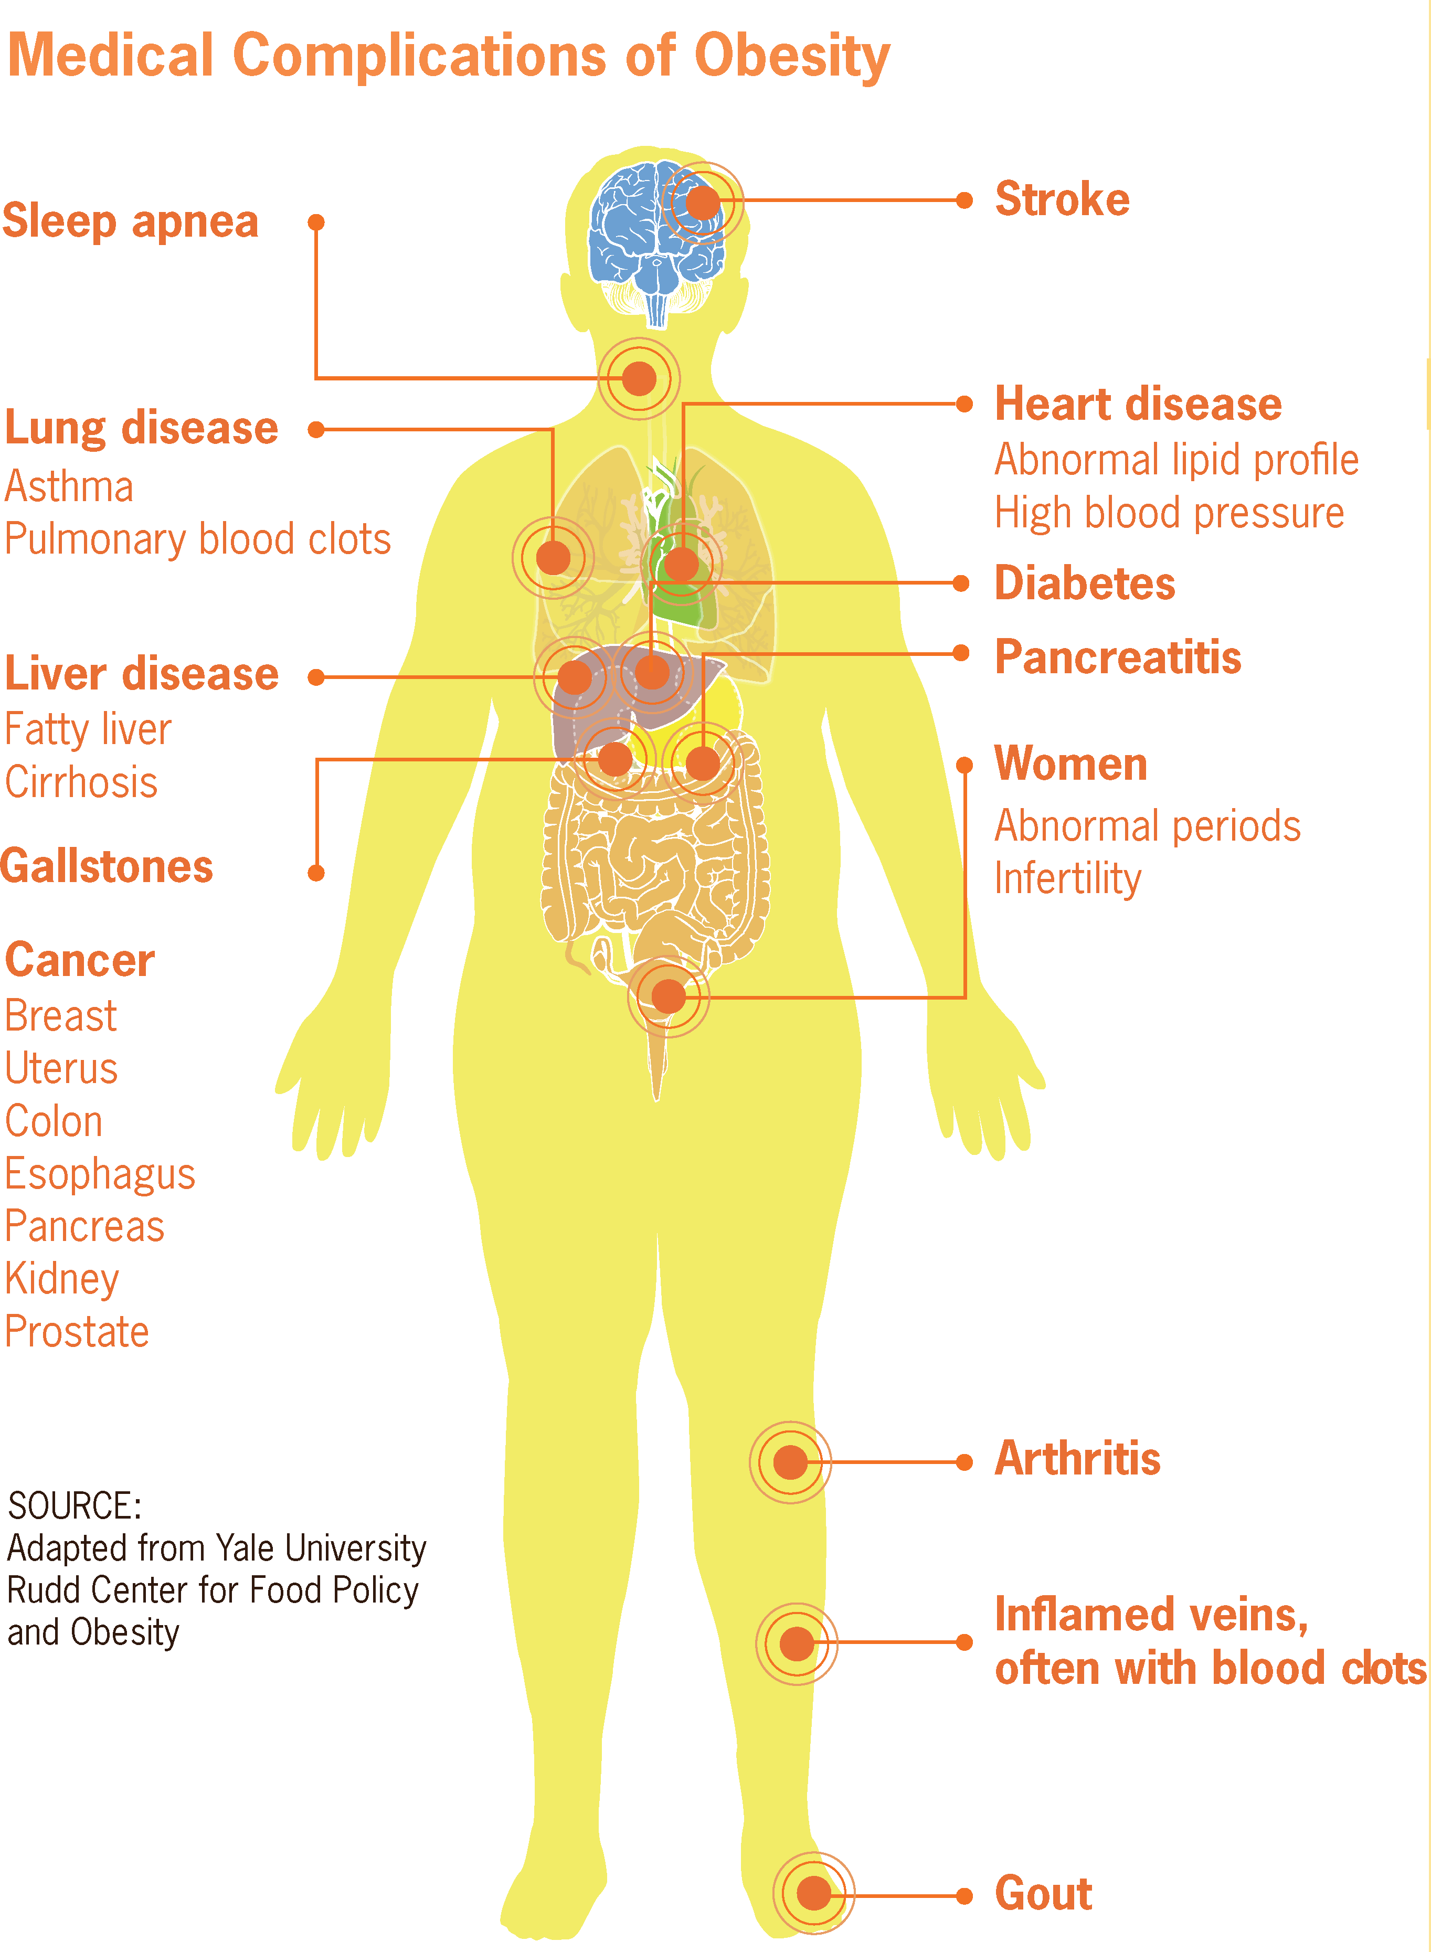
Medical Complications of Obesity
Fat is part of the endocrine and metabolic system – releases hormones
Free fatty acids, resistin (hormone), and TNFα (hormone) are insulin resistant (causing Type II diabetes)
Type II diabetes
Leptin (hormone) is inflammatory
CVD, osteoarthritis
Insulin and insulin-like growth factor binding protein 1 may lead to cell proliferation and reduced apoptosis
Cancer
Non-alcoholic fatty liver disease
Non-alchoholic steatohepatitis
Cirrhosis
Hepatocellular carcinoma (cancer)

Slide 30
Medical Complications of Obesity
61% of all Type II diabetes
17.3% of all CVD
24% of all osteoarthritis
Cancer:
42.5% of kidney cancer
35.4% and 20.8% of men and women colorectal cancer
22.6% of female breast cancer
56.8% of endometrial (uterine lining) cancer
52.4% of esophageal cancer
26.9% of pancreatic cancer
35.5% of gallbladder and gastric cardia cancer
Liver, maybe ovarian, maybe prostate, maybe haematopeietic
Not lung, not cervical

Slide 31
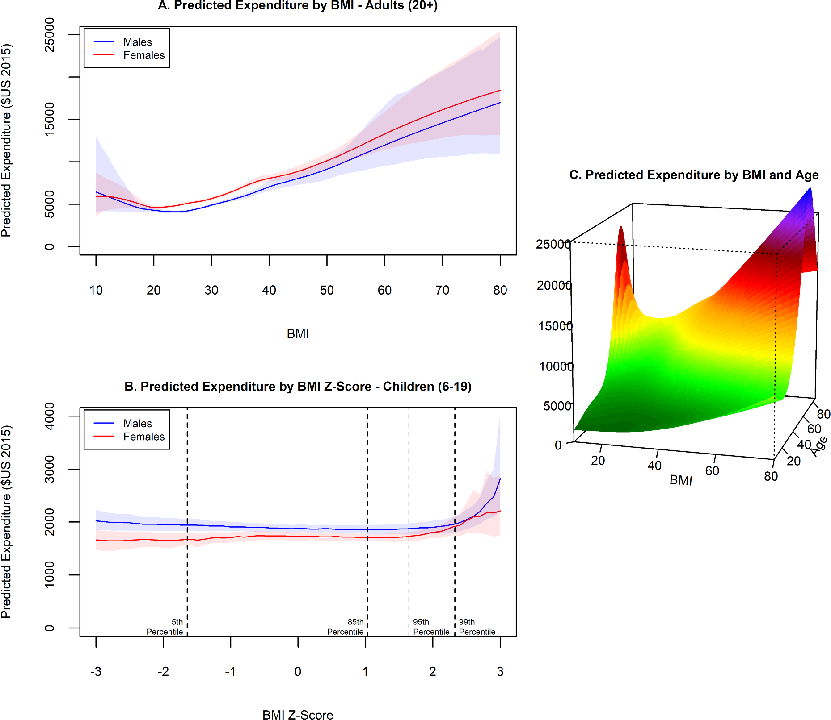

Slide 32
Medical Cost of Obesity
Medical Expenditure Panel Survey (MEPS)
2021 study
2011-2016 data

Slide 33
Growth in cost with age
Normal weight correlated with lowest expenditure across most ages
Difference become more significant around age 30
Study does not consider effect past weight, only current weight
Does obesity in 20s or 30s affect outcomes in 50s or 60s, even if the person loses weight?

Slide 34
Economics of eating disorders
2015 Study (2007-2011 data) of: anorexia nervosa, bulimia nervosa or binge eating, pica, rumination disorder, and psychogenic vomiting
Individuals with eating disorders generally cost health system about $1900 more than individuals without eating disorders
Also heave decreased employment and wage outcomes
Mental health comorbidities may double health costs, and have even larger effects on wages

Slide 35
Employment effects of obesity
Lowers wages for women (10lbs lowers wages 2%)
Effect starts at very low weights
No effect on men
Portly banker effect - Historic
Likely caused by discrimination, not worse health or productivity

Slide 36
Economic Effects of Obesity
Obesity is a bad health investment, leading to higher medical expenditures and lower earnings. Finkelstein and colleagues (2009) report that medical spending for the obese was about 42 percent higher per year when compared to someone of BMI under 25.
Cawley (2004) finds that heavier white females, black females, Hispanic females, and Hispanic males tend to earn less, and heavier black males tend to earn more, than their less heavy counterparts.

Slide 37
Discussion
Semaglutide/Ozempic
Have you head of the treatment vs prevention debate regarding obesity? What have you heard about the debate?
Is there a place for ones own feelings about obesity in a clinical environment?
Would you take/recommend a product like this?

Slide 38
Discussion
Obesity/body image
How

Slide 39
Discussion
Cutler et al:
Do you believe their conclusion that sedentary lifestyle is less important than food consumption in explaining obesity?
They assume calories in equals calories out. If this assumption is not true, how might it change their conclusions? How could they have altered their approach to ask that question?

Slide 40
Bonus Discussion
Can we model irrational behavior? What does a utility function look like for someone who you disagree with about health behavior? What could be a part of that person’s utility function that renders public health campaigns unsuccessful for that person?

Slide 41
Cawley, John. "An economy of scales: A selective review of obesity's economic causes, consequences, and solutions." Journal of health economics 43 (2015): 244-268.
Cohen, Joel W., Steven B. Cohen, and Jessica S. Banthin. "The medical expenditure panel survey: a national information resource to support healthcare cost research and inform policy and practice." Medical care (2009): S44-S50.
Samnaliev, Mihail, H. LeAnn Noh, Kendrin R. Sonneville, and S. Bryn Austin. "The economic burden of eating disorders and related mental health comorbidities: An exploratory analysis using the US Medical Expenditures Panel Survey." Preventive medicine reports 2 (2015): 32-34.
Calle, Eugenia E., and Rudolf Kaaks. "Overweight, obesity and cancer: epidemiological evidence and proposed mechanisms." Nature Reviews Cancer 4, no. 8 (2004): 579-591.
Cawley, John. "The impact of obesity on wages." Journal of Human resources 39, no. 2 (2004): 451-474.

