Slide 1
Risk Management and Insurance
TR 11:00-12:15 – BUSN202
Shane Murphy

Slide 2
Welcome to class!
Introductions:
What is your name and major?
What is one, two, or three pieces of content (tv show, movie, book, podcast) that are explain something about you?
What is the riskiest thing you will admit to doing this summer (optional)?

Slide 3
Class organization
Optional Textbook – McNamara, Michael and Rejda, George. Principles of Risk Management and Insurance (I have 14th edition, 2022)
Readings
Homework (10 points each)
Due on Wednesdays?
One week grace period
After one week, one point will be deducted
Quizzes? (10 points each)
About once a week
Open note/open internet/open friend
Office Hours
Midterm
October 14
Final Project
Final Exam

Slide 4
Risk and Insurance Course Topics
Classification and definitions of risk
Math and Economics
Characteristics of an insurable risk
Steps in risk management process
Techniques of risk management
Role of insurance in risk management
Insurance market operations
Insurance company operations
Government regulation of insurance
Legal principles of risk transfer
Analysis of an insurance contract
Enterprise risk management
Root cause analysis
Loss scenario analysis
Life insurance
Health insurance
Liability insurance
Property insurance
Home insurance
Automobile insurance
Crime & other specialized insurance products

Slide 5
Risk and uncertainty key definitions
Risk is uncertainty concerning the occurrence of a loss
Examples
A risk can colloquially refer to an agent which is a carrier of (high) amounts of risk
Examples
Uncertainty refers to degree of accuracy of risk assessment
Examples
Mathematics
uncertainty is related to standard deviation, standard error, or confidence interval

Slide 6
Risk vocab
Sources of risk or loss exposure
Objective vs subjective risk
Objective
Mathematically estimated
Degree of variation of actual loss compared to expected loss
Subjective
Perceived risk
Drives risk avoiding behavior
Peril – cause of loss

Slide 7
Hazard
Physical – a physical condition that increases the frequency or severity of loss
Examples
Legal hazard – legal or regulatory drivers of frequency or severity of loss
Moral hazard - The propensity to increase the frequency or severity of loss in response to not having to directly face the consequences of loss
Sometimes referred to as attitudinal hazard
Examples

Slide 8
Classification of risk
Pure – downside only; only possibility of loss or no loss
Speculative – upside and downside exist
Diversifiable risk – risk does not affect entire society/economy
Systemic – risk at level of system/market/economy
Firm risks:
Strategic risk – uncertainty regarding firms financial goals and objectives
Operational risk – risk resulting from firm’s business operations
Enterprise risk – all major risks faced by a business

Slide 9
Classification of risk
Property risk
Direct vs indirect – indirect is costs born due to increased expenses while damaged property is unusable
Liability risk
Lien – when damages cannot be payed immediately, a payment plan may be created. A lien is when right to income or assets is used to secure payments. May be voided by bankruptcy in some cases
Commercial risks
Can include: Property, liability, loss of income, cybersecurity and identity theft, etc

Slide 10
Definitions about insurance
Fortuitous losses – losses are unforeseen, unexpected and by chance
Indemnification for losses – insured is restored to approximate financial position prior to occurrence of loss
Ideally insurable risk
Large number of exposure units
Losses are accidental and unintentional
Losses are determinable and measurable
Losses are not catastrophic
Chance of loss must be calculable
Premium must be economically feasible

Slide 11
Thinking about Offering Insurance:
Fire vs Unemployment Insurance
Are there a large number of insurable units?
Are losses accidental and unintentional?
Is loss measurable and determinable?
Is the possible loss catastrophic to the insurer?
Is the chance of loss calculable?
Is the premium economically feasible?

Slide 12
Is fire insurance ideal?

Slide 13
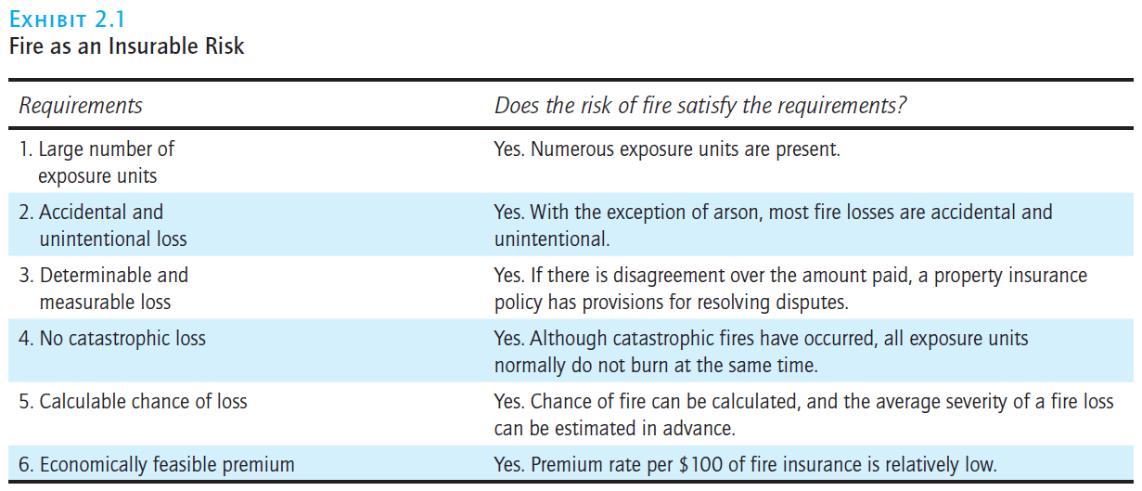
Is fire insurance ideal?

Slide 14
Is unemployment insurance ideal?

Slide 15
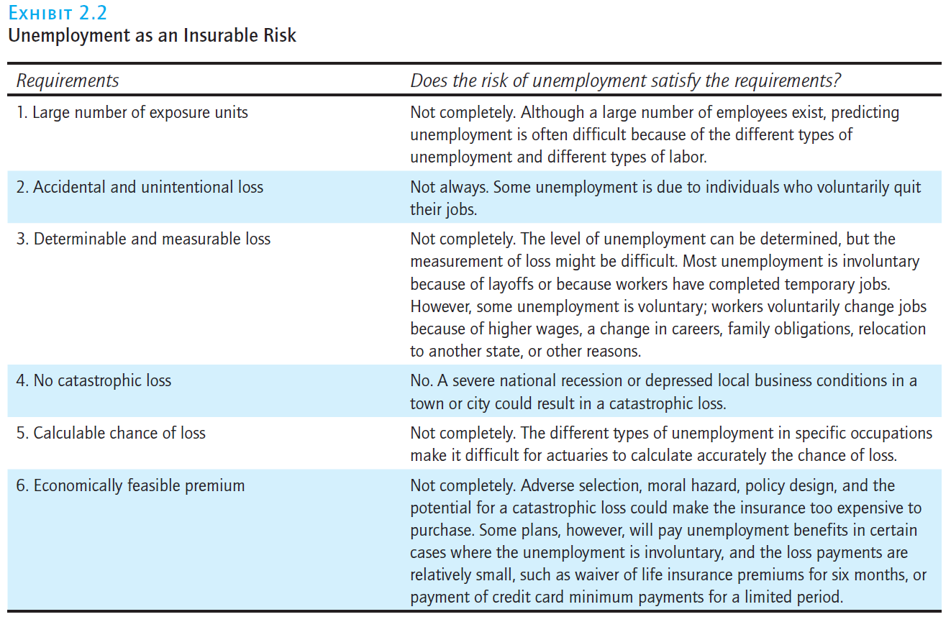
Is unemployment insurance ideal?

Slide 16
Classification of risk: Personal risk
Premature death
Retirement risk
Inadequate income or savings
Poor health
Unemployment
Alcohol and drug addiction

Slide 17
Managing risk
Risk control
Avoidance, loss prevention, loss reduction (duplication of digital assets, diversification of locations or of customers and suppliers)
Risk financing
Retention – deductible or other payments made by agent facing costs
Noninsurance transfers such as hedging, incorporation, service contracts
Insurance including self-insurance

Slide 18
Probability
Probability
(Frequentist definition) relative frequency of different outcomes of a random event (lottery, RV) across multiple measurements
(Bayesian definition) in addition to measurements (data), analyst admits uncertainty about model or reality and validity of objective and/or subjective beliefs

Slide 19
Types of insurance
Private:
Life – by 2016, 797 US insurers – industry also does financial planning
Property and liability – in 2016, 2,538 US insurers
Personal and commercial lines
Health – much smaller number of insurers
Public/Government:
Social insurance – often compulsory, financed by mandatory contributions
Includes Medicare, Medicaid, Social Security, Unemployment programs

Slide 20
Social benefits of insurance
Indemnification
Reduction of risk -> reduction of anxiety
Source of investment funds (pooled premiums play similar role to savings accounts)
Macroeconomics: growth and financial markets
Loss prevention
Enhancement of Credit

Slide 21
Social costs of insurance
Cost of doing business (expense to premium ratio of 15% to 30%)
Fraudulent and inflated claims

Slide 22
Careers in Risk Management and Insurance
Positions in Risk Management and Insurance. Rarely has there been a time when it was so advantageous to consider a career in risk management and insurance. Projections indicate that some 400,000 positions will be open in the next four years.1 The breadth of knowledge and skills required for these positions has never been greater or the opportunities more lucrative. Try to think of an industry with a wider range of employment opportunities. You are probably familiar with sales and claims. These areas interact with the public, such as sales to place the coverage with insurance purchasers, and payment of claims when a loss occurs. However, insurance offers many other careers as well. Underwriters review the applications solicited by agents to determine whether the insurer should accept the applicant. Actuaries price the coverages that agents are selling. Loss control specialists focus on reducing losses and potential claims. Lawyers review policy forms. Accountants prepare financial statements using one or more accounting systems. Financial specialists determine the appropriate mix of financial assets that back an insurance company’s liabilities. Information technology is also crucial for insurers, considering the large volume of data that insurers must manage. All of these functional areas must work together for an insurer to be successful. These areas are discussed in greater detail in Chapter 6.
Importance of Risk Management and Insurance. Whatever your specialty is and wherever you plan to work, experts agree that understanding the principles of risk management and insurance is important. Insurance is a challenging field, and considerable technical knowledge is required for employees who want to rise to top levels. To be effective in risk management and insurance means you must be able to thin logically and apply important principles from law, finance, economics, mathematics, and decision making to problems you will encounter on a daily basis. As a result, insurance companies today require ongoing professional development for their employees as they enter the company and move up through the ranks. Most insurers today encourage their employees to participate in industry-specific education programs such as Chartered Life Underwriter (CLU), Chartered Property Casualty Underwriter (CPCU), Fellow, Life Management Institute (FLMI), Certified Financial Planner (CFP), and others. Studies have consistently shown that employees with these professional designations earn substantially higher salaries than rank-and-file employees. This text provides the basic foundation for many professional designations.
Advantages to Students. Students who study Principles of Risk Management and Insurance in a college or university have a major advantage in regard to acquiring knowledge that will enhance their careers. The principles taught in this text are essential for success in the insurance industry and provide tremendous advantages to employees who understand them. Principles discussed in this text explain not only what happens but why it happens so that when you join a company, you will know considerably more than others who do not have your skills and background. Furthermore, if you are taking a state licensing examination to sell insurance and other financial products, information in this text will give you a major advantage over others who do not have a similar background.
Personal Risk Management Program. Even if you never work professionally for an insurance company, the principles you learn in this text will enable you to develop a solid personal risk management program to deal effectively with and manage a wide variety of major risks in your personal life that create great economic insecurity and financial pain if a loss occurs. In addition, as you study this text, you will realize the following educational and practical benefits: (1) enhancement of critical thinking skills; (2) the ability to analyze complex problems and develop analytical skills that require the synthesis of financial and mathematical tools, higher order reasoning, and important technical information; (3) the development of business ethics and social responsibility; and (4) peace of mind that results from a sound personal risk management program based on the principles discussed in the text. These and other subjects will give you the keys to a successful career for a lifetime.

Slide 23
Careers in Risk Management and Insurance
Positions in Risk Management and Insurance.
Projections indicate that some 400,000 positions will be open in the next four years.
Underwriters review the applications solicited by agents to determine whether the insurer should accept the applicant.
Actuaries price the coverages that agents are selling.
Loss control specialists focus on reducing losses and potential claims. Lawyers review policy forms.
Accountants prepare financial statements using one or more accounting systems.
Financial specialists determine the appropriate mix of financial assets that back an insurance company’s liabilities.
Information technology is also crucial for insurers, considering the large volume of data that insurers must manage.

Slide 24
Careers in Risk Management and Insurance
Importance of Risk Management and Insurance.
To be effective in risk management and insurance means you must be able to thin logically and apply important principles from law, finance, economics, mathematics, and decision making to problems you will encounter on a daily basis
Most insurers today encourage their employees to participate in industry-specific education programs such as
Chartered Life Underwriter (CLU),
Chartered Property Casualty Underwriter (CPCU),
Fellow, Life Management Institute (FLMI),
Certified Financial Planner (CFP).
Studies have consistently shown that employees with these professional designations earn substantially higher salaries than rank-and-file employees.

