Slide 1
HCMI 3221: Economics of Insurance
BUSN 202
Shane Murphy – shane@uconn.edu

Slide 2
Probability
Probability
(Frequentist definition) relative frequency of different outcomes of a random event (lottery, RV) across multiple measurements
(Bayesian definition) in addition to measurements (data), analyst admits uncertainty about model or reality and validity of objective and/or subjective beliefs
What is the probability a coin flip lands heads: 50% (is this true?)
What is the probability a fair dice lands greater than 3?
So 4 or 5: 1/6 + 1/6 = 2/6 = 1/3
Note “or” can serve as an operator in probability space, if A and B are mutually exclusive, the probability of A or B is the sum of the probabilities of A and B

Slide 3
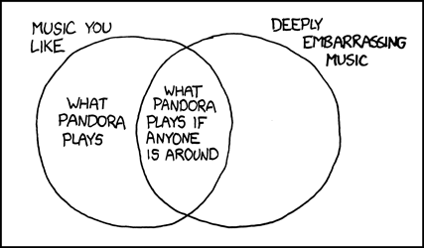
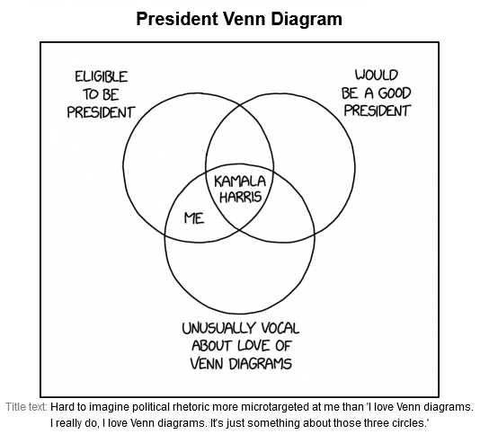
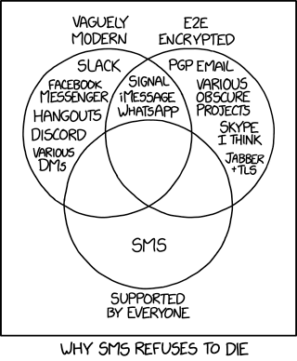
Probability – Venn Diagrams (xkcd)

Slide 4
Expected value
The expected value of one event its its probability times its payoff
The expected value of a one in a million chance at $1,000,000 is $1
A lottery often has multiple events
If I toss a die and pay the number of dollars the die shows, what is the expected value?
Well, there is a 1/6 chance at $1, a 1/6 chance at $2, and so on up to 1/6 chance at $6
In this case, the expected value is the sum for all events of the probability of the event times the payout of the event
We often equate the event and the payout of the event
So for a lottery X with events A, B, … , E(X) = A*P(A) + B*P(B) + …
So what about that dice?

Slide 5
Expected value
The expected value of one event its its probability times its payoff
The expected value of a one in a million chance at $1,000,000 is $1
A lottery often has multiple events
If I toss a die and pay the number of dollars the die shows, what is the expected value?
Well, there is a 1/6 chance at $1, a 1/6 chance at $2, and so on up to 1/6 chance at $6
In this case, the expected value is the sum for all events of the probability of the event times the payout of the event
We often equate the event and the payout of the event
So for a lottery X with events A, B, … , E(X) = A*P(A) + B*P(B) + …
So what about that dice?
$1/6 + $2/6 + $3/6 + $3/6 + $5/6 + $6/6 = $21/6 = $3.5

Slide 6
So when is a lottery profitable
Lotteries aren’t free – Powerball costs $2 (!)
So for a lottery X, compare the cost to the expected value
Risk taking business is expected to be profitable if E(X)>C(X)
Expected profit equals expected value minus cost
E(π(X)) = E(X) - C(X)
If the costs for an risky venture are paid upfront, then a business also looks at returns to investment
ROI = E(π(X))/C(X) = (E(X) – C(X))/ C(X)
What is the ROI on a dice roll that costs $2 to play and returns $1 for each number on the dice?

Slide 7
So when is a lottery profitable
What is the ROI on a dice roll that costs $2 to play and returns $1 for each number on the dice?
E(X) = $3.5
So E(π(X)) = E(X) - C(X) = $3.5 - $2 = $1.5
And ROI = $1.5/$2 = 0.75 or 75%
Is this a good investment?

Slide 8
Expected Loss
In a risky situation, instead of expected value we might think about expected loss
A home is insured for $500,000
There is a 1% chance each year that the house will burn down and become completely worthless
What is the expected loss?
E(L) = L*P(L) =

Slide 9
Expected Loss
In a risky situation, instead of expected value we might think about expected loss
A home is insured for $500,000
There is a 1% chance each year that the house will burn down and become completely worthless
What is the expected loss?
E(L) = L*P(L) = $500,000 * 1% = $500,000 * .01 = %5,000
One more concept, returns to capital, we’ll come back to

Slide 10
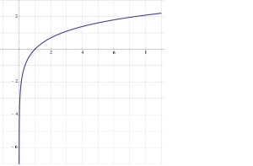
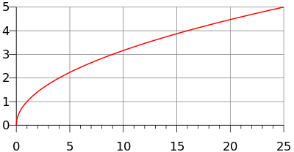
Utility
y=U(x)
Utility is generally increasing in x
(So U’(x)>0)
Utility is generally concave
U(E(x))>E(U(x))
(also U’’(x)<0)
Examples
y=ln(x)
y=√x

Slide 11
Marginal utility
Marginal utility the change in utility from a change in input (wealth) given the current level of the input
What is change in utility if someone's wealth changes by a dollar
Diminishing marginal utility
In general, the wealthier someone is, the less utility they gain from earning an extra dollar
The less utility they lose from losing an extra dollar
The utility lost if someone loses $1000 is greater if they are poor

Slide 12
Risk aversion and Loss aversion
Risk aversion comes about because marginal utility is diminishing
Imagine you are in a coin flip scenario, heads you win $10,000, tails you lose, call that scenario A
Scenario B is a situation where you don’t have to flip a coin
Expected value of the two scenarios is equal (on average, you end up with no change)
Diminishing marginal utility can be used to show people prefer scenario B
People prefer a risk free situation to a risky situation
Loss aversion is based on a psychological approach called Prospect theory
Different from risk aversion, people have a greater aversion to loss than might be expected from the marginal utility approach
So they have two utility functions, a positive one that seeks gains and a negative one that avoids losses
And the negative one is maybe a bit larger in magnitude

Slide 13
Risk Premium
Risk Premium is the maximum amount of money a risk-averse person would pay to avoid taking a risk
Risk Premium is the difference between the expected value of a gamble and the value of a sure outcome such that the utility of that outcome equals the expected utility of the gamble
We won’t use this precise definition in this class, but it is important in an economics class
The risk premium is a function of risk aversion – more risk averse people are willing to pay a greater premium
The risk premium is not a function of loss aversion

Slide 14
Insurance premiums
Insurance capitalizes on this
Under this theory the maximum a person is willing to pay for insurance is the expected loss plus the risk premium (so expected revenue equals expected loss for the insure plus an additional premium)
On average, an insurance company pays out the expected loss (so expected cost equals expected loss)
So the expected profit is the expected revenue minus expected cost
If a persons insurance premium is as large as possible, then profit equals the risk premium!

Slide 15
Demand for Insurance
Factors of Demand:
Risk Aversion
Perception of Risk
Peer Behavior
Wealth and Income
Ability to Externalize Risk
Moral Hazard

Slide 16
Diversification and Pooling and the Role of the Standard Deviation
In a sense, Insurance is a mechanism by which the cost of risks are mediated through pooling
The insured are willing to pay a risk premium to cover administrative and transaction costs of the pool in return for the reduction in risk
Members of a pool do not necessarily make equal contributions
Contributions may be increasing in level of risk and exposure

Slide 17
Diversification and Pooling and the Role of the Standard Deviation
Why are there very few private flood insurance plans?

Slide 19
Next class
We will discuss this question further, adding more concepts
We will also do homework 2 together in part

Slide 20
HCMI 3221: Economics of Insurance
BUSN 202
Shane Murphy – shane@uconn.edu

Slide 21
Law of Large Numbers
Given a fair experiment, the average or mean value of the results obtained from a large number of trials should be close to the expected value. As more trials are performed, the mean will tend to become closer to the expected value.
If X is a random variable and (x1, x2, x3, x4, x5) are random draws from X
Average(x1, x2, x3, x4, x5) ≠ Expected Value (X)
And Average (x1, x2, …, x999, x1000) ≠ Expected Value (X)
But the Average(x1, x2, …, x999, x1000) will usually be closer to E(X)
Risk for an insurance company is that the average loss for its portfolio in a given year will be larger than expected
So what does the Law of Large Numbers suggest an insurance company should do to reduce this risk?

Slide 22
Law of Large Numbers
The larger an insurance company is, the closer the realized losses on its portfolio will be to the expected losses (assuming accurate modeling of probability).
How does an insurance company pay off its losses at the end of the year?
Does it borrow money, meaning to pay back its borrowing using premiums from next year?
Does it hold last years premiums and give money to losing clients from pool of premiums?
(for later discussion) What does an insurance company do with this pool of premiums in the meantime?!

Slide 23
Pooling in Insurance
Efficiency (maximized social welfare) vs Equity (“fairness”)
How do you think Efficiency and Equity could be managed in designing an insurance program?
Pooling equilibrium – all risk types buy the same policy
High risk individuals pay lower rate, low risk individuals pay higher rate
Low risk individuals less likely to buy insurance
High risk individuals more likely to buy insurance
Separating equilibrium – Risk types buy different insurance policies
Low risk individuals pay lower rate, become more likely to buy policy
High risk individuals pay higher rate, become less likely to buy policy

Slide 24
Adverse Selection
Adverse selection occurs when market participation is affected by asymmetric information
Adverse selection occurs when high-risk individuals are more likely to purchase insurance than low-risk individuals

Slide 25
Mitigating Adverse Selection
Require everyone to buy insurance
Individual health insurance mandate in the Affordable Care Act
Waiting period before coverage takes effect
Premiums tied to risk

Slide 26
Moral Hazard
When there is a lack of incentive to guard against risks because an individual is protected from the consequences of those risks

Slide 27
Mitigating Moral Hazard
Co-payments and Deductibles

Slide 28
Separating and pooling equilibria
Consider an insurance market with two types of customers (heterogeneous)
H – high risk
L – low risk
The expected cost of high risk customers is higher than low risk
Costumers know their risk, but insurance companies do not (private information, asymmetric information)

Slide 29
Insurance plans
In a simple model, insurance plans vary on premiums and amount of coverage
Insurance companies need premiums large enough to cover expected medical costs
High risk types have higher expected medical costs
For a simple model, consider insurance plans that have a limit on annual coverage
High risk types want a higher limit

Slide 30
Pooling equilibrium
In a pooling equilibrium, both risk types buy the same insurance plans and pay the same premiums
High risk types want more generous coverage (higher limit)
Pooling equilibria are unstable
Low risk types will be willing to get plans with less coverage If they cost less
High risk types may find less coverage plans to not be worth it
Even if insurance companies don’t know customer types

Slide 31
Separating equilibrium
But if two plans are offered:
low risk types will buy the low premium, low coverage plans
High risk types will buy the higher premium, higher coverage plans
Now insurance companies know who is who
This will drive up cost of high coverage plans!
Low risk types will only be partially insured
In a market where most of the population is healthy, separating equilibria may also be unstable!
It is possible to offer plans that attract both types away from separating equilibria
But these plans will still be unstable – there is no stable plan!

Slide 32
Insurance instability – the death spiral

Slide 33
Demand for insurance: Risk avoidance vs access
In the late 1990s, John Nyman made an argument against excessive concern for moral hazard
His argument is that risk avoidance and the demand for certainty is not the reason people buy insurance, especially health insurance
Instead, people demand health insurance in order to increase their access to health care in time of need (the access motive)

Slide 34
Demand for Insurance: Access effect
More importantly, consider an example:
Elizabeth purchases an insurance policy (for $4,000) that directly writes a check for $40,000 upon a diagnosis with breast cancer
Without the insurance, she would purchase a $20,000 mastectomy
With the insurance, she also buys a $20,000 breast reconstruction procedure
Now consider a separate example:
Elizabeth purchases an insurance policy (for $4,000) that pays up to $40,000 upon a diagnosis with breast cancer
In this case, what would Elizabeth buy?
What if the policy pays up to $80,000?

Slide 35
Demand for Insurance: Access effect
In the first example, Elizabeth’s purchases represent her demand for care when sick and provided with $40,000.
Her spending represents the purchase which provides her with the most welfare
So the moral hazard is, in a sense, efficient.
In the second and third cases, we don’t know how much of her purchases represent what she would do if she had a check or $40,000 and how much of her purchases represent the fact that medical care has an effective price of $0 for the first $40,000 of spending.

Slide 36
Practice expected value problem 1
Lottery L has two outcomes A, B, U(x) = √X
A gives you $25, B gives you $10
P(A) = 0.1, P(B) = 0.9
What is E(X), the expected value of the lottery?
What is U(E(X)), the utility of the expected value?

Slide 37
Practice expected value problem 1 (with Solution)
Lottery L has two outcomes A, B, U(x) = √X
A gives you $25, B gives you $10
P(A) = 0.1, P(B) = 0.9
What is E(X), the expected value of the lottery?
E(X) = A*P(A)+B*P(B) = 0.1*25+0.9*10 = 2.5+9=11.5
What is U(E(X)), the utility of the expected value?
U(x) = √X = U(11.5) = √11.5 = 3.39

Slide 38
Practice expected value problem 1
Lottery L has two outcomes A, B, U(x) = √X
A gives you $25, B gives you $10
P(A) = 0.1, P(B) = 0.9
What is U(A), U(B)?
What is E(U(X)), the expected utility of the lottery?

Slide 39
Practice expected value problem 1 (with Solution)
Lottery L has two outcomes A, B, U(x) = √X
A gives you $25, B gives you $10
P(A) = 0.1, P(B) = 0.9
What is U(A), U(B)?
U(A) = U(25) = √25 = 5 U(B) = U(10) = √10 = 3.16
What is E(U(X)), the expected utility of the lottery?
E(U(X)) = U(A)*P(A)+U(B)*P(B) = 5*0.1+3.16*0.9 = 0.5 + 2.85 = 2.9

Slide 40
Practice expected value problem 1 (with Solution)
Lottery L has two outcomes A, B, U(x) = √X
A gives you $25, B gives you $10
P(A) = 0.1, P(B) = 0.9
What is E(X), the expected value of the lottery?
E(X) = A*P(A)+B*P(B) = 0.1*25+0.9*10 = 2.5+9=11.5
What is U(E(X)), the utility of the expected value?
U(x) = √X = U(11.5) = √11.5 = 3.39
What is U(A), U(B)?
U(A) = U(25) = √25 = 5 U(B) = U(10) = √10 = 3.16
What is E(U(X)), the expected utility of the lottery?
E(U(X)) = U(A)*P(A)+U(B)*P(B) = 5*0.1+3.16*0.9 = 0.5 + 2.85 = 2.9

Slide 41
Practice expected value problem 2
Lottery L has two outcomes A, B, U(x) = √X
A gives you $0, B gives you $16
P(A) = 0.75, P(B) = 0.25
What is E(X), the expected value of the lottery?
What is U(E(X)), the utility of the expected value?
What is U(A), U(B)?
What is E(U(X)), the expected utility of the lottery?

Slide 42
Practice expected value problem 2 (with solution)
Lottery L has two outcomes A, B, U(x) = √X
A gives you $0, B gives you $16
P(A) = 0.75, P(B) = 0.25
What is E(X), the expected value of the lottery?
E(X) = A*P(A)+B*P(B) = .75*0+0.25*16 = 0+4=4
What is U(E(X)), the utility of the expected value?
U(x) = √X = U(4) = √4 = 2
What is U(A), U(B)?
U(A) = U(0) = √0 = 0 U(B) = U(4) = √4 = 2
What is E(U(X)), the expected utility of the lottery?
E(U(X)) = U(A)*P(A)+U(B)*P(B) = 0*0.75+2*0.25 = 0 + 0.5 = 0.5

Slide 43
Practice expected value problem 3
Lottery L has two outcomes A, B, U(x) = √X
A gives you $25, B gives you $81
P(A) = 0.6, P(B) = 0.4
What is E(X), the expected value of the lottery?
What is U(E(X)), the utility of the expected value?
What is U(A), U(B)?
What is E(U(X)), the expected utility of the lottery?

Slide 44
Practice expected value problem 3 (with solution)
Lottery L has two outcomes A, B, U(x) = √X
A gives you $25, B gives you $81
P(A) = 0.6, P(B) = 0.4
What is E(X), the expected value of the lottery?
E(X) = A*P(A)+B*P(B) = 0.6*25+0.4*81 = 15+32.4 = 47.4
What is U(E(X)), the utility of the expected value?
U(x) = √X = U(47.4) = √47.4 = 6.88
What is U(A), U(B)?
U(A) = U(25) = √25 = 5 U(B) = U(81) = √81 = 9
What is E(U(X)), the expected utility of the lottery?
E(U(X)) = U(A)*P(A)+U(B)*P(B) = 5*0.6+9*0.4 = 3 + 3.6 = 6.6

Slide 45
Practice expected value problem 4
Lottery L has three outcomes A, B, C, U(x) = √X
A gives you $0, B gives you $9, C gives you $100
P(A) = 0.7, P(B) = 0.2, P(C) =0.1
What is E(X), the expected value of the lottery?
What is U(E(X)), the utility of the expected value?
What is U(A), U(B), U(C)?
What is E(U(X)), the expected utility of the lottery?

Slide 46
Practice expected value problem 4
Lottery L has three outcomes A, B, C, U(x) = √X
A gives you $0, B gives you $9, C gives you $100
P(A) = 0.7, P(B) = 0.2, P(C) =0.1
What is E(X), the expected value of the lottery?
E(X) = A*P(A)+B*P(B)+C*P(C) = 0*0.7+9*0.2+100*0.1 = 0+1.8+10=11.8
What is U(E(X)), the utility of the expected value?
U(E(X)) = √E(X) = √11.8 = 3.44
What is U(A), U(B), U(C)?
U(A) = √0 = 0, U(B) = √9 = 3, U(C) = √100 = 10
What is E(U(X)), the expected utility of the lottery?
E(U(X)) = U(A)*P(A)+U(B)*P(B)+U(C)*P(C) = 0*0.7+3*0.2+10*0.1 = 0+0.6+1 = 1.6

Slide 47
Sources:
(optional) Klein, Robert (2014) A Primer on The Economics of Insurance (https://www.researchgate.net/publication/270500085_A_Primer_on_The_Economics_of_Insurance)
(optional) Nyman, John A. “Is ‘moral hazard’ inefficient? The policy implications of a new theory.” Health Affairs 23, no. 5 (2004): 194-199.
(optional) Cutler, David M., and Richard J. Zeckhauser. “Adverse selection in health insurance.” In Forum for Health Economics & Policy, vol. 1, no. 1. De Gruyter, 1998.

