Slide 1
Risk Management and Insurance
TR 11:00-12:15 – BUSN202
Shane Murphy

Slide 2
Types of Insurers
Stock Insurers
Mutual Insurers
Advance premium mutual
Assessment mutual
Fraternal insurer
Demutualization
Reciprocal Exchange
Captive Insurance (similar to self-insurance)
Special Types of Health Insurance
Blue Cross and Blue Shield
Formerly had special status as non-profit (rather than governmental) social insurance
Managed Care
Lloyd’s Corporation as an insurer’s marketplace

Slide 3
Life vs Casualty/Property Insurance
In life insurance, mutual insurers typically pay annual dividends to the policyholders.
Property and casualty insurance companies do not pay dividends to policyholders on a regular basis.
Instead, such insurers may charge lower initial or renewal premiums that are closer to the actual amount needed for claims and expenses.

Slide 4
Life Insurance Market
Life insurers sell a variety of life and health insurance products, annuities, mutual funds, pension plans, and related financial products.
At the end of 2016, 797 life insurers were doing business in the United States.

Slide 5
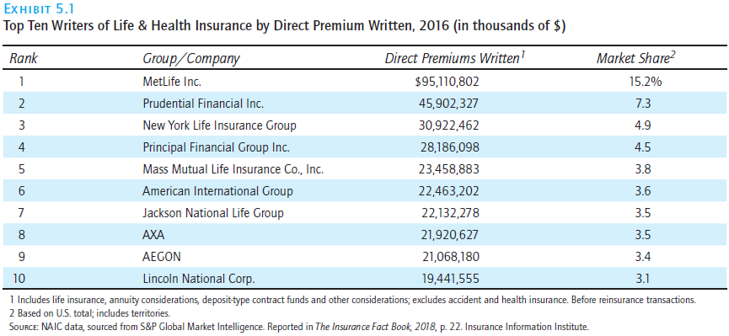
Life Insurance Market

Slide 6
Life Insurance Marketing
Agents – Personal Selling Systems manage majority of policies
Separate from Direct Response Systems
Financial Institution Distribution Systems
Others:
Worksite Marketing
Stock Brokers
Financial Planners
Group Insurance, often through employer or labor union

Slide 7
Property/Casualty Insurance Market
In 2016, 2,538 property and casualty insurers were doing business in the United States.
These insurers sell property and casualty insurance and related lines, including inland marine coverages and surety and fidelity bonds

Slide 8
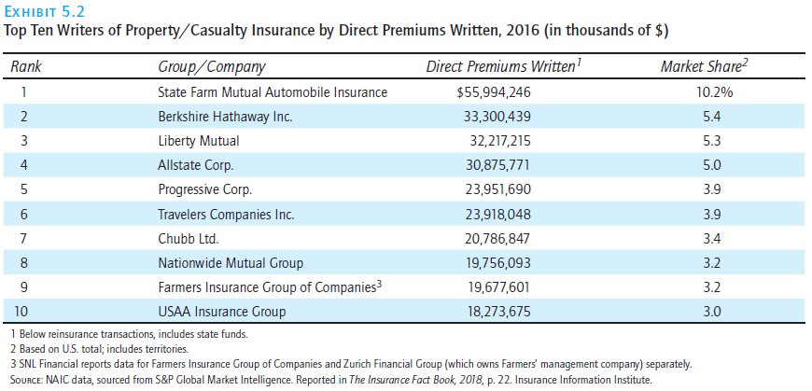
Property/Casualty Insurance Market

Slide 9
Property/Casualty Insurance Marketing
Independent agency system
Business with agents who deal policies from multiple companies
Exclusive agency system
Direct writer
Agents are employees of insurer or in certain types of exclusive agency arrangements
Direct Response System

Slide 10
Stock Insurance vs Market Insurance
A stock insurer is a corporation owned by stockholders. The objective is to earn profits for the stockholders.
The stockholders elect a board of directors who, in turn, appoint executive officers to manage the corporation.
A mutual insurer is a corporation owned entirely by the policyholders
Because relatively few policyholders bother to vote, the board of directors has effective management control of the company
For tax purposes, life insurance dividends are treated as a refund of a premium that is paid if the insurer’s mortality, investment, and operating experience are favorable

Slide 11
Types of Mutual Insurance
An advance premium mutual is one where the premiums charged are expected to cover all claims and expenses.
Vast majority of mutual insurers
An assessment mutual has the right to assess policyholders an additional amount if the insurer’s loss, investment, or expense experience is unfavorable.
Rare, In 2017, 74 companies domiciled in 22 states issued assessable policies, there have been no reports of assessments by any of their members in many years.
After an assessment mutual’s surplus (the difference between assets and liabilities) exceeds a certain amount, the states will not permit the insurer to issue an assessable policy.
fraternal insurers must operate through a “lodge system,” which means that members are affiliated with local units (chapters, churches, clubs, and so on) that are knitted together by an overall representative form of governance.5 Only members of the fraternal benefit society can buy coverage from a fraternal insurer, which must operate solely for the benefit of its members or beneficiaries.
Examples: Knights of Columbus, Modern Woodmen of America, and Thrivent Financial.
Fraternal societies had their heyday in the 19th and 20th centuries and especially since the 1960s have declined in numbers. Only 78 fraternal insurers were doing business in the United States at the end of 2016 covering 10 million individuals.
Today, most fraternal insurers use the level premium method and the legal reserve system that commercial life insurers use
Fraternal insurers also sell term life insurance and annuities.
Because fraternal insurers are nonprofit or charitable organizations, they receive favorable tax treatment.

Slide 12
Structural changes affecting types of insurance
Mergers
At the end of 2016, 797 life insurers were doing business in the United States, down from a peak of 2,343 in 1988, decline mostly due to mergers
Demutualization
Mutual holding company - where a mutual insurer is reorganized as a holding company that owns or acquires control of stock insurance companies that can issue common stock
Later two have subsided

Slide 13
Lloyd’s Corporation (Lloyd’s of London)
Insurance marketplace for specialized insurance
Members include major UK insurers and individuals and partnerships
Famous for insuring unusual exposure units, such as a prize for a hole-in-one at a golf tournament, or injury to a Kentucky Derby horserace winner.
Small part of total business
56 agents and 85 syndicates
Unlicensed in most states in the US, but does lot of business here
Lloyd’s members underwrites seven lines of insurance: casualty, property, marine, energy, motor, aviation, and reinsurance.
Individual members have high net worth, although new members have limited liability
Since losses from 1990s asbestos cases

Slide 14
Other plans
Reciprocal exchange
Unincorporated mutual-like organization
Blue Cross Blue Shield
Initially were organized as nonprofit, community-oriented prepayment plans that provided coverage primarily in the form of hospital services. Blue Shield plans earlier also were organized as nonprofit, prepayment plans that provided coverage for physicians’ and surgeons’ fees and other medical services.
36 independent BCBS companies
Managed Care plans
In addition to financing healthcare, the plan is involved in making healthcare decisions that previously were made only by the patient and the healthcare practitioner.
There is a focus on controlling costs.
It facilitates case management, which means that healthcare practitioners communicate and work toward a unified course of treatment
Savings Bank Life Insurance

Slide 15
Other plans
Captive Insurance
Savings Bank Life Insurance
life insurance that was sold originally by mutual savings banks in three states: Massachusetts, New York, and Connecticut.
Today, SBLI is also sold to consumers over the phone or through websites in those states, and to consumers who reside in other states as well.

Slide 16
Agents and Brokers
An agent is someone who legally represents the principal and has the authority to act on the principal’s behalf.
An agent has the authority to represent the insurer based on express authority, implied authority, and apparent authority.
Authority can be expressed, implied, or apparent
An agent may have the authority to bind an insurer – allowing insurance to be effective before uderwriting
A broker is someone who legally represents the insured even though he or she receives a commission from the insurer.
Work with insurance companies or Managing General Agents (MGAs also can manage insurer to insurer relationships)

Slide 17
Wholesale agents and brokers
Surplus line broker
Declination - When a broker cannot get a coverage for an exposure or coverage has a very high premium or deductible
When an exposure has a sufficient number of declinations (often 5), unlicensed surplus line brokers can be used
Managing General Agents
Producer with underwriting capacity
Deal with low-density areas
Can work with non-licensed insurers
The functions of MGAs and surplus lines have become so intertwined that the American Association
of Managing General Agents (AAMGA) and National Association of Professional Surplus Lines Offices (NAPSLO) recently announced a merger to form the Wholesale & Specialty Insurance Association (WSIA).

Slide 18
Bonus slide

