Slide 1
Risk Management and Insurance
TR 11:00-12:15 – BUSN202
Shane Murphy

Slide 2
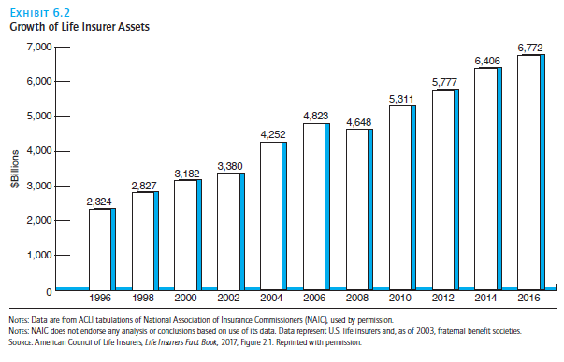
Insurance assets: Investment function of insurance
In 2016:
Life insurance held $6.772 trillion in assets
Property and casualty held $1.59 trillion
Investments must be liquid enough to respond to need

Slide 3
Balance Sheet
Assets
Primary assets are financial (often investments)
Bonds, stock, real estate, other financial instruments, cash
Liabilities
Loss reserves – estimated cost of settling claims for losses that have already occurred but not yet paid
Claims reported and adjusted but not yet paid
Claims filed but not yet adjusted
Claims incurred but not yet reported
Larger for casualty insurer, smaller for property
Case/claim reserves are loss reserves for each individual claim or case (this isn’t on the balance sheet, but the sum of the case reserves are the loss reserves
Can be estimated on case-by-case basis (called judgement method) or average value method
Unearned premium reserve
The unearned portion of gross premiums on all outstanding policies – ie this is the amount of the premium that covers future losses
Loss adjustment expenses, commissions payable, etc
Policyholders surplus
Determines how much volume and flexibility of new business a company can write

Slide 4
Income and expense statement
Revenues
Premiums written and premiums earned
Investment income
Expenses
Net losses incurred
Loss-adjustment expenses – cost of investigating, managing, and settling claims (aka claims adjustment expenses) – paid even if loss turns out not to be covered
Commissions
Premium taxes
Underwriting expenses
Net income

Slide 5
Measuring profit and loss

Slide 6
Life insurance
In 2017 in life insurance,
insurance premiums and annuity considerations made up 62% of total income
Investment earnings contributed 29%
Life insurance assets are longer duration than property/casualty (years vs 6-12 months)
Life insurance policies often have a cash value which in some cases the policy holder might borrow
Creating an asset called contract loans or policy loans
State specific account assets

Slide 7
Asset Valuation Reserve and Interest Maintenance Reserve (specific to life insurance)
Asset Valuation Reserve (AVR)
A liability
Established to offset potential credit related investment losses
For instance, if a bond the company purchased defaults
Meant to offset that potential loss
Interest Maintenance Reserve (IMR)
Defers recognition of realized capital gains and losses
Takes any gains or losses and amortizes them over the remaining life of the investments sold (amoritization according to a schedule)
Making short term investment gains and losses not lead to large swings in an insurance companies balance sheet

Slide 8
JD Vance on health care plan
Discussion of Vance’s health care plan
https://youtu.be/v0DEYf9DBOk?si=vJm8-uUv5Vg_wjV9&t=258 (4:18-6:10)

