Slide 1
Risk Management and Insurance
TR 11:00-12:15 – BUSN202
Shane Murphy

Slide 2
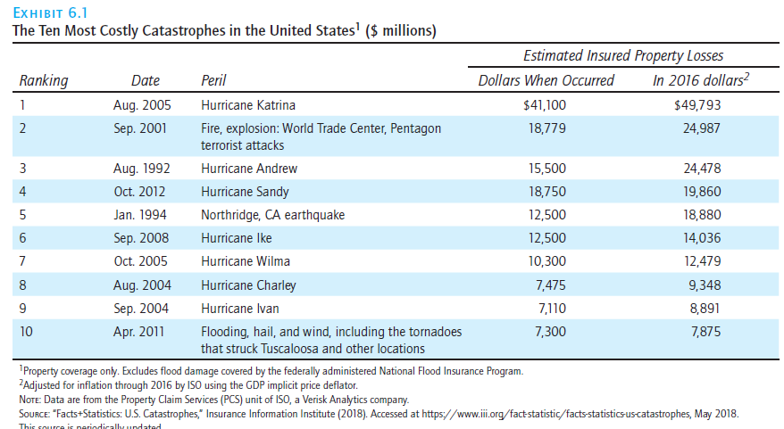
Insurance Company Operations

Slide 3
Rate Making and rating
Pricing of insurance and calculation of premiums
A rate is the price per unit of insurance
An exposure unit is the unit of insurance being sold
Ex: $1,000 of life insurance is 1 exposure unit, while $5,000-$10,000 is an exposure unit in liability
Actuaries can be involved
For more, see the Society of Actuaries, Casualty Actuarial Society, and/or the American Academy of Actuaries

Slide 4
Loss Ratio
In life insurance a major reserve item is the legal reserve, which is a liability item and represents the redundant or excess premiums paid under the level premium method during the early years of the policy.
Assets must be accumulated to offset the legal reserve liability based on state laws on the reserve.
In property and casualty insurance, a loss reserve is an estimated liability item that represents an amount for claims reported but not yet paid, claims in the process of settlement, and claims that have already occurred but not been reported.
Loss ratio is the ratio of incurred losses and loss adjustment expenses to earned premiums.
For example, if incurred losses and loss adjustment expenses are $70 and earned premiums are $100, the loss ratio is 0.70, or 70 percent.
While 70% is a reasonable loss ratio for some products, the ACA mandates loss ratios of 80% and 85% for HI

Slide 5
Underwriting
The process of selecting, classifying, and pricing applicants for insurance
Principles:
Attain an underwriting profit.
Select prospective insureds according to the company’s underwriting standards.
Provide equity among the policyholders.
Agent can perform “field underwriting”
Pay attention to adverse-selection

Slide 6
Underwriting profit
You can only insure that whose expected loses are less than their premiums
If expected losses exceed premiums, loss exposure may be modified
For instance, only insure aspects of business that have no substitutes
Think of a company that makes a product in a number of factories. One factory might make a product in house that could be bought on the market (substitutes exist), so insuring that factory might be less important
Reduce adverse selection through underwriting and policy provisions

Slide 7
More on underwriting
Underwriting and equity
Groups of policy holders should not overly cross-subsidize
20-year olds and 80-year olds should not pay the same premium
Low cost policy groups will not keep high premium policies
Field underwriting
Agent may be told which groups of applicants are acceptable, borderline, or prohibited
What kinds of auto insurance applicants may be less or more preferred?
Additional sources of information
Application
Agent report
Inspection report
Physical inspection/Physical examination

Slide 8
Production
Agents who sell insurance may be called producers
Sales often requires high degree of professionalism and knowledge
Agency department recruits trains, and supervises agents and branch managers

Slide 9
Claims Settlement
Objectives
Verify that the loss is covered.
Pay the claim fairly and promptly.
Provide personal assistance to the insured.
Parties Involved
Agents
Staff adjusters
Independent adjusters
Public adjusters
Steps
The insured provides prompt notice of loss.
The insurer investigates the claim with the cooperation of the insured.
The insured provides a proof of loss if required.
The insurer makes a decision about paying the claim.

Slide 10
Reinsurance
Reinsurance is an arrangement by which the primary insurer that initially writes the insurance transfers to another insurer (called the reinsurer) part or all of the potential losses associated with such insurance.
The ceding company is the primary insurer that initially writes the insurance.
Portion of insurance may be retained or ceded.
The reinsurer is the insurer that accepts part or all of the insurance from the ceding company.
Securitization of risk is insurable risk transferred to market via financial instrument (Insurance-linked security or ILS)

Slide 11
Reasons for reinsurance
Increase underwriting capacity
Stabilize profits
Reduce the unearned premium reserve
Provide protection against a catastrophic loss
Enable an insurer to retire from a territory or class of business
Obtain underwriting advice from the reinsurer

Slide 12
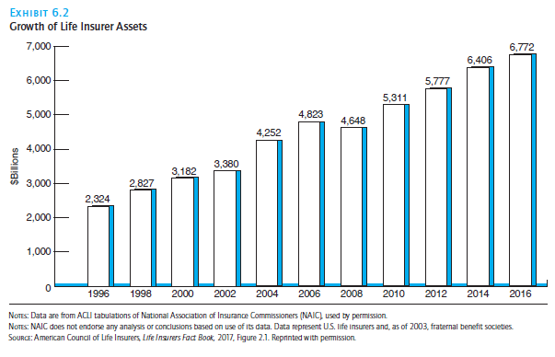
Insurance assets: Investment function of insurance
In 2016:
Life insurance held $6.772 trillion in assets
Property and casualty held $1.59 trillion
Investments must be liquid enough to respond to need

