Slide 1
Complexity and Health Care
TR 2:00-3:15 – BUSN202
Shane Murphy

Slide 2
Models

Slide 3
Complexity
Network relationships
Web-like structure
Nonlinearity
Marginal change a function of starting points
Nonlinear interactions
Externalities
Unintentional concequences

Slide 4
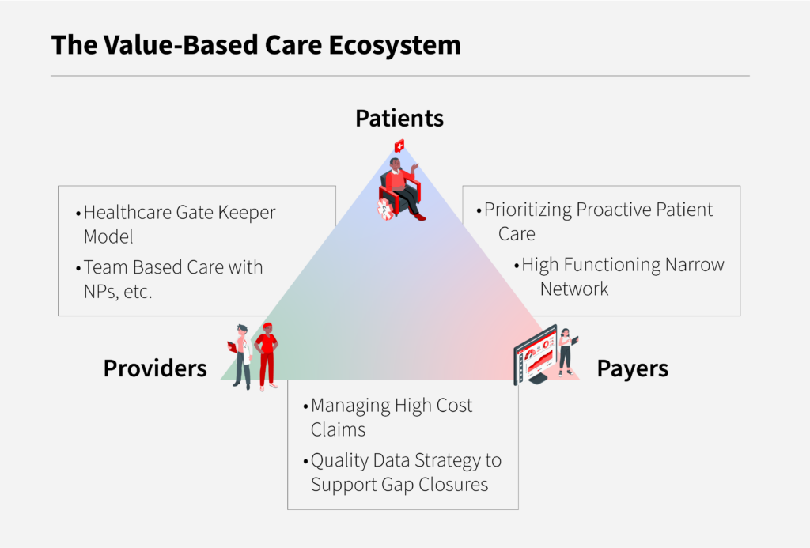
Networks

Slide 5
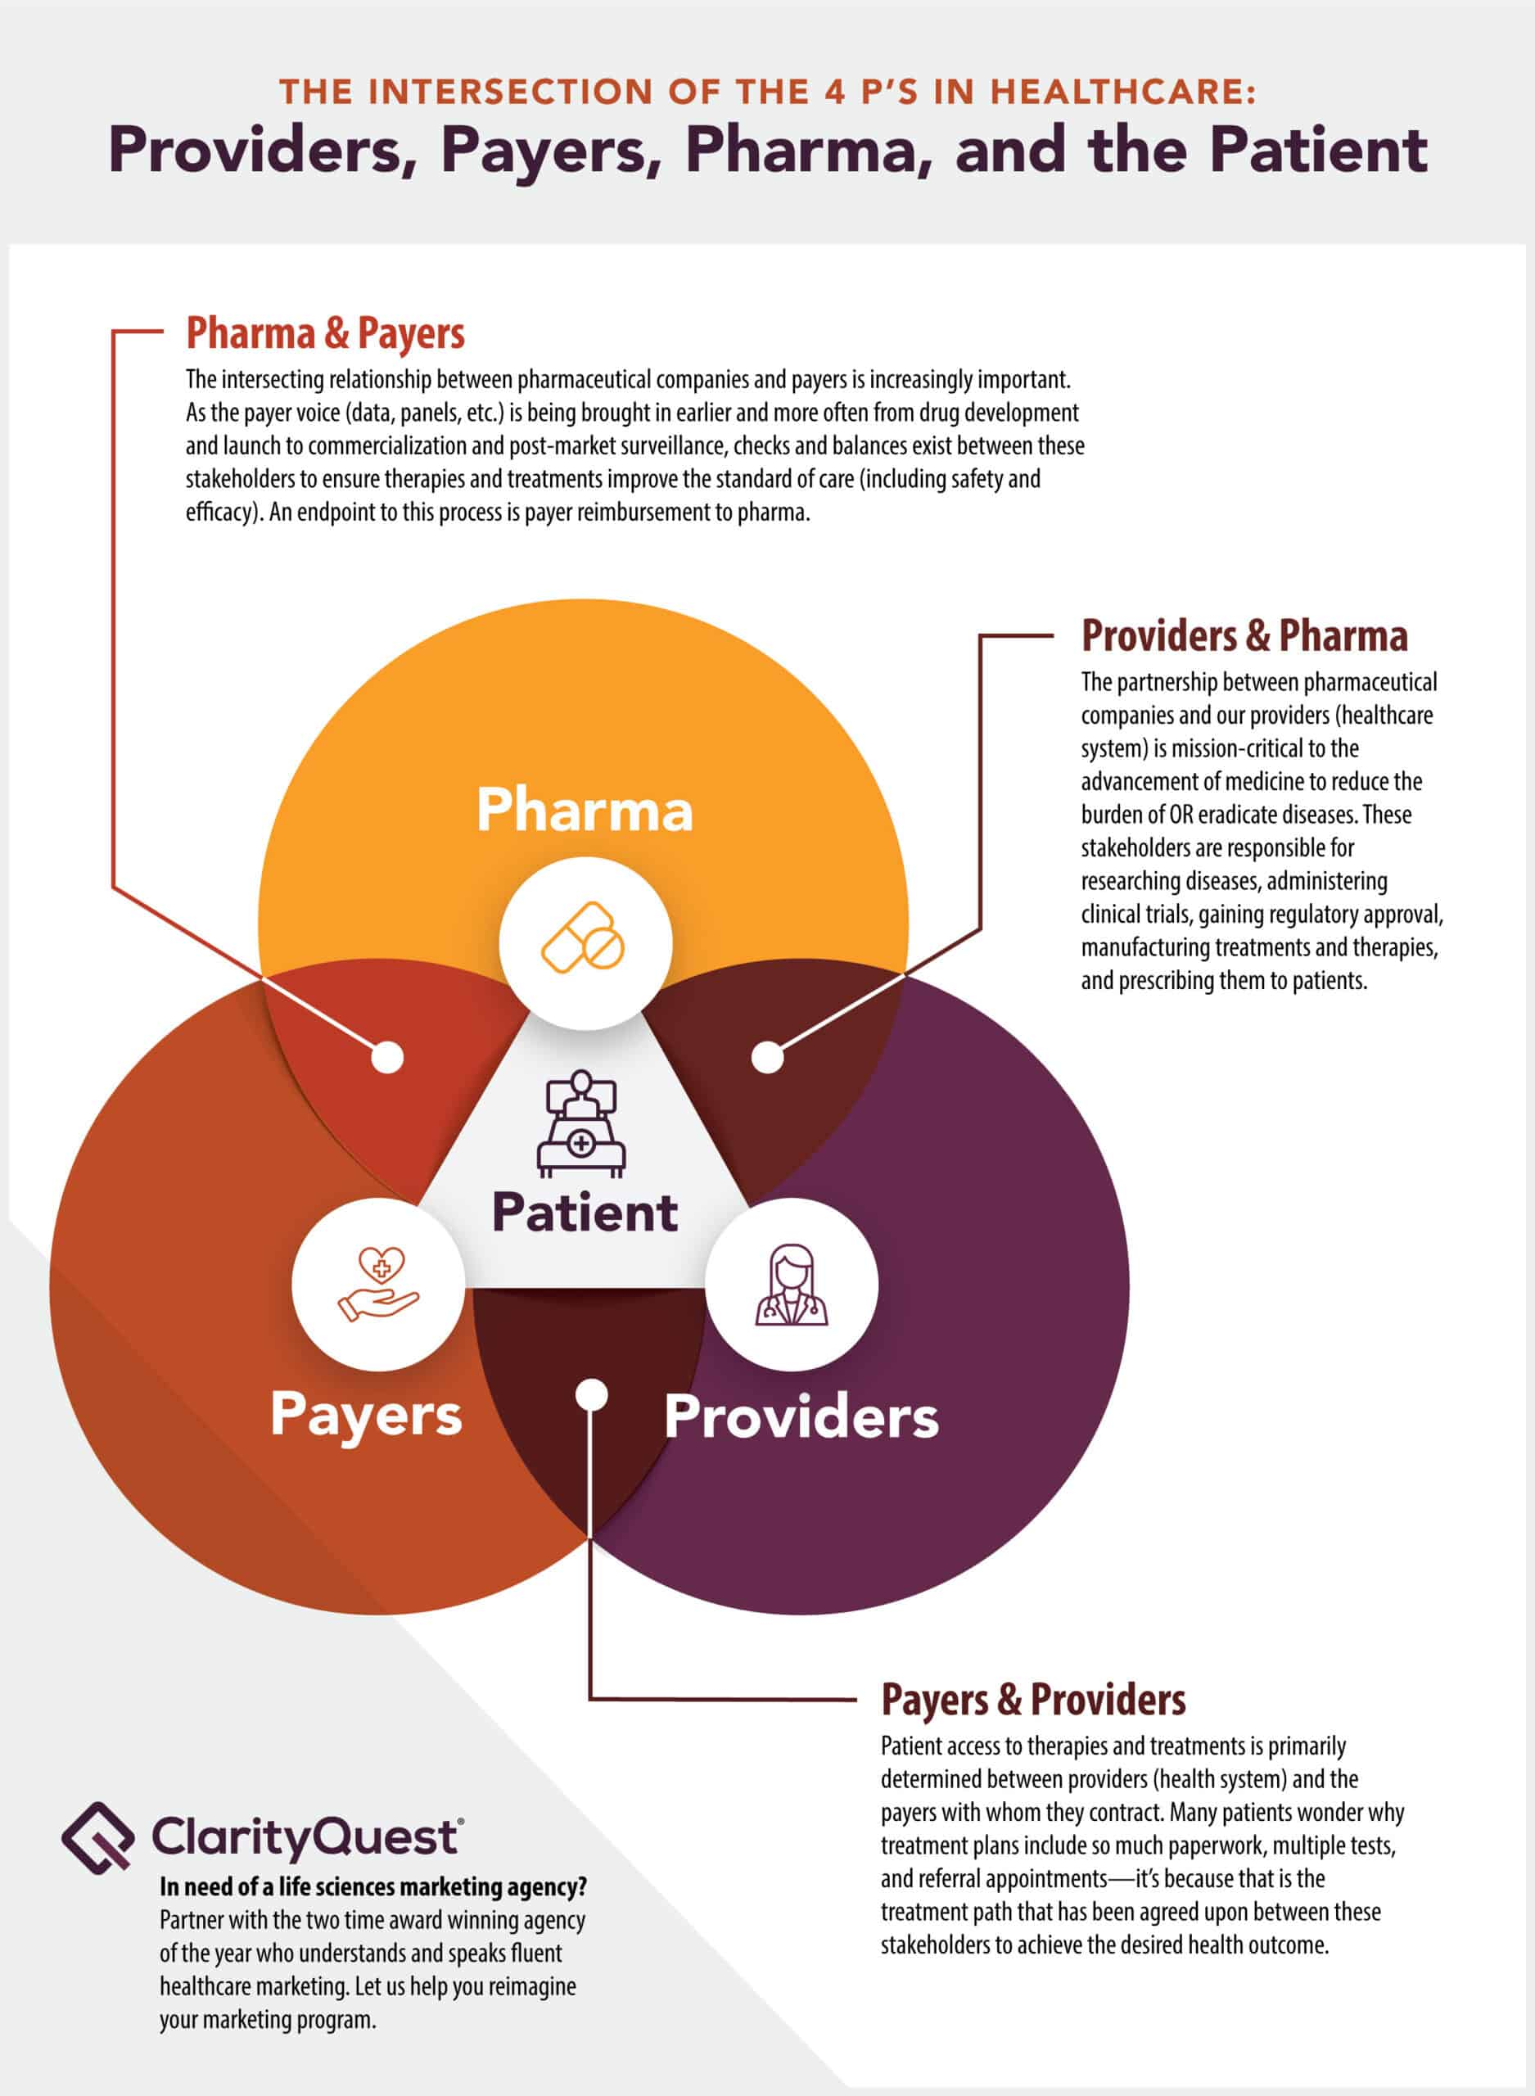
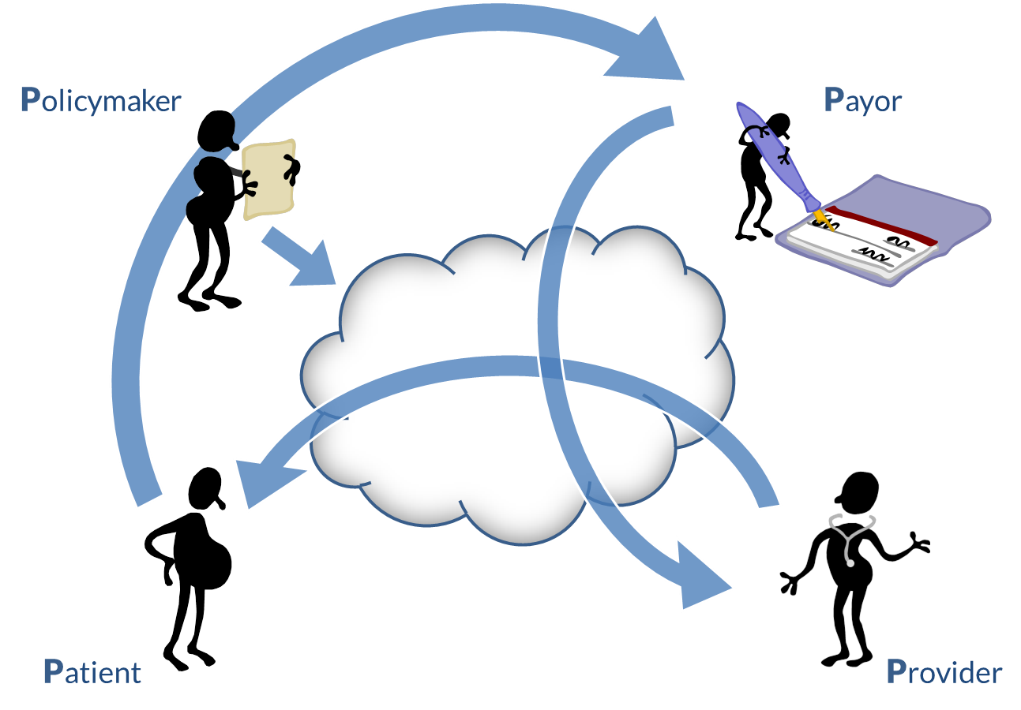
Networks

Slide 6
Embedded Networks
A network model of a business relationship will always break down
Sometimes this can be fixed by augmenting the model
Add a network between patients
Social
Epidemiological
Another between providers
Managed care
Integrated care
Merging organizations
Another between payers
Bargaining models
Mergers and acquisitions (M&A)
Competition

Slide 7
Nonlineaity
Output is greater than sum of its parts
Payments
Fee for service reimburses care summing reimbursement for each service individually
Alternative models reimburse care on more holistic grounds
Bundled payments
Nonlinear interactions
Example: intersectionality

Slide 8
Externalities
Externalities are costs or benefits of an activity that are faced by someone not partaking in the activity
Externalities can include intended and unintended consequences of healthcare
What are the externalities of a vaccine (particularly a Covid vaccine)
Intended:
Unintended:
In light of these, what have we learned about public health provision?

Slide 9
An unintended concequences example
The 3-day stay rule introduced in 1965 was intended to reduce Medicare expenditures for beneficiaries requiring prolonged hospitalization by making them eligible for extended care benefits in a skilled nursing facility if they spent 3 nights in an acute care hospital.
However, elderly patients with acute changes in condition that can now be diagnosed and treated in less than 3 days do not qualify for skilled nursing facility benefits, even if they are unsafe to return home.
Consequently, patients must either forgo rehabilitation or pay for it themselves.
This rule encourages well-meaning physicians to assign a diagnosis code that justifies a 3-day hospital stay as a medical necessity and potentially results in unnecessary tests, treatments, complications, and costs.
However, the rule has persisted because Medicare expenditures increased significantly when it was temporarily waived by the Catastrophic Coverage Act in 1988.

Slide 10
So what could/should be done?
Rule was put into place to control costs
Without rule, costs increase
So without rule either:
Some new rule needs to be implemented
Bundled payments combining acute care with extended care benefits
Regulation of payments based on historical costs
Shared savings when extended stay benefits save costs relative to higher risk of patients released without having nursing care available
Or we accept higher costs or lower quality or…?

Slide 11
Another example
Interaction effects
Lactose intolerance – lack of lactase enzyme in small intestine
Alcohol flush reaction – aldehyde dehydrogenase 2 deficiency
Drug interactions with health conditions
Propranolol and asthma
Propranolol is a beta blocker medication used to treat conditions like high blood pressure. Many healthcare providers avoid prescribing propranolol if someone has asthma. Propranolol can make the muscles that help you breathe to tighten, and can result in an asthma attack.
Diphenhydramine and glaucoma
Diphenhydramine (Benadryl) should be avoided if you have glaucoma. Antihistamines, including diphenhydramine, can raise the pressure inside of your eye and worsen this condition.
Pseudoephedrine and high blood pressure
Pseudoephedrine (Sudafed), a nasal decongestant, works by tightening blood vessels in your nose and sinuses. But it also affects blood vessels throughout your body. This can cause your blood pressure to go up. Generally, it’s recommended to use allergy medications that don’t contain a decongestant if you have high blood pressure.
Furosemide and severe kidney disease
Furosemide (Lasix) is a diuretic (“water pill”). It helps your kidneys remove extra fluid from your body. But for people with severe chronic kidney disease, furosemide may not work as well as it should. In this case, you may need a higher dose of furosemide to effectively remove extra fluid from your body.
Acetaminophen and liver disease
Acetaminophen (Tylenol) is safe for most people to use, but it could be harmful if you have liver problems. Acetaminophen is broken down by your liver. If your liver isn’t working properly, acetaminophen can build up to toxic levels and cause liver damage. And if you have liver disease, you may need to use a lower dose of acetaminophen or avoid it altogether.

Slide 12
Drug-drug interactions
Fluconazole and simvastatin
Fluconazole (Diflucan) stops certain CYP450 enzymes from working properly. This change means fluconazole interactions are common. As an example, fluconazole causes blood levels of cholesterol medication simvastatin (Zocor) to go up. This can make simvastatin side effects more likely.
Ondansetron and dofetilide
Ondansetron (Zofran) is a medication used to prevent nausea and vomiting. But it comes with a number of potential interactions. One example is with the heart rhythm medication dofetilide (Tikosyn). Both medications can lengthen the amount of time between heartbeats. When used together, this time can get too long. This can result in dizziness, fainting, and even death in severe cases. This interaction tends to be more severe when ondansetron is injected into a vein.
Digoxin and amiodarone
Digoxin (Lanoxin) is a heart medication. It’s considered a narrow therapeutic index (NTI) medication. This means that a slight change in its dose could cause serious problems. Because of this, digoxin can be vulnerable to drug interactions. Amiodarone (Pacerone), another heart medication, can interfere with how much digoxin reaches the bloodstream. This can lead to higher amounts of digoxin than usual, and therefore more side effects.
Bactrim and warfarin
Some antibiotics, such as Bactrim (sulfamethoxazole/trimethoprim), can raise the risk of bleeding. This can cause interactions with blood thinners like warfarin (Coumadin, Jantoven). Bactrim can raise the risk of serious bleeding when combined with warfarin.
Levothyroxine and omeprazole
The thyroid medication, levothyroxine (Synthroid), is another example of an NTI medication. So you need to watch out for other medications that could affect how it works. Omeprazole (Prilosec) lowers acid production in your stomach to treat heartburn. But it can lower the absorption of levothyroxine, making it less effective.

Slide 13
drug-food interactions
Atorvastatin and grapefruit
Atorvastatin (Lipitor) is a cholesterol medication that’s broken down and removed from your body by certain CYP450 enzymes. Grapefruit and grapefruit juice can block these same CYP450 enzymes, which could raise the amount of atorvastatin in your body. This can raise your risk of side effects.
Warfarin and leafy greens
Warfarin works by blocking vitamin K’s actions. Vitamin K plays a role in forming blood clots. Leafy green vegetables are full of vitamin K and can undo some of warfarin’s effects. It’s necessary to find a balance between the two. You’ll need to be consistent with how many leafy greens you eat while taking warfarin.
Minocycline and dairy
Some antibiotics, such as minocycline (Minocin), interact with dairy products, such as milk and yogurt. Dairy products can lower the amount of minocycline that’s absorbed by your body. It’s recommended to either take minocycline 1 hour before or 2 hours after eating dairy products.
Metformin and alcohol
Diabetes medication metformin and alcohol both can raise the amount of lactic acid in your bloodstream. This can lead to a rare but life-threatening complication called lactic acidosis. Having one or two drinks every once in a while should be fine. But, it’s best to avoid drinking alcohol with metformin when possible.
MAOIs and aged meats
Taking a monoamine oxidase inhibitor (MAOI), such as selegiline (Emsam) or phenelzine (Nardil), stops your body from breaking down a protein called tyramine. Aged meats, such as sausage and salami, have high amounts of tyramine. Too much tyramine in the body can lead to a sudden rise in blood pressure, which can become dangerous. To avoid this, you should follow a diet that’s low in tyramine if you’re taking an MAOI.

Slide 14
Intersectionality
Intersectionality is related to the concept of interacting effects
Social and political identities combine resulting in unique outcomes, especially related to discrimination and privilege
The nature and cost of discrimination is different for individuals who belong to multiple groups which are discriminated against
Obesity is associated with a number of social and political identities
Including race, poverty, rurality
And the interaction of these factors increases risk

Slide 15
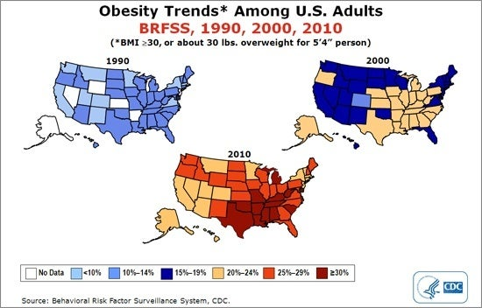
Obesity trends
Notes:
https://www.hsph.harvard.edu/obesity-prevention-source/us-obesity-trends-map/

Slide 16
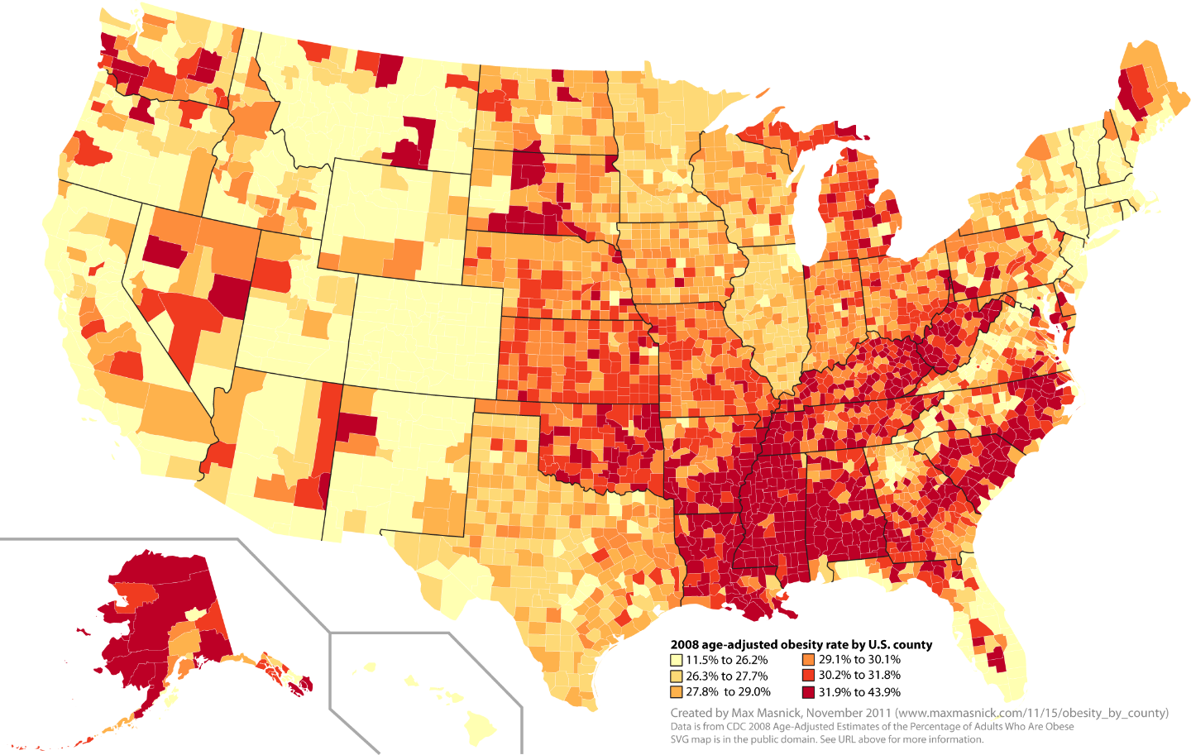
Obesity and poverty
Notes:
https://www.maxmasnick.com/2011/11/15/obesity_by_county/

Slide 17
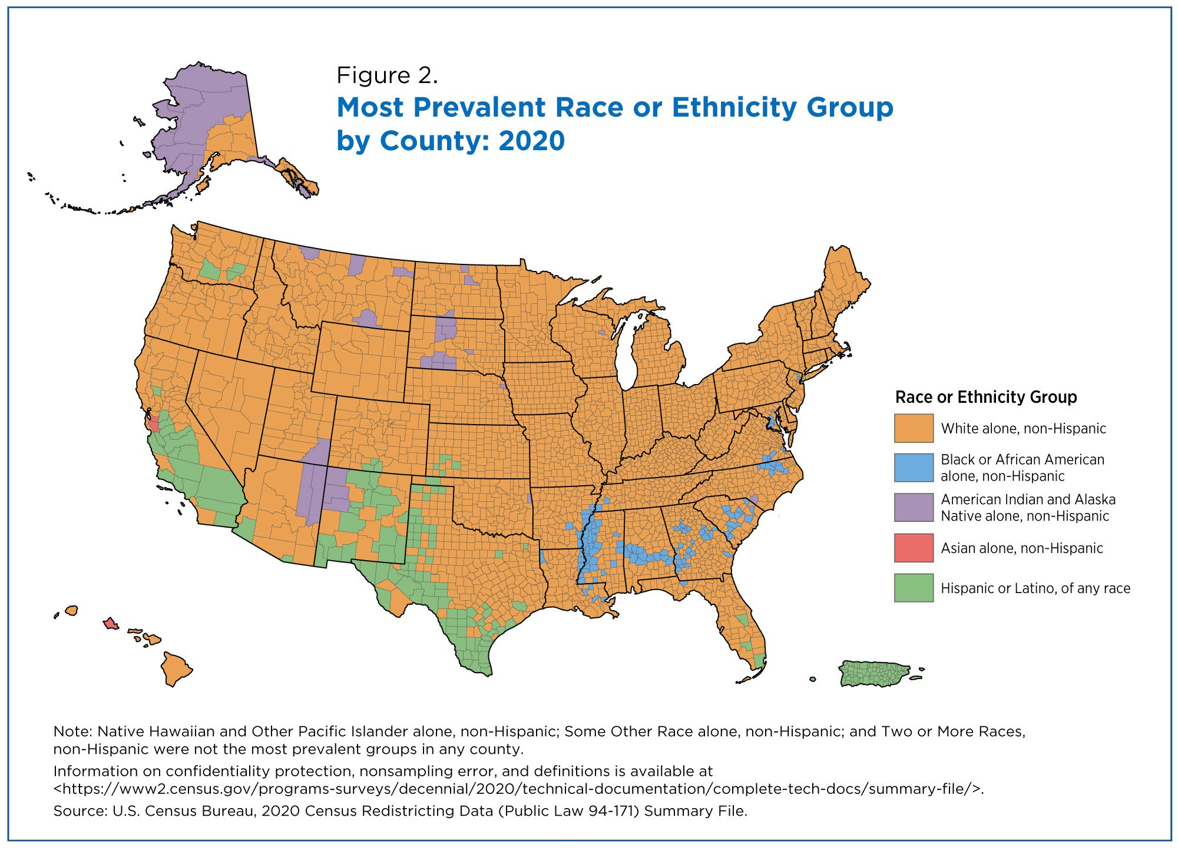
Race
Notes:
https://www.census.gov/library/stories/2021/08/2020-united-states-population-more-racially-ethnically-diverse-than-2010.html

Slide 18
Next class
Bullshit
On Bullshit – Harry Frankfurt
Bullshit Jobs – David Graeber
Ethics
Ethics in healthcare
Business Ethics

Slide 19
Sources
Lipsitz, Lewis A. "Understanding health care as a complex system: the foundation for unintended consequences." Jama 308, no. 3 (2012): 243-244.
Chassin, Mark R. "Improving the quality of health care: what’s taking so long?." Health Affairs 32, no. 10 (2013): 1761-1765.
Cohen, Steven A., Caitlin C. Nash, Erin N. Byrne, Lauren E. Mitchell, and Mary L. Greaney. "Black/White disparities in obesity widen with increasing rurality: evidence from a national survey." Health Equity 6, no. 1 (2022): 178-188.
https://www.goodrx.com/drugs/safety/drug-interactions

