Slide 1
Organizing Healthcare: structure, governing boards, implications
TR 2:00-3:15 – BUSN202
Shane Murphy

Slide 2
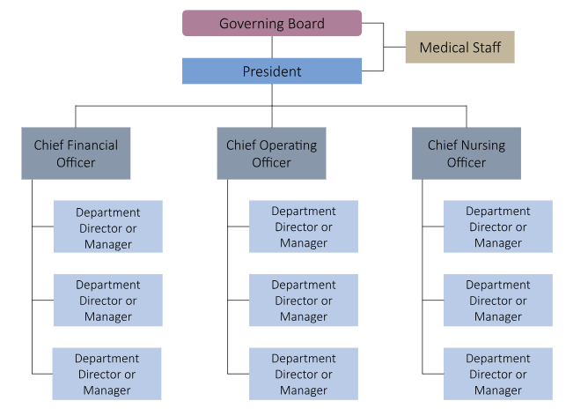
C-Suite Model
Operations (and Nursing) report to respective chiefs
Each department had managers of operations, nursing, and finance respectively
Other offices include CIO

Slide 3
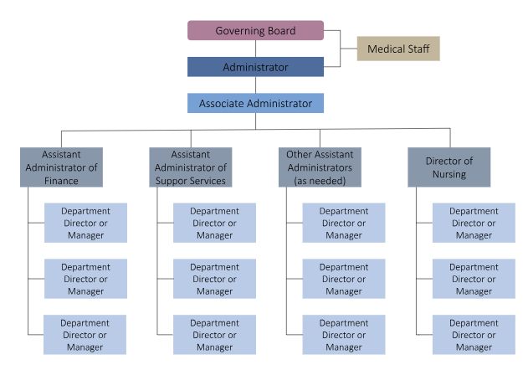
Traditional and Corporate Models
In Corporate Model
Administrator is replaced by President
Associate Administrator by Vice President
Assistant Administrators of … by Vice Presidents of …
Often, Associate Admin/VP have more reporting administrators/VPs than in C-Suite model
Marketing, HR, Res Life, Continuity of Care, Dining, IT …

Slide 4
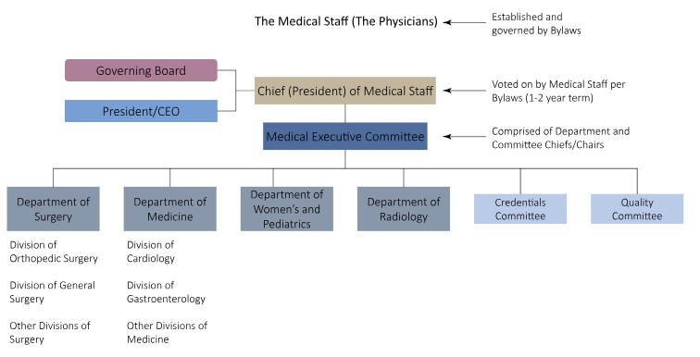
Organization of the Medical Staff

Slide 5
Hospital organization
Other department will have their own organizational charts
Representing patient facing, staff facing, clinician facing, community facing, etc aspects of different department

Slide 6
Hospital boards
Nominated by community board of health for public hospitals
Nominated by ownership structure (stock holders, members, etc) for private hospitals
President runs meetings, spokesperson for board
Secretary orients new members, maintains records
Treasurer oversees finances, liaison between board and hospital financial director/CFO
Generally unpaid, made up of business and political leaders as well as practitioners

Slide 7
Measuring quality
Mortality
Readmissions
Particularly
Excess mortality and excess readmissions
30-days
Case-mix
Conditions
Heart attack, heart failure, pneumonia, joint replacement, and surgical infection prevention
Hospital Acquired Infections and Conditions (HAI/HACs)

Slide 8
Factors contributing to good management
Seniority/tenure
Inclusive of practitioners (nurses and doctors)

Slide 9
Factors contributing to good boards
Expertise
Pre-existing
Board training in quality
Engagement
Priority setting
Is quality on board agendas
Goal setting in meetings
Use of clinical quality dashboard
Data and feedback based incentives
CEO evaluation and pay responsive to patient safety measures

Slide 10
Why (not?) practitioners as leaders
Ethical commitments and training of doctors enhance value of their presence on boards
No significant differences between medically-educated and managerially-educated senior managers:
In their ability to make strategic decisions that maximize the quality of care provided by the organization
In total revenue and profit margin
Doctors on boards drive increased salaries of doctors at hospital
Possible negative relationship between doctor representation on the governing board and the amount of private donations is found

Slide 11
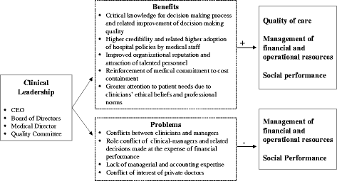

Slide 12
If not quality, then what
Quality is on the agenda of every board meeting in just 63% of hospitals
Financial performance in 93%
Only 59% of boards have a quality subcommittee, and of those, only 64% report to board at every meeting
72% of boards review quality dashboard regularly
Less than 70% review data on HAI, Medication errors quarterly
76% have quarterly review of patient satisfaction data

Slide 13
Importance
Hospitals with more effective management practices provided higher-quality care.
Higher-rated hospital boards had superior performance by hospital management staff.
Hospitals with boards that paid greater attention to clinical quality had management that better monitored quality performance.
Hospitals with boards that used clinical quality metrics more effectively had higher performance by hospital management staff on target setting and operations.

Slide 14
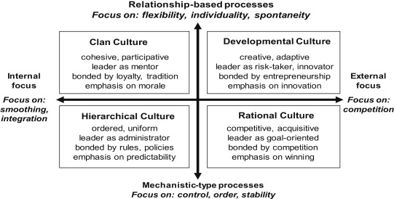
Organizational cultures – Competing Values Framework

Slide 15
Organizational culture and performance
Dominant culture types: | Valued aspects: | Expected performance variables favoured:
Clan | Tradition, cohesion, commitment, morale ∼Internal/relational | Smaller; better staffing levels, staff opinions/morale; higher degree of specialisation; higher level of cancelled operations; high levels of trust; however, may have poorer star ratings.
Developmental | Innovation, dynamism, growth, entrepreneurship ∼External/relational | Lower waiting times; better star ratings; more likely FTs; low level complaints, rapidly dealt with; lower clinical negligence; more imaging tests; more likely specialist; higher consultant and nurse salaries; higher daycase rates.
Hierarchical | Order, procedures, stability, predictability ∼Internal/mechanistic | Better data quality and financial balance, but perhaps higher costs associated with bureaucracy; shorter length of stay.
Rational | External competitiveness, achievement ∼External/mechanistic | More research; more teaching; higher costs; better star ratings; more likely FTs; low level complaints, rapidly dealt with; higher management salaries.

Slide 16
Sources
Tsai, Thomas C., Ashish K. Jha, Atul A. Gawande, Robert S. Huckman, Nicholas Bloom, and Raffaella Sadun. "Hospital board and management practices are strongly related to hospital performance on clinical quality metrics." Health affairs 34, no. 8 (2015): 1304-1311.
Jha, Ashish, and Arnold Epstein. "Hospital governance and the quality of care." Health Affairs 29, no. 1 (2010): 182-187.
Sarto, Fabrizia, and Gianluca Veronesi. "Clinical leadership and hospital performance: assessing the evidence base." BMC health services research 16 (2016): 85-97.
Tasi, Michael C., Aakash Keswani, and Kevin J. Bozic. "Does physician leadership affect hospital quality, operational efficiency, and financial performance?." Health Care Management Review 44, no. 3 (2019): 256-262.

