Slide 1
Ethics, AI, Trilemmas
TR 2:00-3:15 – BUSN202
Shane Murphy

Slide 2
Continuing AI conversation
Can You Tell Which Short Story ChatGPT Wrote? (0:36-17:40)
https://www.youtube.com/watch?v=xKaCvH0l6Io
What does this tell us about how AI can be used and misused in business today?
What is AI good at today? What is it bad at?
What does this tell us about how AI can be used and misused in business today?

Slide 3
AI ctd
What is AI good at today? What is it bad at?
What does this tell us about how AI can be used and misused in business today?
How do we mitigate the costs of webMD and maximize its benefits, and is AI similar?

Slide 4
AI ctd
What is AI good at today? What is it bad at?
AI is good at prediction, but bad at new knowledge generation
What does this tell us about how AI can be used and misused in business today?
How do we mitigate the costs of webMD and maximize its benefits, and is AI similar?

Slide 5
Finishing ethics
So what do we know?

Slide 6
Keys to navigating tension
Foster trust between management and providers
Treat management jobs as a vocation (as many providers do)
Make clear data about effectiveness and outcomes
Transparency about decision making and focus on patient and population creates and maintains alignment of interests
“Obviously, choosing ways to spend [health] resources is not a rational process. It is largely influenced by assumptions and powerful groups, all as potent as they are nonrational”

Slide 7
Practical advice
Conspiracies are uncovered, secrets are told
You can’t withhold information from patients, they might not find out in every case, but they often will
Whistle blower protection generally doesn’t work – you can’t rely on whistle blowers so you need robust procedures
“among whistle blowers surveyed, 62% lost their jobs, 18% felt that they were harassed or transferred and 11% had their responsibilities or salaries reduced.”
Legal liability is shared between payers and providers – it is the responsibility of each party to protest when care dictated by the other party does not serve the patients interest.
Wickline v California
Cutting staff is less ethical in healthcare than in other industries

Slide 8
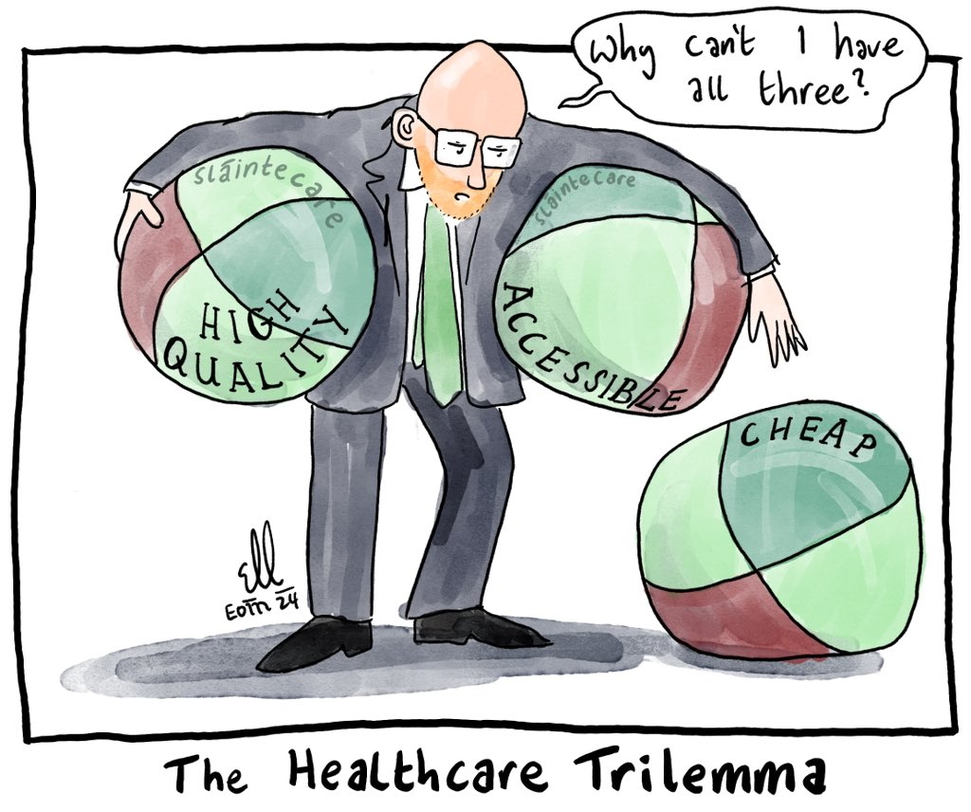
Dilemmas and trilemmas
Complexity has another manifestation

Slide 9
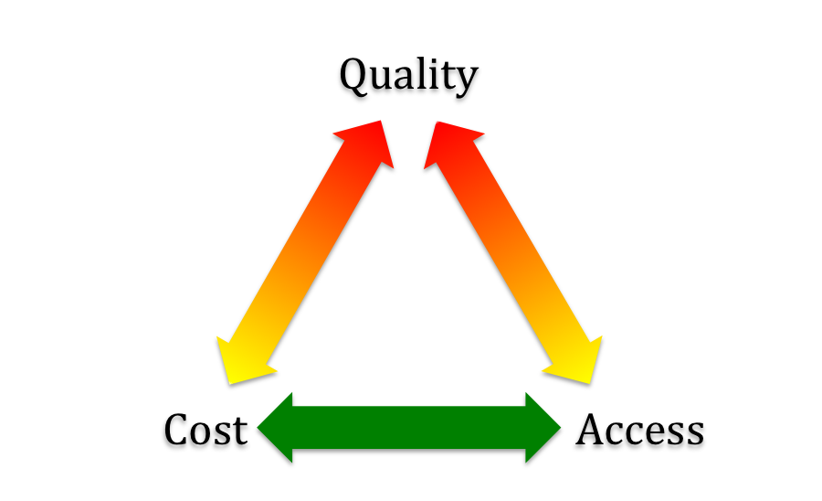
Trilemma 1: Iron triangle of healthcare

Slide 10
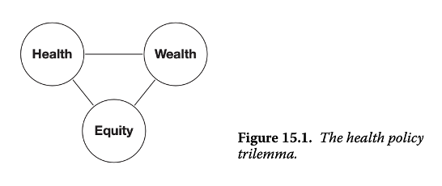
Trilemma 2: National health policy

Slide 11
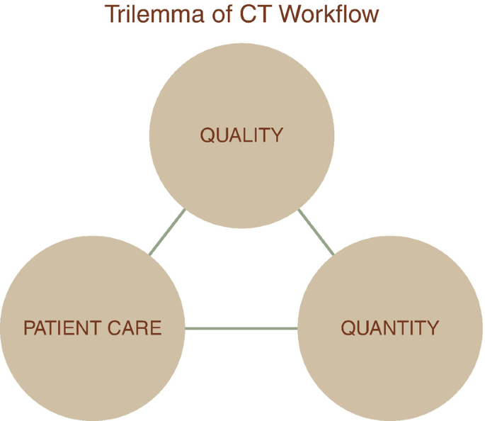
Trilemma 3: Hospital department

Slide 12
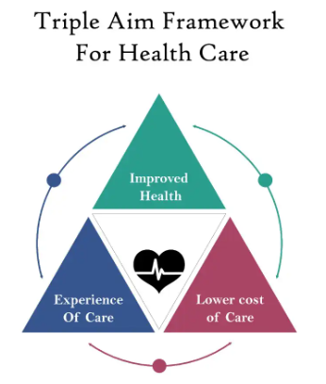
Trilemma 4 (triple aim): Healthcare providers

Slide 13
Trilemma N: The diet, health, and environment trilemma
Clark, Michael, Jason Hill, and David Tilman. "The diet, health, and environment trilemma." Annual Review of Environment and Resources 43, no. 1 (2018): 109-134.
Abstract:
During the past century, human activity has stressed and pushed the limits of the natural environment while food systems and food choices became a major contributor to environmental degradation and poor health outcomes. This chapter will discuss the nexus and challenges posed as diet, the environment and human health intersect. First, the excessive use of natural resources that are consumed before they can be naturally replenished within a year’s time will be discussed. An overview of our planetary boundaries will follow where an emphasis is placed on the role of industrialized agriculture in biodiversity loss, land use changes, water and energy use, and nitrogen and phosphorus pollution. Next, the role of food systems and the burden of diet-related chronic diseases will be delineated that includes obesity, type 2 diabetes, cardiovascular diseases, cancer, and antibiotic resistance.

Slide 14
Tilemmas abound! Can you BS your way through?
Alola, Andrew A. "Carbon emissions and the trilemma of trade policy, migration policy and health care in the US." Carbon Management 10, no. 2 (2019): 209-218.
Hambræus, Leif. "How to balance biofuel and food production for optimal global health and nutrition: The food crop-feed crop-fuel crop trilemma." Economic Effects of Biofuel Production 57 (2011).
Maggi, Stefania, Domenico Rogoli, and Fiona Ecarnot. "Healthy aging in the context of the Mediterranean diet–health-environment trilemma." Aging and Health Research 1, no. 2 (2021): 100015.
Martine, George, and José Eustáquio Diniz Alves. "Economy, society and environment in the 21st century: three pillars or trilemma of sustainability?." Revista Brasileira de Estudos de População 32 (2015): 433-460.
One of these is not like the others?

Slide 15
What’s the lesson
I dunno, people like trilemmas!
Quadruple aims and more

Slide 16
Next time:
Organizing Healthcare
For profit vs not for profit
Governing boards

