Slide 1
Public health management
TR 2:00-3:15 – BUSN202
Shane Murphy

Slide 2
Public Health
Stakeholders
Local, city, and state/national actors
Local
Hospitals, community organizations, universities, businesses, religious organizations
City
City and county departments of public health, mayors office, parks and recreation
State
State/national departments of public health, NGOs, IGOs

Slide 3
Role of private health organizations
Providers, especially Hospitals
Service large segments of a community (often only one or two local hospitals)
Public and non-profit financing available
Historical connections to community
Company towns
Insurance company
Service large employers
Clear benefit from lowering costs
Preventative care and outreach from PCPs more cost-effective than acute care

Slide 4
Program management
Program managers are responsible for the design and implementation of specific health services programs to achieve their objectives
Growing field – related to promotion of evidence-based decision making
Planning, dealing with complex interdependencies, service integration and appropriate pacing of the program
Key skills:
Identifying and assessing evidence
Applying results to local context
Understanding of factors potentially affecting uptake, implementation or sustainability of the evidence

Slide 5
Program implementation
Innovation to develop the evidence base for action
Technical package of a limited number of high-priority, evidence-based interventions that together will have a major impact
Effective performance management, especially through rigorous, real-time monitoring, evaluation, and program improvement
Partnerships and coalitions with public- and private-sector organizations
Communication of accurate and timely information to the health care community, decision makers, and the public to effect behavior change and engage civil society
Political commitment to obtain resources and support for effective action.

Slide 6
Public health innovation
Variety of types
Science/medicine
Information systems
Data collection
Communication techniques
Issue framing
Bridge the gap between need and uptake
Otherwise problems would solve themselves

Slide 7
Technical package
Simple to understand and implement
Clarity (avoid vagueness)
Specific targets
Issues and population
Comprehendible impact
Scalability
Example
Surveillance combined with intervention (vaccines/treatments/education)

Slide 8
Managing performance
Ideas are cheap, can a program be implemented by the infrastructure and human capital available?
Information systems for surveillance and implementation important
But costs of IT can be underestimated and benefits overestimated
Simplicity still valued
Monitoring and evaluation
Avoid bias, do not overestimate effectiveness
Constant improvement
Resource management
Particularly with recruiting, training, and retaining workforce

Slide 9
Partnerships
Coalitions with stakeholders
Schools, businesses, law enforcement, transportation, agriculture, labor, and many other sectors in society
Financial and human resources
Including shared resources
Connections to populations or interest and at-risk populations
Ethical issues:
Cross purposes
Whitewashing/greenwashing/public-health-washing(?)

Slide 10
Communication
Encourage political commitment, change public perception
Strategic, timely, well executed strategies important
Message and messenger important
Effect social norms
Present human face on issues and solutions
Create channels of communication in advance, especially in emergency response

Slide 11
Political commitment
Builds upon previous points
Key to resource availability
Public health may follow rather than lead civil society due
Political salience lags popular salience
Politics often promotes status quo and punishes risk taking
Opponents of public health may be vocal, well funded, and organized
Politicians need to feel secure and see that opposition threat is minimized
Opposed programs:
water fluoridation, vaccination mandates, smoke-free workplace laws, disease reporting, environmental protection, and motor vehicle safety.

Slide 12
Game theory
Tragedy of the commons:
A preventive measure that brings large benefits to the community offers little to each participating individual
Prisoner’s dilemma

Slide 13
Game Theory: Prisoner’s dilemma
Suppose you and your buddy commit a crime and you are both arrested by the police and placed in different rooms while being interrogated.
If neither of you talk, then there's only enough evidence to convict you both of a lesser crime and you'll each only get 2 years in prison.
If you fully confess and agree to testify against your partner, then you will go free and your partner will get a 10 year sentence.
Same goes for him: If he fully confesses and agrees to testify against you, then he will go free and you will get the 10 year sentence.
If you both fully confess, then they are offering 5 years for each of you.
So what do you do?
If he confesses, then you get 10 years if you don't confess and 5 years if you do.
If he doesn't confess, then you get 2 years if you don't confess and 0 years if you do.
Therefore, regardless of what he does, you are better off confessing. And he does the same analysis and concludes that no matter what you do, he should also confess. And so you both act rationally, confess, and go away for 5 years. But, you'd both be better off if you'd both stayed silent.

Slide 14
Game theory
Tragedy of the commons:
A preventive measure that brings large benefits to the community offers little to each participating individual
Prisoner’s dilemma
Examples
Narcotics prescription
Doctor might as well believe and patient might as well feign extreme pain
Disinformation
Hard to break from group
Advertising
Insurance upcoding and denial

Slide 15
Barriers to program management
Informational: availability of relevant research
Applying information to local context
Research doesn’t focus on complex reality of real medicine
Too much information
Assessing multiple, possibly conflicting streams of information
Organizational: difficulty integrating evidence and methods across complex organizational decision processes
Time and resource constraints, including workload
Lack of leadership and availability of senior management
Planning processes and processes for incorporating evidence
Poor communication between levels and isolation of programs

Slide 16
Barriers to program management
Organization culture
Crisis management focus makes it difficult to prioritize important but non-urgent needs
Politicization
Resistance to change
Individual skills, capacity, and experience
Lack of contact and mutual understanding between researchers and decision makers
Scalability

Slide 17
Scalability
Sometimes this means smaller programs that can be repeated
And sometimes this means programs that can be meaningful when implemented on small and large scales alike
Organizations, physicians, and advocates often focus on individual approaches
Challenge for scalability
But standardization within the individualization can lower costs, allowing for more scalability

Slide 18
Solutions/facilitators: Information
Access to information
Systematic reviews bypass the stage of looking at individual studies, increase confidence
Building interaction time between researchers and decision-makers
Targeting dissemination of research findings important

Slide 19
Solutions/facilitators: Organizational structure
Intra-organizational linkages
Expertise in research utilization
Processes for integration of evidence
Administrative support
Data – especially operational data – availability

Slide 20
Solutions/facilitators: Organizational culture
Supporting evidence use
Human resources training
And rewards
Inter-organizational collaboration
Visible research utilization

Slide 21
Solutions/facilitators: Skills
Contact between researchers and decision-makers
Mutual respect
Researcher and decision-maker focus on application

Slide 22
Sustainability
Avoiding attrition of program goals and capabilities
Continuing infrastructure and expertise as issues change, mature
Avoiding program creep
Required: structures and processes that allow a program to leverage resources to effectively implement and maintain evidence-based policies and activities
Up to 40% of all new programs do not last beyond the first few years after the end of initial funding

Slide 23
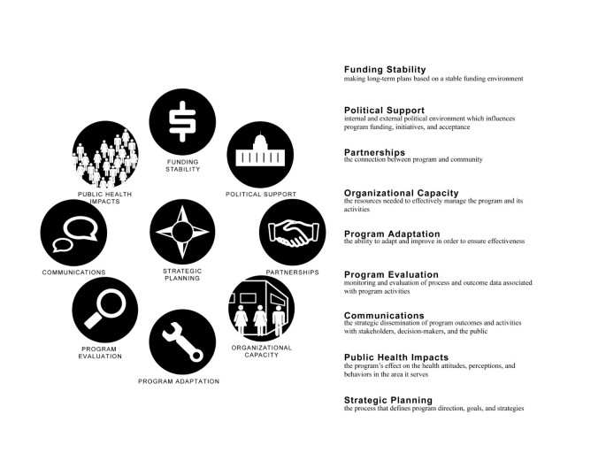
Sustainability

Slide 24
Discussion
Compare your list of 5 public health crisis/interventions
You need 5 interventions, it might help to think of the crisis first
Pick two or three:
What were some of the big challenges that your intervention faced?
Would you consider your intervention successful, unsuccessful, or too early to tell?

Slide 25
Sources
Frieden, Thomas R. "Six components necessary for effective public health program implementation." American journal of public health 104, no. 1 (2014): 17-22.
Humphries, Serena, Tania Stafinski, Zubia Mumtaz, and Devidas Menon. "Barriers and facilitators to evidence-use in program management: a systematic review of the literature." BMC Health Services Research 14 (2014): 1-15.
Schell, Sarah F., Douglas A. Luke, Michael W. Schooley, Michael B. Elliott, Stephanie H. Herbers, Nancy B. Mueller, and Alicia C. Bunger. "Public health program capacity for sustainability: a new framework." Implementation science 8 (2013): 1-9.

