Slide 1
Risk Management and Insurance
TR 11:00-12:15 – BUSN202
Shane Murphy

Slide 2
Life insurance contractual provisions
Ownership clause
The policyholder possess all contractual rights in the policy while th einsurred is living
Entire contract clause
Life insurance policy and application constitutes the entire contract
Incontestable clause
Insurer cannot contest the policy after it has been in force for two years
Exceptions for fraud (intent to murder, no insurable interest, impersonation)
Suicide clause
Policy will not be paid (but premiums will be refunded) if death by suicide within two years of policy
Grace period
31 days to pay overdue premiums, insurance remains in place, longer periods for flexible-premium policies
Reinstatement clause
Owner of policy can reinstate a lapsed policy under certain conditions
Misstatement of age or sex clause
Amount payable is calculated at correct age and sex

Slide 3
Life insurance contractual provisions
Beneficiary designation
Primary and contingent beneficiary
Primary is first entitled receiver
Contingent is entitled if primary dies
Guardian may be required for minor beneficiaries
Trustee – may be a bank
Revocable and irrevocable beneficiary
Policyholder may or may not need permission of beneficiary to change designation
Specific and class beneficiary
Class could refer, for instance, to “children of the insured”

Slide 4
Life insurance contractual provisions
Change of plan provision
Exclusions and limitations
Suicide for two or sometimes one year
War clause
Status clause – excludes case where beneficiary is in military
Results clause – excludes case where beneficiary dies as result of war
Aviation exclusions
Excludes aviation deaths other than as a fare-paying passenger on a regularly scheduled airline
Commercial airline workers may be allowed
Certain hobbies
Auto racing, skydiving, scuba diving, hang gliding, travel or residence in dangerous countries
Payment of premiums

Slide 5
Life insurance contractual provisions
Assignment clause
Policy can be donated (perhaps to a church)
Policy can be used as collateral for a loan
Only up to the extent of the loan, beneficiary still receives rest
Policy Loan Provision
Cash-Value may be borrowed by policy holder at interest rate stated in policy (5%, 6%, sometimes up to 8%)
Cash value legally belongs to insurer not policy holder
Loan reduces face value if death occurs before loan is repaid
Advantages: No credit check, no fixed repayment schedule
Disadvantages: no legal requirement of repayment
Automatic premium loan
Overdue premium is borrowed from cash value

Slide 6
Dividend options
Participating policy - policy pays dividends
Cash
Apply to premiums
Dividend accumulation
Paid up additions
Different from paid up contract
Term insurance (fifth dividend option)

Slide 7
Nonforfeiture options
Nonforfeiture value or Cash-surrender value
If a cash-value policy is purchased, a policyholder pays more than is actuarially necessary for the life insurance protection. Thus, he or she should get something back if the policy is surrendered
If an individual stops paying premiums, they have a right to the cash value, or to have the cash value
Cash
Extended term
used to pay premiums to extend the insurance
Reduced paid-up
contributed to a new, reduced, paid-up policy

Slide 8
Settlement options
Cash
Interest Option
Fixed-Period Option
Fixed-Amount Option
Life Income Option
Without guaranteed period
No contingent beneficiary
With guaranteed period
Contingent beneficiary
Guaranteed total amount
Use of a trust
For people who cannot manage financial affairs or if amount is substantial

Slide 9
Additional benefits
Waiver of premium provisions
Become disabled before some stated age, such as before age 60 or 65
Be continuously disabled for six months (Some insurers have a shorter waiting period.)
Satisfy the definition of total disability
Furnish proof of disability satisfactory to the insurer
Term insurance riders
Premium contributes to whole life and term policies
Guaranteed purchase option
Allows policyholder to purchase additional insurance at set rates without giving further evidence of insurability
Accidental death benefit
Cost of living rider
Allows increase of amount of coverage to be purchased in line with COL increases without giving further evidence of insurability

Slide 10
Additional benefits
Accelerated death benefit
Give part of benefit to chronically or terminally ill policy holder
Viatical settlement
the sale of a life insurance policy by a terminally ill insured to another party, typically to investors or investor groups who hope to profit by the insured’s early death
Price is discounted, premium paid by buyer
Life settlement
Similar to viatical but not terminally ill policyholder
Stranger-Owned Life Insurance (STOLI) – problem for life insurers

Slide 11
Buying Life Insurance
Determining the cost of life insurance
Traditional net cost
Interest adjusted cost method
Rate of return on saving component/cash value
Taxation of life insurance
Federal income tax
Lump sums are income tax free
Interest component of payments are taxable
Premiums are not deductible
Payments or dividends that are less than premiums are not taxable
Federal and state estate tax
Exemption amount ($13.61M/$27.22M)
Shopping for life insurance
Chartered Life Underwriter (CLU), Chartered Financial Consultant (ChFC), or Certified Financial Planner (CFP)

Slide 12
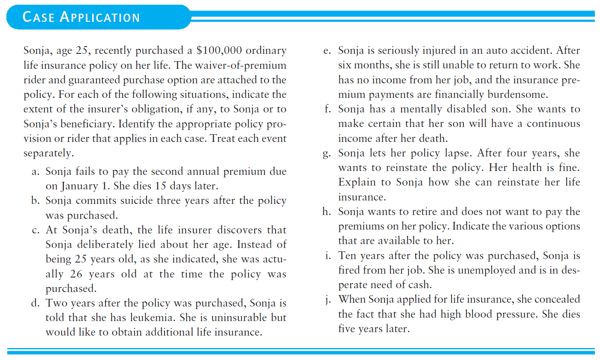
Discussion

