Slide 1
Risk Management and Insurance
TR 11:00-12:15 – BUSN202
Shane Murphy

Slide 2
Rawlsian social contract
Utilitarianism
Associated with founders of economics (Jeremy Bentham)
Government should maximize net social utility
Aggregate welfare
Effective altruism (Singer)
Disease Control Priorities Project
Rawls:
Veil of ignorance
Under such a veil, what principles of justice would people choose for society
Maximin
Means (deontic) rather than ends (consequentialist) approach

Slide 3
Proto-insurance
Risk spreading/shifting
Escaped Greek slaves
Death insurance for roman soldiers
Roman government indemnifying Mediterranean traders
No company, poorly defined premium, no ex ante probabilities

Slide 4
Early insurance
13th century shipping
Growing out of
Using cooperatives to risk pool
Maritime loans/Sea loans condition repayment on safe arrival of ship
Shippers loaning to merchants to be repaid upon successful delivery and forgiven if unsuccessful
Spread to land trade, then to other types including life
Insurers attracted to the gamble rather than mutual organization
Early insurance often did not follow principle of insurable interest

Slide 5
Start of modern insurance in 17th century in the UK
Life – 1680s
Edmond Halley’s life tables
Expanded to allow people of all ages to buy life insurance by end of 1700s
Property
Mutual societies for fire insurance
Business insurance
Edward Lloyd cargo insurance and betting in 1688
Underwriting

Slide 6
Friendly and Mutual Societies in the UK
Friendly societies
Become popular in early 1700s
Men of similar class created mutual trust
Similar age often also a requirement
Mutual societies
Dues not based on risk
Benefits paid in part by dues part by calls to members

Slide 7
Value of legal recognition
Friendly organizations gained (in 1793 in the UK) access to laws of settlement which gave them responsibilities to beneficiaries and the right to expel members
Set up registration process with local authorities
Later laws
Allowed societies access to investing in the Treasury
Required premiums to be based on professional statistics
Not universal
The case of burial insurance and insurable interest
Not considered insurable interest under 1774 law

Slide 8
US urban Life Insurance industry
Early commercial programs in the US were less restricted by insurable interest
Life insurance plans often focused on commercial risk
For example, creditors insuring the lives of debtors
Merchants adding life insurance plans to fire and marine insurance plans
As the US Civil War (1861-1865) approached, personal life insurance grew for middle-classes

Slide 9
Mutual Aid and Fraternal Insurance in the US
Ancient Order of United Workmen (AOUW) formed in 1868
3 years after the end of the Civil War
Fraternal insurers grew from beginnings in 1860s to controlling half the market in the 1890s
Regulated after 1900
Generally required solvency
Disappeared thereafter, shrinking to 8% of the market by 1930s

Slide 10
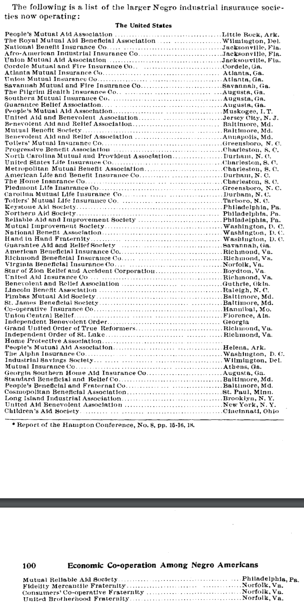
African American Insurance Societies
Mutual Aid Societies also played multiple important roles in African American Society
Insurance and social organization

Slide 11
Products of Fraternal Societies
Life Insurance
Sickness Insurance
Accident Insurance
Fixed-Fee Medical Care Provision
Other Charity
Social Organization

Slide 12
Causes of decline of Fraternal Insurance
Regulation
No regulation until 1888
Federal regulation began in 1893
Reserve requirement
Self regulating Mobile Bill of 1910
Growth of group insurance
Financial strain and dissolution
Workers compensation laws and assistance

Slide 13
Men vs women based mutual social organization
Male dominated social groups cut across class and region
But middle class female dominated groups formed with religious, charitable, and welfare purposes
Task of shaping public opinion was key both in influencing legislatures to act and influencing courts to accept
This was in contrast with courts striking down laws intended to shield unions, regulate working conditions, and regulate the market

Slide 14
Insuring slave and indentured laborers in the US
After the 1793 invention of the cotton gin and 1808 prohibition on international slave trading, the value of slaves increased in the US
Slave based economies also grew further south, driving up trade
And environmental diseases were worse further south, increasing mortality
Urban, northern commercial-focused life insurance marketed to slave holders
Property and fire insurance companies began underwriting slave lives
Underwriting also included investigating slave owners to understand risk of mistreatment of slaves leading to death
First policies in 1831 by Baltimore Life Insurance Company
Slave insurance grew from rare to most common type of policy for this and other southern life insurance companies

Slide 15
Northern companies selling slave insurance
Northern companies include:
New York Life, United States Life of New York, Aetna Life of Hartford, Hartford Life, Charter Oak of Hartford, National Safety Life and Trust of Philadelphia, Mutual Benefit of New Jersey, British Commercial Life of London, and the New York office of National Loan Fund Life Insurance Company of London
Of New York Life’s first 1,000 policies , 339 were on slaves (in 1845)
By 1850, slave policies were discontinued as free person life insurance policies were sustainable

Slide 16
More on slave and non-slave policies
Slave insurance was also used to protect manumission “loans”
A person could buy a slave (say, for $600), and then free the slave. The then free person would pay the former owner $600 plus interest over some period
The former owner would also buy a life insurance policy on the free former slave in case the person died and is not able to pay back the cost of manumission
Often used to protect people from being sold south
Manumission policies were the minority
Policies common for urban slaves in dangerous jobs such as mining, railroad construction, and working on steamboats
Additional premium for such individuals

Slide 17
Conclusion
Development in field of statistics and epidemiology in the 1600s and 1700s made life insurance possible
Life insurance was heavily driven by commercial interest
Either third party protecting future income from laborer
Maritime, indentured or slave worker
Or to replace breadwinner income
Policies also sought to cover burial cost
Commercial plans competed with Friendly and Mutual Societies

Slide 18
Sources
Friedman, Rachel Z. Probable justice: risk, insurance, and the welfare state. University of Chicago Press, 2020.
Murphy, Sharon Ann. Investing in life: Insurance in antebellum America. Johns Hopkins University Press+ ORM, 2010.

