Slide 1
Health Care Management
TR 2:00-3:15
Shane Murphy

Slide 2
Final project
https://www.instagram.com/fantasydocs/?hl=en
https://www.youtube.com/results?search_query=interview+with+Nithin+Natwa
https://www.google.com/search?q=interview+with+Nithin+Natwa
https://www.sdtplanning.com/podcasts/how-an-mba-can-help-doctors-discover-opportunities-and-earn-passive-income

Slide 3
Mental Health Provision
Public Good?
Opportunity cost and Marginal Social Benefit?
Ability to pay?
Natural Monopoly?

Slide 4
Mental Health up to the 1950s
Dorothea Dix’s national crusade for moral treatment for the mentally ill in the 1840s
Clifford Beers mental hygiene movement of the 1910s and 1920s
Hospitals run by states, but with increasing levels of federal financial support
Block grants as a part of FDRs New Deal in the 1930s
Truman’s National Mental Health Act of 1946 creating the NIMH
In 1955, the first antipsychotic, Chlorpromazine (Thorazine), came on the market and was quickly heavily prescribed
Gave hope for an end to mental health illness
Dire conditions in mental health facilities was growing in the national consciousness
One Flew Over the Cuckoo’s Nest – Ken Kesey (1962)

Slide 5
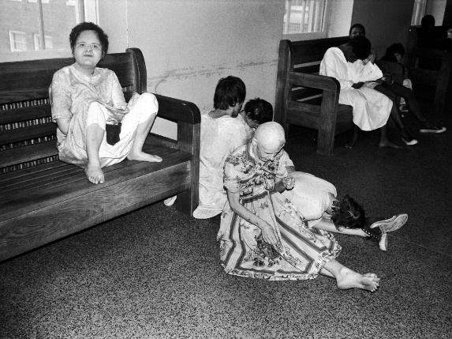
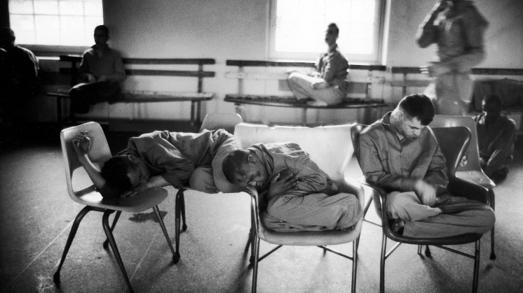
Mental Health: Willowbrook Wars
“The Willowbrook State School, located in Staten Island, New York City, was a squalid dumping ground for 5,400 profoundly mentally retarded children and adults. . .Naked bodies could be found sprawling on concrete floors; some residents seemed to live in soiled clothing; toilets didn't work, feces were everywhere, and the stench was unbearable. The physical plant was dilapidated, the interior filthy beyond imagination. Disease-especially hepatitis and shigella-was rampant. Medical care was inadequate, therapy largely nonexistent.”

Slide 6
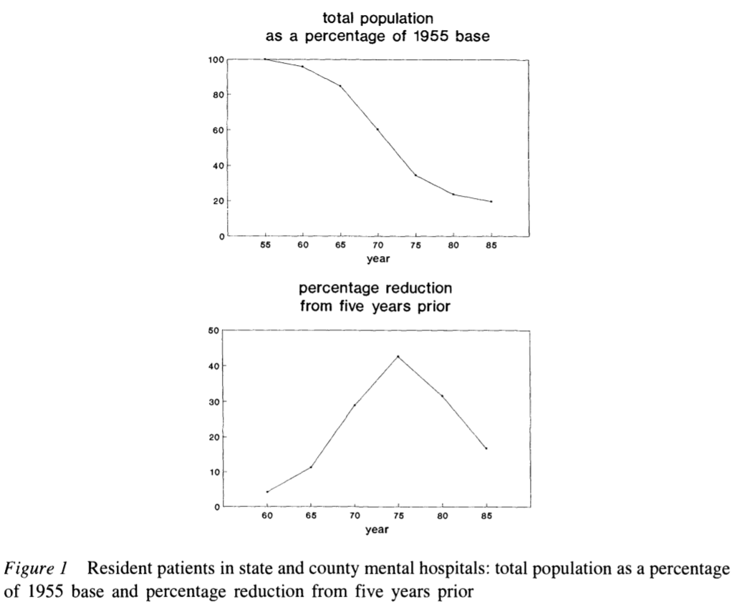
Deinstitutionalization
The peak institutionalized population was in 1955-- approximately 550,000 patients in mental institutional around the US, at a time when the US population was 165 million, roughly one in every 300 Americans.
In 2019, with a population twice the size of 1955, we have roughly 110,000 patients institutionalized -- roughly a %90 reduction in the percentage of the population institutionalized.

Slide 7
Federalization: Kennedy’s Community Mental Health Act of 1963
US government decided for the first time since President Pierce vetoed the National Mental Health Act of 1854 that it had a role in the direct delivery of mental health services
At the time, there were 30,000 psychiatrists in the US
This has increased 10 fold, 20 fold if psychiatric nurses are included
However, Congress did not authorize adequate funding
Kennedy was assassinated the next month, in November 1963
funding amendments passed in 1965 (along with the creation of Medicare and Medicaid)

Slide 8
Decentralization of Care: Role of Insurance and Community Hospitals
Insurance began to cover mental health benefits
Including Medicaid, which was created in 1965
Created federally designated mental health catchment areas which were eligible to apply for federal grants to fund care
Supplementary Security Income (created in a 1972 law) provided additional assistance for people whose mental illness constituted a recognized disability
Hospitals developed specialized psychiatric units
Mental health episodes became characterized by short lengths of stay
But little community follow up
Functions previously associated with mental health hospitals now distributed across various groups/agencies

Slide 9
Defunding
Through the 1970s, Governors including Reagan in California and Carter in Georgia passed progressive mental health care laws
Ford opposed extending funding of mental health care but Johnson era law was kept in place using continuing resolutions until the election of Carter in 1976
Carter's Mental Health Systems Act of 1980 (repealed in 1981 and 1985) & Civil Rights of Institutionalized Persons Act of 1980
Reagan’s (elected to president in 1980) cut funding to community health centers (sunsetting the funds, cutting 25% per year for 4 years)
SSI, Medicaid, and patient fees made up some of the difference
Depriving the community based health organizations of the funding they needed to support the deinstitutionalized.

Slide 10
Managed Care era
Health Maintenance Organizations became a federally supported preferred method of insurance with the HMO act of 1973
Since then, and growing in importance starting in the 1990s there has been increased emphasis on managed care as a method of price control
This system incentivizes patients to use in-network providers for care
Reduction in fee-for-service reimbursement and growth of network requirements further defunded mental health care providers
Managed Care coverage varies for mental health and psychiatric prescriptions
Carve-in
Integrated, part of physical health insurance
Carve-out
separated, third party managed, usually in contract with insurance company
Subcontracted management
Similar to carve-out

Slide 11
Types of mental health care organizations

Slide 12
Types of Mental health care organizations

Slide 13
Primary care serves as the de facto mental health delivery system in the US
Most depressed patients seek treatment in primary care settings
Under-treated
Training focuses on diagnosis and pharmacology
Part of primary care training – rotations and lectures

Slide 14
Holes in primary care training
Majority of residents (62%) received little to no exposure working with couples or families
Psychotherapy skills like motivational interviewing and psychoeducation less common than cognitive behavioral or solution-focused therapy
Almost 20% of residents reported deficits
Medication management
Especially beyond SSRIs and SNRIs
Treatment of substance abuse, ADHD, schizophrenia, ASD, depression
Lack of diversity of clinic types and modalities

Slide 15
Types of Mental health care organizations
Primary health care
PCP provides basic mental health needs, frequently plays large role
General hospital
ED is not an efficient entry-point
Formal community health services
Informal community mental health services
Specialist institutional mental health services
Dedicated mental hospitals

Slide 16
Patient issues
Referral
Self-referral vs referral via PCP
Outpatient clinics
Low show rates
Self-referrals can have higher show rates, better outcomes

Slide 17
988 and suicide prevention
Substance Abuse and Mental Health Services Administration
National and local numbers, routed to local centers
Helpers are trained to provide emotional support, assessment, crisis intervention, and/or linkages to necessary community resources
Imminent risk issues
Cases where suicide attempt has just occurred, is in process, or imminent

Slide 18
Stigmas in care
Social distance increased when sick person is stigmatized
Social network key in healing for all disease, even more so for mental health and substance use related diseases
Explicit bias
Directly expressed, provider is aware of action
Implicit bias
Indirectly expressed, provider is unaware of action
Navigating bias
Public awareness campaigns

Slide 19
Neurodiversity paradigm
Movement which started within the autistic community
Note difference in language to represent self-perceived culture vs external diagnosis
More common in some conditions (ADHD, dyslexia, dyspraxia, Tourettes)
Skeptical of treatment which promotes behaviors seen as masking
Contrast with the pathology paradigm
Activism and controversy

Slide 20
Language in Substance Use Care
General public and providers stigmatize individuals with substance use and mental health disorders
Public support and individual behaviors impacted by language choice
Negative terms:
Substance abuser, addict, alcoholic, opioid addict, clean, dirty, alcoholic
Relapse, medication-assisted treatment, untreated
Mixed: Recurrence of Use
Positive terms
Person with substance use disorder, person with opioid use disorder
Pharmacotherapy, medication-assisted recovery, long-term recovery

Slide 21
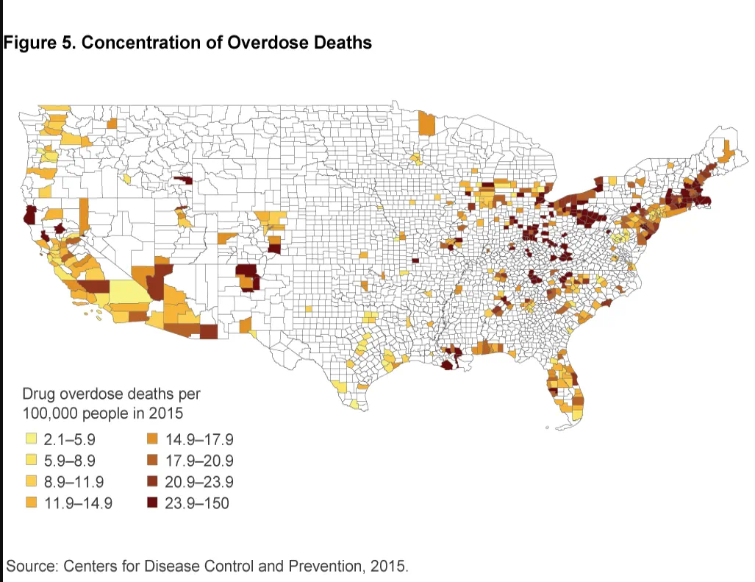
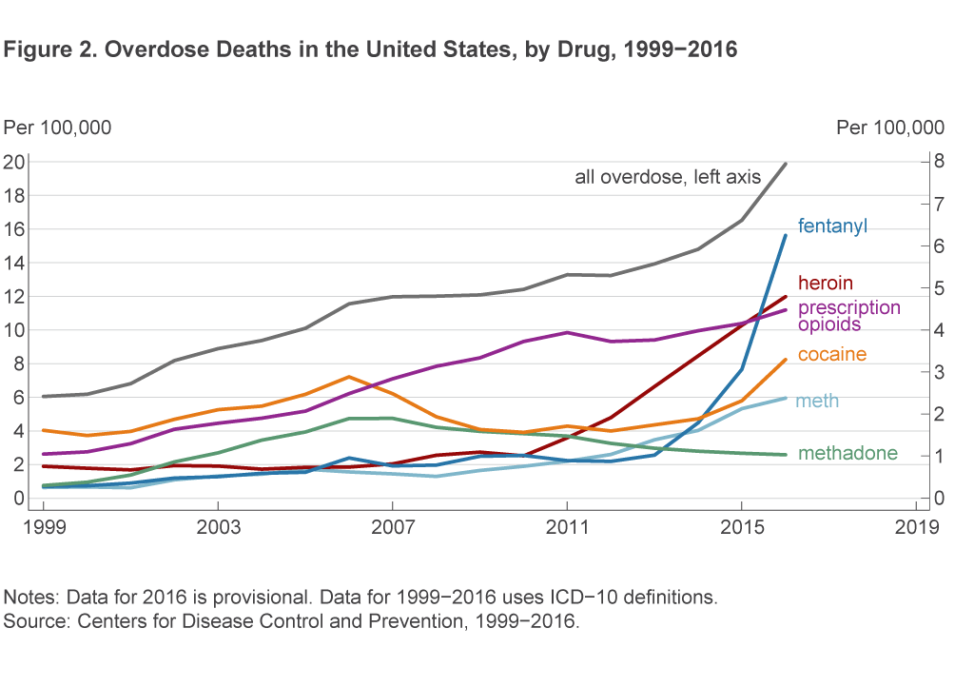
Addictive drugs

Slide 22
Substance use treatment
Multiple aspects multiple sites
Pharmacological
reduces cravings
μ-opioid antagonist (Naltrexone – alcohol, opioids, others)
Serotonergic agents like SSRIs (meth, alcohol, coke, nicotine, opioids)
Block effect of drug (Gaba agents?)
Withdrawal reducing (Dopaminergic agents)
Induce negative physical reaction to drugs (Disulfiram for alcohol)
Non-pharmacological
CBT
Motivational enhancement therapy
Conditioning based behavioral therapy
Group therapy
12 step programs
Sponsor/buddy system
Co-occurring mental health and substance use

Slide 24
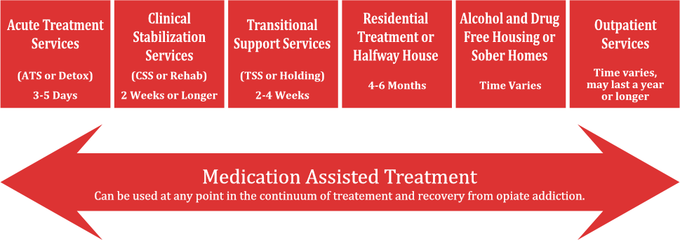

Slide 25
Co-occurring mental health and substance use
Can include depression, psychosis, stress disorders, ADHD, …
Facilities should be equipped to manage comorbidities
Treatment plans should have broad focus
Practitioners should have broad skill sets

Slide 26
Mental Health external content
https://www.youtube.com/watch?v=xYnZ1BDWMfM&ab_channel=TheUnplannedPodcast – 72:25-75:15
https://www.lawyersgunsmoneyblog.com/2024/03/maine-mass-killer-had-severe-brain-damage-from-routine-military-training
https://www.reddit.com/r/MadeMeSmile/comments/jxlmv9/wholesome_lgbt_bookstore/

Slide 27
Substance Use Awareness external content
Patient care:
https://www.youtube.com/watch?v=h4oDbDcKWnM&ab_channel=JeffersonHealth
Recognizing and treating:
https://www.youtube.com/watch?v=u8YpPB19tl0&ab_channel=WWLTV

Slide 28
Why fentanyl
Fentanyl is potent, which makes it cheap
Transportation is more expensive than production
Fentanyl is a cheap opioid, so used directly as an opioid
A dilute dose of another drug, cut with mostly an inert substance (talc?) and a tiny bit of fentanyl can give a stronger effect than an undiluted dose of the original drug
Uppers and downers can mix

Slide 29
Sources
Zubatsky, Max, Jay Brieler, and Christine Jacobs. "Training experiences of family medicine residents on behavioral health rotations." Fam Med 49, no. 8 (2017): 635-639.
Bauer, Nerissa S., Paula D. Sullivan, Anna M. Hus, and Stephen M. Downs. "Promoting mental health competency in residency training." Patient Education and Counseling 85, no. 3 (2011): e260-e264.
Ashford, Robert D., Austin M. Brown, and Brenda Curtis. "Substance use, recovery, and linguistics: The impact of word choice on explicit and implicit bias." Drug and alcohol dependence 189 (2018): 131-138.
Forthal, Sarah, Karolina Sadowska, Kathleen M. Pike, Manya Balachander, Kristina Jacobsson, and Sabrina Hermosilla. "Mental health first aid: A systematic review of trainee behavior and recipient mental health outcomes." Psychiatric services 73, no. 4 (2022): 439-446.
Draper, John, Gillian Murphy, Eduardo Vega, David W. Covington, and Richard McKeon. "Helping callers to the National Suicide Prevention Lifeline who are at imminent risk of suicide: The importance of active engagement, active rescue, and collaboration between crisis and emergency services." Suicide and Life‐Threatening Behavior 45, no. 3 (2015): 261-270.

Slide 30
Sources
Cutler, David L., Joseph Bevilacqua, and Bentson H. McFarland. "Four decades of community mental health: A symphony in four movements." Community Mental Health Journal 39, no. 5 (2003): 381-398.
Mechanic, David, and David A. Rochefort. "Deinstitutionalization: An appraisal of reform." Annual Review of Sociology 16, no. 1 (1990): 301-327.

