Slide 1
Risk Management and Insurance
TR 11:00-12:15 – BUSN202
Shane Murphy

Slide 2
Competitive market
A competitive market is an ideal in economics that arises when:
There are many buyers and sellers in the market
This is equivalent to the idea that no single agent in the market has excess market power
The prices and quantities in the market are a function only of market itself
There are no governmental restrictions on production, purchasing, or pricing
The barriers to entry in the market are not significant
This means that the capital costs to take part in the market are affordable, companies can enter and leave the market depending
As a result, innovative outsiders might enter the market, lowering prices
The costs and benefits of the good are only accrued to the buyers and seller
There are no externalities

Slide 3
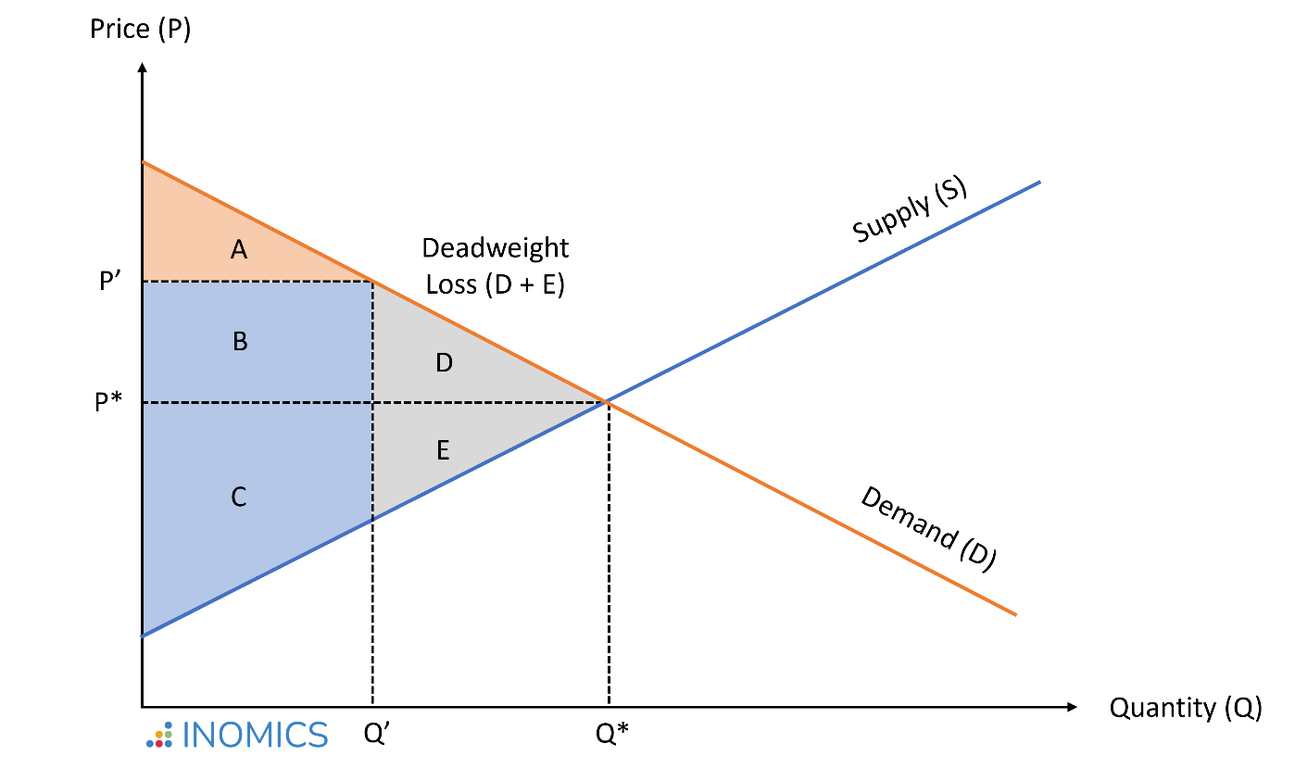
Consumer welfare
In a competitive market, supply and demand curves define equilibrium price and quantity
Consumer surplus is the area between demand and price
Producer surplus is the area between price and supply
Why?
Market failures often lead to a reduction in quantity sold and a reduction in total surplus
Total surplus = consumer plus producer surplus
Decline in total surplus is deadweight loss

Slide 4
Market failure
The most common market failure arises when there is a social cost or social benefit that creates a different supply or demand curve when estimating social consumer welfare relative to private consumer welfare.
This can lead to under consumption or over consumption relative to social optimum

Slide 5
Class activity
Pick a healthcare market:
Individuals buying insurance
Individuals going to health providers
Individuals buying pharmaceuticals
Providers such as hospitals buying medical equipment
What is an example of a positive externality in this market?
How could this externality be internalized into the market?
Is this being done? Why or why not?
What is an example of a negative externality in this market?
How could this externality be internalized into the market?
Is this being done? Why or why not?
Is this a big deal? If so, is it politically salient (is it an issue in the upcoming election)?
Why or why not?

Slide 6
Mental Health Provision
Public Good?
Opportunity cost and Marginal Social Benefit?
Ability to pay?
Natural Monopoly?

Slide 7
Mental Health up to the 1950s
Dorothea Dix’s national crusade for moral treatment for the mentally ill in the 1840s
Clifford Beers mental hygiene movement of the 1910s and 1920s
Hospitals run by states, but with increasing levels of federal financial support
Block grants as a part of FDRs New Deal in the 1930s
Truman’s National Mental Health Act of 1946 creating the NIMH
In 1955, the first antipsychotic, Chlorpromazine (Thorazine), came on the market and was quickly heavily prescribed
Gave hope for an end to mental health illness
Dire conditions in mental health facilities was growing in the national consciousness
One Flew Over the Cuckoo’s Nest – Ken Kesey (1962)

Slide 8
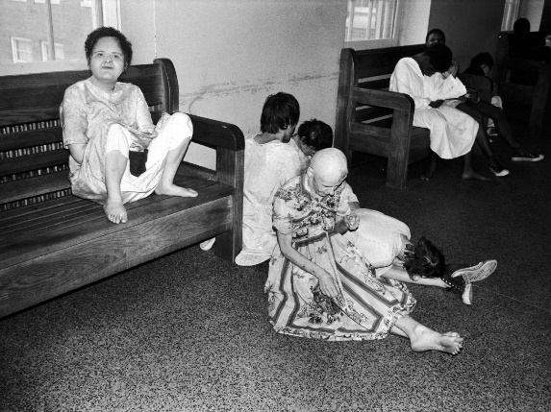
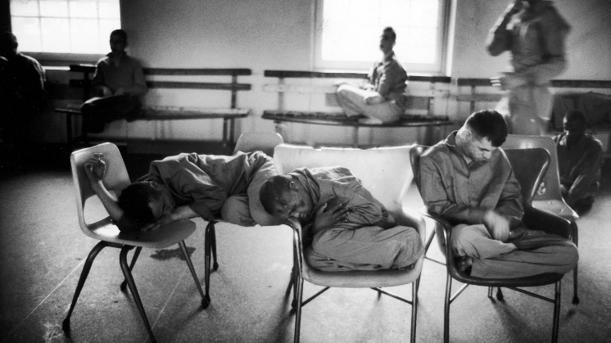
Mental Health: Willowbrook Wars
“The Willowbrook State School, located in Staten Island, New York City, was a squalid dumping ground for 5,400 profoundly mentally retarded children and adults. . .Naked bodies could be found sprawling on concrete floors; some residents seemed to live in soiled clothing; toilets didn't work, feces were everywhere, and the stench was unbearable. The physical plant was dilapidated, the interior filthy beyond imagination. Disease-especially hepatitis and shigella-was rampant. Medical care was inadequate, therapy largely nonexistent.”

Slide 9
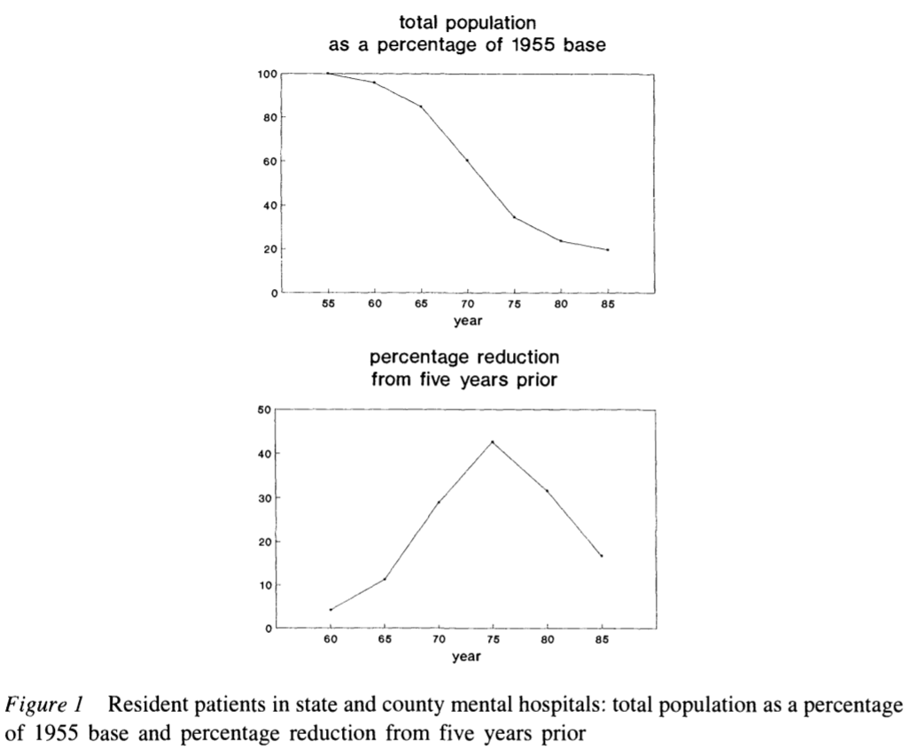
Deinstitutionalization
The peak institutionalized population was in 1955-- approximately 550,000 patients in mental institutional around the US, at a time when the US population was 165 million, roughly one in every 300 Americans.
In 2019, with a population twice the size of 1955, we have roughly 110,000 patients institutionalized -- roughly a %90 reduction in the percentage of the population institutionalized.

Slide 10
Federalization: Kennedy’s Community Mental Health Act of 1963
US government decided for the first time since President Pierce vetoed the National Mental Health Act of 1854 that it had a role in the direct delivery of mental health services
At the time, there were 30,000 psychiatrists in the US
This has increased 10 fold, 20 fold if psychiatric nurses are included
However, Congress did not authorize adequate funding
Kennedy was assassinated the next month, in November 1963
funding amendments passed in 1965 (along with the creation of Medicare and Medicaid)

Slide 11
Decentralization of Care: Role of Insurance and Community Hospitals
Insurance began to cover mental health benefits
Including Medicaid, which was created in 1965
Created federally designated mental health catchment areas which were eligible to apply for federal grants to fund care
Supplementary Security Income (created in a 1972 law) provided additional assistance for people whose mental illness constituted a recognized disability
Hospitals developed specialized psychiatric units
Mental health episodes became characterized by short lengths of stay
But little community follow up
Functions previously associated with mental health hospitals now distributed across various groups/agencies

Slide 12
Defunding
Through the 1970s, Governors including Reagan in California and Carter in Georgia passed progressive mental health care laws
Ford opposed extending funding of mental health care but Johnson era law was kept in place using continuing resolutions until the election of Carter in 1976
Carter's Mental Health Systems Act of 1980 (repealed in 1981 and 1985) & Civil Rights of Institutionalized Persons Act of 1980
Reagan’s (elected to president in 1980) cut funding to community health centers (sunsetting the funds, cutting 25% per year for 4 years)
SSI, Medicaid, and patient fees made up some of the difference
Depriving the community based health organizations of the funding they needed to support the deinstitutionalized.

Slide 13
Managed Care era
Health Maintenance Organizations became a federally supported preferred method of insurance with the HMO act of 1973
Since then, and growing in importance starting in the 1990s there has been increased emphasis on managed care as a method of price control
This system incentivizes patients to use in-network providers for care
Reduction in fee-for-service reimbursement and growth of network requirements further defunded mental health care providers
Managed Care coverage varies for mental health and psychiatric prescriptions
Carve-in (integrated) vs Subcontracted management vs Carve-out (separated

Slide 14
Sources
Cutler, David L., Joseph Bevilacqua, and Bentson H. McFarland. "Four decades of community mental health: A symphony in four movements." Community Mental Health Journal 39, no. 5 (2003): 381-398.
Mechanic, David, and David A. Rochefort. "Deinstitutionalization: An appraisal of reform." Annual Review of Sociology 16, no. 1 (1990): 301-327.

