Slide 1
Risk Management and Insurance
TR 11:00-12:15 – BUSN202
Shane Murphy

Slide 2
JIT/lean production and consultancy
Just in time
Manage production like supermarket manages milk
Lean production
Liquidate inventory also drives short term returns for leadership and stock holders
Lean Taliban
McKenzie consultants push for lean inventory and lean workforce
Culture within the consultancy became conformist to these ideas and consultants who disagreed were pushed into less favorable assignments

Slide 3
Share price vs profitability
Return on assets
Hold shipments that arrive near quarterly reports
Optimize system on share price
Political and donor class may be driven by share price
Works more for investors than full economy
Share price is a function on current profit and estimated future profits
Estimated future profit is a function of company policy and market share
But high market share may not be socially optimal
And company policies valued by the market
May not be indicators of future profit
May not be socially optimal

Slide 4
Covid supply shock
The pandemic made social distancing necessary, requiring large parts of the economy to be shut down. As a result, the fall in economic activity was deeper and more abrupt than during the Great Recession
Massive size of supply chain disruptions during COVID-19, which rivaled in magnitude what Japan saw after the Fukushima nuclear disaster in 2011, only that COVID-19 supply disruptions were worldwide and lasted far longer
Price of outputs rose more than input prices
Raised markups/raised margins
Preserve inventory to avoid future shortages
Margins slow to return to normal

Slide 5
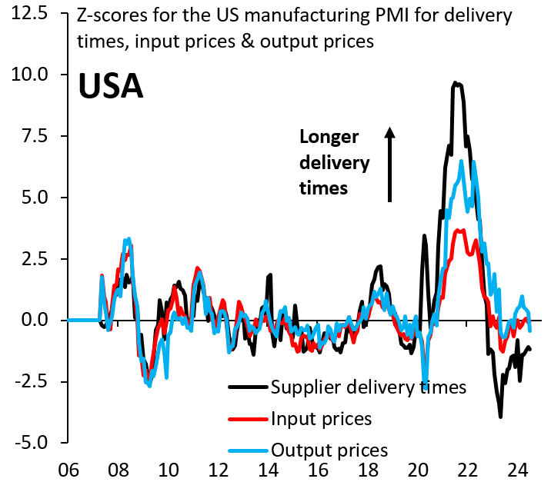
Margins slow to return to normal

Slide 6
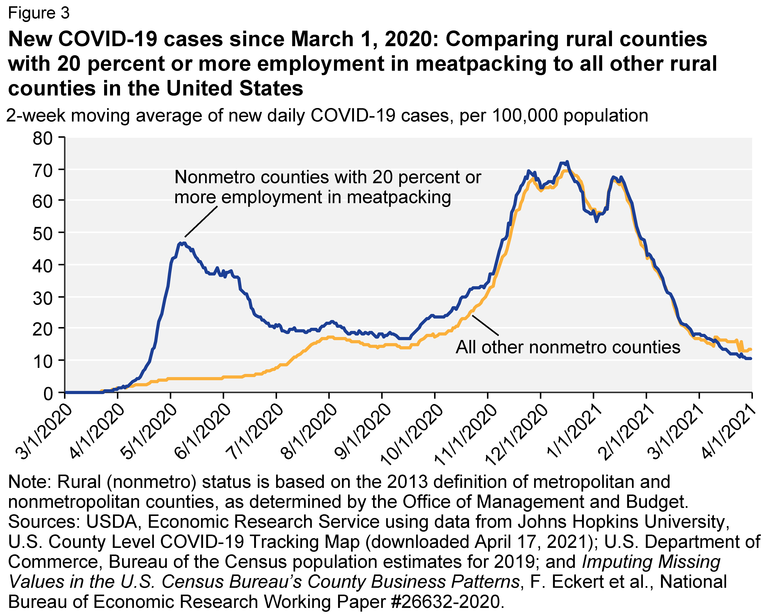
Meatpacking
Lean manufacturing and monopsonistic hiring led to meat packers being especially hard hit in Covid
Meat packers were denied social protection during early days of crisis as essential workers

Slide 7
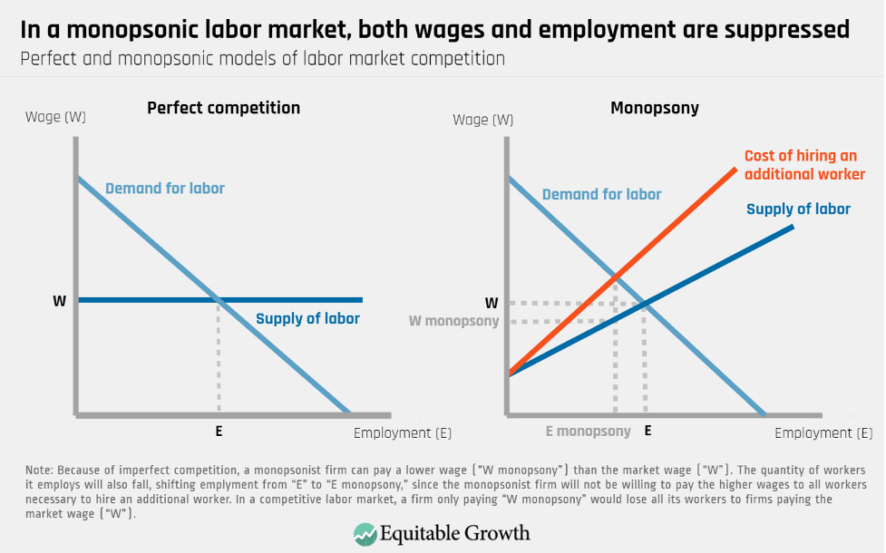
Monopsony and market power
Econ 101:
In a monopoly, output goes down and prices go up
In fact, whenever a producer has high market power, this can be the case
High market power means that negotiating between buyers and sellers favors seller, so seller has increased ability to set price
Monopsony is a monopoly in a labor market, where only one hirer is present
Very common in healthcare

Slide 8
Mergers and market power
Intersects with production with high market power
Robert Bork said no merger should be opposed so long as it doesn’t raise prices
Lina Khan at the FTC is real change to this approach
Price setters have raised prices for consumers while lowering prices for inputs
Captive contracts for production chains
Direct to consumer as a workaround
Pharmacies and Providers opting out of insurance
Struggle to be efficient

Slide 9
Lessons? from Covid
McKenzie’s lean production policies had added benefit of creating scarcity
Engineered scarcity means that shocks tend to increase profits
Anxiety gives cartels more pricing power – can’t miss deadlines in shipping, for example
Handler charges added to shipments in order to ensure on time delivery
Government regulators afraid of corporate power
Resulting in more market power, reduced safety for labor
Captive contracts for labor
Service contracts tied to training
Increase turnover
Also pushing regulators to lower restrictions on laborers such as age, training

Slide 10
Lessons from Covid
Race to the bottom
Just in case production
India and Mexico as producers as diversification away from China

Slide 11
Government response
Increased mandate to FTC to address these issues
Partially as response to crisis
Also due to influence of Warren and Sanders in early days of Biden presidency
More legal-academic, Midwest, and rust belt connections than politicians who raise more money from California
Leading to Lina Khan become head of FTC
Tech enmity to Lina Khan

Slide 12
Federal Trade Commission (FTC)
Ensure open, fair, and competitive markets
Enforce consumer protection laws
Protect against deceiving consumers
Protect against engaging in unfair or coercive practices

Slide 13
FTC actions in healthcare
Non-compete clauses
Prevalent in many sectors, including healthcare
New rule bans such clauses for all but senior executives
Rural provider non-compete clauses contributing to shortages
FTC does not have jurisdiction over nonprofits
But is pressuring firms to confirm and justify nonprofit status

Slide 14
FTC actions in healthcare
Orange Book fraud
FDA's Orange Book is this repository where companies are able to list certain patents or certain underlying medical active ingredients
When you successfully list a patent in the Orange Book, it results in an automatic 30-month stay of any competitors that are looking to compete
Inhaler patents – Americans pay $100s for inhalers while other countries pay ~$20
Companies listing the cap of inhalers or certain components of devices
Different from the underlying medical ingredient or drug ingredient.

Slide 15
FTC actions in healthcare
Pharmaceutical mergers
Mergers are a well known area where FTC has influence
FTC stopped two recent pharma mergers
Horizon-Amgen
Sanofi-Maze
Serial acquisition
Numerous small mergers leading to large changes in market power

Slide 16
FTC actions in healthcare
Privacy breach cases
Increase healthcare company liability for data breaches
Ensure healthcare companies do not use health data for advertising or without consumer consent
Part of current collapse of 23andme

Slide 17
Sources
Goodman, Peter S. How the World Ran Out of Everything: Inside the Global Supply Chain. HarperCollins, 2024.
Robin Brooks, Peter R. Orszag, and William E. Murdock III. COVID-19 inflation was a supply shock. Brookings, August 15, 2024 https://www.brookings.edu/articles/covid-19-inflation-was-a-supply-shock

