Slide 1
Risk Management and Insurance
TR 11:00-12:15 – BUSN202
Shane Murphy

Slide 2
Types of nurses
Certified Nursing Assistant (CNA)
  Median salary: $36,220 per year or $17.41 per hour
  Career outlook: 4% growth from 2022 to 2032
  Education requirements: State-approved training program
  Job duties: Gathering bedside supplies, assisting patients with ADLs, assisting with medical procedures, answering patient calls, and obtaining vital signs.
Licensed Practical Nurse (LPN)
  Median salary: $54,620 per year or $26.26 per hour
  Career outlook: 5% growth from 2022 to 2032.
  Education requirements: Accredited practical nursing certificate program, which is usually offered at community colleges and takes about a year to complete.
  Job duties: Provide patients with essential care, including eating, drinking, and bathing, as well as taking blood pressure, inserting catheters, and recording vital signs.
Registered Nurse (RN)
  Median salary: $81,220 per year or $39.05 per hour
  Career outlook: 6% growth from 2022 to 2032.
  Education requirements: ADN, BSN, or RN diploma.
  Job duties: Care, education, and coordination of sick and dying patients. Responsibilities include assessing patients, administering medications and treatments, and collaborating with other healthcare providers. Responsibilities include assessing patients, administering medications and treatments, collaborating with other healthcare providers, educating patients and families on disease processes and management, and assisting with procedures.
Nurse Practitioner (NP)
  Median salary: $124,680 per year or $59.94 per hour
  Career outlook: 45 percent growth from 2022 to 2032.
  Education requirements: MSN from an NP program.
  Job duties: Varies by NP specialty, but generally, they prescribe medication, examine patients, order diagnostic tests, diagnose illnesses, and provide treatment.

Slide 3
Specialties
No or optional certification
  Labor/Obstetrics
  Pediatrics
  Neonatal ICU
  Oncology
  ER RN
Less optional or required certification
  ICU RN
  Surgical RN
  OR RN
  Post-Anesthesia CU RN
  Trama RN
MSN required
  NP
  Certified Nurse Midwife
  Certified Registered Nurse Anesthetist
  Clinical Nurse Specialist
  Nurse Educator
  Nurse Administrator
  Clinical Nurse Leader

Slide 4
Measuring Nurse staffing
patient-to-nurse ratios
number of full-time equivalent (FTE) nursing staff per patient day
number of nursing hours per patient day (HPPD)
skill mix of nursing personnel, usually registered nurse (RN) skill mix, measured by the proportion of hours provided by RNs in the total nursing staff
perceived staffing adequacy
RN ratio – RN to aid skill mix (85% is common goal, other targets include 70%)

Slide 5
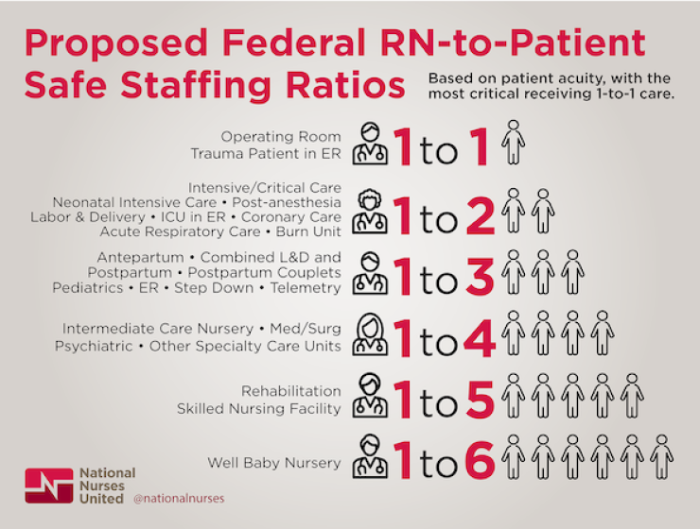

Slide 6
Measuring Nurse staffing
Indirect vs direct patient care
  Supervisory nurses and coordinators of patient care
Productive or non-productive care
  Time spent in vacation, sick leave, or continuing education
    Work-to-paid ratio

Slide 7
Measures of nursing quality
Decubitus ulcer – bed sore
Failure to rescue (FTR) – death from complications after surgery due to:
  Omission of care
  Failure to recognize change in patient condition
  Failure to communicate change in patient condition
  Poor clinical decision making
Hospital acquired infections

Slide 8
Nursing Care Delivery Models
Patient Focused Care
  RNs as care managers and aids/assistants in expanded roles, possibly including drawing blood, performing EKGs, and other assessments
Primary or Total Nursing Care
  All-RN staff for all direct care, allows RN to care for same patient throughout stay
Team or Functional Nursing Care
  RN is team leader, aids perform activities such as bathing and feeding, nurses’ duties may be split into “medication nurse” and “treatment nurse”
Magnet Hospital Environment
  High RN autonomy, MD-RN collaboration, shared governance/decision making between RNs and managers

Slide 9
Effects on patients of different models
Limited effects across the board
In general, RNs are better than aids
But hospitals do not implement disastrous models
  Garden of forking paths
    Butler, Michelle, Timothy J. Schultz, Phil Halligan, Ann Sheridan, Leigh Kinsman, Thomas Rotter, Jonathan Beaumier, Robyn Gail Kelly, and Jonathan Drennan. "Hospital nurse‐staffing models and patient‐and staff‐related outcomes." Cochrane Database of Systematic Reviews 4 (2019).

Slide 10
Effects on nurses of different models
Nurse staffing shortages increase risk of intent-to-leave, burnout, and job dissatisfaction
  And maybe needlestick injury
    Shin, Sujin, Jin-Hwa Park, and Sung-Heui Bae. "Nurse staffing and nurse outcomes: A systematic review and meta-analysis." Nursing outlook 66, no. 3 (2018): 273-282.

Slide 11
Occupational Burnout
Chronic workplace stress that hasn't been successfully managed
Symptoms characterized by
  feelings of energy depletion or exhaustion
  increased mental distance from one’s job
  feelings of negativism or cynicism related to one's job
  reduced professional efficacy
Maslach Burnout Inventory-Human Service Scale
  The 22-item measure comprises 3 subscales: emotional exhaustion (9 items), depersonalization (5 items), and personal accomplishment (8 items).
  The items are framed as statements of job-related feelings (eg, "I feel burned out from my work," "I feel confident that I am effective at getting things done"), and are rated on a 7-point frequency scale (ranging from "never" to "daily").
  Burnout is reflected in higher scores on emotional exhaustion and depersonalization and lower scores on personal accomplishment.

Slide 12
Needle-stick injury
High frequency event
Infections rare
Prior Vaccination and Post-exposure prophylaxis (PEP) important
HIV
  Risk of transmission from a single percutaneous needle stick or cut with a scalpel from an HIV-infected individual is about 0.3%
Hepatitis B (and C)
  100x more common than HIV in absence of vaccine, but vaccine has greatly reduced risk
  PEP within 24 hours key
  Hep C more dangerous, no PEP, no vaccine, but rarer
Safety devices less effective than proper policies and disposal
Notes:
https://www.ncbi.nlm.nih.gov/books/NBK493147/

Slide 13
Reducing Early-career burnout
Programs
  Mentoring programs, Preceptorship, Orientation, Clinical ladder/advancement programs
  Residency, Externship
Mechanism
  Peer support, relationship
  Commitment to career development
  Teaching/training -> Increase competence and confidence

Slide 14
Nursing Shortage
Growing demand
  20th century
    Increasing number of hospitals, increasing medical technology
  21st century
    Aging population
Decreasing supply
  20th century
    Low salary and poor conditions/treatment
    Decrease in financing of nursing students after WWII
      Shift to aids: Estimates of the proportion of patient care provided by professional nurses declined from over 70 percent in 1941 to only 30 or 40 percent in 1951.
    Increase in tuition late in century and into 21st century
  21st century
    Wages
Everywhere (check Gscholar)
  Compare to teaching, “no one wants to work anymore”
Notes:
https://www.nursing.upenn.edu/nhhc/workforce-issues/where-did-all-the-nurses-go/

Slide 15




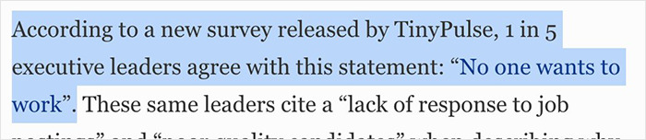

Slide 16


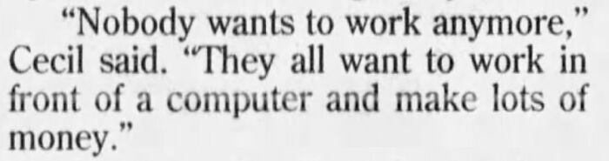

Slide 17





Slide 18
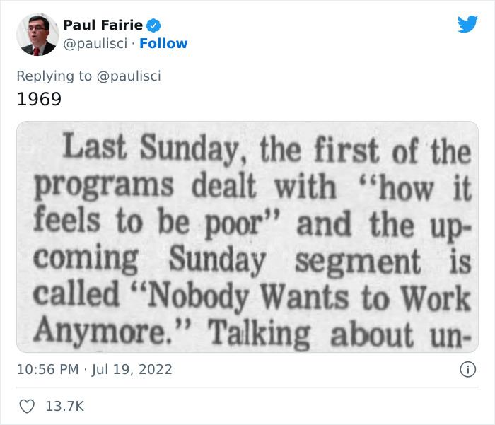



Slide 19
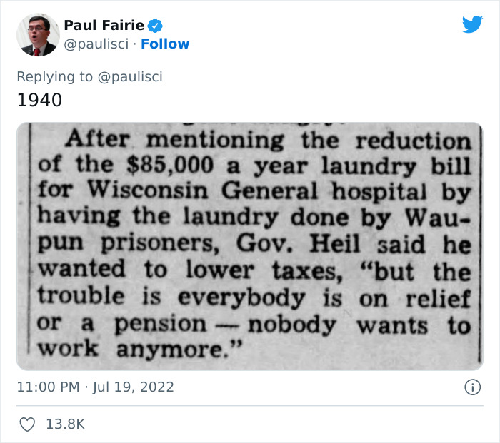
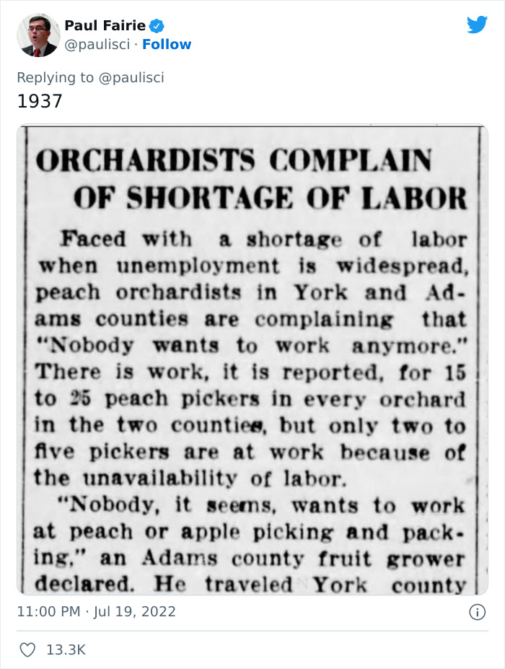

Slide 20


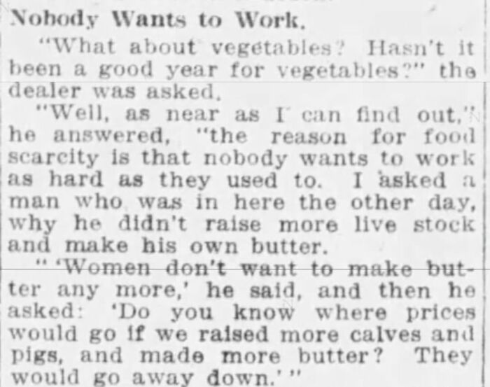

Slide 21


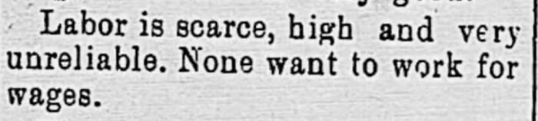
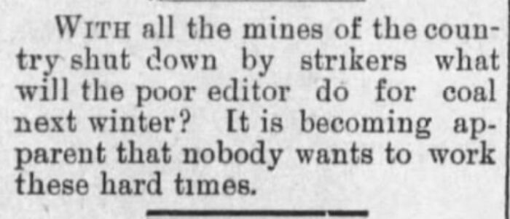

Slide 22
Nursing retention
What can increase nurse retention?
  Work environment
  Adequate, qualified staffing
  Wages
  Autonomy and governance
  Quality patient care

Slide 23
Nursing retention: Work environment
Lower workload (improved patient to nurse ratio)
Educated workforce
  Why?
Nurses given flexibility to make decisions in an environment of trust and respect
Promoting the status of nursing as independent practitioners by clearly defining the role and improving salaries
  Encourage education, support specialty certification with salary increases
Clinical career ladder programs
Staffing and resource adequacy
  Adequate numbers of staff, appropriate skill mix, Retention of experienced staff
Collaborative nurse–physician relationships

Slide 24
Nursing retention: Governance
Empowering work structures, characterised by access to information, support, opportunity and resources, enhanced meaning in work
Increase employees understanding of the rationale behind decision making
Nurse advocates on major committees
Nursing grand rounds
  Journal clubs, professional conferences, workshops
Magnet
Acknowledgement
Access to hospital executive

Slide 25
Nursing retention: Leadership
Managers should aim to be visible, accessible and responsive to their staff
Key attributes of a clinical leader: “…expert clinical skills, patient-focus, vision, stamina, innovation, dynamism, confidence, selflessness, assertiveness and collaboration with other health professionals”
Stability in leadership positions
Encourage collaborative relationships
Mentorship, supervision programmes and involvement in professional societies

Slide 26
Quick note about cost-effectiveness
$80,000 to $200,000 per life year
$10M to $20M per life saved

Slide 27
Cost-effectiveness of nurse staffing and training
Increasing staff from 8 patients per nurse to 7:
  $56,394 to $30,593 per life saved
Increasing staff from 5 patients per nurse to 4:
  $174,464 to $86,864 per life saved
Increasing nursing hours per patient day to the 75th percentile compared with a ‘do nothing’ approach was associated with an ICER of US$25,702 per avoided death and US$2,572 per life year gained
Daily cost of $4,030 for a survival rate of 976·2/1000 patients (8 PTN ratio/20% RNs) to a daily cost of $7,746 for a survival rate of 983·5/1000 patients (4 PTN ratio/80% RNs).
Increasing training may be cost-benafitial
  Increasing the RN proportion to the 75th percentile

Slide 28
Cost-effectiveness of nurse staffing and training
Societal benefits larger than benefits for hospital
Hospitals generally see higher costs
  Incentive to provide good care, but maybe not best possible care
  Offset only partially by decline in readmissions/ED visits
Non-linear effect/diminishing returns
  Effect declines as nursing ratio improves

Slide 29
More Issues in Optimal Staffing
Planning for average demand can be inefficient because of the high cost of being understaffed during rushes
  “over-staffing” much less costly than understaffing
Nurse shortage may be largest and most detrimental in middle pay bands

Slide 30
Travel nursing
AKA temporary nurses, agency nurses, or contract nurses
Travel nursing began in the 1980s (hovering around 4% up until 2008)
  Grew to 10% from 2021-2023 (Covid)
  Recently declining
Can cost 3x to 4x, recently pay is declining
Mixed estimates on effect on patient outcomes
  Travel nurses may have broader experience and skill
  But come with disruption and may be less experienced overall
6, 8, 13 week contracts common

Slide 31
Pediatric Travel Nurse Experience
Theme | Subcategory | Definition
Financial | • Advancement • Advocating • Uncertainty | • Salary is 2-3 times higher than a permanent staff nurse. • Asking for a raise in salary • Salaries can vary; there is a certain risk to leaving a permanent job. Contracts can be canceled at any time.
Flexibility | • Schedule • Clinical practice | • Have control over days off and time off in between contracts • Can try different types of nursing units
Searching for healthy work environments | • Impact of COVID-19 • Short staffing • Burnout • A way out • Impact of travel nursing on environment | • Nurse constantly under stress from short staffing • Feeling mentally and physically exhausted • Poor leadership • Not locked into a unit; can leave after the contract • Negative impact of travel nurses with permanent staff
Just nursing care | • Just patient care • Less acute patients | • Responsible for only patient care; no other committee or unit responsibilities • Patient assignment
Solutions | • Improving retention of the bedside role | • Improved pay • More flexibility with time off • Decreased workload • Healthy work environment • The role as a career
Notes:
https://www.youtube.com/watch?v=rVN4p6ebIXk&ab_channel=JerineNicole

Slide 32
Career strategizing
Movement between jobs is natural part of career path
Increases in education/role/pay often come with job changes
  Create pathway for employees within organization
  Advocate employees self-identify desire to increase role
    Including growing within and beyond organization
Work-life and family-life issues
  Family and medical leave
  Extended leave of absence

Slide 33
Discussion
Experience with nurses
  CNAs
Cost-effectiveness and management
Travel Nursing

Slide 34
Sources
Park, Shin Hye, Mary A. Blegen, Joanne Spetz, Susan A. Chapman, and Holly A. De Groot. "Comparison of nurse staffing measurements in staffing-outcomes research." Medical Care 53, no. 1 (2015): e1-e8.
Hall, Linda McGillis, Diane Doran, G. Ross Baker, George H. Pink, Souraya Sidani, Linda O’Brien-Pallas, and Gail J. Donner. "Nurse staffing models as predictors of patient outcomes." Medical care 41, no. 9 (2003): 1096-1109.
Hall, Linda McGillis, Diane Doran, and George H. Pink. "Nurse staffing models, nursing hours, and patient safety outcomes." JONA: The Journal of Nursing Administration 34, no. 1 (2004): 41-45.
Twigg, Di, and Kylie McCullough. "Nurse retention: A review of strategies to create and enhance positive practice environments in clinical settings." International journal of nursing studies 51, no. 1 (2014): 85-92.
Brook, Judy, Leanne Aitken, Rebecca Webb, Julie MacLaren, and Debra Salmon. "Characteristics of successful interventions to reduce turnover and increase retention of early career nurses: A systematic review." International journal of nursing studies 91 (2019): 47-59.
Twigg, Diane E., Helen Myers, Christine Duffield, Margaret Giles, and Gemma Evans. "Is there an economic case for investing in nursing care–what does the literature tell us?." Journal of advanced nursing 71, no. 5 (2015): 975-990.
Jones, Cheryl Bland, and R. N. Michael Gates. "The costs and benefits of nurse turnover: A business case for nurse retention." Online Journal of Issues in Nursing 12, no. 3 (2007): N_A.
Saville, Christina E., Peter Griffiths, Jane E. Ball, and Thomas Monks. "How many nurses do we need? A review and discussion of operational research techniques applied to nurse staffing." International journal of nursing studies 97 (2019): 7-13.
Vander Weerdt, Candice, Jessica A. Peck, and Tracy Porter. "Travel nurses and patient outcomes: A systematic review." Health care management review 48, no. 4 (2023): 352-362.
Hickey, Patricia A., Jean Anne Connor, Jon Whiting, and Laura J. Wood. "The Voice of Travel Nurses: Facilitating Effective Staffing During Pandemic and Expansion-Related Demands in a Children's Hospital." JONA: The Journal of Nursing Administration 54, no. 4 (2024): 213-219.

Slide 35
Mental Health Provision
Public Good?
Opportunity cost and Marginal Social Benefit?
Ability to pay?
Natural Monopoly?

Slide 36
Mental Health up to the 1950s
Dorothea Dix’s national crusade for moral treatment for the mentally ill in the 1840s
Clifford Beers mental hygiene movement of the 1910s and 1920s
Hospitals run by states, but with increasing levels of federal financial support
  Block grants as a part of FDRs New Deal in the 1930s
Truman’s National Mental Health Act of 1946 creating the NIMH
In 1955, the first antipsychotic, Chlorpromazine (Thorazine), came on the market and was quickly heavily prescribed
  Gave hope for an end to mental health illness
Dire conditions in mental health facilities was growing in the national consciousness
  One Flew Over the Cuckoo’s Nest – Ken Kesey (1962)

Slide 37
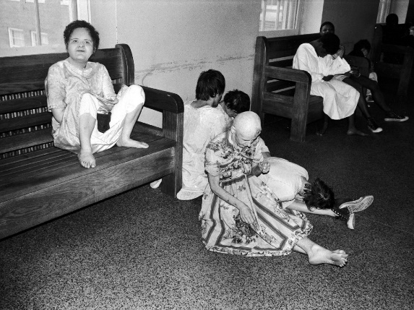

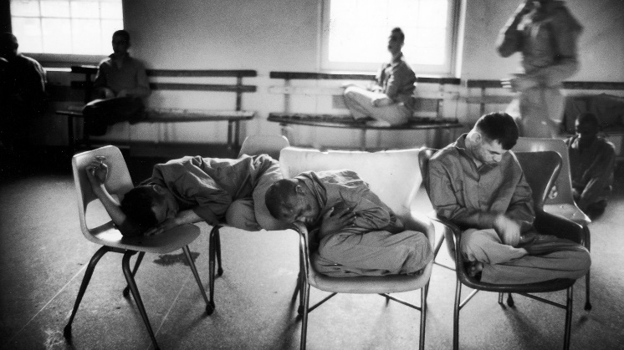
Mental Health: Willowbrook Wars
“The Willowbrook State School, located in Staten Island, New York City, was a squalid dumping ground for 5,400 profoundly mentally retarded children and adults. . .Naked bodies could be found sprawling on concrete floors; some residents seemed to live in soiled clothing; toilets didn't work, feces were everywhere, and the stench was unbearable. The physical plant was dilapidated, the interior filthy beyond imagination. Disease-especially hepatitis and shigella-was rampant. Medical care was inadequate, therapy largely nonexistent.”

Slide 38
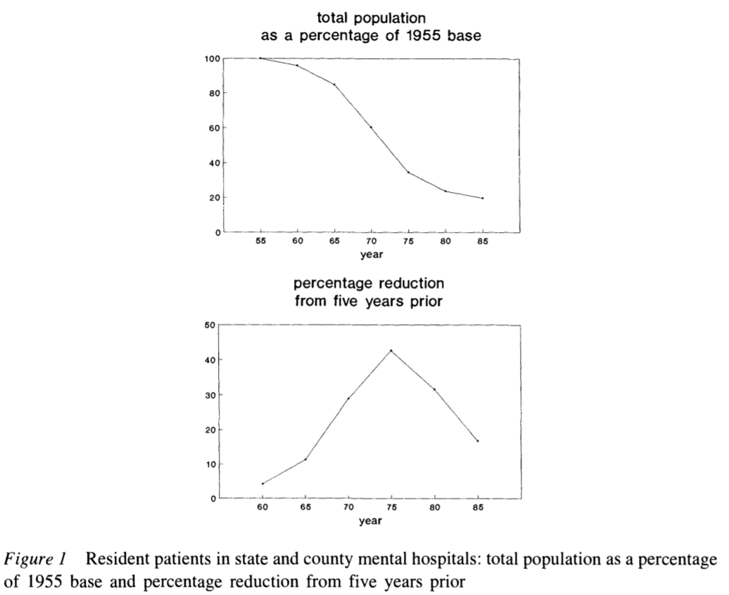
Deinstitutionalization
The peak institutionalized population was in 1955-- approximately 550,000 patients in mental institutional around the US, at a time when the US population was 165 million, roughly one in every 300 Americans.
In 2019, with a population twice the size of 1955, we have roughly 110,000 patients institutionalized -- roughly a %90 reduction in the percentage of the population institutionalized.

Slide 39
Federalization: Kennedy’s Community Mental Health Act of 1963
US government decided for the first time since President Pierce vetoed the National Mental Health Act of 1854 that it had a role in the direct delivery of mental health services
  At the time, there were 30,000 psychiatrists in the US
  This has increased 10 fold, 20 fold if psychiatric nurses are included
However, Congress did not authorize adequate funding
  Kennedy was assassinated the next month, in November 1963
  funding amendments passed in 1965 (along with the creation of Medicare and Medicaid)

Slide 40
Decentralization of Care: Role of Insurance and Community Hospitals
Insurance began to cover mental health benefits
Including Medicaid, which was created in 1965
  Created federally designated mental health catchment areas which were eligible to apply for federal grants to fund care
Supplementary Security Income (created in a 1972 law) provided additional assistance for people whose mental illness constituted a recognized disability
Hospitals developed specialized psychiatric units
Mental health episodes became characterized by short lengths of stay
  But little community follow up
Functions previously associated with mental health hospitals now distributed across various groups/agencies

Slide 41
Defunding
Through the 1970s, Governors including Reagan in California and Carter in Georgia passed progressive mental health care laws
Ford opposed extending funding of mental health care but Johnson era law was kept in place using continuing resolutions until the election of Carter in 1976
  Carter's Mental Health Systems Act of 1980 (repealed in 1981 and 1985) &
  Civil Rights of Institutionalized Persons Act of 1980
Reagan’s (elected to president in 1980) cut funding to community health centers (sunsetting the funds, cutting 25% per year for 4 years)
  SSI, Medicaid, and patient fees made up some of the difference
  Depriving the community based health organizations of the funding they needed to support the deinstitutionalized.

Slide 42
Managed Care era
Health Maintenance Organizations became a federally supported preferred method of insurance with the HMO act of 1973
Since then, and growing in importance starting in the 1990s there has been increased emphasis on managed care as a method of price control
  This system incentivizes patients to use in-network providers for care
  Reduction in fee-for-service reimbursement and growth of network requirements further defunded mental health care providers
Managed Care coverage varies for mental health and psychiatric prescriptions
  Carve-in (integrated) vs Subcontracted management vs Carve-out (separated

Slide 43
Sources
Cutler, David L., Joseph Bevilacqua, and Bentson H. McFarland. "Four decades of community mental health: A symphony in four movements." Community Mental Health Journal 39, no. 5 (2003): 381-398.
Mechanic, David, and David A. Rochefort. "Deinstitutionalization: An appraisal of reform." Annual Review of Sociology 16, no. 1 (1990): 301-327.

