Slide 1
Risk Management and Insurance
TR 11:00-12:15 – BUSN202
Shane Murphy

Slide 2
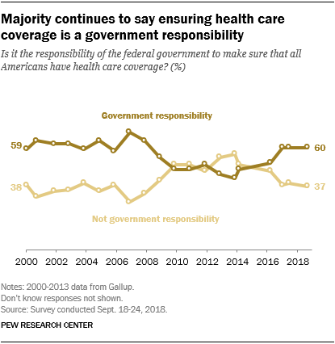
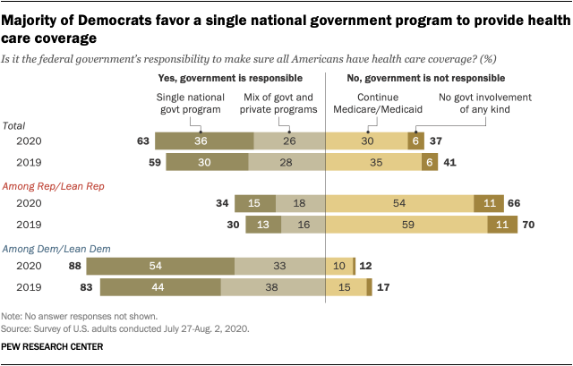
Opinion Polling
Pew and Kaiser are main health policy opinion pollsters
March 2017, ¼ of people thought ACA was repealed (Pew)
September 2017, ½ of people thought ACA marketplaces collapsing (Kaiser)

Slide 3
Notable provisions in ACA for private insurance
Prohibits lifetime limits and annual limits
Prohibits excluding coverage or denying claims for pre-existing conditions
Attainment of age 26
Guaranteed access to health insurance
Grandfathered plans (based on March 23, 2010)
80% MLR/85% MLR

Slide 4
Individual mandate
In 2018 (pre-zeroing law in 2019 based on 2017 law), penalty was $695 per adult and $347.50
Exemptions included financial hardship, religious objection, Native Americans, individuals uninsured for fewer than 3 months, incarcerated individuals, undocumented immigrants, and individuals with incomes below threshold requiring tax filing

Slide 5
Excluded interventions
Acupuncture
Bariatric surgery
Cosmetic surgery
Dental care (adults)
Hearing aids
Infertility aids
Long-term care
Private-duty nursing
Routine eye care (adults)
Routine foot care
Weight loss programs

Slide 6
Premium tax credits
American Rescue Plan Act of 2021
Marketplace subsidy expansion
Medicaid private option
Increased subsidy
More people eligible for subsidy
Expire at end of 2022
Medicaid expansion covers up to 138% FPL
Non-Medicaid expansion state residents now eligible for subsidized marketplace insurance coverage
No subsidy cliff at 400% FPL
Table 1: Percent of Income Paid for Marketplace Benchmark Silver Premium, by Income
Income (% of poverty) | Affordable Care Act (before legislative change) | COVID-19 Relief (current law 2021-2022)
Under 100% | Not eligible for subsidies* | Not eligible for subsidies**
100% – 138% | 2.07% | 0.0%
138% – 150% | 3.10% – 4.14% | 0.0%
150% – 200% | 4.14% – 6.52% | 0.0% – 2.0%
200% – 250% | 6.52% – 8.33% | 2.0% – 4.0%
250% – 300% | 8.33% – 9.83% | 4.0% – 6.0%
300% – 400% | 9.83% | 6.0% – 8.5%
Over 400% | Not eligible for subsidies | 8.5%
NOTES: *Lawfully present immigrants whose household incomes are below 100% FPL and are not otherwise eligible for Medicaid are eligible for tax subsidies through the Marketplace if they meet all other eligibility requirements. **In the COVID-19 relief law, lawfully present immigrants in states that have not expanded Medicaid would continue to be eligible for marketplace subsidies. In addition, people receiving Unemployment Insurance (UI) are treated as though their income is no more than 133% of poverty for the purposes of the premium tax credit. This could extend premium tax credits to some individuals with incomes below poverty. SOURCE: KFF

Slide 7
Cost Sharing Reductions
Cost-sharing reductions (also called “extra savings”) are also available that reduce the annual out-of-pocket payments for deductibles, coinsurance, and other cost-sharing provisions.
Repealed in 2017

Slide 8
Small Business Healthcare Tax Credits
The ACA provides tax credits to small business firms that have fewer than 25 full-time equivalent employees, pay average annual wages of less than $50,000 (adjusted for inflation from 2014), and pay at least half of employee health insurance premiums.
A tax credit of up to 50 percent of the employer’s contribution is available if the employer contributes at least 50 percent (35 percent for small tax-exempt employers) of the total premiums for full-time employees.
The tax credit is available for two consecutive years.
The full tax credit is available to employers that have 10 or fewer full-time equivalent employees and pay average annual wages of less than $25,000.
The maximum tax credit is phased out as the number of employees and average annual wages increase.
Employers are not required to offer coverage to parttime employees working fewer than 30 hours weekly or to their dependents.

Slide 9
Health Savings Accounts
Tax exempt of custodial account established exclusively for paying qualified medical expenses
Partners with high-deductible health plans
At least $1350 for individual, $2700 for family (2018)
OOP expenses limit of $6500/$13,300 (2018)
Contribution limit of $3450/$6900 (2018) – catch up contribution of $1000 for over 55s
Contributions are pre-tax, investment earnings are tax free, contributions not allowed after 65, but funds still usable

Slide 10
Other products
Managed Care
Long-term care insurance
Disability income insurance

Slide 11
Important contractual provisions
Guaranteed renewable
Most common
Noncancelable
Fixed premiums
Conditionally renewable
Renewals up to specified age, some declines possible
Nonrenewable
Guaranteed issue
Most policies are mandated such by ACA

Slide 12
Health Insurance Marketplace
Goto: Healthcare.gov
Compare health insurance products for a hypothetical CT resident
Is an imaginary member of your family who needs help
Whose income is:
In the range of 150% to 400% FPL
In the low 6 figures

