Slide 1
Risk Management and Insurance
TR 11:00-12:15 – BUSN202
Shane Murphy

Slide 2
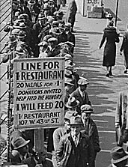
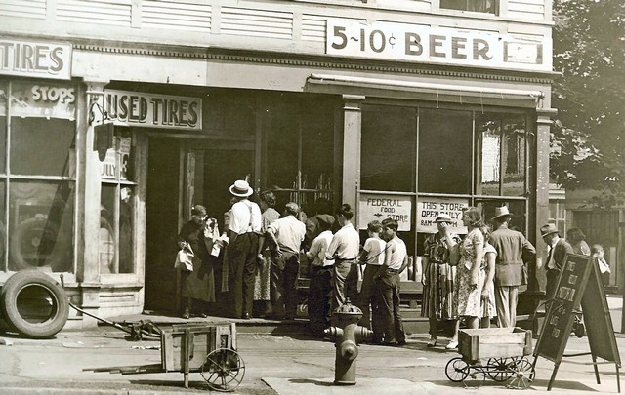
Great Depression (1929-1939)
Notes:
https://www.youtube.com/watch?v=IzjWk1DD6gE
https://www.youtube.com/watch?v=l4zfEkKs2ZM

Slide 3
1935 Social Security Act and the Welfare State in the US
Federal Old Age, Survivors, Disability and Hospital Insurance Program
Originally entitled the Federal Old Age Benefits (I) program
Program now also encompasses Medicare and is funded through FICA
Federal-state unemployment compensation program
FUTA (1954)
9 other programs including aid to states for programs for the blind (X), needy dependent children (IV)
Avoided using the word “insurance” to provide some protection from conservative SC justices – but programs were called social insurance after SC ruling in support in 1939
American Medical Association opposed early efforts for state or national health insurance

Slide 4
Health Insurance programs in the Social Security Act
Four key programs
Maternal and Child Health
Crippled Children Services
Vocational rehabilitation
Public Health
Created as grants to states for state run programs
Initial plans included national health insurance, which AMA opposed and FDR thought was politically too risky, eventual AMA support of Act was reluctant

Slide 5
New Deal
First New Deal included banking reform, the National Recovery Administration, and the Civil Works Administration
Second New Deal included labor union protections, establishment of the Works Progress Administration, the creation of the US Housing Authority, the Fair Labor and Standards Act of 1938, and the Social Security Act
FDR (a New York Democrat) vs the conservative coalition of Republicans and Southern Democrats
Harry F. Byrd Sr was a noted leader of the conservative coalition
Opposed Federal control over standards for old age assistance and other programs

Slide 6
National Labor Relations Act (Wagner Act) of 1935
Collective bargaining
Right to form and join unions
Collective Action
Legalizing strikes
Defines unfair labor practices
Creation of the National Labor Relations Board to enforce the act
Exclusions
Government employees, rail and airline workers
Protection for Blacks not allowed in unions
Independent contractors, domestic workers, and farm workers
Expanded to include employees of non-profit hospitals in 1974 after Taft-Hartley Act excluded this group in 1947

Slide 7
Rise of Fascism, American Fascism, and the New Deal
Mussolini, not Hitler, was the superstar of Fascist politics in the early 1930s
Fritz Julius Kuhn’s German-American Bund, founded in 1936
William Dudley Pelley’s Silver Legion, founded in 1933
Business Plot of 1933
William Joseph Simmons’s 2nd KKK, founded in 1915
William Shepard and Virgil Effinger’s Black Legion, founded in 1920s, Effinger took control in 1931
National Industrial Recovery Act of 1933 - authorized the President to regulate industry for fair wages and prices
Supported by Huey Long and Father Charles Coughlin
Recognized as being modelled on Italian cooperative state
However, Italian statism, liberals argued, was in the service of the state
The NRA sought to protect the interests of the people
German and Italian Fascism came to be identified with business interests
New Deal philosophy more closely resembled the British Labor Party or Social Corporatism/Social Democracy (1930s Norway and Sweden)
Division grew and by 1939, the New Deal was called the Jew Deal by Kuhn

Slide 8
World Wars
World War I (1914-1918) and World War II (1939-1945)
WWI: Allied Powers (France, Britain, Russia, Serbia, Belgium, Japan, Italy, US, Romania, Portugal, US, China, and others) vs Central Powers (Germany, Austria-Hungary, Ottoman Empire (Turkey), Bulgaria)
WWII: Allies (Russia [1941], US [1941], UK, China) vs Axis (Germany, Japan, Italy)
https://www.youtube.com/watch?v=JKQif8qBRVg

Slide 9
1942: Stabilization Act
During WWII, increased government spending was leading to inflation
Increased demand for war-time goods and increased demand for workers due to increased military spending led to labor shortages
Bill meant to combat inflation and labor shortages
Limit employer’s ability to raise wages
Employer response was to increase benefits
Health benefits became part of employment packages
1943 US: Wagner-Murray-Dingell Bill
Failed law for national medical and hospitalization coverage

Slide 10
Blue Cross
In 1929, a group of Dallas school teachers contracted with Baylor University Hospital to receive up to 21 days of inpatient care a year for regular monthly payments of 50 cents.
By 1937, there were 26 such plans with more than 600,000 members total.
These combined under the auspices of the American Hospital Association (AHA) to form the Blue Cross network of plans

Slide 11
Blue Shield
In the 1930s, physicians became concerned about proposals for compulsory national health insurance and the threat of insurance competition from Blue Cross.
Specifically, doctors worried that third-party payers would lower their incomes by restricting their ability to set their own fees. In response, physicians established a network of their own insurance plans covering physician services.
These plans, known as Blue Shield, preempted the hospital-oriented Blue Cross plans from entering into the primary care sector.

Slide 12
WWII and the 1950s
During World War II wage and price controls prevented employers from using higher salaries to attract workers.
They were, however, allowed to offer fringe benefits like health insurance for up to 5 percent of a worker's wages.
In addition, the National Labor Relations Board ruled that health insurance benefits were a legitimate subject of labor-management negotiations.
Lastly, the IRS and the National War Labor Board determined that employers could deduct the cost of employee health benefits from taxable business income, and employees did not have to include the value of those benefits in calculating their taxable income.
As a result the market for health insurance of all kinds increased dramatically during the 1940s, from a total enrollment of 20,662,000 in 1940 to 142,334,000 in 1950.

Slide 13
LBJ and the Great Society
Civil Rights
Civil Rights Act of 1964 outlawed discrimination based on race, color, religion, sex, or national origin
Voting Rights Act of 1965
Section 5 largely struck down by Shelby County v. Holder (2013)
War on Poverty
1964 creation of the Office of Economic Opportunity
Job corps and work training programs
Head Start
1965 Elementary and Secondary Education Act
Housing and Urban Development Act of 1965
National Endowment for the Humanities and the National Endowment for the Arts
1965 National Foundation on the Arts and Humanities Act
Environmental legislation
Pro-immigration legislation
https://youtu.be/nXVAOcs5oVA?t=24

Slide 14
1965: Social Security Amendments of 1965 (Medicare and Medicaid)
Major issue in 1962 Kennedy Campaign (Kennedy was assassinated in 1963)
Johnson strongly supported legislation
Initial proposal failed in 1964
Supported by the AFL-CIO, both parties

Slide 15
1970: Title X
Provides federal support for comprehensive family planning and related preventive health services
prioritize the needs of low-income families or uninsured people (including those who are not eligible for Medicaid)
These services are provided to low-income and uninsured individuals at reduced or no cost.
Created in 1970
FDA approved the Pill in 1960
Planned Parenthood formed in 1916, changed name to Planned Parenthood in 1942, large advocate for Title X

Slide 16
Title X
Administered by US Department of Health and Human Services (10 regional offices)
Award grants to health departments, university and community centers, Planned Parenthood clinics, and other public and nonprofit agencies.
Any public or nonprofit entity (located in a designated state) that offers a broad range of acceptable family planning methods and services is eligible to apply.
In 2008, there were 4522 Title X clinics serving more than 5 million individuals.

Slide 17
Age of privatization
Neo-liberal ideology grew in influence in the 1970s and especially 1980s
Chicago Boys, Led by University of Chicago economists such as Milton Friedman
1981 privatization of the Chilean pension system
Under the Pinochet regime
Replace public pension with fully funded individual accounts system with contributions by individuals and administered privately
During debt crises in the 1980s (and carrying into the 1990s) in low and middle income countries (especially in Latin America) the World Bank and IMF pushed other countries with to privatize

Slide 18
1990s regulation and medicaid expansion
After failing to get extensive health care reform passed, the Clinton administration promoted more insurance regulation (HIPAA 1996) and worked with states to expand Medicaid under existing law
Ex. Oregon expanded to all individuals under FPL
Tennessee expanded to all families under 400% FPL
This increased interest in cutting Medicaid by fiscal conservatives
HIPAA also expanded pre-existing conditions protections
SCHIP/CHIP - State Children’s Health Insurance Program of 1997
Provide insurance to children in families earning up to 200% of FPL (with more generosity allowed)

Slide 19
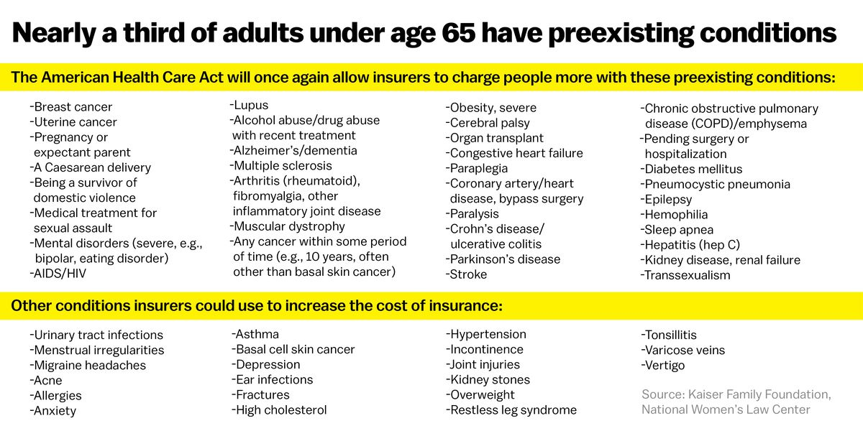
Pre-existing conditions

Slide 20
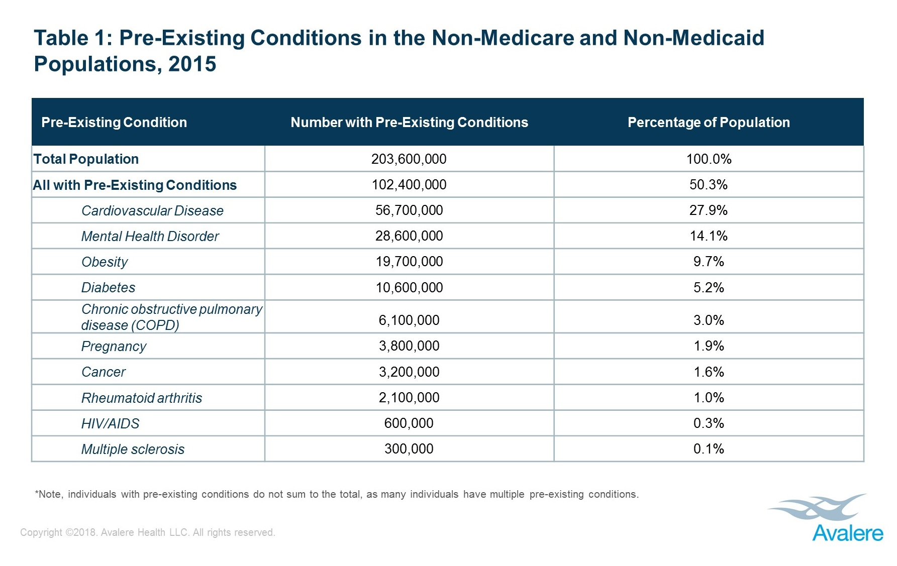
Pre-existing conditions

Slide 21
2006 Massachusetts Health Care Reform Plan
Heritage Foundation designed plan
Followed plans promoted at the federal level under Nixon and Carter in the 1970s; and Clinton in the 1980s
State exchange
Employer and individual mandate
Fully subsidized coverage for individuals up to 150% FPL
Passed when Mitt Romney was governor, became major influence on ACA

Slide 22
ACA, March 23, 2010
900 pages and 10 titles
Clarity v vagueness:
Clarity: “Title 1: Quality Affordable Health Care for All Americans”
Vagueness: 150 times “the secretary shall” and 50 times “the secretary may”
Empowering bureaucracy and rule-making
Shared federal and state responsibility
State: insurance exchanges, premium stabilization, consumer protections…

Slide 23
Major provisions of the ACA
Individual mandate
Fines on employers
Standard benefits package
Bans on denying medical coverage for preexisting conditions
Establishes state-based exchanges/purchasing groups
Offers subsidies for low-income people to buy insurance
Improves efficiency of health care system
Equalizes tax treatment for insurance of self-employed
Reduces growth in Medicare spending
Controls high-cost health plans Yes (taxes plans over $8,500 for single coverage, $23,000 for family plan)
Prohibits insurance company from canceling coverage
Prohibits insurers from setting lifetime spending caps
Expands Medicaid
Extends coverage to dependents (up to age 26)
Notes:
https://www.youtube.com/watch?v=KoTOzNRw8bg

Slide 24
Note about the Independent Payment Advisory Board (IPAB)
Question of cost control fundamental to health insurance
Moral Hazard
Limits on high cost care
Effectiveness and cost-effectiveness
Rationing and regulation
IPAB called death panels (importantly by Republican VP candidate Palin)
Different from crisis standard of care
https://www.youtube.com/watch?v=MQsaAuwYAfE

Slide 25
Center for Medicare and Medicaid Innovation (CMMI), 2010
Tasked with designing, implementing, and testing new health care payment models to address growing concerns about rising costs, quality of care, and inefficient spending
Medicare, Medicaid, and the Children’s Health Insurance Program (CHIP)
Organizes accountable care organizations (ACOs), bundled payment models, and medical homes models
Two CMMI models have met the statutory criteria to be eligible for expansion by reducing program spending while preserving or enhancing quality.
Diabetes Prevention Program model and the Pioneer ACO model.

Slide 26
Components of the bill delayed
Employer mandate delays, 2013-2016
Play or Pay
Obama decision to delay mandate until 2016
Attempted further delays
Authority for Mandate Delay Act of 2013
Save American Workers Act of 2013, 2014, 2015, 2017, 2018
Additional compliance mandates delayed since 2014
Cadillac Tax delays
Designed to disincentivize high-cost employer-sponsored coverage
Would have created a 40 percent excise tax on employer plans that exceed an estimated $10,800 in annual premiums for individuals and $29,050 for families
Protecting Americans from Tax Hikes (PATH) Act of 2015 delayed implementation from 2018 to 2020.
Also made tax deductible
Further postponed to 2022 by The Tax Cut and Jobs Act of 2018

Slide 27
National Federation of Independent Business v. Sebelius (2012)
Consolidated suits by the NFIB and by the State of Florida
Other suits by the state of Virginia, Liberty University (Liberty University v. Geithner), a group of people with religious objections in DC (Mead V. Holder), a law group in Michigan (Thomas More Law Center v. Obama), and Seven-Sky v. Holder (as CoA judge, Kavanaugh dissented – see http://www.scotusblog.com/2018/07/kavanaugh-on-the-affordable-care-act-seven-sky-v-holder/)
Kathleen Sebelius
Secretary of Health and Human Services (2009-2014)

Slide 28
National Federation of Independent Business v. Sebelius (2012)
Constitutional:
Anti-Injunction Act – individuals can’t sue to avoid paying taxes
Court found that since the act is a penalty and not a tax, suits were allowed
Congress taxing power
The individual mandate was a valid exercise of taxing power
Medicaid Expansion
Roberts, Breyer, and Kagan felt states should be allowed to opt out
Scalia, Kennedy, Thomas, and Alito felt Medicaid expansion (and the entire ACA) was unconstitutional
Ginsburg and Sotomayor dissented, would have upheld Medicaid expansion in all states
Commerce Clause and the Necessary and Proper Clause
“As for the Medicaid expansion, that portion of the Affordable Care Act violates the Constitution by threatening existing Medicaid funding. Congress has no authority to order the States to regulate according to its instructions. Congress may offer the States grants and require the States to comply with accompanying conditions, but the States must have a genuine choice whether to accept the offer.” – John Roberts

Slide 29
NFIB v Sibelius, 2012
John Roberts Biography: The Chief by Joan Biskupic
https://youtu.be/ESse04SnSU0?t=2038
Notes:
historic three days of oral arguments back in March of 2012 over President Obama's major domestic achievement this this law the Affordable Care Act that was signed in March of 2010 so they they have these arguments they go into their private conference and the initial vote led by the chief is five to four to strike down what we've all called the individual mandate and that was the requirement that everyone buy health insurance so that the the health insurance structure is supported by people who are healthy not just people who are ill you know it's the the idea that this cost should be borne by everyone and the the law established the new marketplaces and had many many other provisions another provision was the Medicaid expansion for people near the poverty line so there are two major planks of this thing and they vote 5-2 for that Congress lacked the power under its Commerce Clause power to to demand this individual insurance requirement and that's where everybody was paying attention all the attention at the time was on and there were the five conservatives led by the chief voted to strike it down and the four liberals said no but meanwhile they also took a vote on the Medicaid expansion and they voted to uphold it and the chief was with them to uphold it they don't vote in any way on this taxing power issue which again becomes relative becomes relevant in the very end because that's what the chief hangs on the question coming out of the conference conference as they call their private sessions is what's going to fall with the individual mandate because all these different parts were intertwined and Justice Kennedy who's normally in the middle on these things was adamant that the whole law had to fall this major you know nearly a thousand page law that had all sorts of other provisions that were popular with people would have to would have to be overturned because of how intertwined it was and Congress had not written in any kind of so-called severability clause and the Chief Justice starts having second thoughts about that the consequences of that and you remember this was an election year there's so much pressure on the court and there's a presumption among some commentators that the Republican controlled Supreme Court is going to invalidate the signature domestic achievement of President Barack Obama and the chief the chief is trying to figure out a middle ground on this and he's not getting any cooperation or assistance or you know help it all from Anthony Kennedy who he usually deals with who he was usually dealing with any kind of compromise meanwhile over to the far right our justices Alito Scalia and Clarence Thomas and they're they're not going to play they're not in play at all on the far left Justice Ginsburg and justice Sotomayor are not going to be in play either and they they are traditionally the ones who are always over to the far left and not working with the chief that much but justices Kagan and Breyer on the left but open to trying to take down the temperature try to find some compromise with the chief begin to work with him after he decides that he can find legitimate grounds for the individual mandate to be upheld on taxing power and what makes the conservative so angry is first of all even though the taxing power was completely briefed by the Obama administration it was even subject to arguments it was never voted on in conference they they never took an up or down vote on that so they were they felt you know in Scalia's word that it was you know fly-by-night briefing that was just was not a fair fair thing to suddenly turn to and the the liberal justices our want want this to unfold this way but they're also worried that the chief is going to you know possibly shift back again because you know they're they're feeling their original feeling coming out of that conference was complete de moron demoralisation because they're thinking it's gonna be five to four this big law is gonna go down and there's nothing we can do about it but all of a sudden the Chiefs show some flexibility but at the same time that he decides to find grounds to pull the mandate he decides that the Medicaid expansion should be killed and this is again and what didn't get a lot of attention at the time but this was really important for millions of Americans near the poverty line but the problem with it as the chief then decided was that the way Congress had written the expansion law it was it was essentially coercing the states into doing this program Medicaid is almost entirely funded by the federal government but it with that comes a lot of strings and the federal government was Congress said in the Medicaid expansion if you're if you don't expand the clientele the reach of the Medicaid all of your Medicaid funding is going to disappear and as the chief ends up writing this was essentially like holding a gun to the head of the state's the justices Breyer and Kagan decide to change their votes and go with the chief on that to show a certain amount of cooperation and feeling that the chief himself was making this big compromise that was going to get lots of criticism among his conservative brethren which it did so as a show of cooperation and sort of moving toward him that's why they changed their votes but they also figured that this was essentially free money for the state's weren't all the states going to adopt the expansion but lo and behold so many Republican governors did not want anything to do with the Obama expansion there and said no it that that has changed over the years but that turned out to be a bit of a surprise to the justices I'm left ok so I'm gonna make a strong statement just for the sake of it I'd like your reaction yeah John Roberts gets huge credit for this decision yes his hero is John Marshall Chief Justice John Marshall who he admires for committing acts of judicial jujitsu engaging in judicial statesmanship avoiding battles in the short term in order to shore up the courts power in the long term and by visibly struggling with the most polarized question of his age by pulling the court back from the point of really narrowing federal power in the most significant way since the New Deal he preserved the courts bipartisan legitimacy and proved that he meant when he said when he cared said that he would put legitimacy above politics discuss that's right no I think he should he people come up to him still and thank him and that decision has again you know going with that part of the decision that decision has really held in people's minds to define John Roberts as a moderate it's a one-of-a-kind decision but it was a hugely important decision and Charles freed a Reagan Solicitor General who succeeded Rex Lee who was seen as much more ideological actually gives him credit to says look it wasn't pretty the the ruling was shot through with uh with all sorts of problems people could rightly complain about the taxing rationale because it wasn't consistent with other parts of the ruling but it it got the job done it got the job done so I would say that yes this was an important ruling that he did and that the the grief he has gotten and continues to get from conservatives and and got at the time from then businessman Donald Trump and continues to get from President Donald Trump probably for the country was worth it but inside the way he went about it I think it still puzzles and confuses his colleagues but your point is well-taken for the country it's it made a big difference in people's lives and it still does and and the the Affordable Care Act is coming back to the court and I cannot imagine that John Roberts would now suddenly want to do what a judge down in Texas did invalidates the whole thing all over again

Slide 30
Other Supreme Court Cases
Burwell v. Hobby Lobby Stores, Inc. 2014
Allowing closely held for-profit corporations to be exempt from a regulation its owners religiously object to, if there is a less restrictive means of furthering the law's interest, according to the provisions of the Religious Freedom Restoration Act (RFRA) of 1993
Struck down the contraceptive mandate in the ACA
May have broader implications for RFRA applications
Definition of “closely held” has possible liability implications
King v. Burwell, 2015
Challenged subsidies to plans purchased on national exchanges
Theory that ACA meant only to subsidize state exchanges
Standing
Plaintiffs argue that they have standing because, without the subsidies, they would be exempt from the individual mandate because the cost of the cheapest insurance plan exceeded 8% of their income, but, with the subsidies, the subsidized cost was low enough to require plaintiffs to purchase insurance or pay a penalty.
Plaintiffs may have been eligible for free care or otherwise exempt
Plaintiffs won in circuit court, lost in supreme court (6-3)
California v Texas (Texas v Azar), 2018-2021
Judge Reed O’Connor of the Northern District of Texas holds that the ACA is unconstitutional in its entirety
Removal of mandate invalidates the law
Trump AG Willian Barr decided DOJ would not defend the ACA in appeal, California Attorney General Xavier Becerra (who became head of HHS under Biden) is led the defense of the ACA
Cases challenging the ACA risk adjustment transfer formula (Minuteman Health, Inc v. U.S. Dept of HHS et al.; New Mexico Health Connections et al. v. U.S. Dept of HHS et al.; Evergreen Health Cooperative, Inc. v. U.S. Dep’t. of Health and Human Services et al.
Challenges risk adjustment methods
Court rarely overturns administrative decisions of this nature

Slide 31
Trump (2017-2020) policy overview
1 – Frequent overt criticism of ACA
2 – Enforcement of letter of law
Example: Refusal to let Idaho authorize plans in violation
3 – Improving parts of the law
Example: Political appointees not interfering with CMS civil services
4 – Prioritize individual options
Example: Supported short-term plans
5 – Undermined law where possible
Example: Terminating cost-sharing payments

Slide 32
Trump inauguration day executive order, 2017
"It is the policy of my Administration to seek the prompt repeal“
"exercise all authority and discretion available to them to waive, defer, grant exemptions from, or delay“
"minimizing the economic burden [of Obamacare] pending repeal”

Slide 33
Tax Cuts and Jobs Act of 2017
Zeroed the penalty of the individual mandate – left all other provisions in place
Massachusetts has had it own health coverage mandate since 2006
New Jersey passed a state-wide mandate that took effect in 2019
Vermont passed a health coverage mandate that will take effect in 2020

Slide 34
Biden Marketplace expansion
American Rescue Plan Act of 2021
Marketplace subsidy expansion
Medicaid private option
Increased subsidy
More people eligible for subsidy
Expire at end of 2022
Medicaid expansion covers up to 138% FPL
Non-Medicaid expansion state residents now eligible for subsidized marketplace insurance coverage
No subsidy cliff at 400% FPL
Table 1: Percent of Income Paid for Marketplace Benchmark Silver Premium, by Income
Income (% of poverty) | Affordable Care Act (before legislative change) | COVID-19 Relief (current law 2021-2022)
Under 100% | Not eligible for subsidies* | Not eligible for subsidies**
100% – 138% | 2.07% | 0.0%
138% – 150% | 3.10% – 4.14% | 0.0%
150% – 200% | 4.14% – 6.52% | 0.0% – 2.0%
200% – 250% | 6.52% – 8.33% | 2.0% – 4.0%
250% – 300% | 8.33% – 9.83% | 4.0% – 6.0%
300% – 400% | 9.83% | 6.0% – 8.5%
Over 400% | Not eligible for subsidies | 8.5%
NOTES: *Lawfully present immigrants whose household incomes are below 100% FPL and are not otherwise eligible for Medicaid are eligible for tax subsidies through the Marketplace if they meet all other eligibility requirements. **In the COVID-19 relief law, lawfully present immigrants in states that have not expanded Medicaid would continue to be eligible for marketplace subsidies. In addition, people receiving Unemployment Insurance (UI) are treated as though their income is no more than 133% of poverty for the purposes of the premium tax credit. This could extend premium tax credits to some individuals with incomes below poverty. SOURCE: KFF

Slide 35
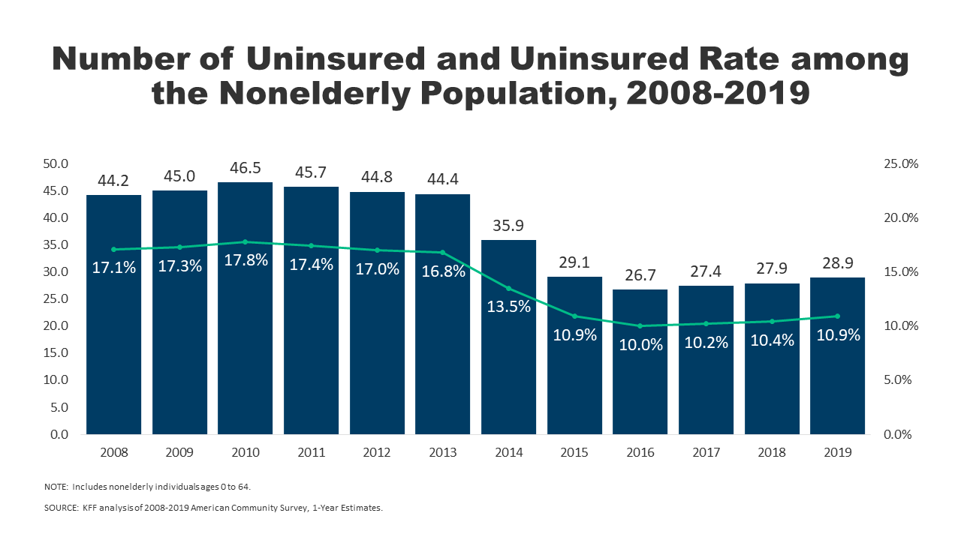
Effects of ACA on health and coverage
Largest effect on coverage was due to Medicaid expansion, not the exchanges
Largest effect on health comes from self-perceived health, mental health, financial stability
These three factors are all closely interrelated
Benefits of wellness visits are difficult to measure
Health benefits for chronic conditions require large samples sizes, studies are hard to perform

Slide 36
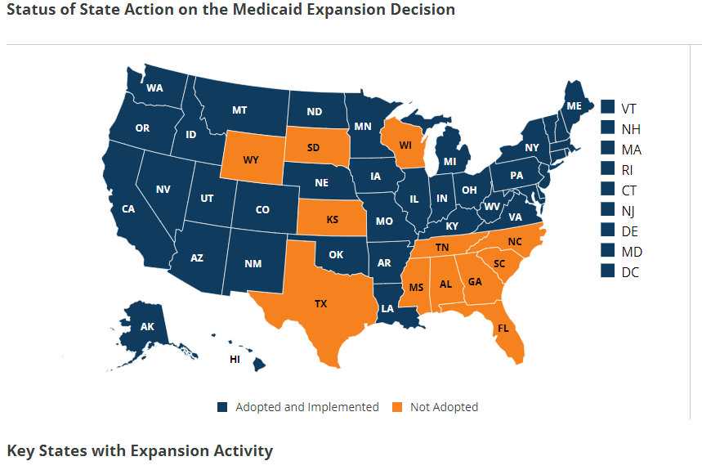
Coverage: Medicaid expansion
All US citizens and legal residents with income up to 138% FPL qualify for coverage in participating states
Led to large growth in enrollment in participating states, smaller growth in non-participating states
Reduction in uninsured rates, especially among low-income individuals
Partial Woodwork effect/welcome mat effect
Growth among individuals who were previously eligible

Slide 37
Coverage: Medicaid expansion: criticism
Crowding out of private insurance
Mixed results, although there has been some decline in private coverage in participating states

Slide 38
Cost Sharing Reductions (CSR)
Another provision of the ACA is that consumers with incomes below 250% FPL are entitled to CSRs
Lower deductibles, copays, and other cost-sharing for low-income consumers
Increases the actuarial value of the plan
HHS was then required to reimburse insurance companies for the CSRs
Reimbursement was opposed by the conservative-majority House of Representatives
House v Burwell -> House v Azar
CSR reimbursement payments stopped
Drove up premiums on the marketplace

Slide 39
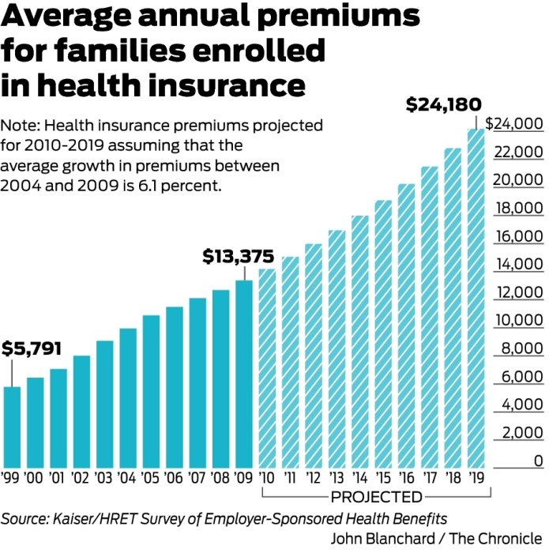
Health Insurance Premiums: Skyrocketing?
Premiums grew by over 6% between 2004 and 2009
If such growth continued, the cost for a family would grow to:
2010 | 14190.88
2011 | 15056.52
2012 | 15974.97
2013 | 16949.44
2014 | 17983.35
2015 | 19080.34
2016 | 20244.24
2017 | 21479.14
2018 | 22789.37
2019 | 24179.52

Slide 40
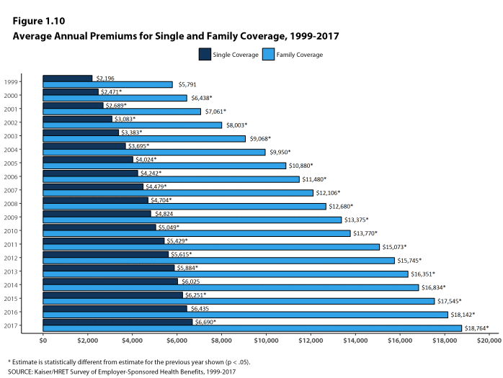
Health Insurance Premiums: Skyrocketing?
Actual growth rate has ben about 4.3%

Slide 41
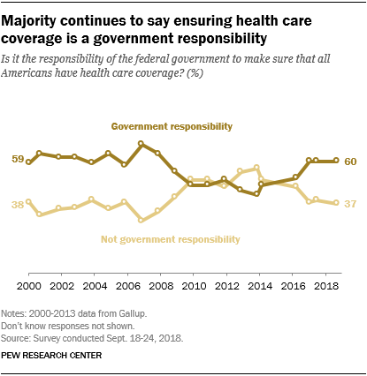
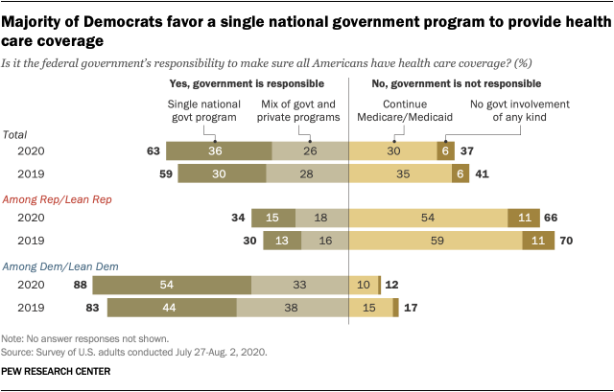
Opinion Polling
Pew and Kaiser are main health policy opinion pollsters
March 2017, ¼ of people thought ACA was repealed (Pew)
September 2017, ½ of people thought ACA marketplaces collapsing (Kaiser)

Slide 42
Sources
Berkowitz, Edward. "Getting to the Affordable Care Act." Journal of Policy History 29, no. 4 (2017): 519-542.
Halpin, Helen A., and Peter Harbage. "The Origins And DemiseOf The Public Option." Health Affairs29, no. 6 (2010): 1117-1124.

Slide 43
Reading
Grogan, Colleen M. "How the ACA addressed health equity and what repeal would mean." Journal of Health Politics, Policy and Law 42, no. 5 (2017): 985-993.
Levy, Helen, Andrew Ying, and Nicholas Bagley. "What’s Left of the Affordable Care Act? A Progress Report." RSF: The Russell Sage Foundation Journal of the Social Sciences 6, no. 2 (2020): 42-66.
Rosenbaum, Sara, and Sara Schmucker. "Viewing Health Equity through a Legal Lens: Title VI of the 1964 Civil Rights Act." Journal of Health Politics, Policy and Law 42, no. 5 (2017): 771-788.

