Slide 1
Risk Management and Insurance
TR 11:00-12:15 – BUSN202
Shane Murphy

Slide 2
Final Project Notes
Choices of > 2 people
John Q - Cassavetes but not John
Rainmaker
Franchises: Saw, Fast and Furious
Dallas Buyers Club
Out of the box (Zootopia) example
Role of risk management in social systems, community, stability
Tv show (Suits) example – focus on one episode, name the episode (by episode title and by season and episode number), note showrunner as well as episode writer and director

Slide 3
Commercial property insurance examples:
Hospital AC system breaks down
Electrical damage to the electronic controls in a hospital’s HVAC system went unnoticed until one of the compressors broke down. The damaged controls caused a chiller to keep running until the tubes froze and ruptured, resulting in severe damage to the compressor, tubes and other parts.
Total Paid Loss $54,118

Slide 4
Commercial property insurance examples:
Ransomware infects medical manufacturer
A ransomware virus spread through the systems of a medical equipment manufacturer, infecting computers and servers. HSB’s cyber insurance paid to recover data that was encrypted and to replace proprietary software that was corrupted.
Total Paid Loss $33,599

Slide 5
Commercial property insurance examples:
Apartment building boiler breakdown
The boiler in an apartment building broke down when it overheated and seven of nine sections cracked. The repair bill included overtime the contractor paid his workers so heat could be restored for tenants.
Total Paid Loss $35,230

Slide 6
Commercial property insurance examples:
Hospital diagnostic equipment damaged
When hospital technicians powered up equipment after a utility outage, they discovered electrical damage to fluoroscopy and CAT scan machines. The machines were down for three days during repairs, forcing the hospital to cancel diagnostic tests for patients.
Repair Cost $38,864
Business Interruption $4,225
Total Paid Loss $43,089

Slide 7
Commercial property insurance examples:
Optical equipment shorts out
An optician’s shop in a strip mall replaced an eyeglass-making machine when a power surge damaged electronic components.
Total Paid Loss $11,400

Slide 8
Commercial property insurance examples:
Car Wash Electronics
A power surge damaged electronic and electrical equipment in a service station store and car wash, including fuel pump readers, security cameras, an air compressor motor, automatic doors and various washing equipment. The car wash closed for six weeks.
Repair Cost $46,460
Business Income $8,415
Total Paid Loss $54,875

Slide 9
Commercial liability insurance
The easiest way to understand how General Liability Insurance protects small businesses is to look at a bunch of examples of this insurance policy in action. We’ll do that in one second. First, let’s review the basic facts about what this policy covers:
General Liability Insurance pays for lawsuits when you’re sued by third parties, which is the legal term for people not employed by your company.
GL coverage pays for lawyer’s fees, court expenses, and damages owed to the party who sued you.
Covered lawsuits include claims about property damage, bodily injuries, advertising injuries, reputation damages, copyright infringement, slip-and-fall accidents, and other common lawsuits.
Employee injuries are not covered by GL, but are covered by Workers’ Compensation Insurance.
Some policies also cover immediate medical costs—ambulances, emergency room fees, etc., for people injured on your property.

Slide 10
Commercial liability insurance examples
Property damage lawsuit. A contractor is installing a new kitchen. Unfortunately, one of his co-workers forgets to shut off the water and floods the kitchen. The water seeps into the floors and the walls of the finished basement. The homeowner sues them for $200,000 in damages to their house.
Slip-and-fall accident. A restaurant is sued when a self-employed produce deliveryman slips on the wet floor of the freshly mopped kitchen. Tomatoes go flying everywhere, but the real damage is done to the deliveryman’s shinbone, which he breaks smashing it into a table. He sues the restaurant for $100,000 in medical costs, lost wages, and other expenses.

Slide 11
Commercial liability insurance examples
Customer injury lawsuit. A photographer is shooting senior photos for a client. As the family walks into the studio, the mother trips over the cord for the flash and falls to the ground, breaking her collar bone. The family sues the photographer for $75,000 in medical damages.
Product liability lawsuit. A sporting goods distributor is sued for $500,000 when a jungle gym they sold breaks and injures a customer’s child.

Slide 12
Commercial liability insurance examples
In each of these examples, the insurance company would cover the cost of the lawsuit, paying for a lawyer to represent the company and covering the final judgment or settlement in the case. The judgment is when the judge or jury rules on a dollar amount you owe the party suing your business.
However, some cases are resolved before that point. Settlements occur when both parties voluntarily agree on an amount of damages out of court.
One of the benefits of having insurance is that the insurance company often helps small businesses settle their lawsuits. The insurance company can pay for a settlement, which will help you avoid wasting time (and more money) in the courtroom and get you back to business.

Slide 13
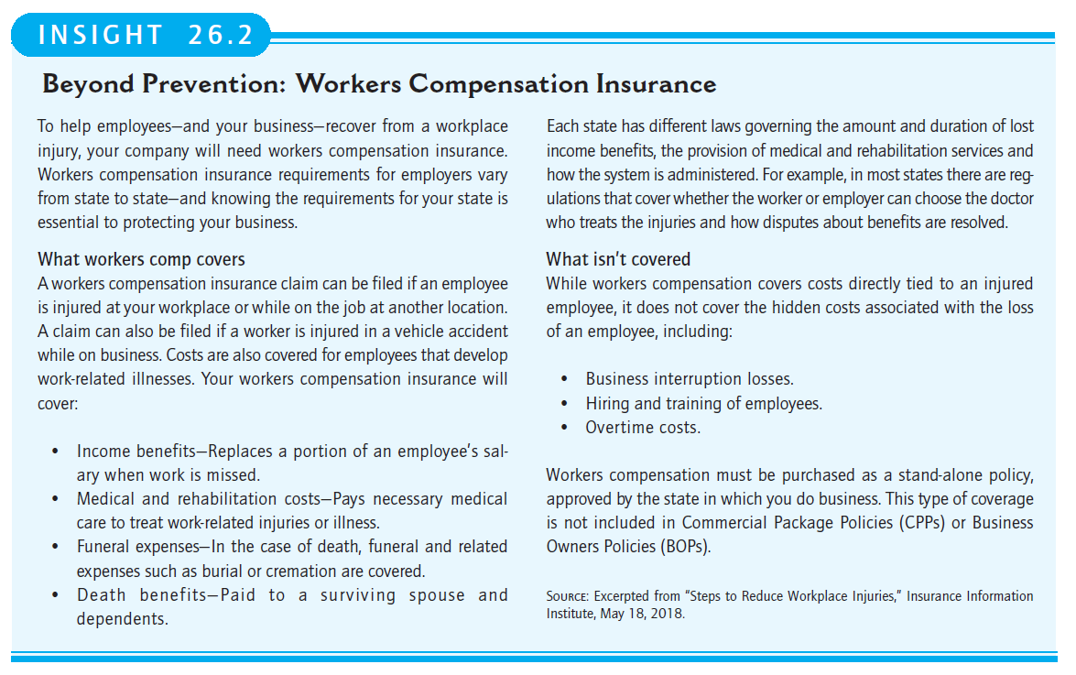

Slide 14
