Slide 1
HealthCare Management
Shane Murphy

Slide 2
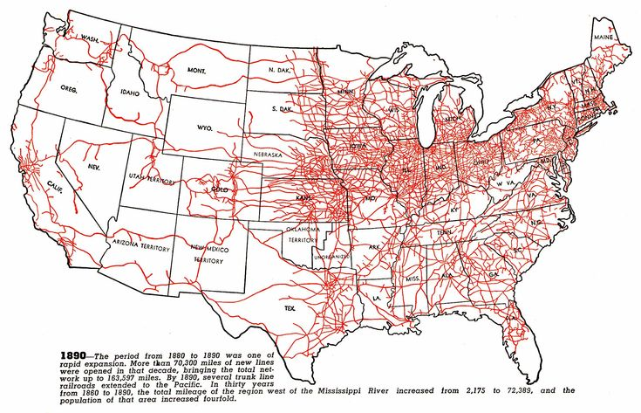
Labor Patterns in the US
Free soil and the 1860 election
Industry before electricity
Note about electrification
Land, slavery, and rural economies
Water and rail

Slide 3
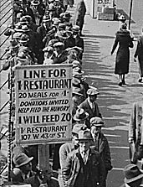
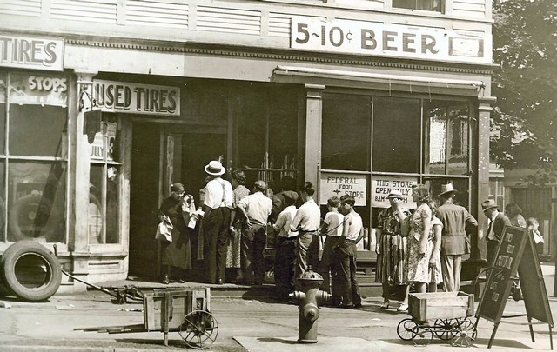
Great Depression (1929-1939)
Notes:
https://www.youtube.com/watch?v=IzjWk1DD6gE
https://www.youtube.com/watch?v=l4zfEkKs2ZM

Slide 4
1935 Social Security Act and the Welfare State in the US
Federal Old Age, Survivors, Disability and Hospital Insurance Program
Originally entitled the Federal Old Age Benefits (I) program
Program now also encompasses Medicare and is funded through FICA
Federal-state unemployment compensation program
FUTA (1954)
9 other programs including aid to states for programs for the blind (X), needy dependent children (IV)
Avoided using the word “insurance” to provide some protection from conservative SC justices – but programs were called social insurance after SC ruling in support in 1939
American Medical Association opposed early efforts for state or national health insurance

Slide 5
New Deal
First New Deal included banking reform, the National Recovery Administration, and the Civil Works Administration
Second New Deal included labor union protections, establishment of the Works Progress Administration, the creation of the US Housing Authority, the Fair Labor and Standards Act of 1938, and the Social Security Act
FDR (a New York Democrat) vs the conservative coalition of Republicans and Southern Democrats
Harry F. Byrd Sr was a noted leader of the conservative coalition
Opposed Federal control over standards for old age assistance and other programs

Slide 6
National Labor Relations Act (Wagner Act) of 1935
Collective bargaining
Right to form and join unions
Collective Action
Legalizing strikes
Defines unfair labor practices
Creation of the National Labor Relations Board to enforce the act
Exclusions
Government employees, rail and airline workers
Protection for Blacks not allowed in unions
Independent contractors, domestic workers, and farm workers
Expanded to include employees of non-profit hospitals in 1974 after Taft-Hartley Act excluded this group in 1947

Slide 7
Rise of Fascism, American Fascism, and the New Deal
Mussolini, not Hitler, was the superstar of Fascist politics in the early 1930s
Fritz Julius Kuhn’s German-American Bund, founded in 1936
William Dudley Pelley’s Silver Legion, founded in 1933
Business Plot of 1933
William Joseph Simmons’s 2nd KKK, founded in 1915
William Shepard and Virgil Effinger’s Black Legion, founded in 1920s, Effinger took control in 1931
National Industrial Recovery Act of 1933 - authorized the President to regulate industry for fair wages and prices
Supported by Huey Long and Father Charles Coughlin
Recognized as being modelled on Italian cooperative state
However, Italian statism, liberals argued, was in the service of the state
The NRA sought to protect the interests of the people
German and Italian Fascism came to be identified with business interests
New Deal philosophy more closely resembled the British Labor Party or Social Corporatism/Social Democracy (1930s Norway and Sweden)
Division grew and by 1939, the New Deal was called the Jew Deal by Kuhn

Slide 8
World Wars
World War I (1914-1918) and World War II (1939-1945)
WWI: Allied Powers (France, Britain, Russia, Serbia, Belgium, Japan, Italy, US, Romania, Portugal, US, China, and others) vs Central Powers (Germany, Austria-Hungary, Ottoman Empire (Turkey), Bulgaria)
WWII: Allies (Russia [1941], US [1941], UK, China) vs Axis (Germany, Japan, Italy)
https://www.youtube.com/watch?v=JKQif8qBRVg

Slide 9
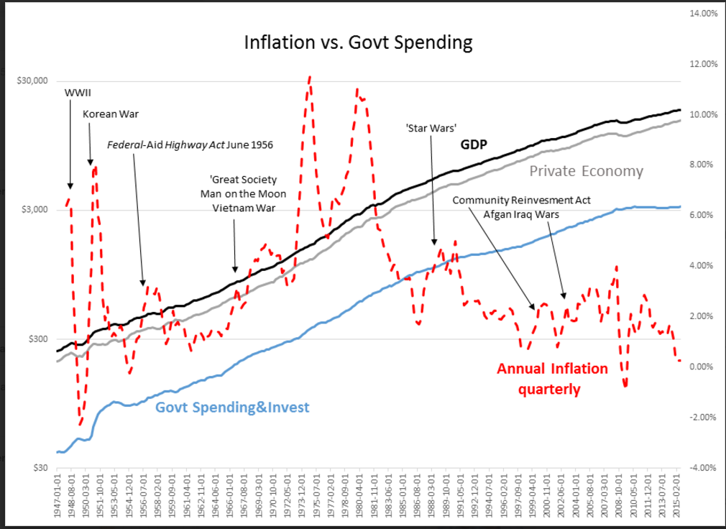
War spending and inflation

Slide 10
1942: Stabilization Act
During WWII, increased government spending was leading to inflation
Increased demand for war-time goods and increased demand for workers due to increased military spending led to labor shortages
Bill meant to combat inflation and labor shortages
Limit employer’s ability to raise wages
Employer response was to increase benefits
Health benefits became part of employment packages
1943 US: Wagner-Murray-Dingell Bill
Failed law for national medical and hospitalization coverage

Slide 11
WWII and the 1950s
During World War II wage and price controls prevented employers from using higher salaries to attract workers.
They were, however, allowed to offer fringe benefits like health insurance for up to 5 percent of a worker's wages.
In addition, the National Labor Relations Board ruled that health insurance benefits were a legitimate subject of labor-management negotiations.
Lastly, the IRS and the National War Labor Board determined that employers could deduct the cost of employee health benefits from taxable business income, and employees did not have to include the value of those benefits in calculating their taxable income.
As a result the market for health insurance of all kinds increased dramatically during the 1940s, from a total enrollment of 20,662,000 in 1940 to 142,334,000 in 1950.

Slide 12
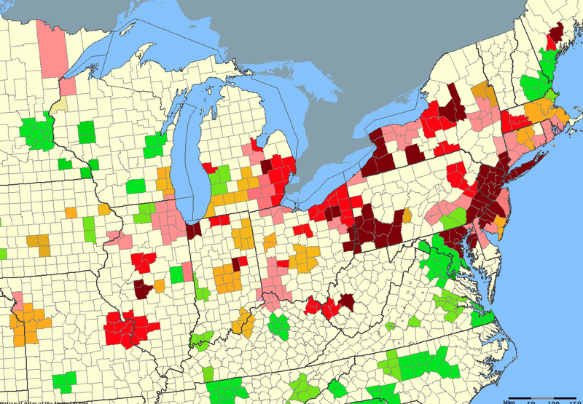
Deindustrialization
Change in total number of manufacturing jobs in metropolitan areas, 1954/1958-2002. The national average over this period was —8.65%.
KEY:
Green=greater than 60% growth in manufacturing jobs
Light green=54.4% growth to 7.5% decrease
Yellow=8.7% to 29.1% decrease
Pink=31.2% to 43.2% decrease
Red=43.6% to 56.2% decrease
Maroon=58% to 88.6% decrease
Notes:
https://en.wikipedia.org/wiki/File:Total_mfctrg_jobs_change_54-02.png

Slide 13
LBJ and the Great Society
Civil Rights
Civil Rights Act of 1964 outlawed discrimination based on race, color, religion, sex, or national origin
Voting Rights Act of 1965
Section 5 largely struck down by Shelby County v. Holder (2013)
War on Poverty
1964 creation of the Office of Economic Opportunity
Job corps and work training programs
Head Start
1965 Elementary and Secondary Education Act
Housing and Urban Development Act of 1965
National Endowment for the Humanities and the National Endowment for the Arts
1965 National Foundation on the Arts and Humanities Act
Environmental legislation
Pro-immigration legislation
https://youtu.be/nXVAOcs5oVA?t=24

Slide 14
1965: Social Security Amendments of 1965 (Medicare and Medicaid)
Major issue in 1962 Kennedy Campaign (Kennedy was assassinated in 1963)
Johnson strongly supported legislation
Initial proposal failed in 1964
Supported by the AFL-CIO, both parties

Slide 15
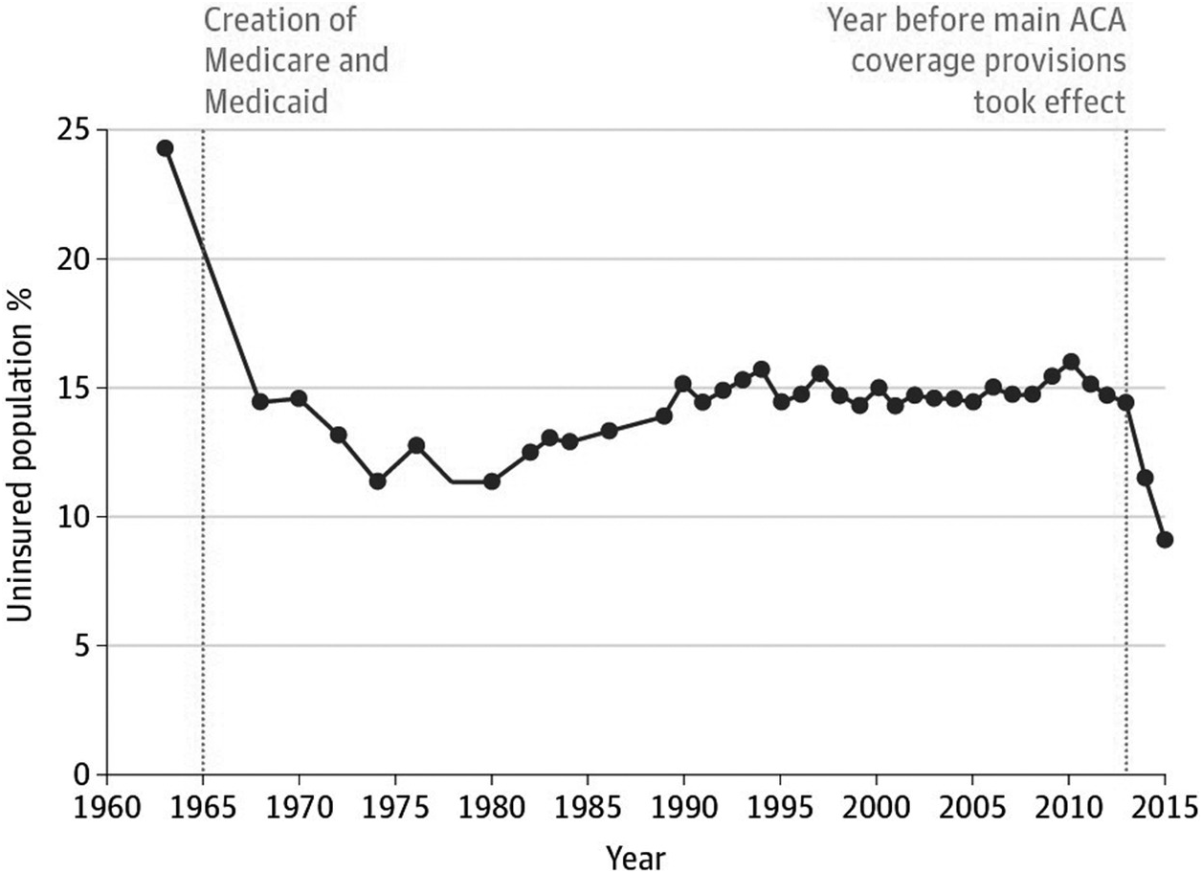
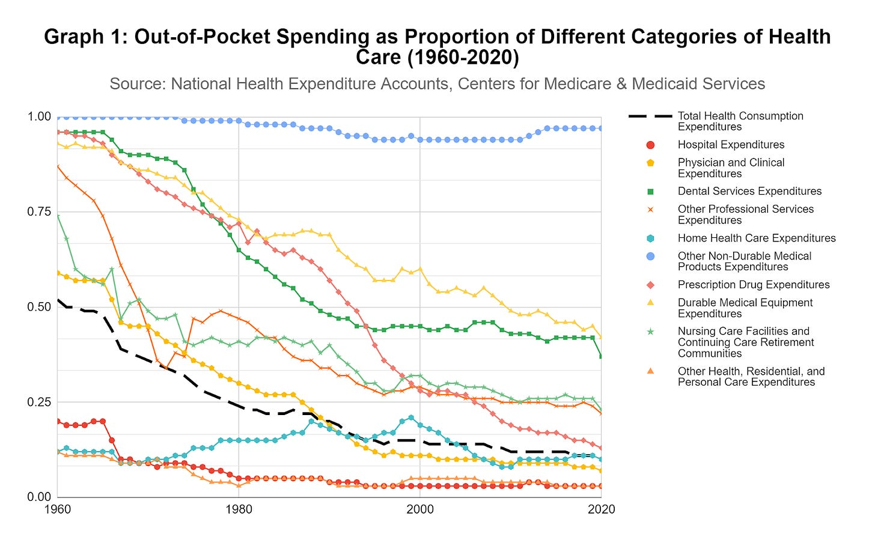
Impact of 1965 on uninsurance and oop

Slide 16
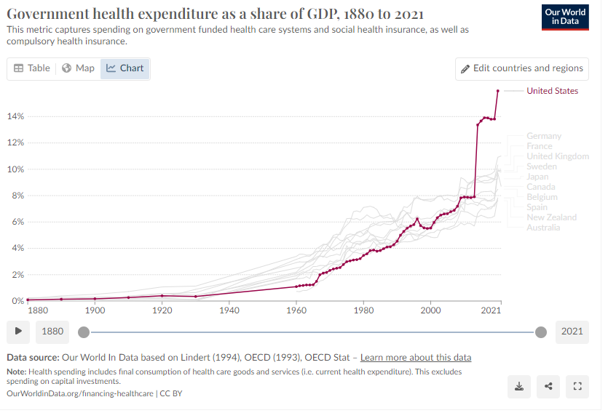
Impact of 1965 on health expenditure

Slide 17
Sources
Berkowitz, Edward. "Getting to the Affordable Care Act." Journal of Policy History 29, no. 4 (2017): 519-542.
Halpin, Helen A., and Peter Harbage. "The Origins And DemiseOf The Public Option." Health Affairs29, no. 6 (2010): 1117-1124.

Slide 18
Reading
Grogan, Colleen M. "How the ACA addressed health equity and what repeal would mean." Journal of Health Politics, Policy and Law 42, no. 5 (2017): 985-993.
Levy, Helen, Andrew Ying, and Nicholas Bagley. "What’s Left of the Affordable Care Act? A Progress Report." RSF: The Russell Sage Foundation Journal of the Social Sciences 6, no. 2 (2020): 42-66.
Rosenbaum, Sara, and Sara Schmucker. "Viewing Health Equity through a Legal Lens: Title VI of the 1964 Civil Rights Act." Journal of Health Politics, Policy and Law 42, no. 5 (2017): 771-788.

