Slide 1
HealthCare Management
Shane Murphy

Slide 2
Steel City
Flashdance video: https://www.youtube.com/watch?v=miax0Jpe5mA
In 1950, Pittsburgh had 134,494 people working in steel (total population 2.2 M)
6% managers, 8% clerical staff
86% skilled craftsmen and foremen, semi-skilled operatives, and unskilled labor
Black workers made up 14% of unskilled, 7% of semiskilled, and less than 1% of skilled
Jobs passed from fathers to sons
863,001 workforce, 2/3 in manufacturing, mining, construction, rail, trucking, and warehousing
These industries were also majority of women’s jobs, although those were largely in clerical roles
45% of employed Black working women worked as domestic workers

Slide 3
De-industrialization
https://newsinteractive.post-gazette.com/in-the-lead-top-businesses-pittsburgh-rankings/tables/index.php

Slide 4
Industrial homogeneity
1950s work culture: Management
Youth organizations, golf outings, country club memberships sored
Hierarchy within management and between management and factory floor maintained
1950s work culture: Unions
Culture of masculinity challenged hierarchical relationship between labor and foremen

Slide 5
Downfall of steel
United Steel and United Steelworkers Union (USWA) set American prices, controlled 80% of domestic market
Federal subsidies protected industry
Expand through extensive (more mills) rather than intensive (more technology, capital) growth
Financial conservativism -> refusal to borrow to finance technology adoption
Oxygen furnace adopted in EU, later Asia
Layoffs began in second half of 1950s
Black workers, generally holding worst jobs, laid off earlier and at higher rates

Slide 6
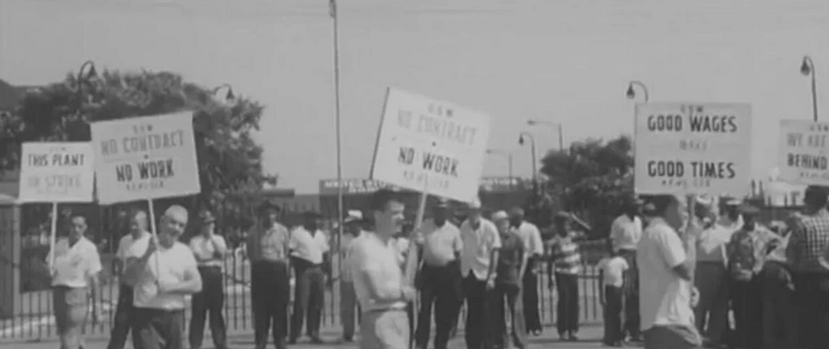
Downfall of steel
Reduced crew sizes and performance pressure led to labor unrest

Slide 7
Union professionalization
USWA had become highly bureaucratic and even undemocratic
President David McDonald had never worked in a mill
Weaker solidarity between union and leadership made negotiating more difficult
Leading to largest strike in US history in 1959
Broken up by federal government

Slide 8
Women’s role in strikes
In single-earning households, homemakers played important role during strikes
Managing home economics
Managing morale
“scab” on the “home front”
Aging workforce meant changing marriage dynamics

Slide 9
Deindustrialization of the 1960s
Industrial employment in Pittsburgh decreased from 162,514 to 128,142 between 1960 and 1970
Unskilled labor saw largest fall
9%-12% and reaching 20% unemployment
Automation
LBJ and War on Poverty
Civil rights struggle intersected with the civil rights crisis
MLKs Poor People’s Campaign
White populist response

Slide 10
August Wilson’s Pittsburgh Cycle
Ma Rainey’s Black Bottom
https://www.youtube.com/watch?v=buT3uWuLnag
Two Trains Running
Steel Job Scene
https://www.youtube.com/watch?v=2QvxWpwRF-Y
Monologue
https://www.youtube.com/watch?v=Sz6p3-K9em0

